Slide 1
Decimals
19 May 2026

Slide 2


Calculate:
$$0.7+0.56$$
$$1.26$$

Slide 3


Calculate:
$$1.2−0.87$$
$$0.33$$

Slide 4
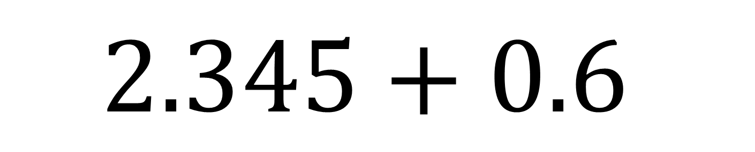

Calculate:
$$2.345+0.6$$
$$2.945$$

Slide 5
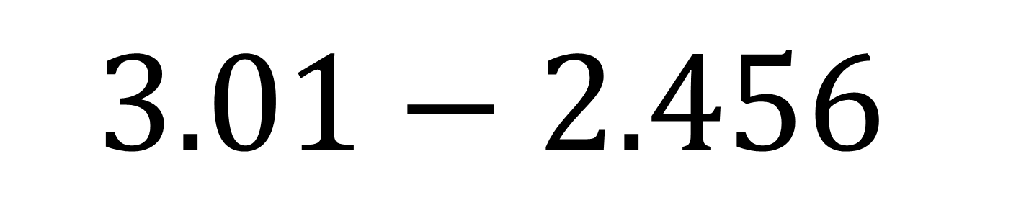

Calculate:
$$3.01−2.456$$
$$0.545$$

Slide 6
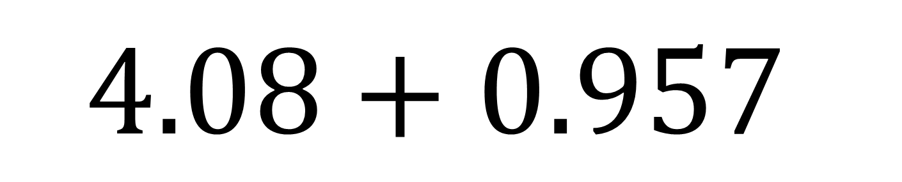

Calculate:
$$4.08+0.957$$
$$5.037$$

Slide 7
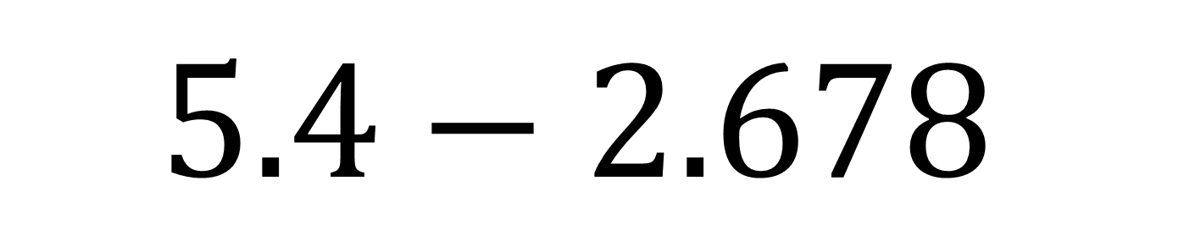

Calculate:
$$5.4−2.678$$
$$2.722$$

Slide 8
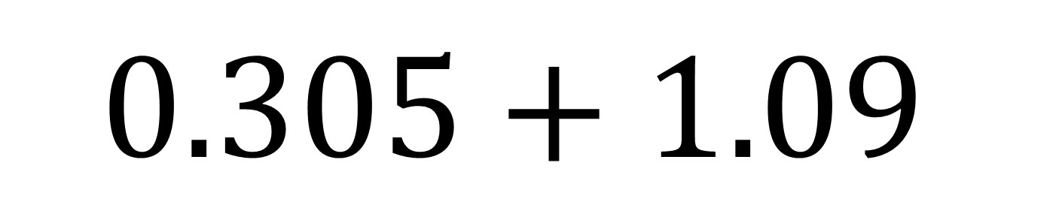

Calculate:
$$0.305+1.09$$
$$1.395$$

Slide 9
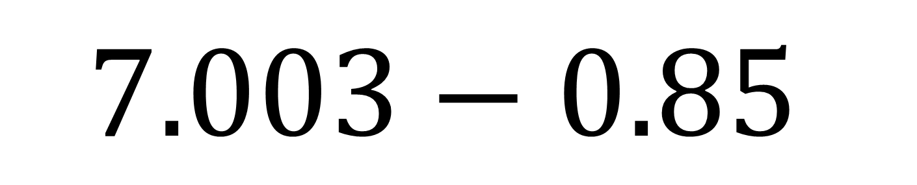

Calculate:
$$7.003−0.85$$
$$6.153$$

Slide 10
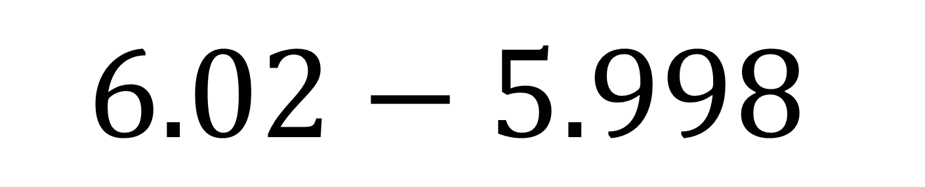

Calculate:
$$6.02−5.998$$
$$0.022$$

Slide 11
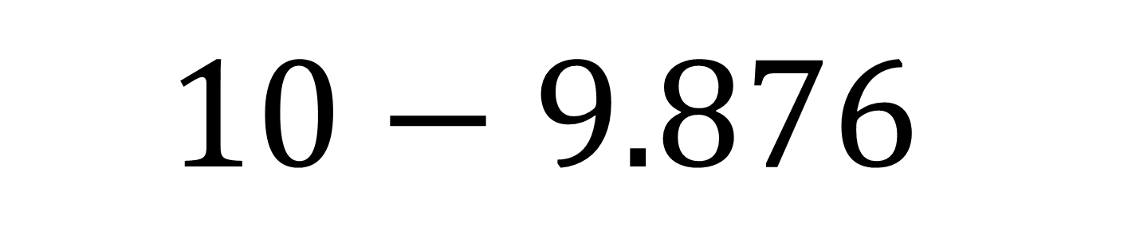

Calculate:
$$10−9.876$$
$$0.124$$

Slide 12


A bottle contains $1.5l$ of water.
You drink $0.35l$.
How much water is left?
$$1.15l$$

Slide 13
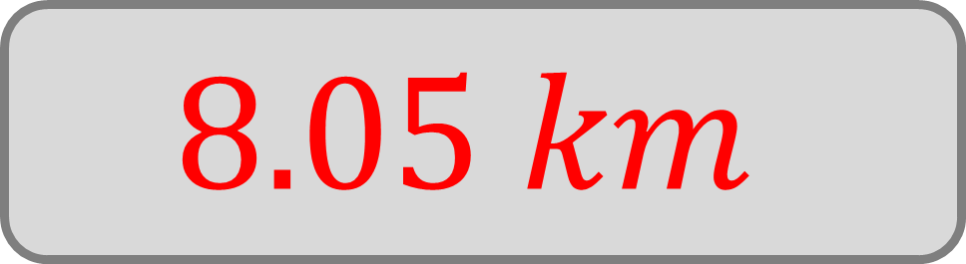
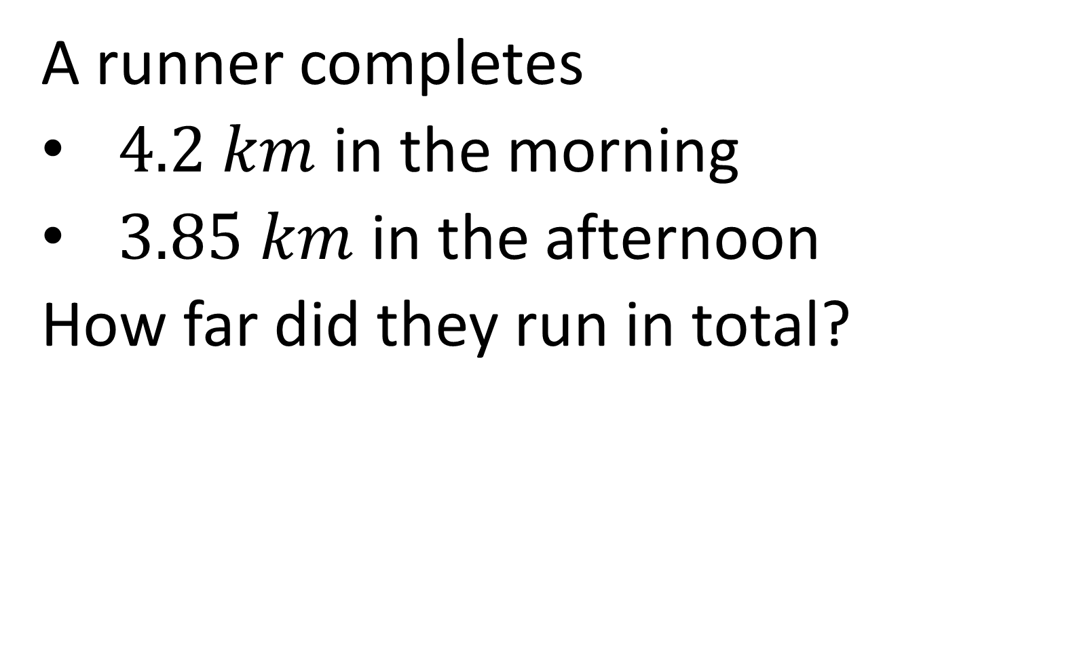
A runner completes
$4.2 km$ in the morning
$3.85 km$ in the afternoon
How far did they run in total?
$$8.05 km$$

Slide 14


A pencil costs $£1.29$ and you pay with $£2$.
How much change do you get?
$$£0.71$$

Slide 15
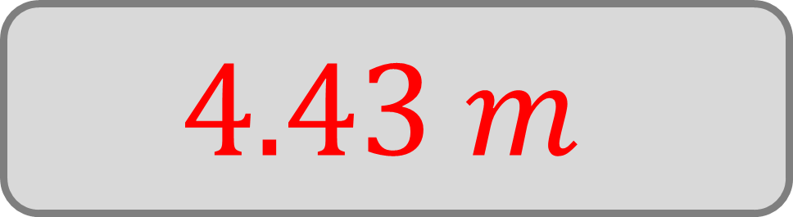
A rope is 6.5 m long. You cut off 2.07 m.
How much rope is left?
$$4.43 m$$

Slide 16


A jug has $0.75l$ in it.
You pour in another $0.125l$.
How much liquid is in the jug?
$$0.875l$$

Slide 17

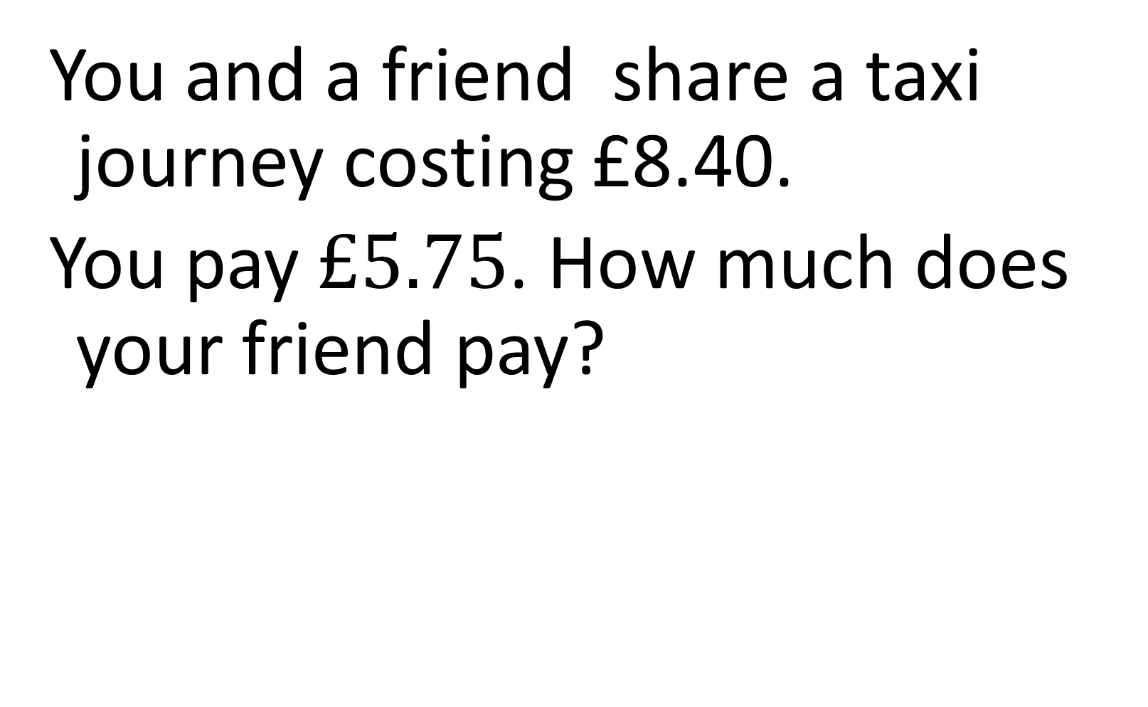
You and a friend share a taxi journey costing £8.40.
You pay $£5.75$. How much does your friend pay?
$$£2.65$$

Slide 18

A phone battery is at 78%.
It drops to 63.4%.
What is the decrease?
$$14.6\%$$

Slide 19

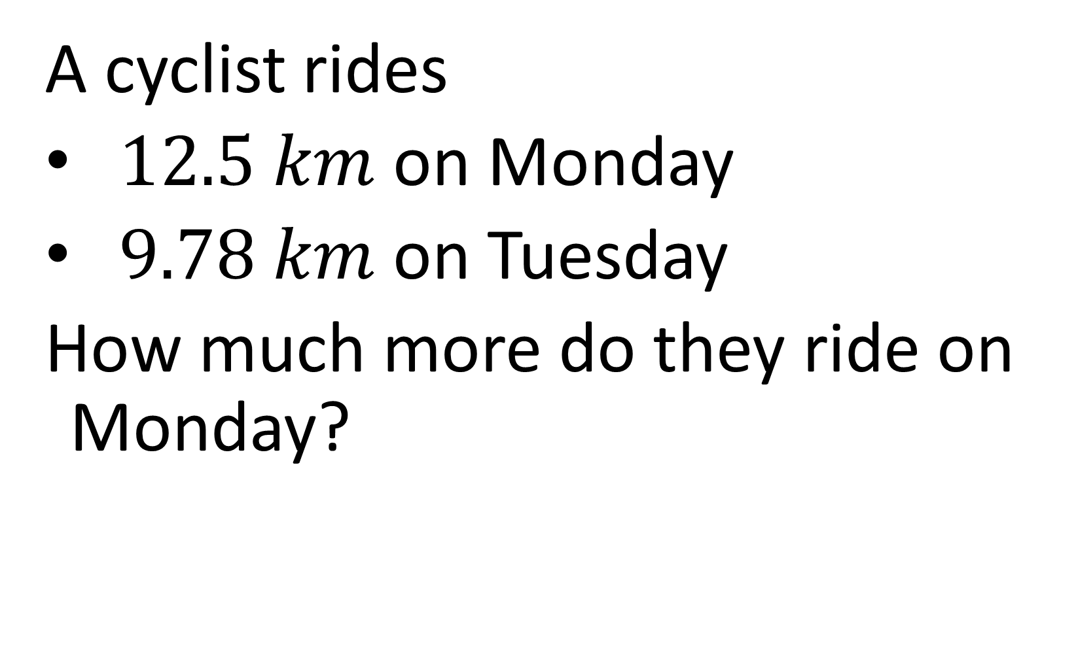
A cyclist rides
$12.5 km$ on Monday
$9.78 km$ on Tuesday
How much more do they ride on Monday?
$$2.72 km$$

Slide 20
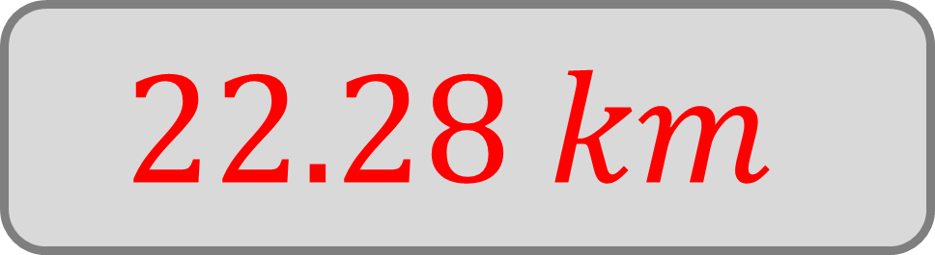
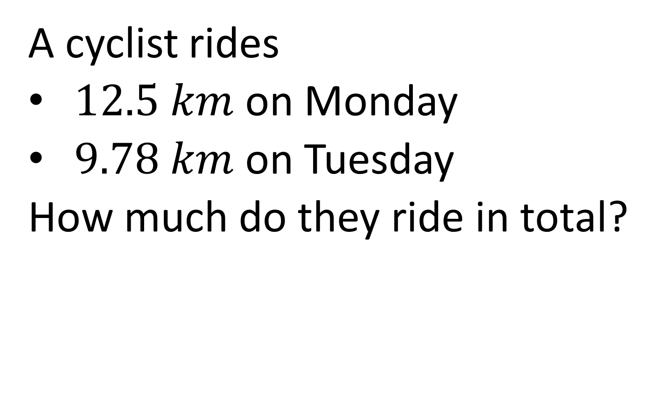
A cyclist rides
$12.5 km$ on Monday
$9.78 km$ on Tuesday
How much do they ride in total?
$$22.28 km$$

Slide 21
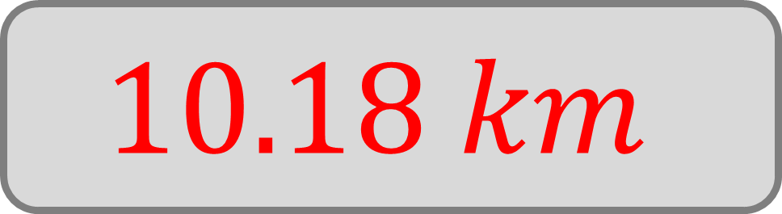
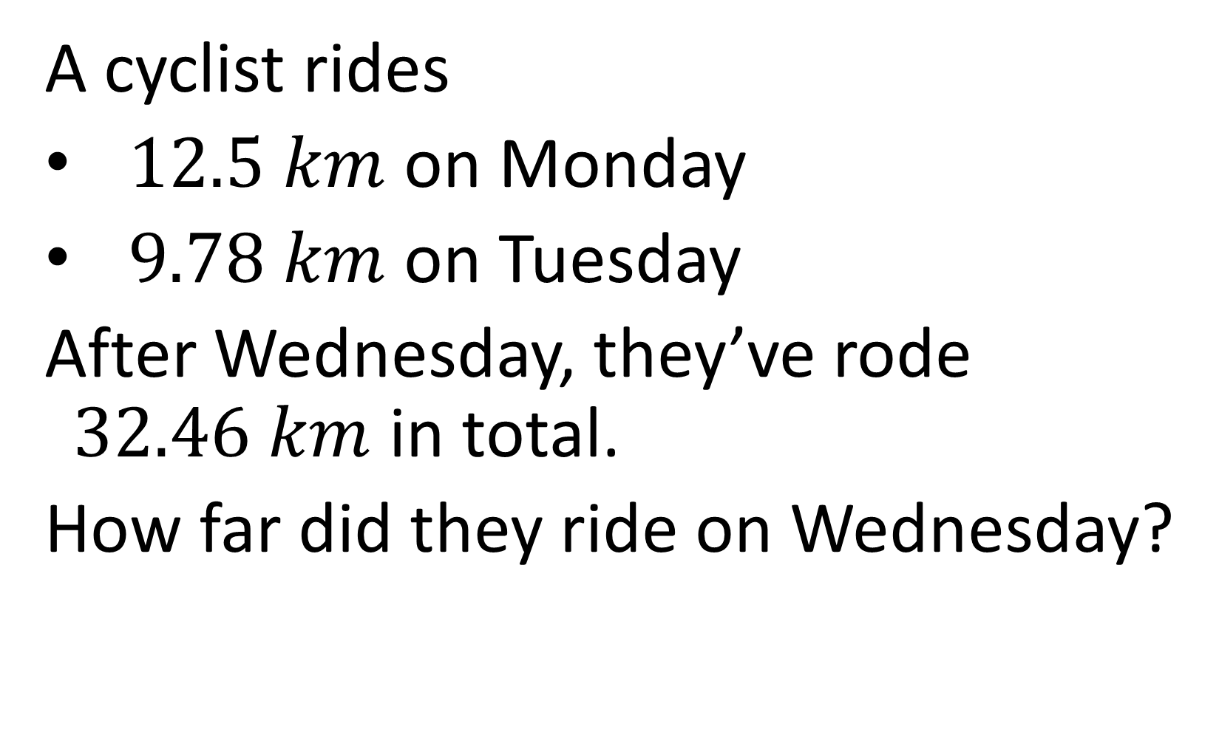
A cyclist rides
$12.5 km$ on Monday
$9.78 km$ on Tuesday
After Wednesday, they’ve rode $32.46 km$ in total.
How far did they ride on Wednesday?
$$10.18 km$$

