Slide 1
Equivalent Fractions
18 May 2026

Slide 2

Write two fractions equivalent to:
$$\frac{7}{9}$$

Slide 3


Complete the fraction:
$\frac{3}{4}=\frac{}{16}$
$$\frac{12}{16}$$

Slide 4


Complete the fraction:
$\frac{5}{6}=\frac{20}{}$
$$\frac{20}{24}$$

Slide 5


Complete the fraction:
$\frac{12}{20}=\frac{?}{50}$
$$\frac{30}{50}$$

Slide 6
Complete the fraction:
$\frac{12}{20}=\frac{?}{50}$
$$\frac{30}{50}$$

Slide 7


Complete the fraction:
$\frac{?}{14}=\frac{15}{35}$
$$\frac{6}{14}$$

Slide 8


Complete the fraction:
$\frac{18}{42}=\frac{?}{28}$
$$\frac{12}{28}$$

Slide 9


Complete the fraction:
$\frac{?}{6}=\frac{16}{24}$
$$\frac{4}{6}$$

Slide 10


Complete the fraction:
$\frac{21}{49}=\frac{?}{77}$
$$\frac{33}{77}$$

Slide 11


Complete the fraction:
$\frac{21}{?}=\frac{9}{15}$
$$\frac{21}{35}$$

Slide 12

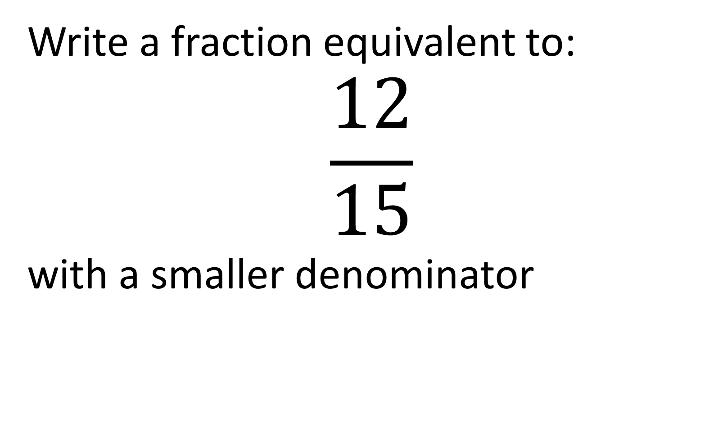
Write a fraction equivalent to:
$$\frac{12}{15}$$
with a smaller denominator
$$\frac{4}{5}$$

Slide 13

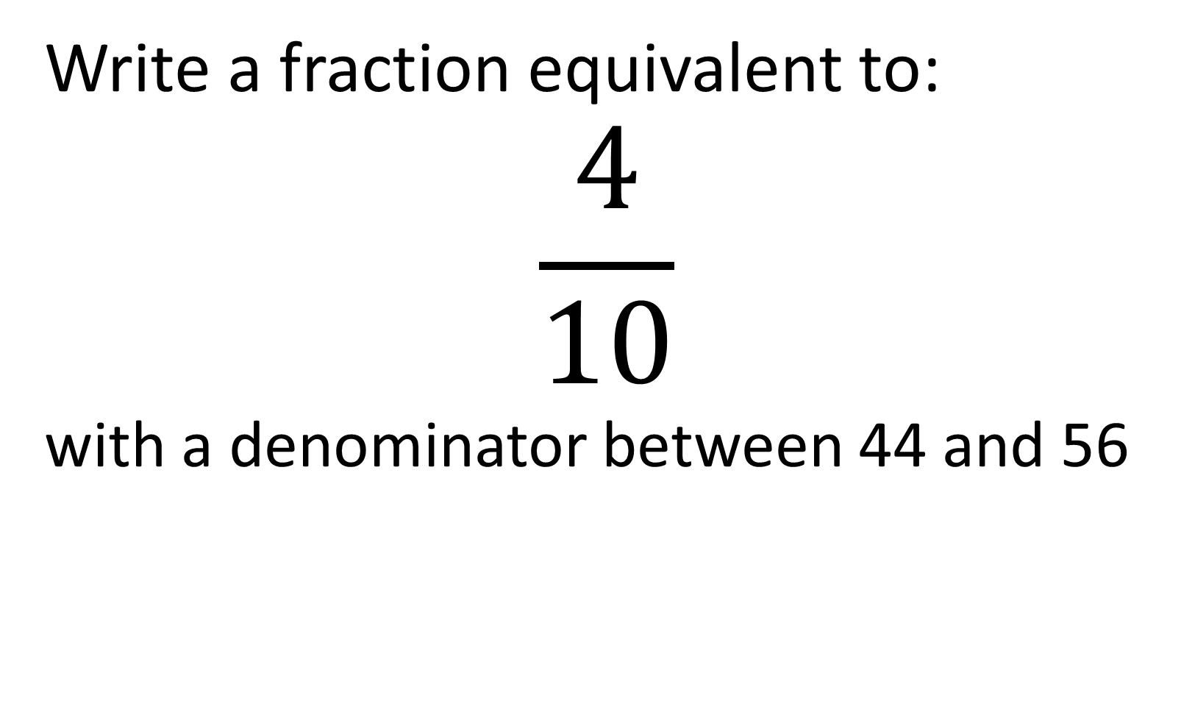
Write a fraction equivalent to:
$$\frac{4}{10}$$
with a denominator between 44 and 56
$$\frac{20}{50}$$

Slide 14

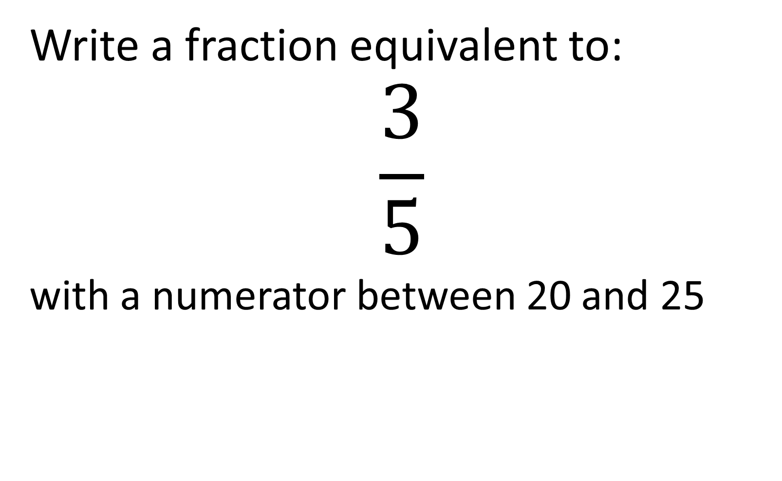
Write a fraction equivalent to:
$$\frac{3}{5}$$
with a numerator between 20 and 25
$\frac{21}{35}$ or $\frac{24}{40}$

Slide 15

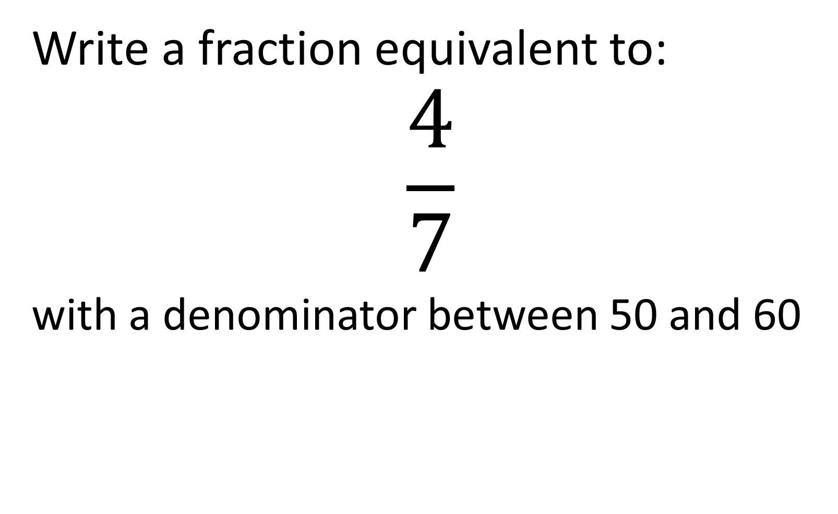
Write a fraction equivalent to:
$$\frac{4}{7}$$
with a denominator between 50 and 60
$$\frac{32}{56}$$

Slide 16

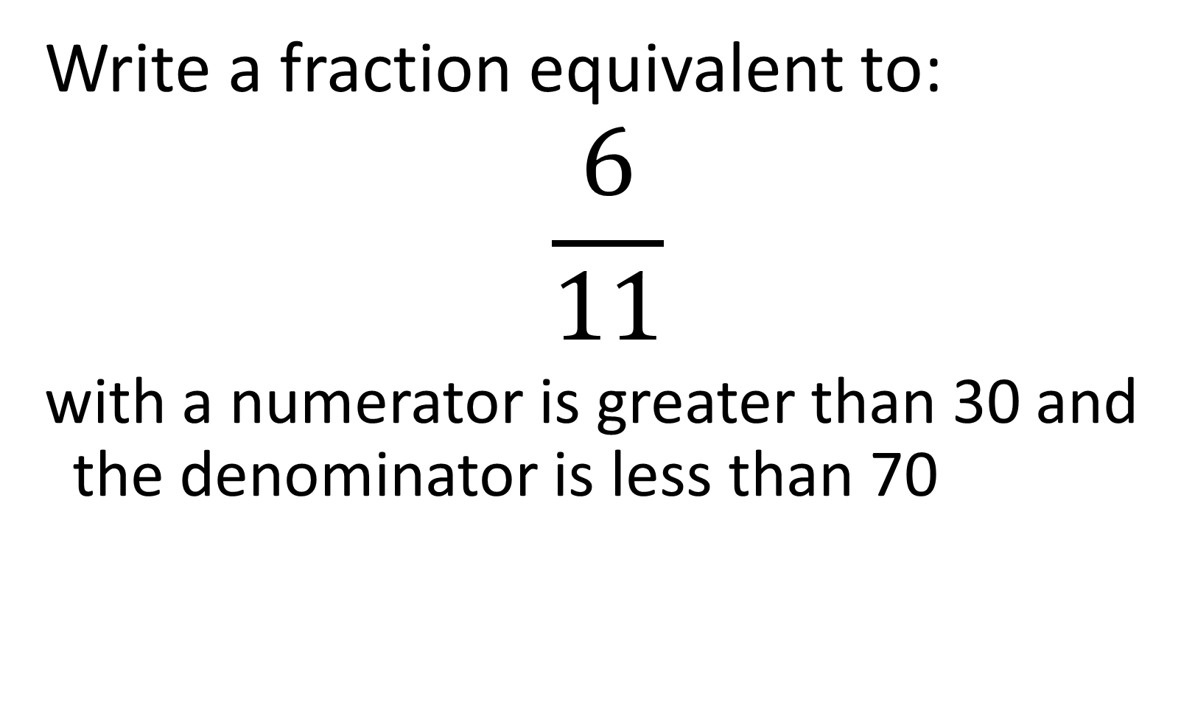
Write a fraction equivalent to:
$$\frac{6}{11}$$
with a numerator is greater than 30 and the denominator is less than 70
$$\frac{36}{66}$$

Slide 17

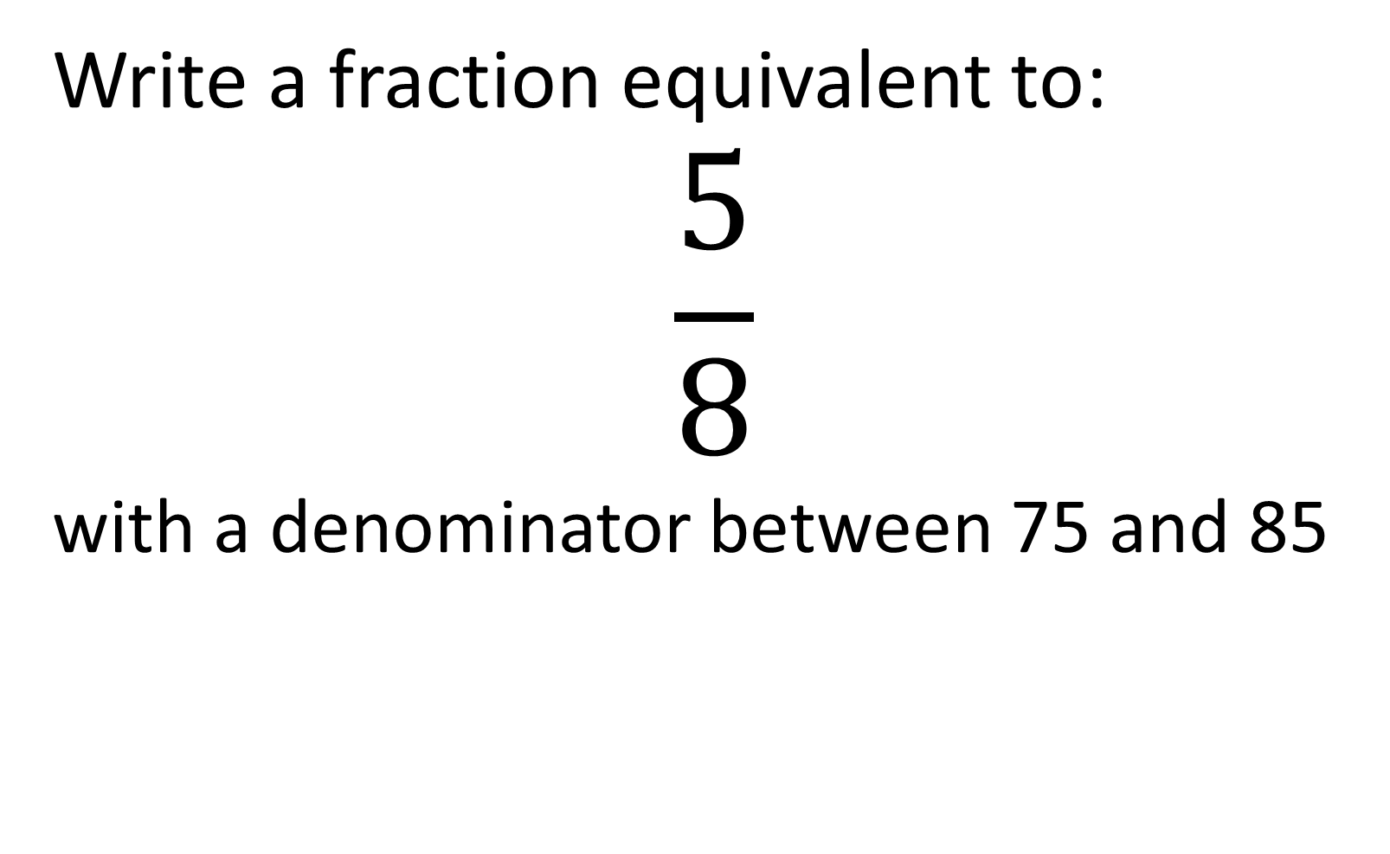
Write a fraction equivalent to:
$$\frac{5}{8}$$
with a denominator between 75 and 85
$$\frac{50}{80}$$

Slide 18

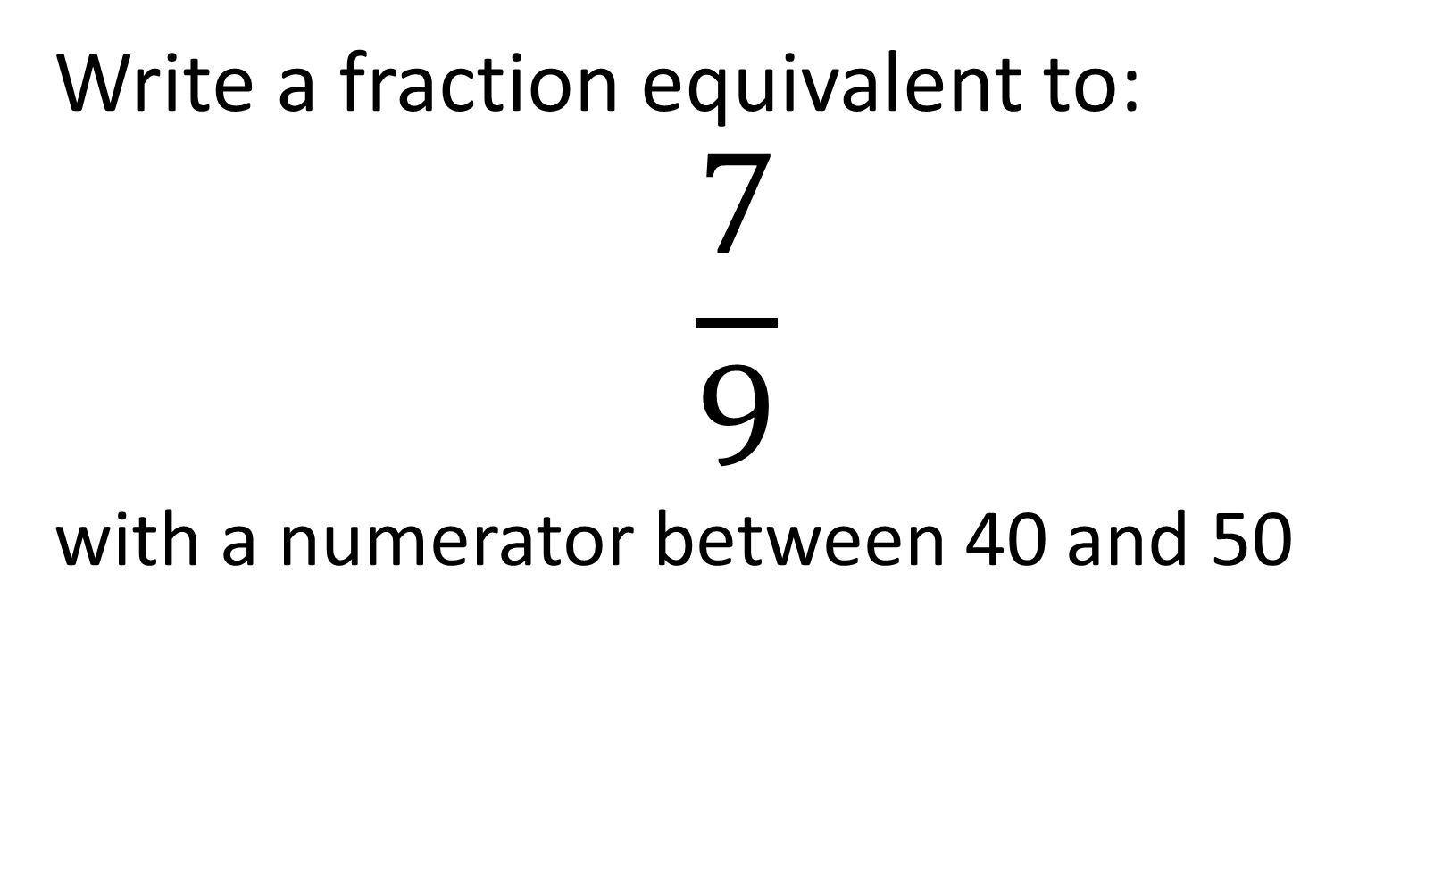
Write a fraction equivalent to:
$$\frac{7}{9}$$
with a numerator between 40 and 50
$$\frac{42}{54}\text{or}\frac{49}{63}$$

Slide 19

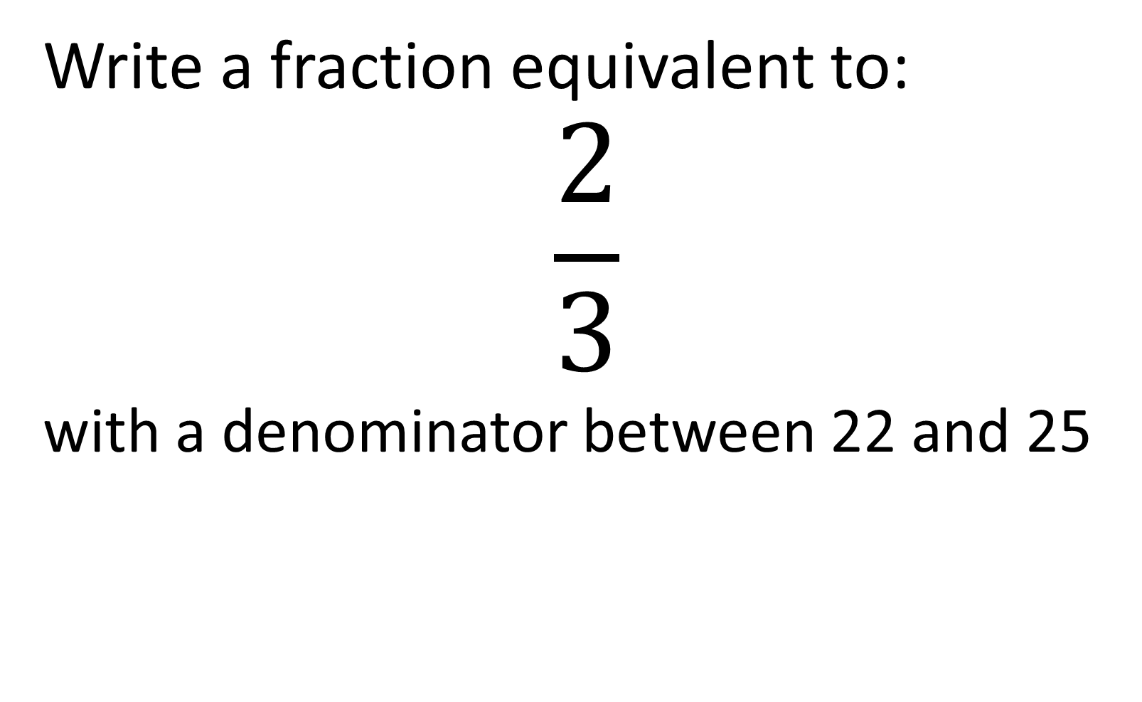
Write a fraction equivalent to:
$$\frac{2}{3}$$
with a denominator between 22 and 25
$$\frac{16}{24}$$

Slide 20
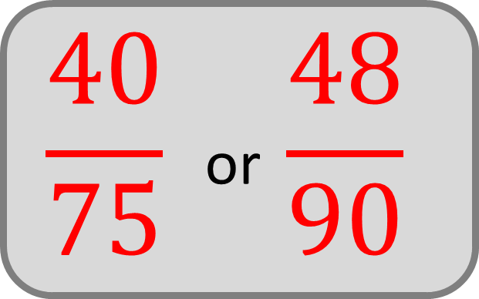
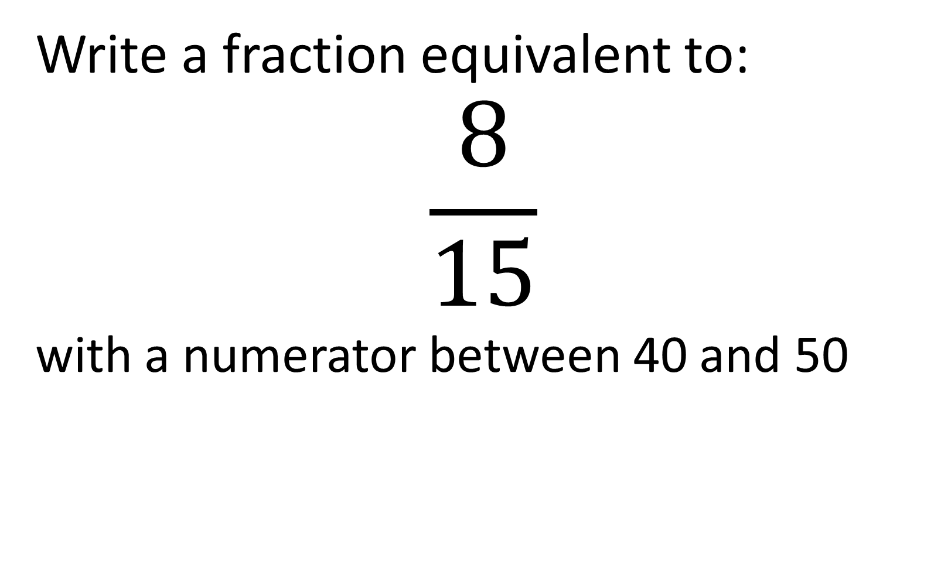
Write a fraction equivalent to:
$$\frac{8}{15}$$
with a numerator between 40 and 50
$$\frac{40}{75} \text{or} \frac{48}{90}$$

Slide 21

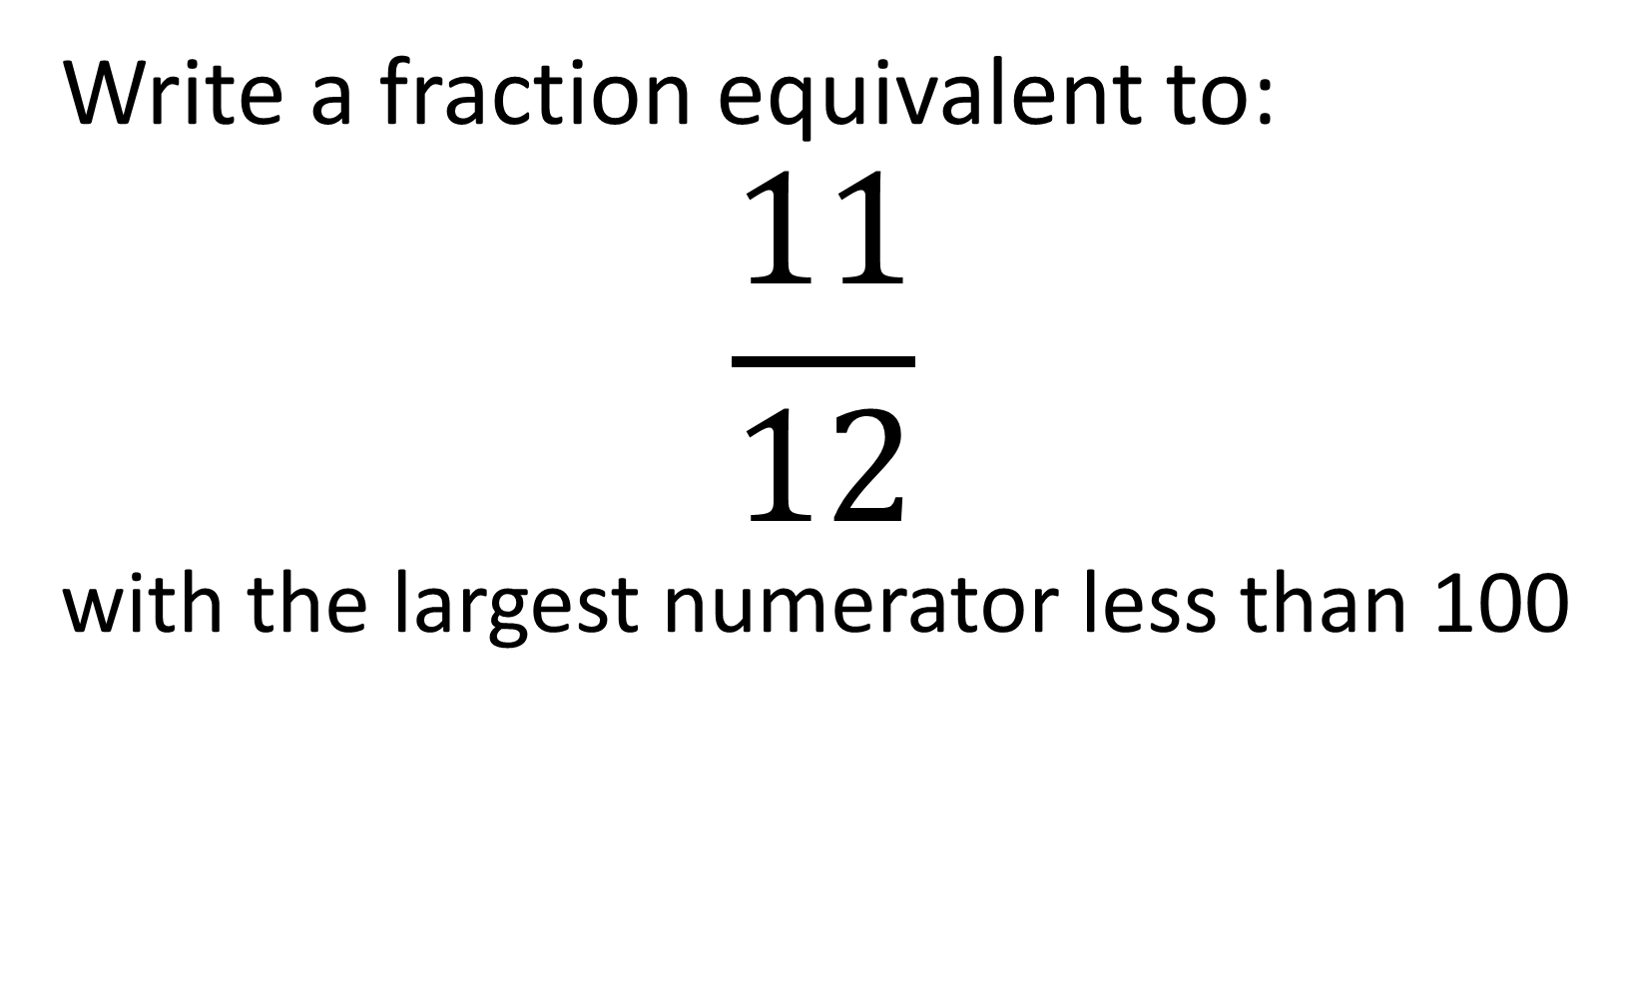
Write a fraction equivalent to:
$$\frac{11}{12}$$
with the largest numerator less than 100
$$\frac{99}{108}$$

