Slide 1
Expanding Brackets
20 May 2026

Slide 2

A pupil writes:
$$\left(x+5\right)\left(x+3\right)=x^{2}+15$$
Are they correct?
No

Slide 3
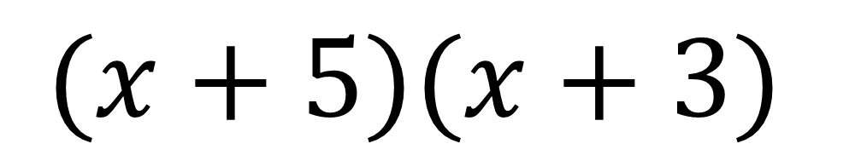
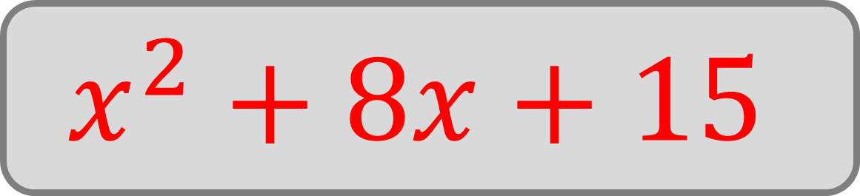
Expand:
$$(x+5)(x+3)$$
$$x^{2}+8x+15$$

Slide 4
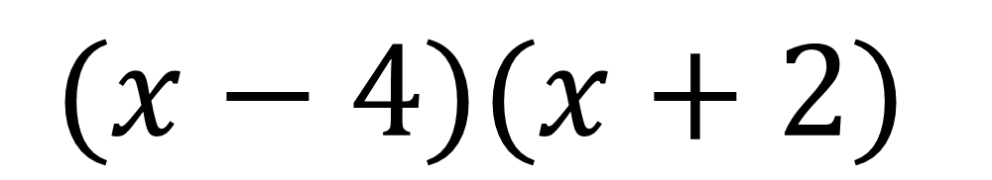
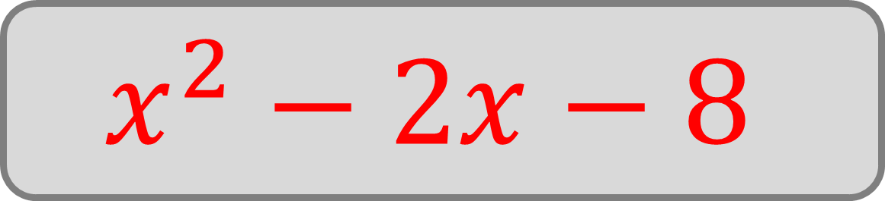
Expand:
$$(x−4)(x+2)$$
$$x^{2}−2x−8$$

Slide 5

A pupil writes:
$$\left(x−4\right)\left(x−2\right)=x^{2}−6x−6$$
Are they correct?
No

Slide 6
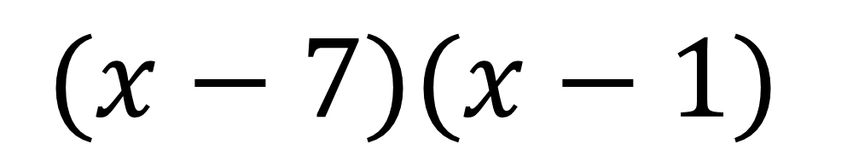
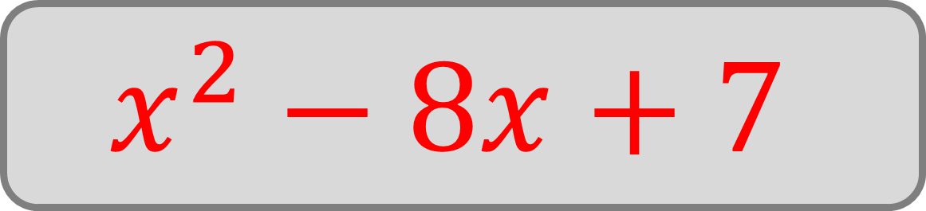
Expand:
$$(x−7)(x−1)$$
$$x^{2}−8x+7$$

Slide 7
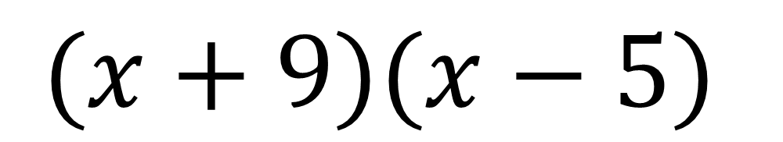
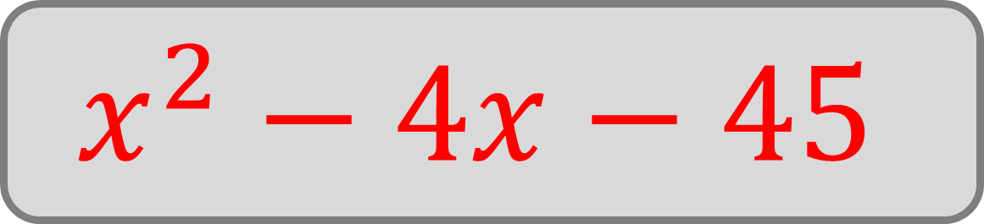
Expand:
$$(x+9)(x−5)$$
$$x^{2}−4x−45$$

Slide 8
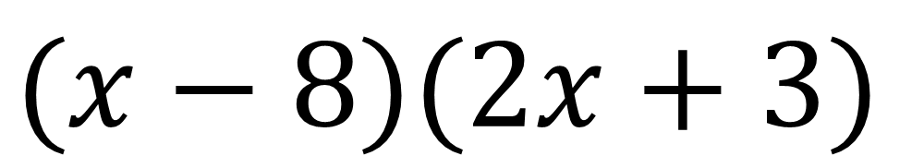
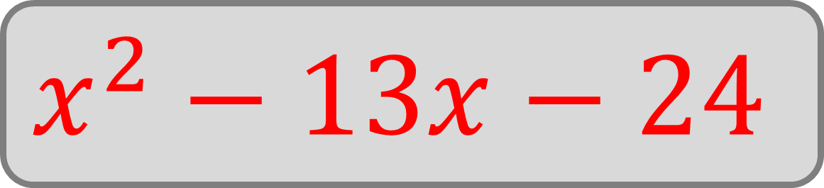
Expand:
$$(x−8)(2x+3)$$
$$x^{2}−13x−24$$

Slide 9
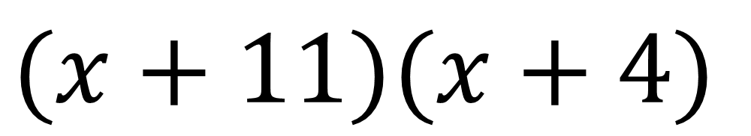
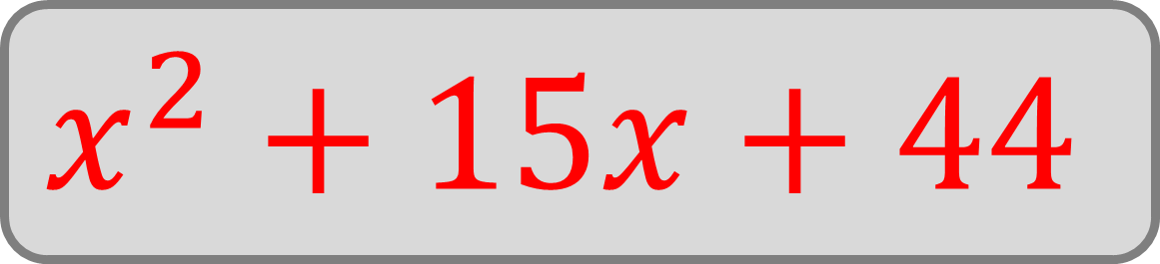
Expand:
$$(x+11)(x+4)$$
$$x^{2}+15x+44$$

Slide 10
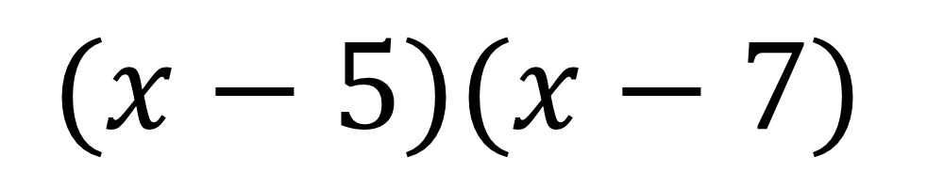
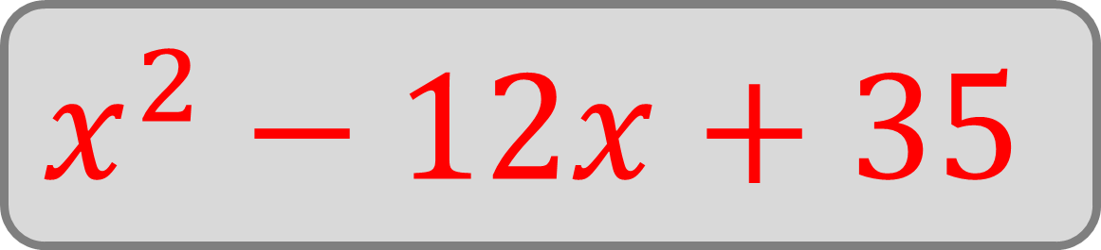
Expand:
$$(x−5)(x−7)$$
$$x^{2}−12x+35$$

Slide 11
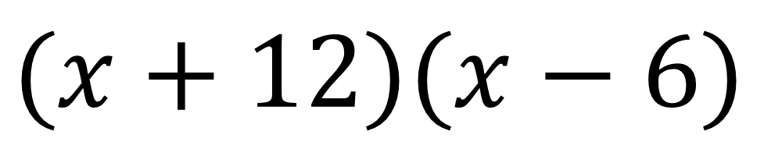
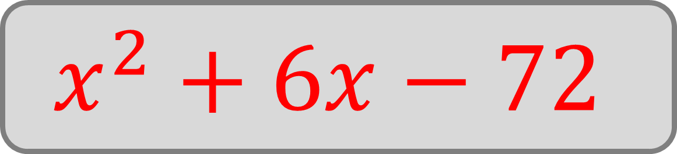
Expand:
$$(x+12)(x−6)$$
$$x^{2}+6x−72$$

Slide 12
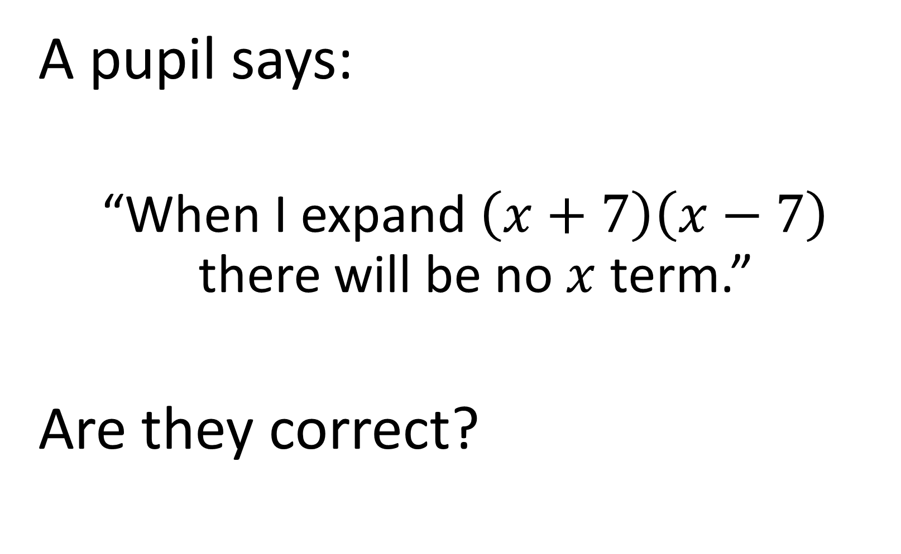
A pupil says:
“When I expand $\left(x+7\right)\left(x−7\right)$ there will be no $x$ term.”
Are they correct?
Yes

Slide 13
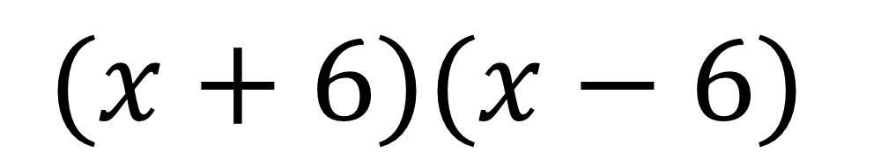

Expand:
$$(x+6)(x−6)$$
$$x^{2}−36$$

Slide 14
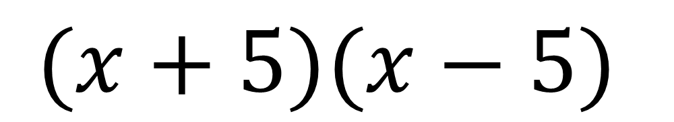

Expand:
$$(x+5)(x−5)$$
$$x^{2}−25$$

Slide 15
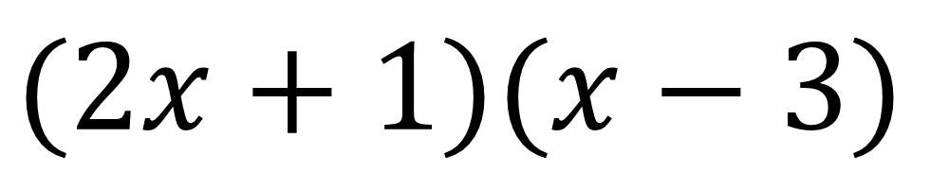
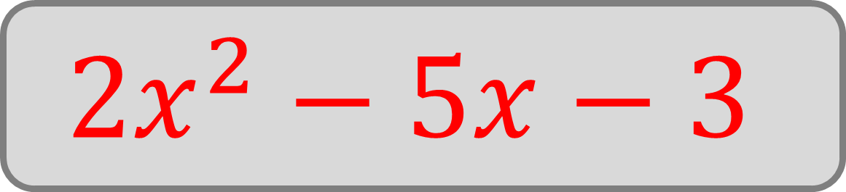
Expand:
$$(2x+1)(x−3)$$
$$2x^{2}−5x−3$$

Slide 16
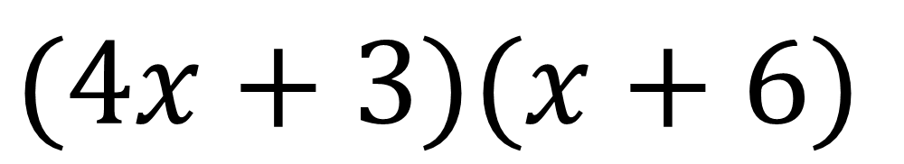
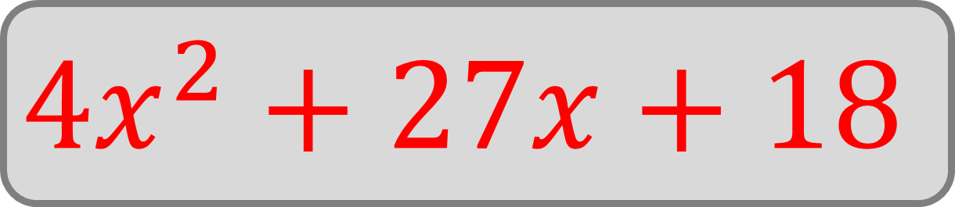
Expand:
$$(4x+3)(x+6)$$
$$4x^{2}+27x+18$$

Slide 17
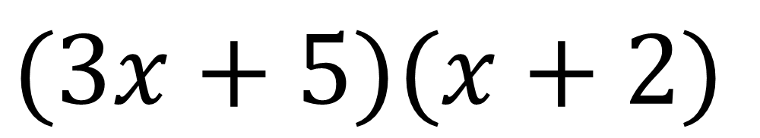
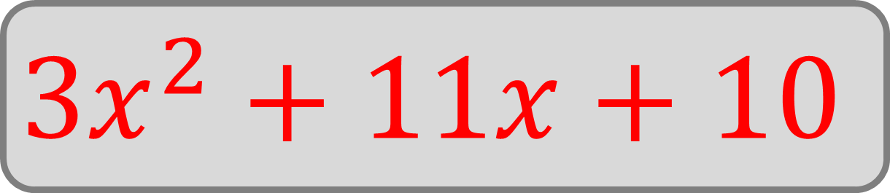
Expand:
$$(3x+5)(x+2)$$
$$3x^{2}+11x+10$$

Slide 18
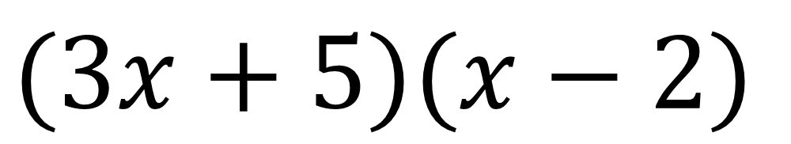
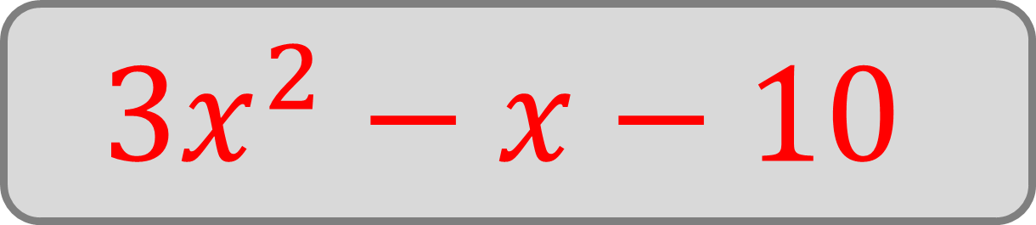
Expand:
$$(3x+5)(x−2)$$
$$3x^{2}−x−10$$

Slide 19
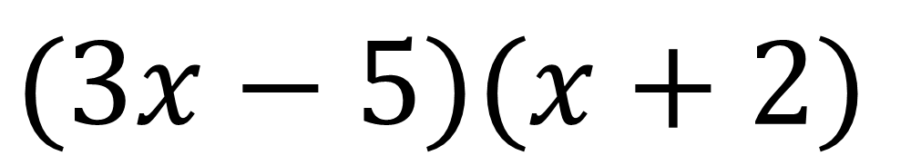
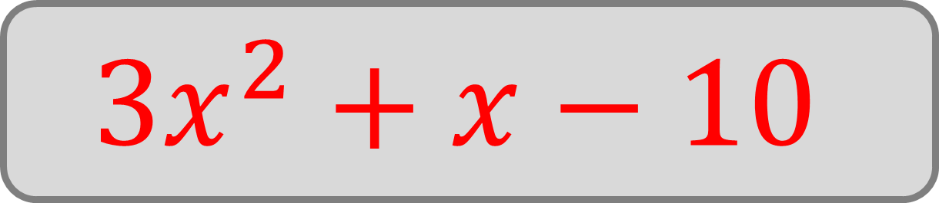
Expand:
$$(3x−5)(x+2)$$
$$3x^{2}+x−10$$

Slide 20
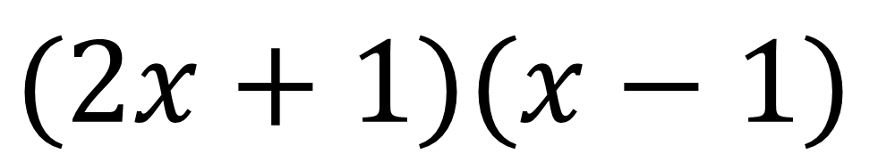
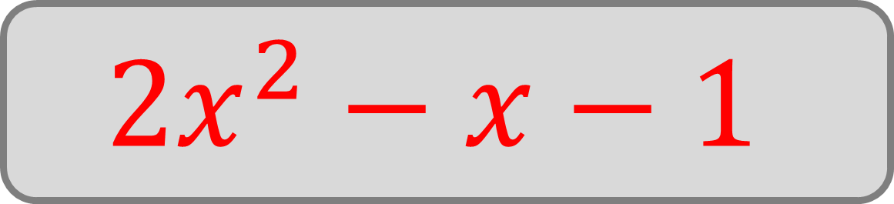
Expand:
$$(2x+1)(x−1)$$
$$2x^{2}−x−1$$

Slide 21
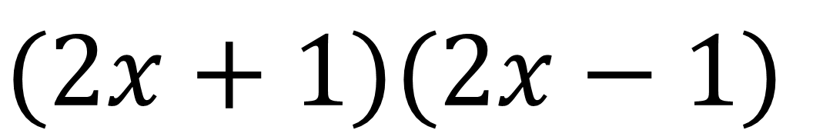

Expand:
$$(2x+1)(2x−1)$$
$$4x^{2}−1$$

