Slide 1
Fraction Addition
18 May 2026

Slide 2
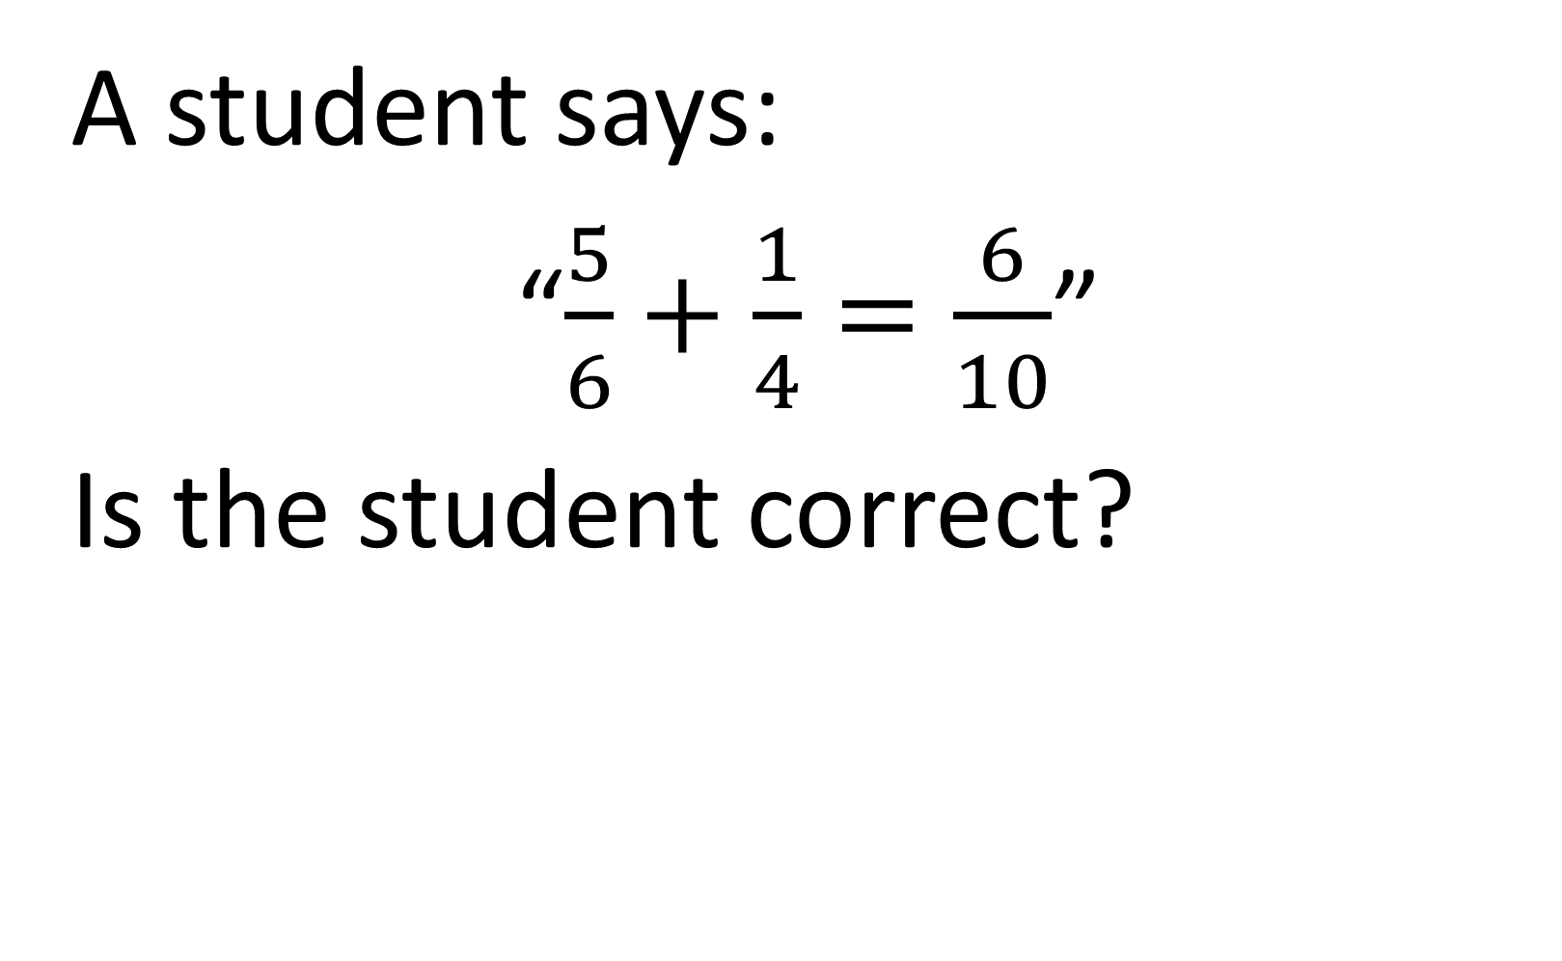
A student says:
“$\frac{5}{6}+\frac{1}{4}=\frac{6}{10}$”
Is the student correct?
NO

Slide 3


Calculate:
$$\frac{1}{4}+\frac{1}{6}$$
$$\frac{5}{12}$$

Slide 4

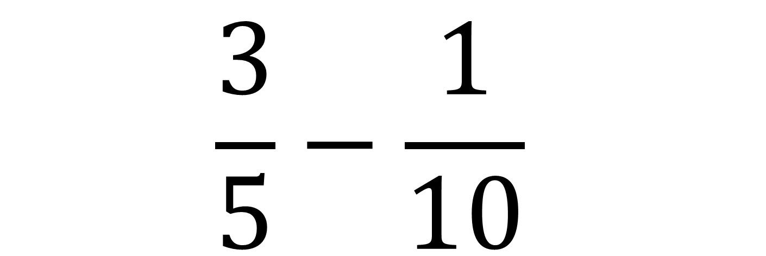
Calculate:
$$\frac{3}{5}−\frac{1}{10}$$
$$\frac{1}{2}$$

Slide 5


Calculate:
$$\frac{2}{3}+\frac{1}{9}$$
$$\frac{7}{9}$$

Slide 6


Calculate:
$$\frac{5}{8}−\frac{1}{4}$$
$$\frac{3}{8}$$

Slide 7


Calculate:
$$\frac{5}{6}−\frac{1}{8}$$
$$\frac{17}{24}$$

Slide 8


Calculate:
$$\frac{2}{5}+\frac{3}{10}$$
$$\frac{7}{10}$$

Slide 9

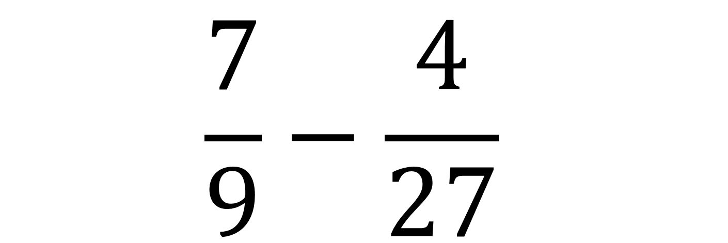
Calculate:
$$\frac{7}{9}−\frac{4}{27}$$
$$\frac{17}{27}$$

Slide 10

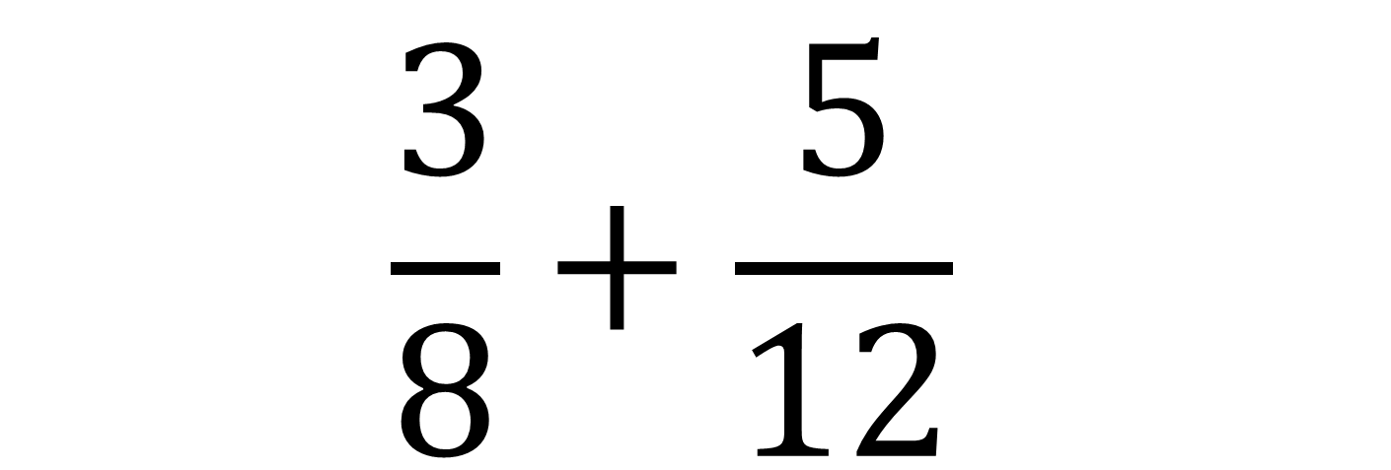
Calculate:
$$\frac{3}{8}+\frac{5}{12}$$
$$\frac{19}{24}$$

Slide 11

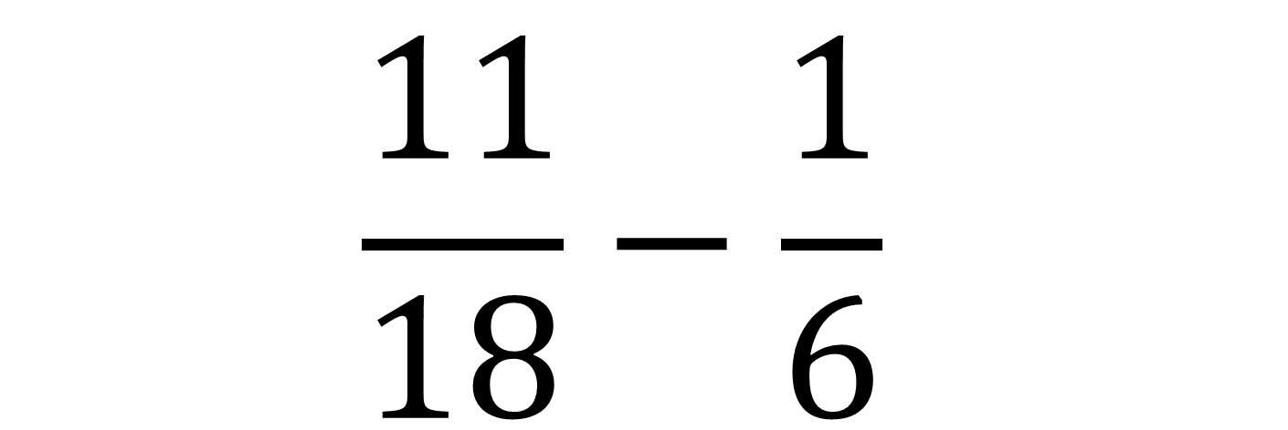
Calculate:
$$\frac{11}{18}−\frac{1}{6}$$
$$\frac{4}{9}$$

Slide 12

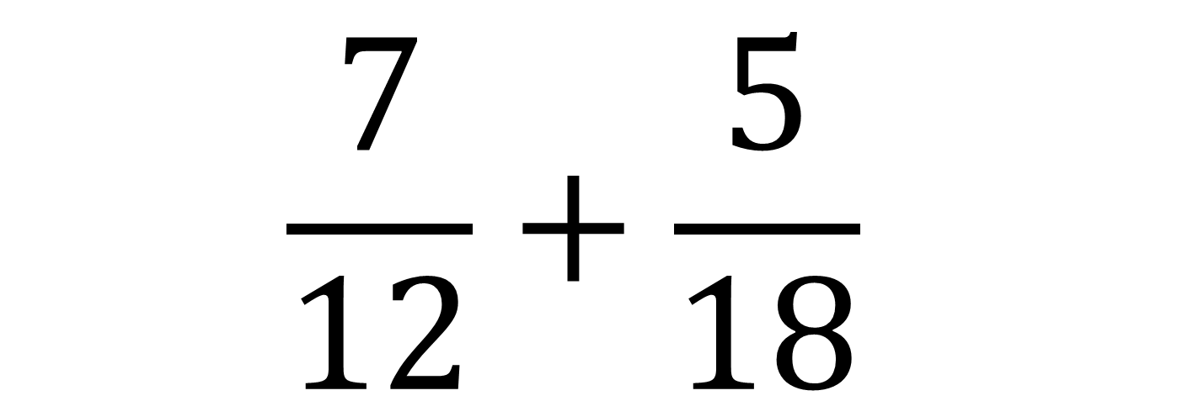
Calculate:
$$\frac{7}{12}+\frac{5}{18}$$
$$\frac{31}{36}$$

Slide 13


Calculate:
$$\frac{3}{7}+\frac{2}{21}$$
$$\frac{11}{21}$$

Slide 14

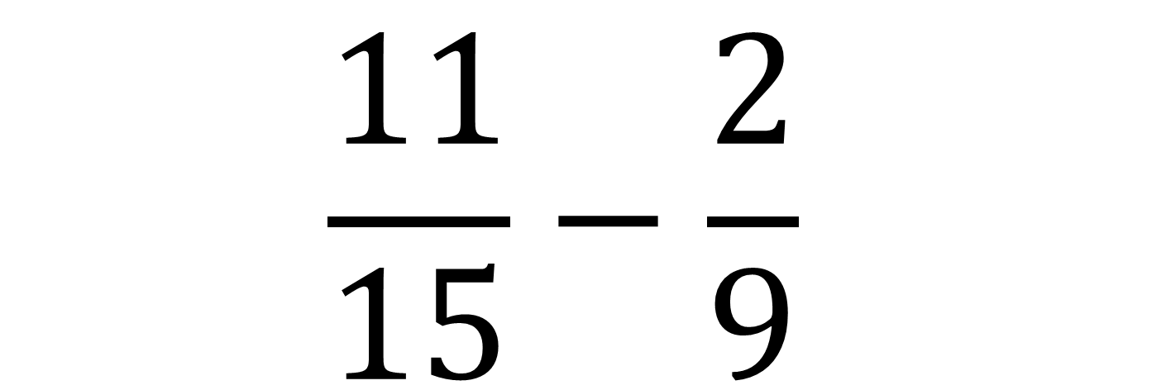
Calculate:
$$\frac{11}{15}−\frac{2}{9}$$
$$\frac{23}{45}$$

Slide 15


Calculate:
$$\frac{9}{14}+\frac{5}{28}$$
$$\frac{23}{28}$$

Slide 16

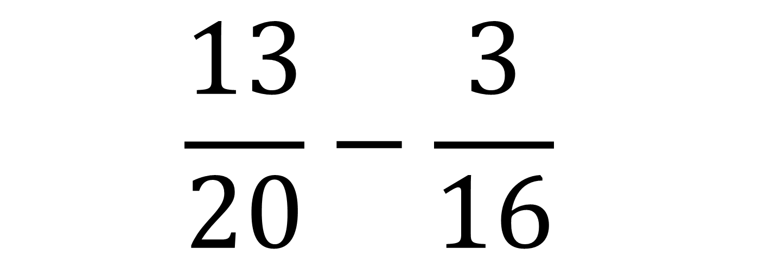
Calculate:
$$\frac{13}{20}−\frac{3}{16}$$
$$\frac{37}{80}$$

Slide 17


Calculate:
$$\frac{4}{9}+\frac{7}{12}$$
$$\frac{37}{36}$$

Slide 18


Two fractions add to $\frac{1}{2}$.
One is $\frac{3}{20}$.
Find the other.
$$\frac{29}{60}$$

Slide 19

The sum of two fractions is $\frac{5}{6}$.
One of them is $\frac{1}{3}$.
What is the other?
$$\frac{1}{2}$$

Slide 20
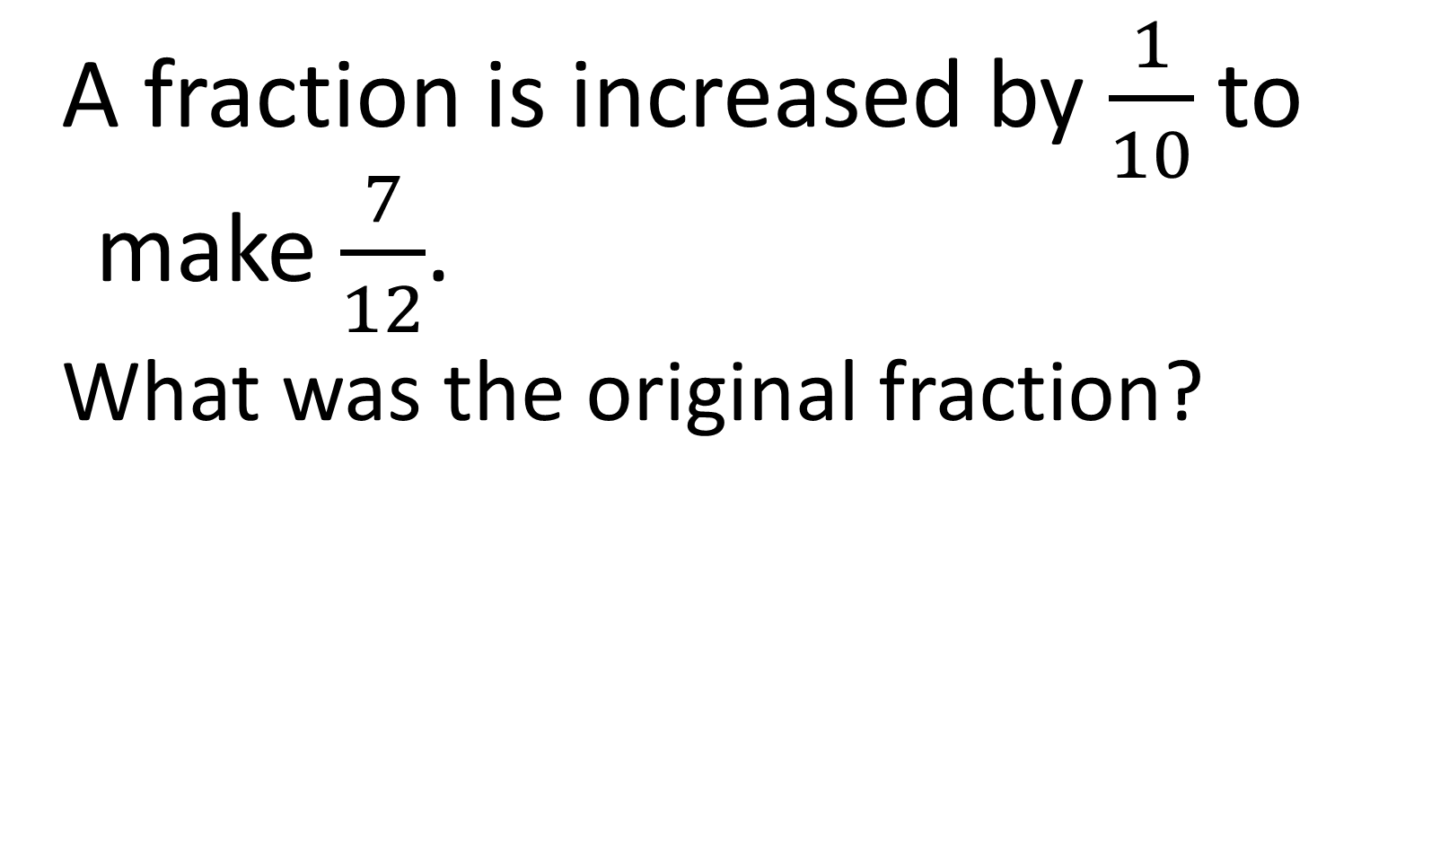
A fraction is increased by $\frac{1}{10}$ to make $\frac{7}{12}$.
What was the original fraction?
$$\frac{29}{60}$$

Slide 21


$\frac{3}{4}$ is how much bigger than $\frac{2}{9}$ ?
$$\frac{19}{36}$$

