Slide 1
Fraction of amounts
18 May 2026

Slide 2


Find:
$\frac{1}{2}$ of 84
$$42$$

Slide 3


Find:
$\frac{1}{3}$ of 90
$$30$$

Slide 4


Find:
$\frac{3}{4}$ of 64
$$48$$

Slide 5


Find:
$\frac{2}{5}$ of 45
$$18$$

Slide 6


Find:
$\frac{4}{7}$ of 70
$$40$$

Slide 7


Find:
$\frac{5}{6}$ of 72
$$60$$

Slide 8


Find:
$\frac{3}{8}$ of 56
$$21$$

Slide 9


Find:
$\frac{7}{10}$ of 120
$$84$$

Slide 10

Find:
$\frac{5}{12}$ of 96
$$40$$

Slide 11


Find:
$\frac{2}{3}$ of 81
$$54$$

Slide 12


Find:
$\frac{3}{5}$ of 125
$$75$$

Slide 13

Find:
$\frac{4}{9}$ of 108
$$48$$

Slide 14


Find:
$\frac{7}{8}$ of 144
$$126$$

Slide 15


Find:
$\frac{11}{12}$ of 60
$$55$$

Slide 16

Find:
$\frac{5}{7}$ of 84
$$60$$

Slide 17

A class has 32 students.
Find three quarters of them.
$$24$$

Slide 18

A shop sells 120 apples in a day.
They sell two-fifths before lunchtime.
How many do they sell after lunchtime?
$$72$$

Slide 19
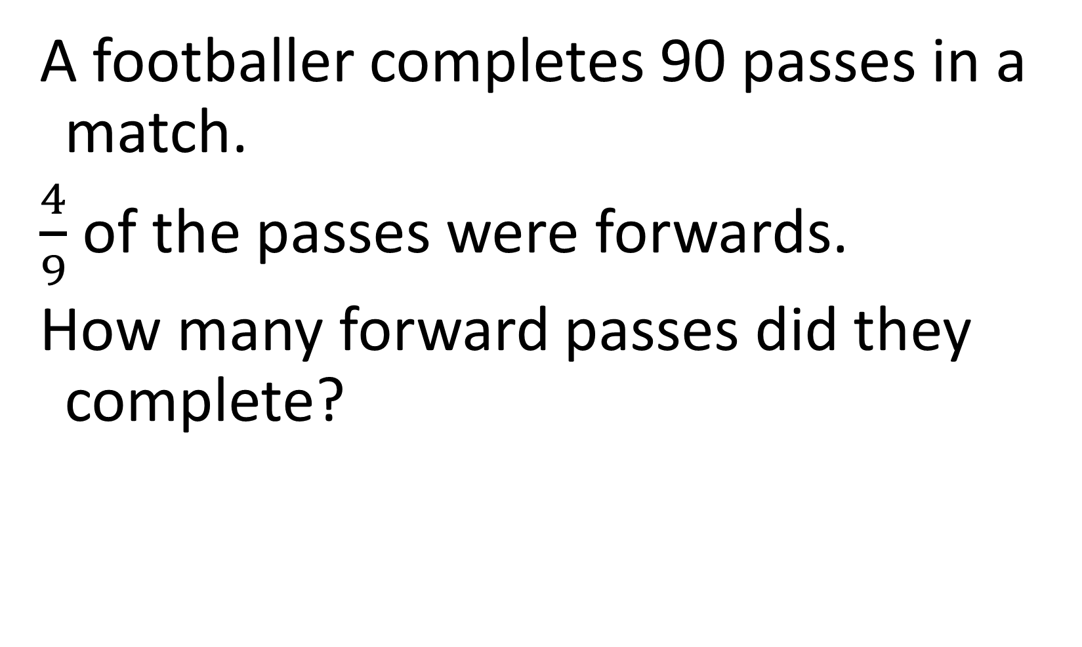
A footballer completes 90 passes in a match.
$\frac{4}{9}$ of the passes were forwards.
How many forward passes did they complete?
$$40$$

Slide 20


A tank holds 80 litres of water.
The tank is $\frac{7}{10}$ full.
How many litres are in the tank?
$$56$$

Slide 21


A book has 240 pages.
Find $1/3$ of the book.
$$80$$

