Slide 1
Improper Fractions
18 May 2026

Slide 2

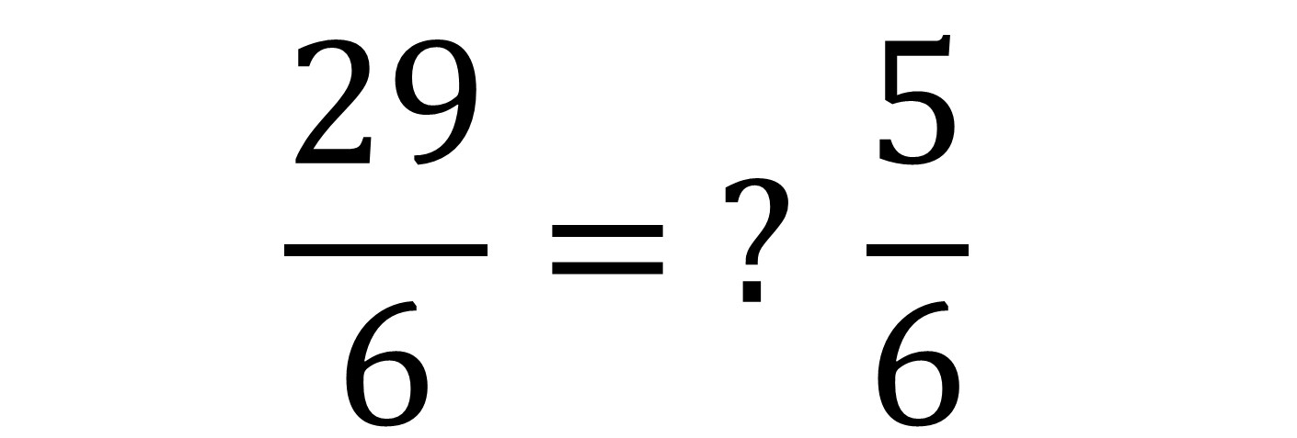
Fill in the blank:
$$\frac{29}{6}= ? \frac{5}{6}$$
$$4$$

Slide 3


Fill in the blank:
$$\frac{50}{9}= ? \frac{5}{9}$$
$$5$$

Slide 4
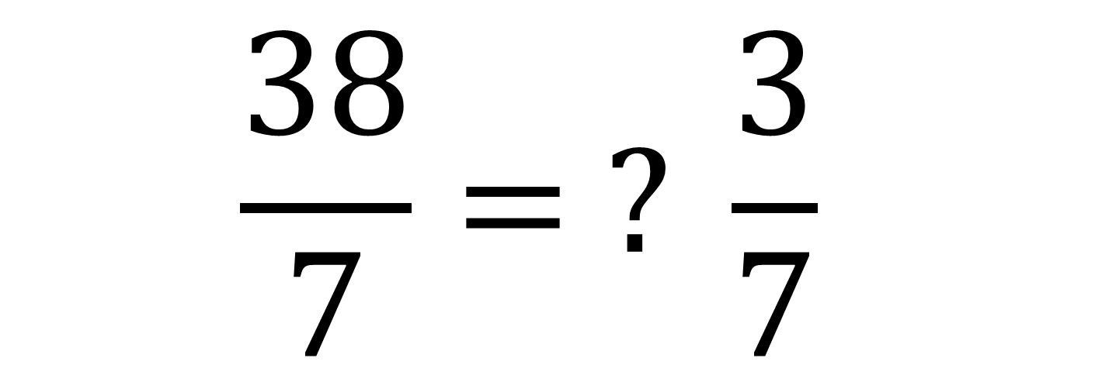
Fill in the blank:
$$\frac{38}{7}= ? \frac{3}{7}$$
$$5$$

Slide 5

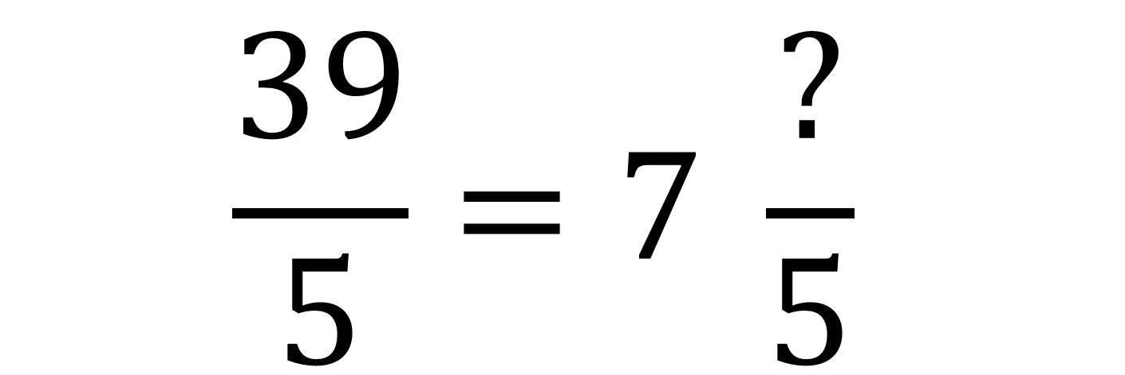
Fill in the blank:
$$4$$
$$\frac{39}{5}=7 \frac{?}{5}$$

Slide 6
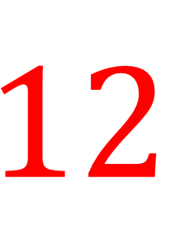
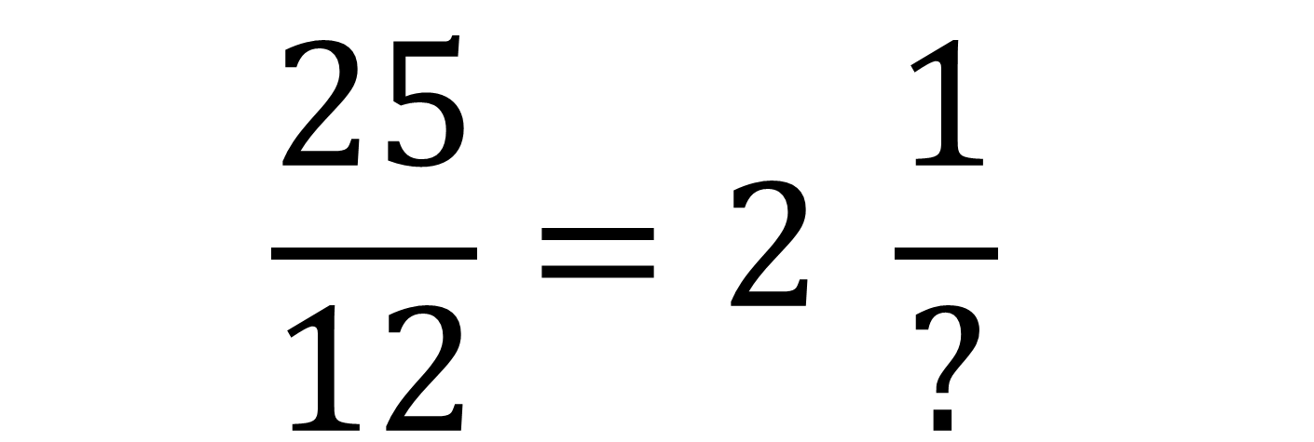
Fill in the blank:
$$\frac{25}{12}=2 \frac{1}{?}$$
$$12$$

Slide 7


Convert to a mixed number:
$$\frac{17}{5}$$
$$3\frac{2}{5}$$

Slide 8


Convert to a mixed number:
$$\frac{29}{6}$$
$$4\frac{5}{6}$$

Slide 9


Convert to a mixed number:
$$\frac{41}{8}$$
$$5\frac{1}{8}$$

Slide 10


Convert to a mixed number:
$$\frac{55}{12}$$
$$4\frac{7}{12}$$

Slide 11


Convert to a mixed number:
$$\frac{73}{10}$$
$$7\frac{3}{10}$$

Slide 12


Convert to an improper fraction:
$$3\frac{2}{7}$$
$$\frac{23}{7}$$

Slide 13


Convert to an improper fraction:
$$7\frac{5}{9}$$
$$\frac{68}{9}$$

Slide 14


Convert to an improper fraction:
$$5\frac{3}{4}$$
$$\frac{23}{4}$$

Slide 15


Convert to an improper fraction:
$$2\frac{6}{11}$$
$$\frac{28}{11}$$

Slide 16


Convert to an improper fraction:
$$9\frac{1}{8}$$
$$\frac{73}{8}$$

Slide 17

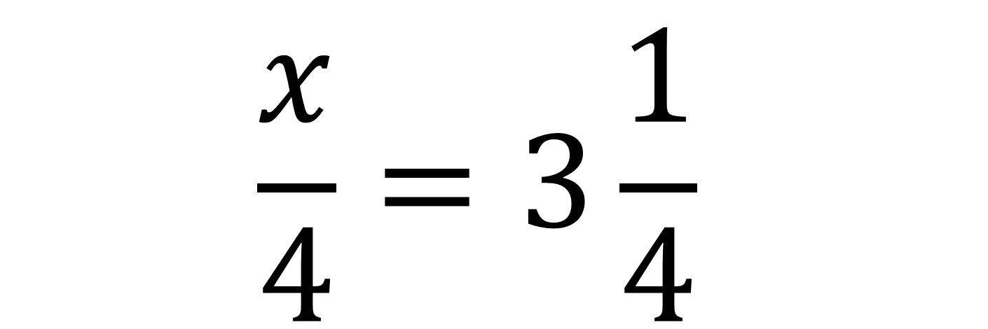
Solve:
$$\frac{x}{4}=3\frac{1}{4}$$
$$x=13$$

Slide 18

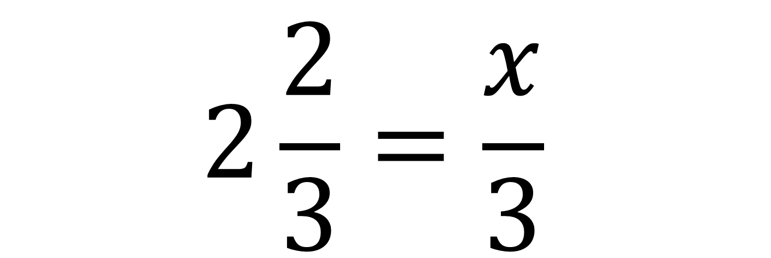
Solve:
$$2\frac{2}{3}=\frac{x}{3}$$
$$x=8$$

Slide 19


Solve:
$$\frac{x}{5}=4\frac{3}{5}$$
$$x=23$$

Slide 20


Solve:
$$8\frac{1}{2}=\frac{x}{6}$$
$$x=51$$

Slide 21

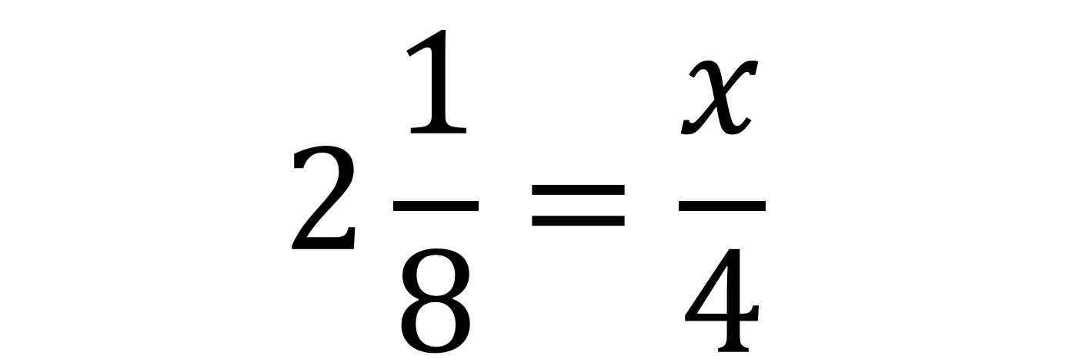
Solve:
$$2\frac{1}{8}=\frac{x}{4}$$
$$x=8.5$$

