Slide 1
Decimals
19 May 2026

Slide 2


A bottle contains $0.75l$ of juice.
How much juice is in 8 bottles?
$$6l$$

Slide 3

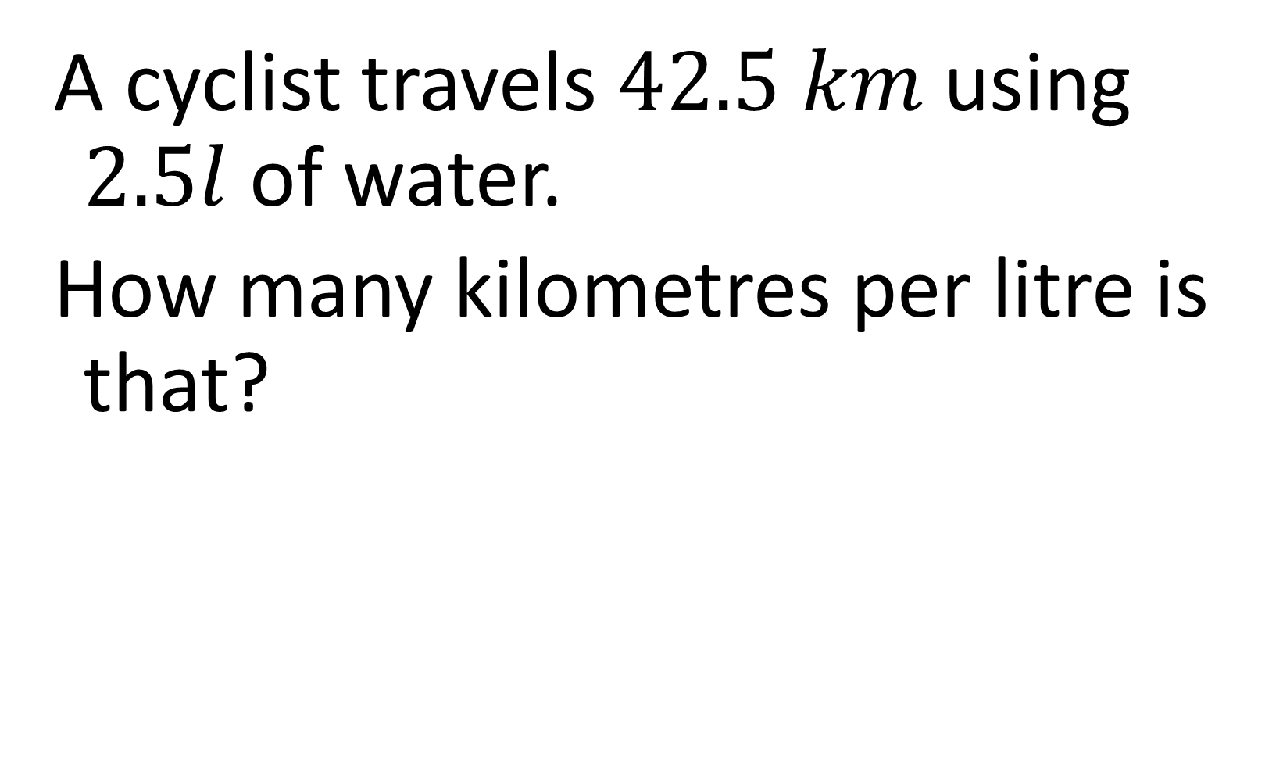
A cyclist travels $42.5 km$using $2.5l$ of water.
How many kilometres per litre is that?
$$19$$

Slide 4


One sticker costs $£0.18$.
How much do 25 stickers cost?
$$£4.50$$

Slide 5


A rope is $12.6 m$ long and is cut into 6 equal pieces.
How long is each piece?
$$2.1 m$$

Slide 6


A cake recipe uses $0.4 kg$ of sugar.
How much sugar is needed for 3.5 cakes?
$$1.4 kg$$

Slide 7


A taxi charges $£1.28$ per $km$.
How much does a $7.5 km$ journey cost?
$$£9.60$$

Slide 8


A runner completes $9.5 km$ in 2 hours.
What is their speed in $km$ per hour?
$$4.75 km/h$$

Slide 9


A shop sells $2.4 kg$ of rice for $£3.60$.
What is the price per kilogram?
$$£1.50$$

Slide 10

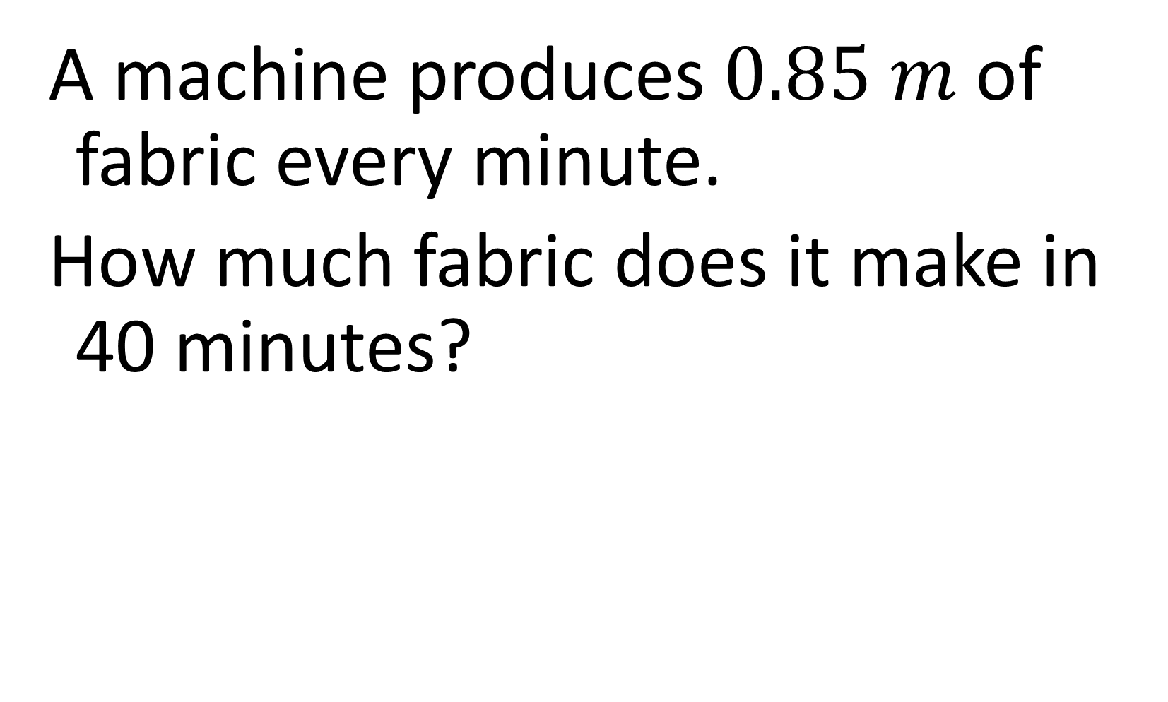
A machine produces $0.85 m$ of fabric every minute.
How much fabric does it make in 40 minutes?
$$34 m$$

Slide 11

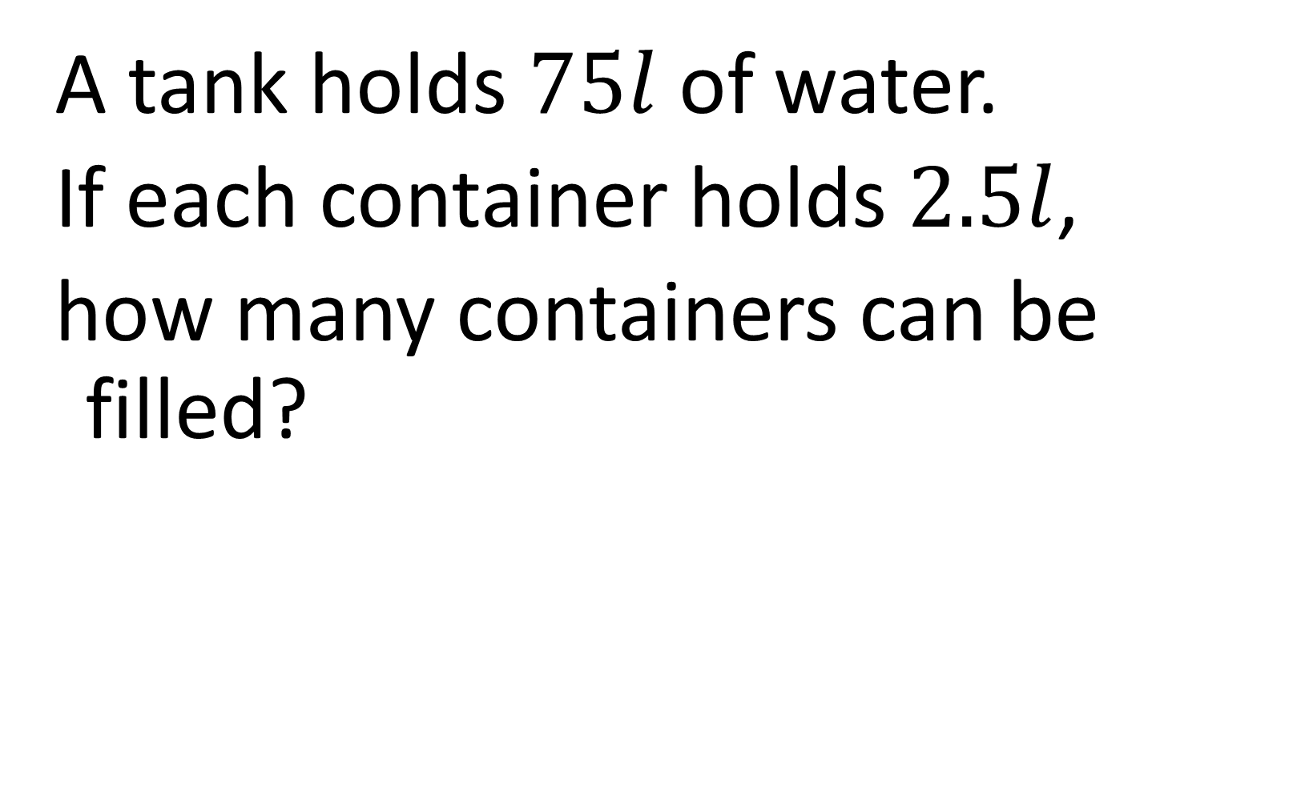
A tank holds $75l$ of water.
If each container holds $2.5l$,
how many containers can be filled?
$$30$$

Slide 12

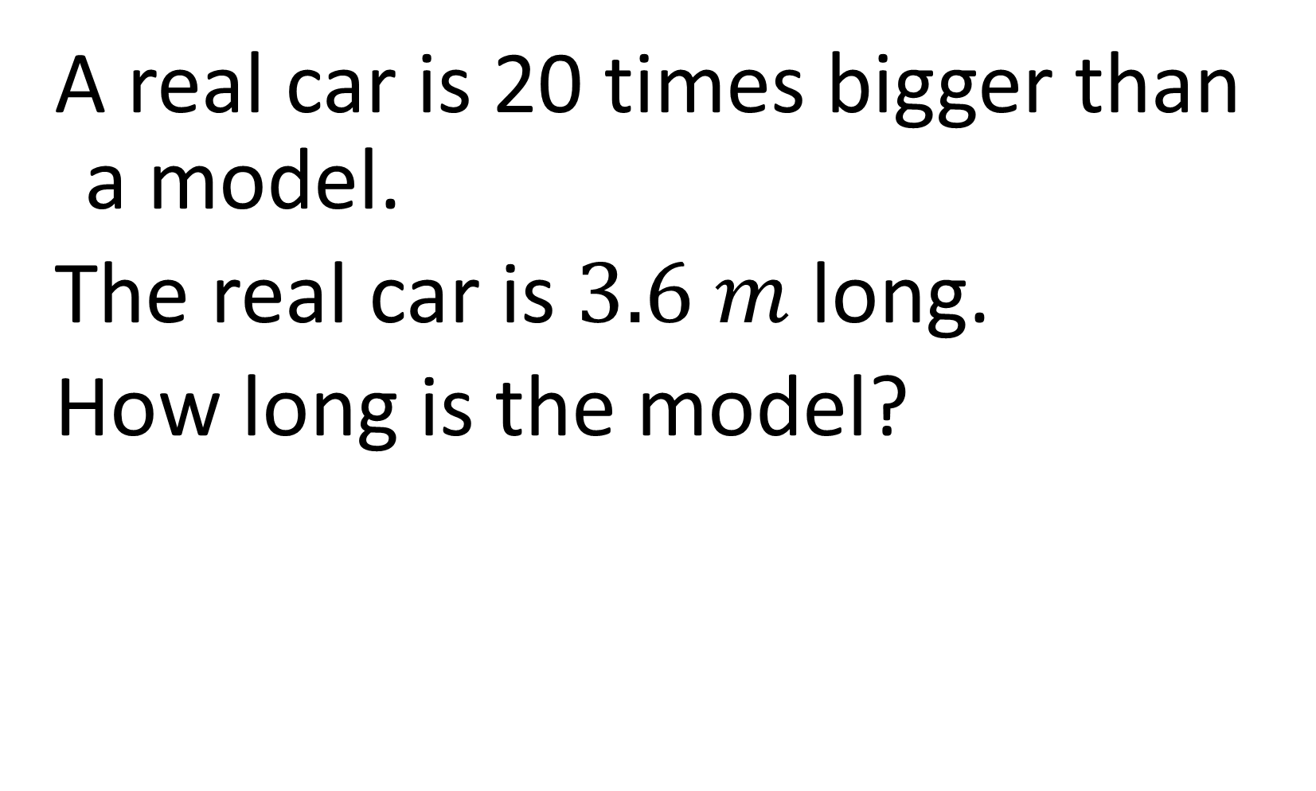
A real car is 20 times bigger than a model.
The real car is $3.6 m$ long.
How long is the model?
$$0.18 m$$

Slide 13

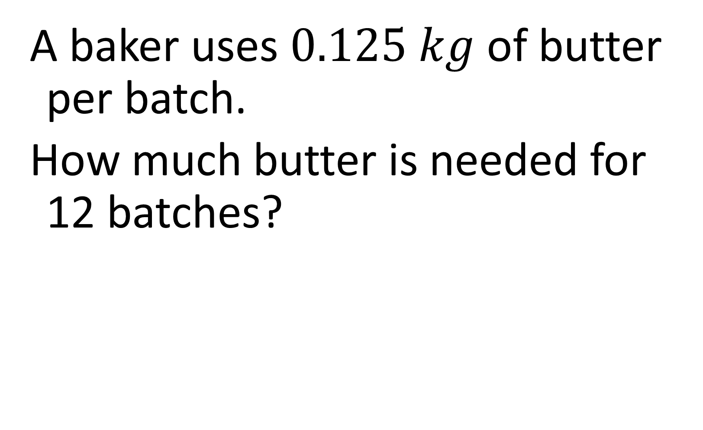
A baker uses $0.125 kg$ of butter per batch.
How much butter is needed for 12 batches?
$$1.5 kg$$

Slide 14


A car travels $31.5 km$ on $2.1l$ of fuel.
How many $km$ per litre is that?
$$15$$

Slide 15

A swimmer completes 2.5 lengths per minute.
How many lengths in 18 minutes?
$$45$$

Slide 16


A shop buys 48 identical pens for $£19.20$.
What is the cost of one pen?
$$£0.40$$

Slide 17

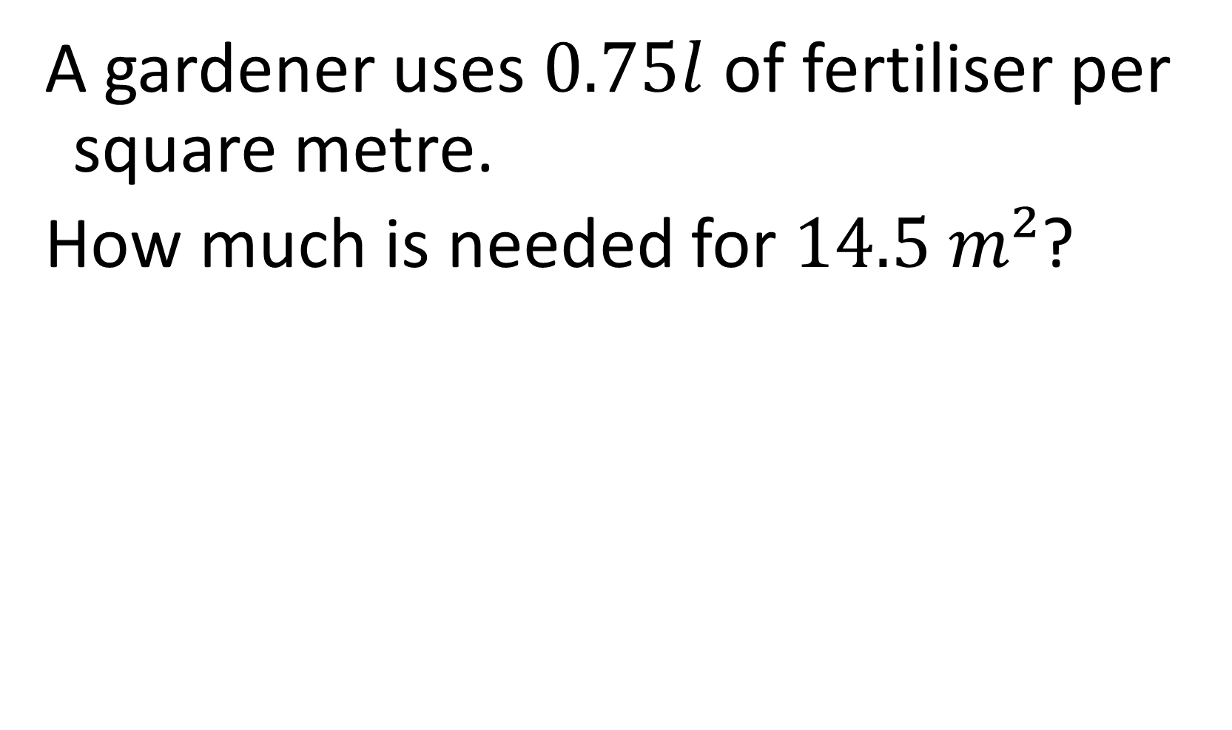
A gardener uses $0.75l$ of fertiliser per square metre.
How much is needed for $14.5 m²$?
$$10.875l$$

Slide 18


A pack of rope weighs $6.4 kg$.
If each metre weighs $0.2 kg$,
how many metres are in the pack?
$$32$$

Slide 19

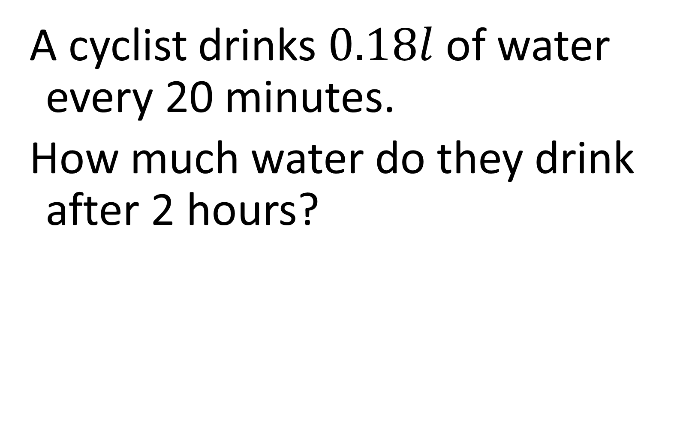
A cyclist drinks $0.18l$ of water every 20 minutes.
How much water do they drink after 2 hours?
$$1.08l$$

Slide 20


A tank contains $18.9l$ of oil.
Each bottle holds $0.35l$.
How many bottles can be filled?
$$54$$

Slide 21

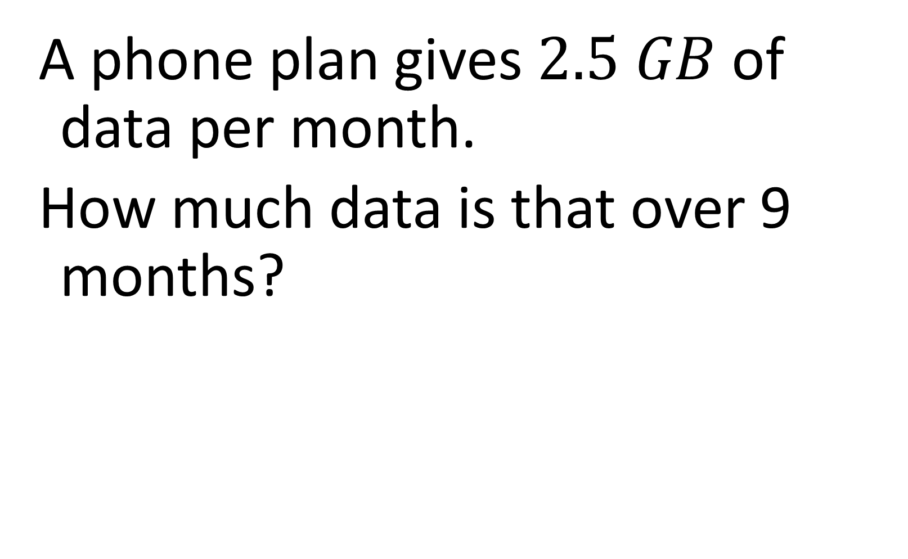
A phone plan gives $2.5 GB$ of data per month.
How much data is that over 9 months?
$$22.5 GB$$

