Slide 1
Decimals
19 May 2026

Slide 2


Calculate:
$$0.4×0.6$$
$$0.24$$

Slide 3


Calculate:
$$0.7×0.08$$
$$0.056$$

Slide 4


Calculate:
$$1.2×0.5$$
$$0.6$$

Slide 5


Calculate:
$$0.35×0.4$$
$$0.14$$

Slide 6


Calculate:
$$0.09×0.7$$
$$0.063$$

Slide 7
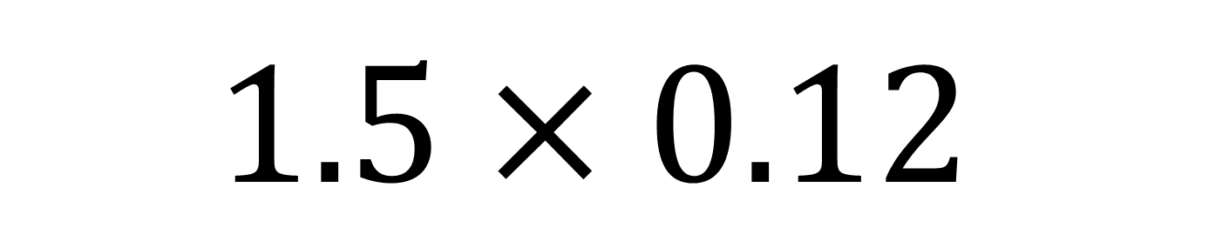

Calculate:
$$1.5×0.12$$
$$0.18$$

Slide 8


Calculate:
$$0.25×0.3$$
$$0.075$$

Slide 9


Calculate:
$$0.48×0.2$$
$$0.096$$

Slide 10
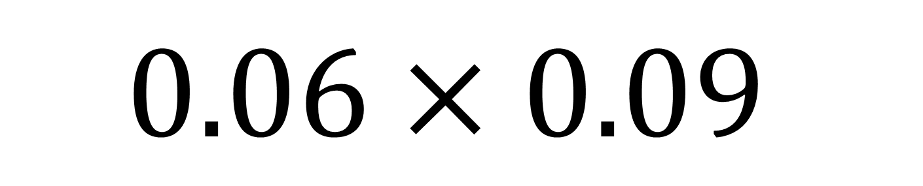

Calculate:
$$0.06×0.09$$
$$0.0054$$

Slide 11
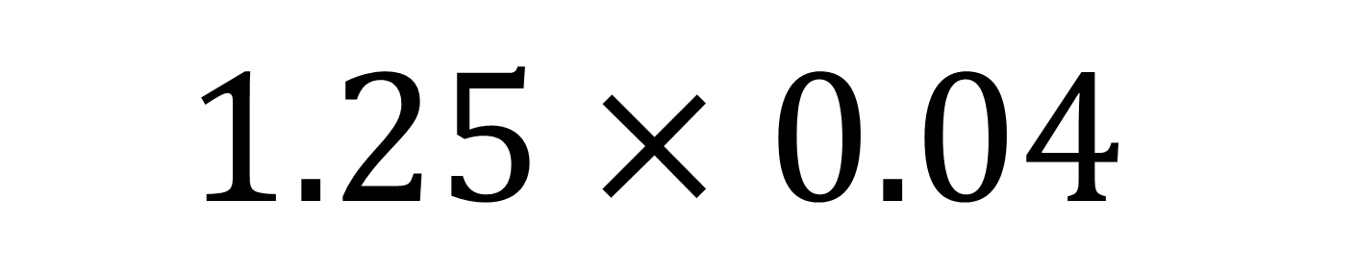

Calculate:
$$1.25×0.04$$
$$0.05$$

Slide 12


Calculate:
$$0.72×0.5$$
$$0.36$$

Slide 13
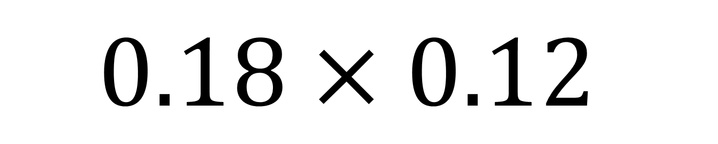

Calculate:
$$0.18×0.12$$
$$0.0216$$

Slide 14
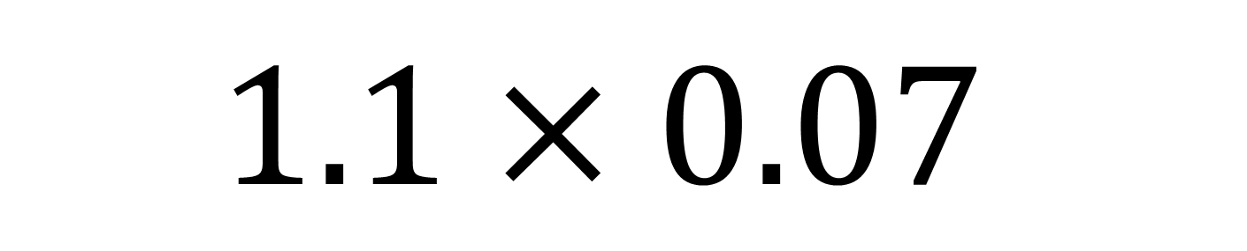

Calculate:
$$1.1×0.07$$
$$0.077$$

Slide 15


Calculate:
$$0.33×0.6$$
$$0.198$$

Slide 16
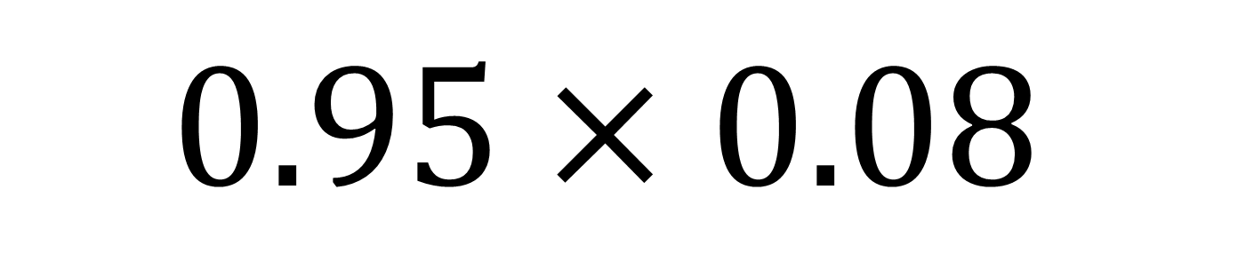

Calculate:
$$0.95×0.08$$
$$0.076$$

Slide 17


Apples cost $£0.45$ each.
You buy 6.
How much does it cost?
$$£2.70$$

Slide 18
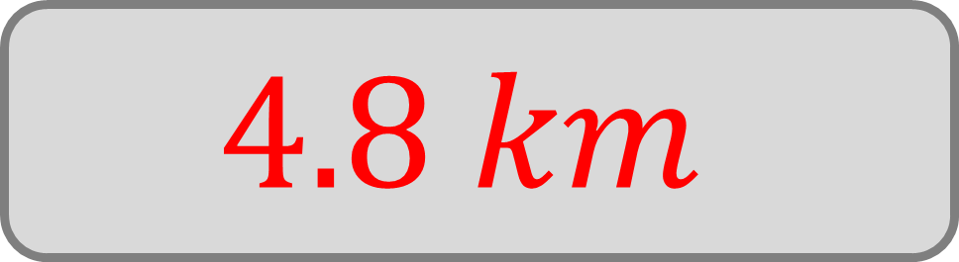
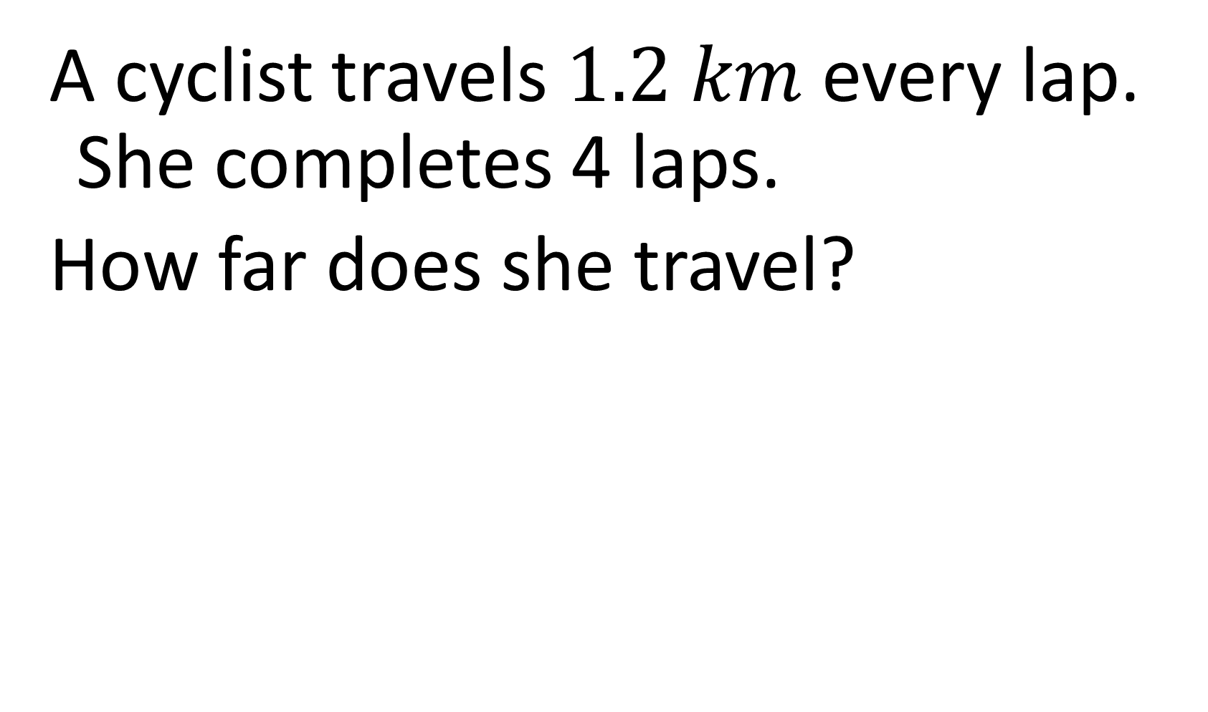
A cyclist travels $1.2 km$ every lap. She completes 4 laps.
How far does she travel?
$$4.8 km$$

Slide 19

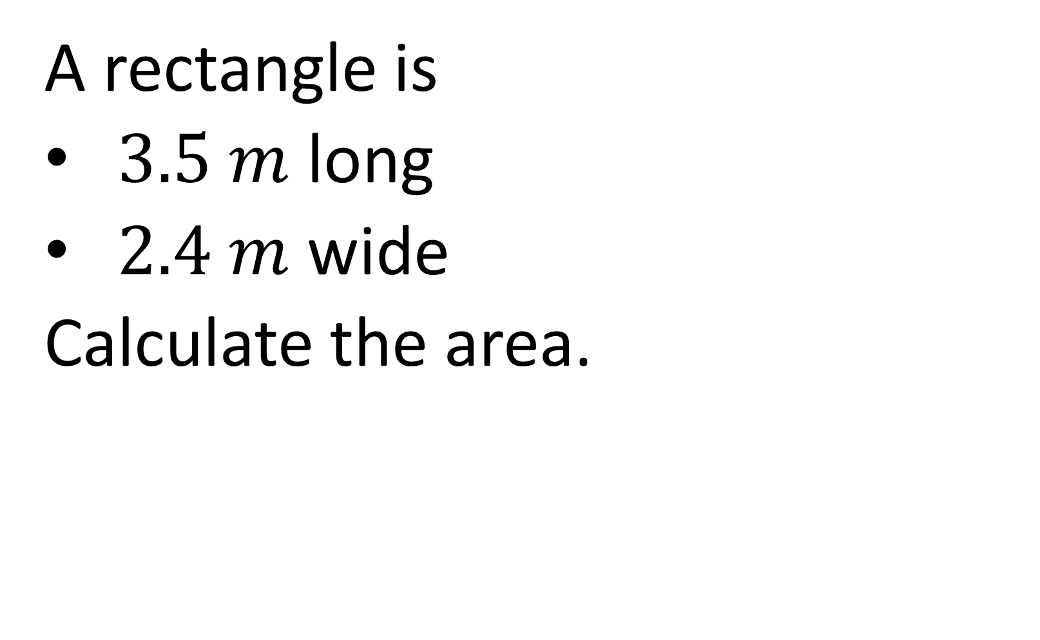
A rectangle is
$3.5 m$ long
$2.4 m$ wide
Calculate the area.
$$8.4 m^{2}$$

Slide 20

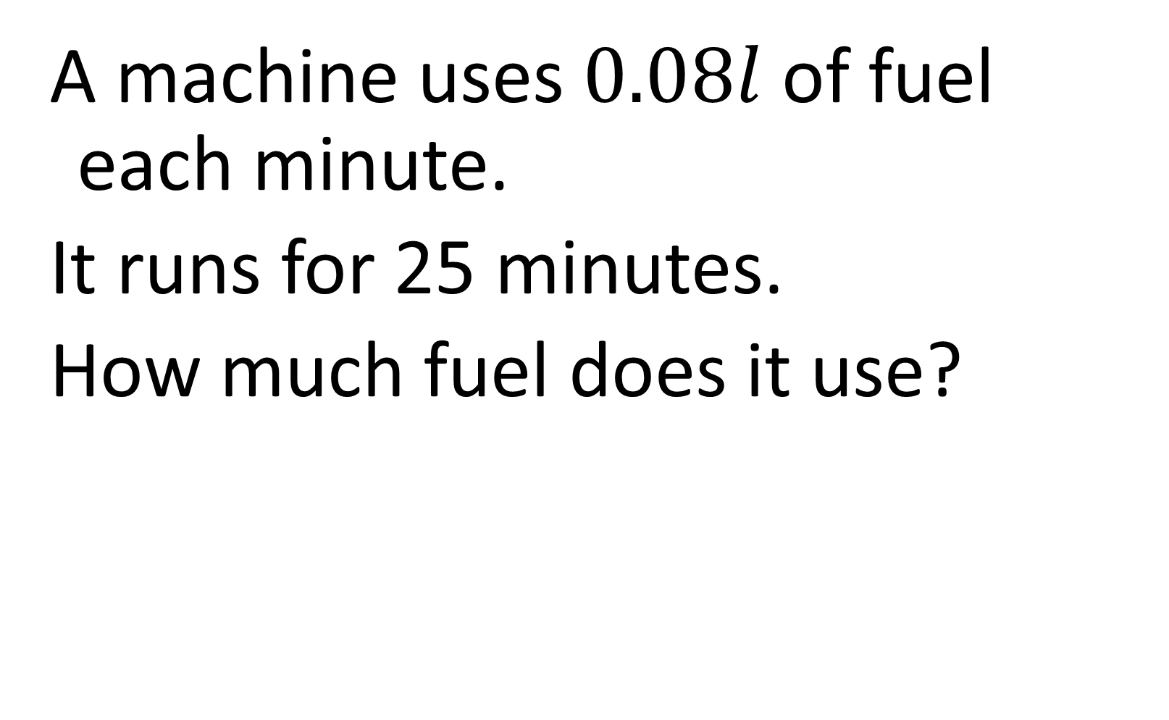
A machine uses $0.08l$ of fuel each minute.
It runs for 25 minutes.
How much fuel does it use?
$$2l$$

Slide 21


Seeds costs $£1.40$ for $1 kg$ .
You buy a $0.8 kg$ packet.
How much does it cost?
$$£1.12$$

