Slide 1
Venn Diagrams
22 May 2026

Slide 2

How many students are in the choir and the band?
The Venn diagram shows the members of a choir and a band
ξ
Choir
Band
6
4
5
3
$$4$$

Slide 3
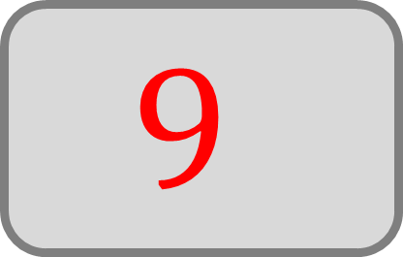
How many students are not in the band?
The Venn diagram shows the members of a choir and a band
ξ
Choir
Band
6
4
5
3
$$9$$

Slide 4
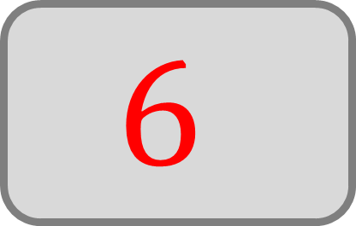
How many choir members are not in the band?
The Venn diagram shows the members of a choir and a band
ξ
Choir
Band
6
4
5
3
$$6$$

Slide 5
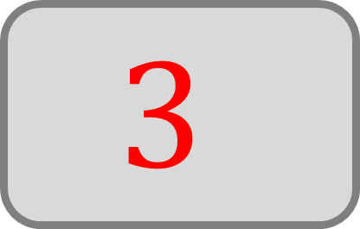
How many members are in neither?
The Venn diagram shows the members of a choir and a band
ξ
Choir
Band
6
4
5
3
$$3$$

Slide 6
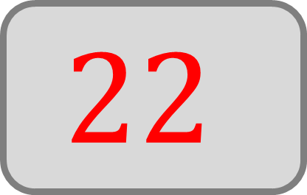
How many members are there in total?
The Venn diagram shows the members of a football club and a drama group
ξ
Football
Drama
7
5
4
6
$$22$$

Slide 7
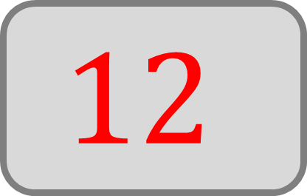
How many members are in the football club?
The Venn diagram shows the members of a football club and a drama group
ξ
Football
Drama
7
5
4
6
$$12$$

Slide 8
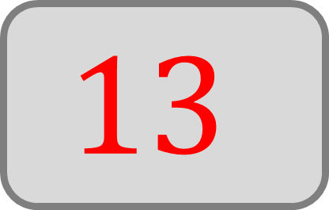
How many members are not in the drama group?
The Venn diagram shows the members of a football club and a drama group
ξ
Football
Drama
7
5
4
6
$$13$$

Slide 9
Tim says “most people play football”, is he correct?
The Venn diagram shows the members of a football club and a drama group
ξ
Football
Drama
7
5
4
6
Yes

Slide 10
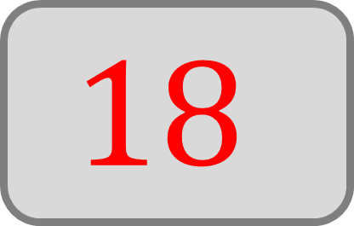
How many people own at least one pet?
The Venn diagram shows the owners of dogs and cats
ξ
Dogs
Cats
9
3
6
8
$$18$$

Slide 11
How many people own more than one pet?
The Venn diagram shows the owners of dogs and cats
ξ
Dogs
Cats
9
3
6
8
$$3$$

Slide 12
How many people own cats?
The Venn diagram shows the owners of dogs and cats
ξ
Dogs
Cats
9
3
6
8
$$9$$

Slide 13
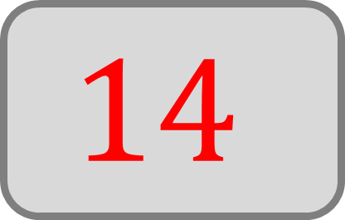
How many people do not own dogs?
The Venn diagram shows the owners of dogs and cats
ξ
Dogs
Cats
9
3
6
8
$$14$$

Slide 14
How many study art?
The Venn diagram shows the students of art and music
ξ
Art
Music
4
2
10
5
$$6$$

Slide 15
How many study art but not music?
The Venn diagram shows the students of art and music
ξ
Art
Music
4
2
10
5
$$4$$

Slide 16
How many study only one subject?
The Venn diagram shows the students of art and music
ξ
Art
Music
4
2
10
5
$$14$$

