Slide 1
Completing the Square
01 June 2026

Slide 2
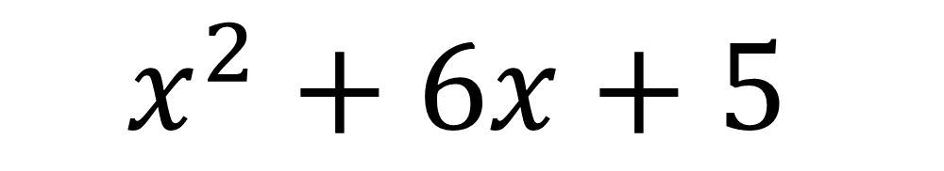
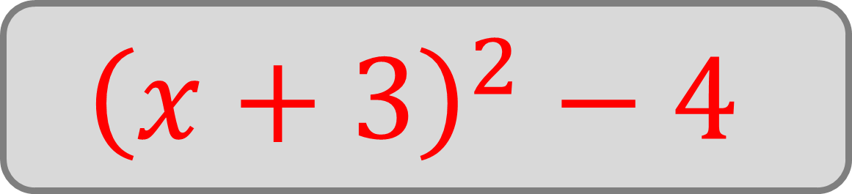
Write in ‘completed square form’:
$$x^{2}+6x+5$$
$${\left(x+3\right)}^{2}−4$$

Slide 3
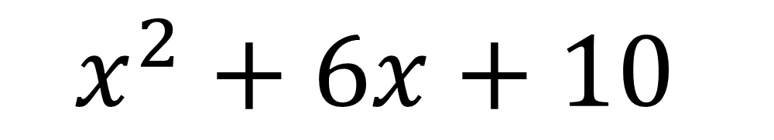
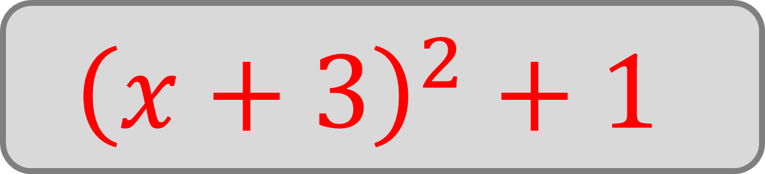
Write in ‘completed square form’:
$$x^{2}+6x+10$$
$${\left(x+3\right)}^{2}+1$$

Slide 4
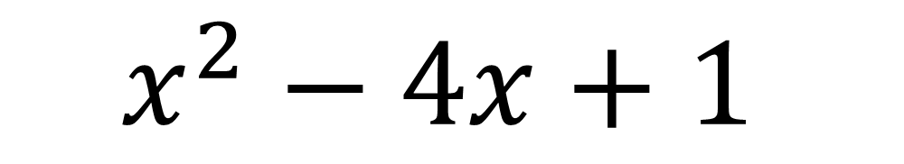
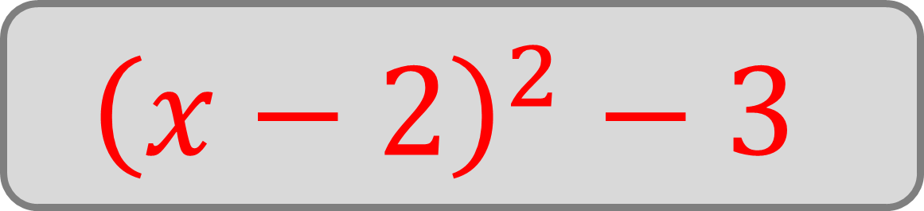
Write in ‘completed square form’:
$$x^{2}−4x+1$$
$${\left(x−2\right)}^{2}−3$$

Slide 5
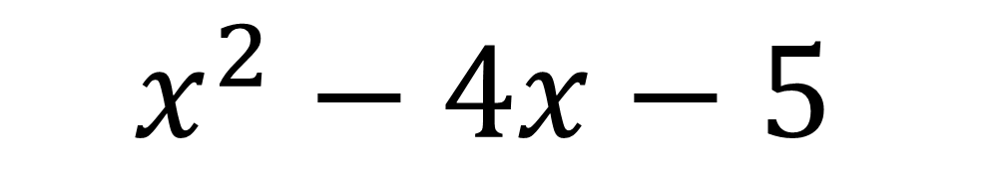
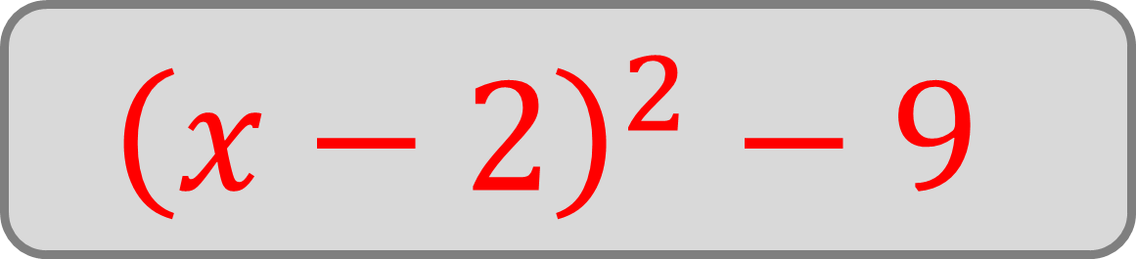
Write in ‘completed square form’:
$$x^{2}−4x−5$$
$${\left(x−2\right)}^{2}−9$$

Slide 6
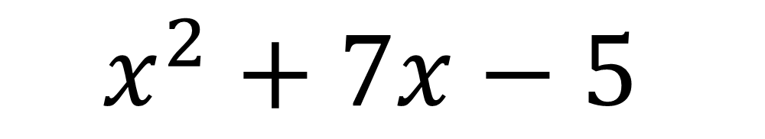
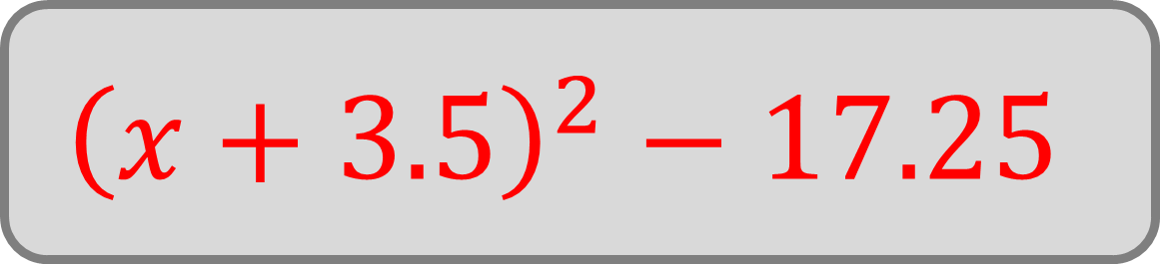
Write in ‘completed square form’:
$$x^{2}+7x−5$$
$${\left(x+3.5\right)}^{2}−17.25$$

Slide 7
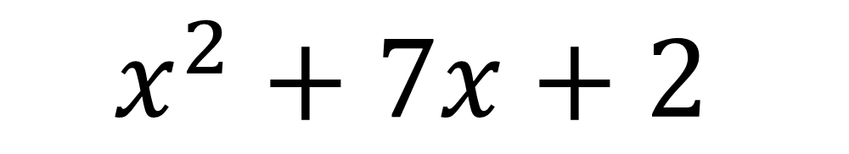
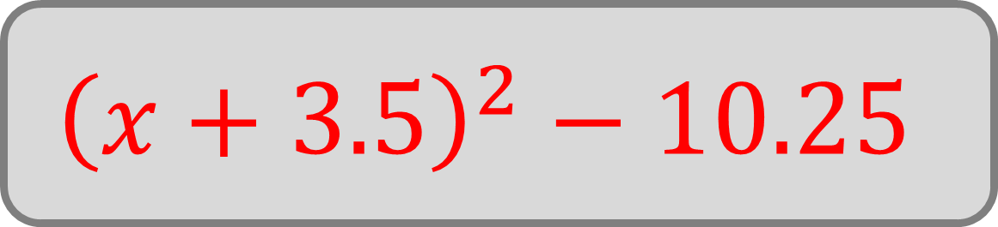
Write in ‘completed square form’:
$$x^{2}+7x+2$$
$${\left(x+3.5\right)}^{2}−10.25$$

Slide 8
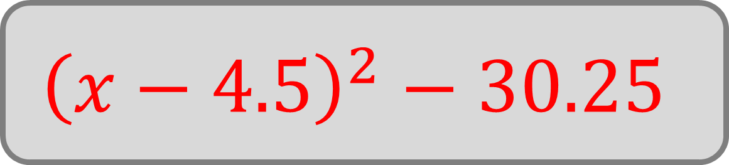

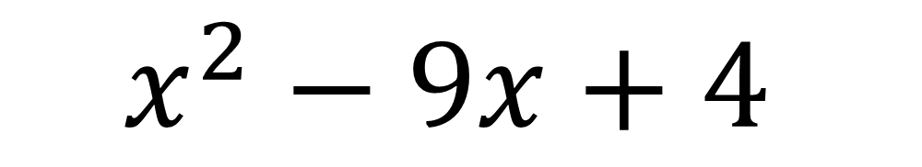
Write in the form ${\left(x+p\right)}^{2}+q$:
$$x^{2}−9x+4$$
$${\left(x−4.5\right)}^{2}−30.25$$

Slide 9
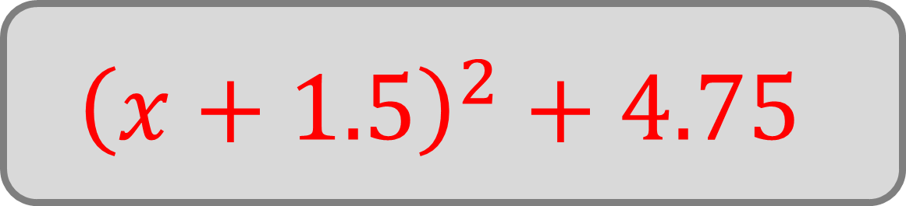
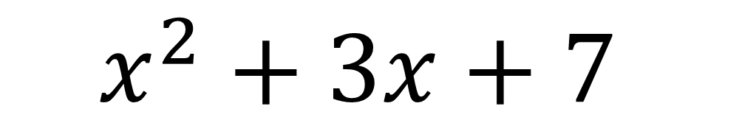
Write in the form ${\left(x+p\right)}^{2}+q$:
$$x^{2}+3x+7$$
$${\left(x+1.5\right)}^{2}+4.75$$

Slide 10

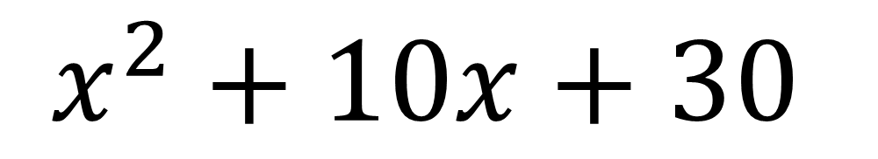
Write in the form ${\left(x+p\right)}^{2}+q$:
$$x^{2}+10x+30$$
$${\left(x+5\right)}^{2}+5$$

Slide 11

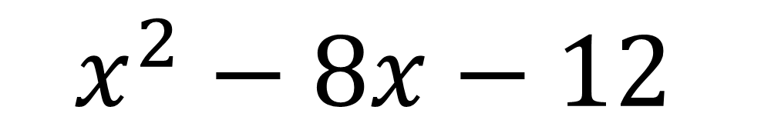
Write in the form ${\left(x+p\right)}^{2}+q$:
$$x^{2}−8x−12$$
$${\left(x−4\right)}^{2}−28$$

Slide 12


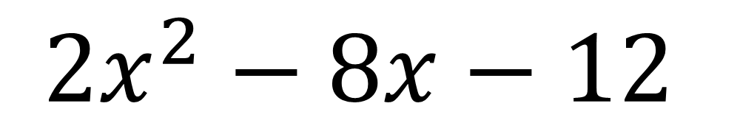
Write in the form ${2\left(x+p\right)}^{2}+q$:
$$2x^{2}−8x−12$$
$${2\left(x−2\right)}^{2}−20$$

Slide 13
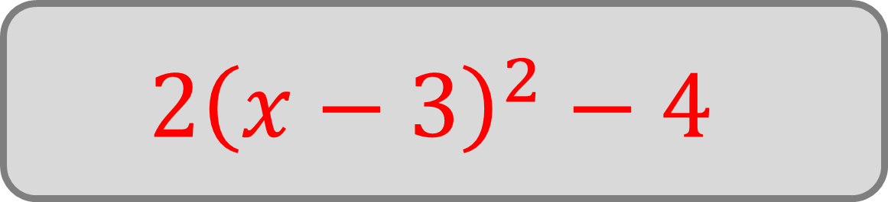

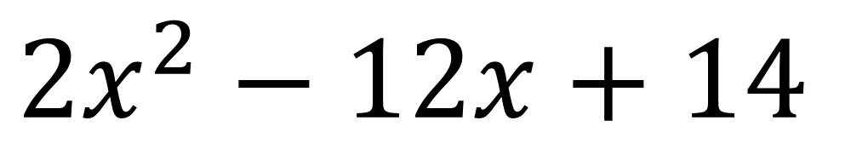
Write in the form ${a\left(x+p\right)}^{2}+q$:
$${2x}^{2}−12x+14$$
$${2\left(x−3\right)}^{2}−4$$

Slide 14

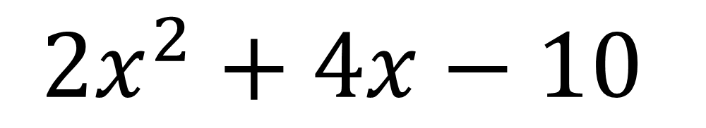
Write in the form ${a\left(x+p\right)}^{2}+q$:
$${2x}^{2}+4x−10$$
$${2\left(x+1\right)}^{2}−12$$

Slide 15

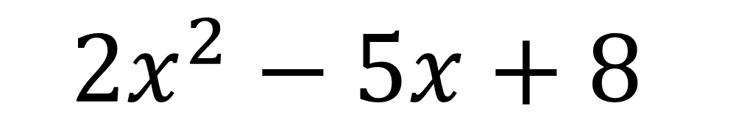
Write in the form ${a\left(x+p\right)}^{2}+q$:
$${2x}^{2}−5x+8$$
$${2\left(x−\frac{5}{4}\right)}^{2}+\frac{39}{8}$$

Slide 16

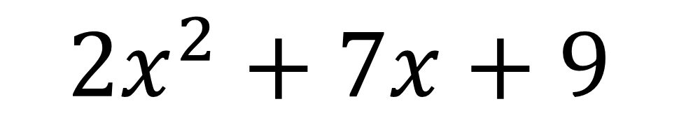
Write in the form ${a\left(x+p\right)}^{2}+q$:
$${2x}^{2}+7x+9$$
$${2\left(x+\frac{7}{4}\right)}^{2}+\frac{23}{8}$$

Slide 17

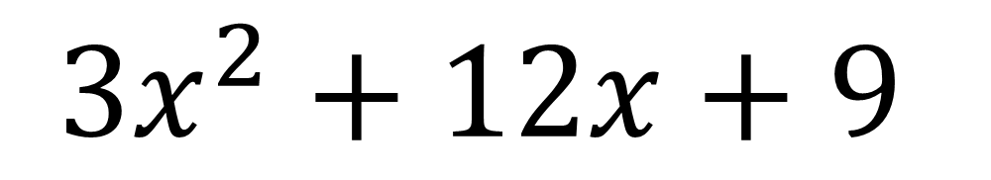
Write in the form ${a\left(x+p\right)}^{2}+q$:
$${3x}^{2}+12x+9$$
$${3\left(x+2\right)}^{2}−3$$

Slide 18

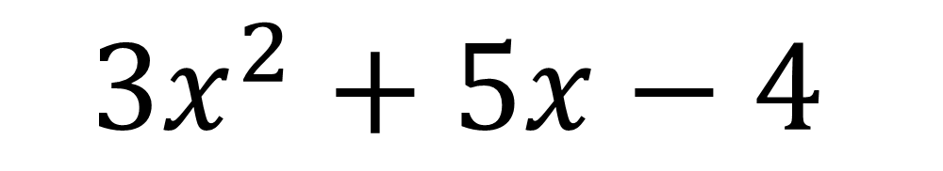
Write in the form ${a\left(x+p\right)}^{2}+q$:
$${3x}^{2}+5x−4$$
$${3\left(x+\frac{5}{6}\right)}^{2}−\frac{73}{12}$$

Slide 19
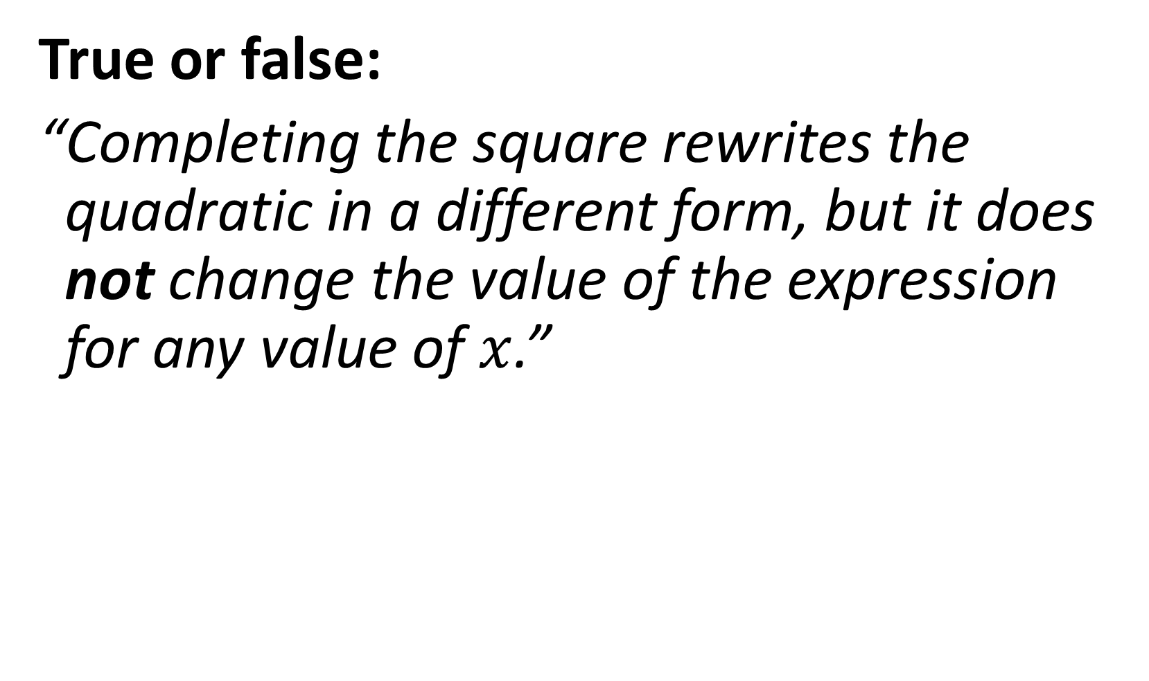
True or false:
“Completing the square rewrites the quadratic in a different form, but it does not change the value of the expression for any value of $x$.”
True

Slide 20
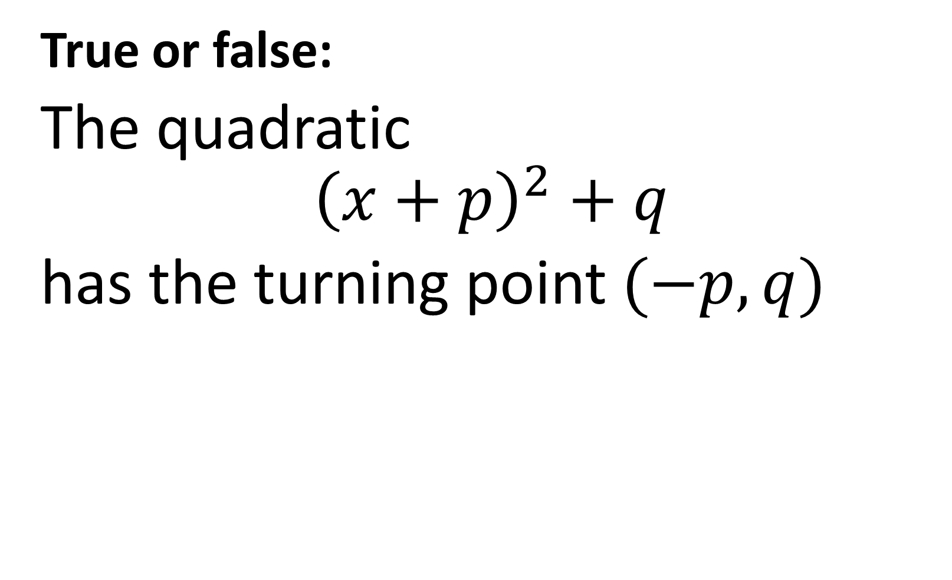
True or false:
The quadratic
$${\left(x+p\right)}^{2}+q$$
has the turning point $(−p,q)$
True

Slide 21

True or false:
$$−x^{2}+10x+40≡15−{\left(x+5\right)}^{2}$$
False

