Slide 1
Bar Charts
27 June 2026

Slide 2

The chart shows Year 7 boys and girls taking part in three clubs.
How many pupils in total take part in Netball?
$$20$$

Slide 3

The chart shows Year 7 boys and girls taking part in three clubs.
How many boys in total take part in any of the clubs?
$$22$$

Slide 4

The chart shows Year 7 boys and girls taking part in three clubs.
How many girls take part in Drama?
$$10$$

Slide 5

The chart shows sales of chocolate and crisps in three shops.
What is the total number of items sold in Shop B?
$$60$$

Slide 6

The chart shows sales of chocolate and crisps in three shops.
How many more chocolate than crisps were sold in Shop C?
$$30$$

Slide 7

The chart shows sales of chocolate and crisps in three shops.
How many crisps were sold in all the shops combined?
$$65$$

Slide 8

The chart shows sales of chocolate and crisps in three shops.
Chocolate is more profitable than Crisps, which shop made more money – A or C?
$$C$$

Slide 9

The chart shows time spent revising by two students across three subjects: Maths, English, Science.
How many hours did Alex spend revising Science?
$$3$$

Slide 10

The chart shows time spent revising by two students across three subjects: Maths, English, Science.
How many more hours did Priya spend revising Maths than English?
$$1$$

Slide 11
The chart shows time spent revising by two students across three subjects: Maths, English, Science.
True or false: Alex and Priya revised for the same amount of time in total.
True

Slide 12
The chart shows number of books read by KS3 pupils recently.
What is the total number of books read in Autumn?
$$30$$

Slide 13

The chart shows number of books read by KS3 pupils recently.
Which term had more non‑fiction books read, and by how many?
Autumn - $4$

Slide 14

The chart shows showing favourite pets among pupils.
For Cats, how many more girls than boys chose it as their favourite pet?
$$4$$

Slide 15

The chart shows showing favourite pets among pupils.
How many boys and girls altogether chose Dogs as their favourite pet?
$$24$$

Slide 16
The chart shows showing favourite pets among pupils.
True or false: Rabbits were the least popular pet?
True

Slide 17

The chart shows sales of clothes in a shop.
How many more hoodies were sold in January than in September?
$$5$$

Slide 18

The chart shows sales of clothes in a shop.
In which month were more jackets sold, and by how many?
January - $20$

Slide 19
The chart shows sales of clothes in a shop.
True or false: The shop sold twice as many t-shirts in January than September?
False

Slide 20
The chart shows choice of dishes in a restaurant..
On which day was Pasta the most popular?
Tuesday

Slide 21
The chart shows choice of dishes in a restaurant..
Which dish was most popular on Monday?
Lasagna

Slide 22
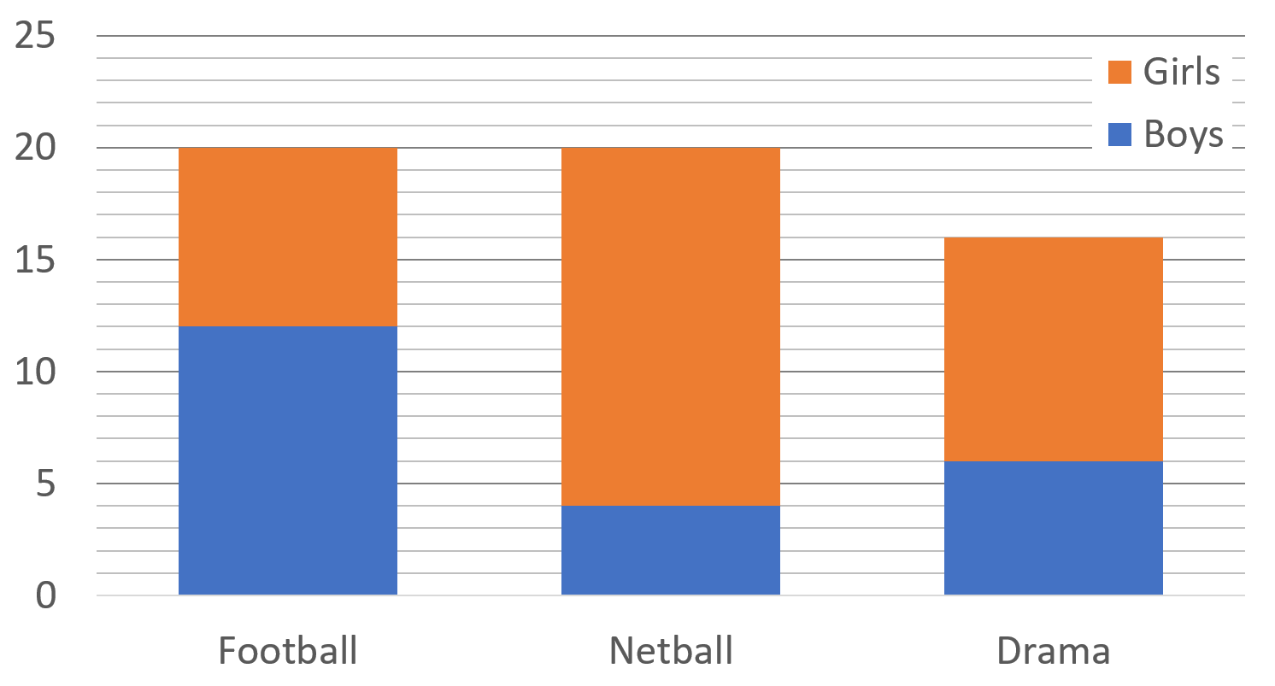
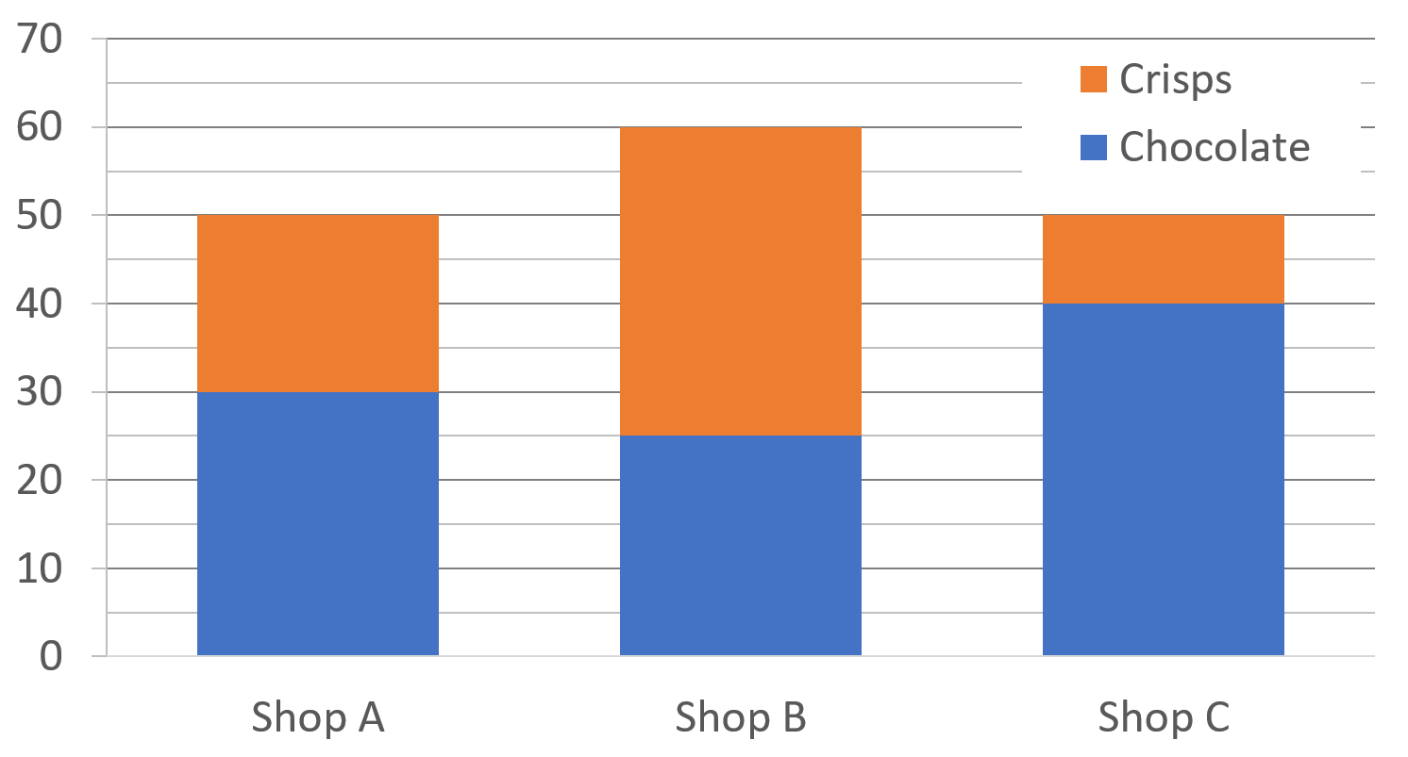
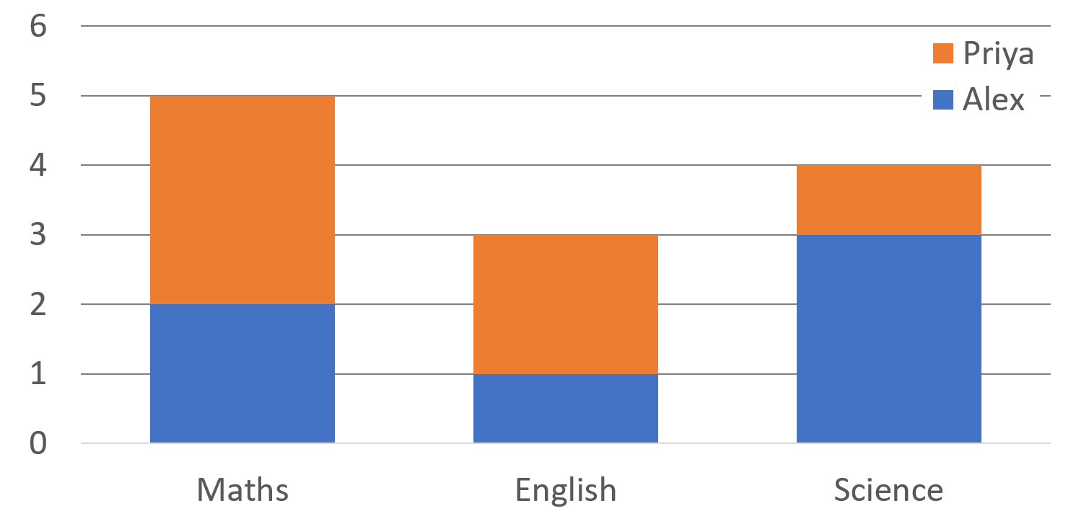
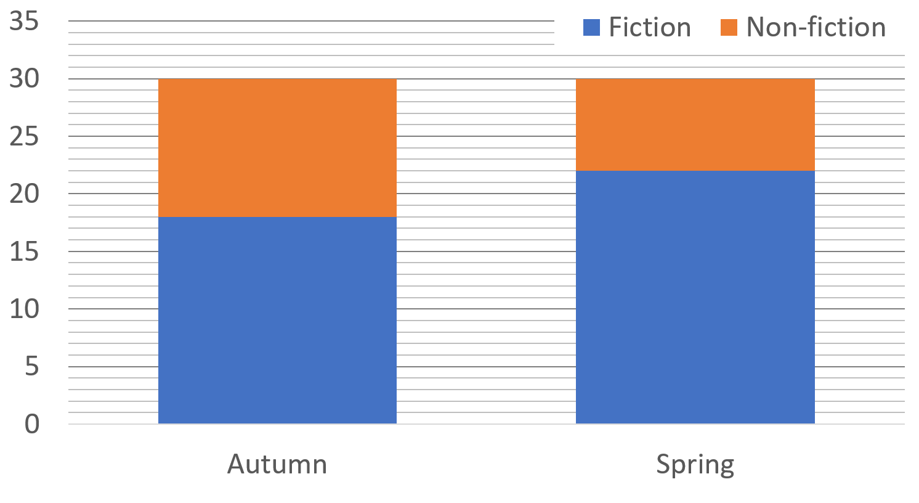

Slide 23
