Slide 1
Direct Proportion
04 June 2026

Slide 2


$y$ is directly proportional to $x$.
When $x=9$, $y=54$.
Write a formula for $y$ in terms of $x$.
$$y=6x$$

Slide 3


$a∝b$, and when $a=5$, $b=8$.
Write a formula for $b$ in terms of $a$.
$$b=1.6a$$

Slide 4


$y$ is directly proportional to $x$.
When $x=4$, $y=10$.
Write a formula for $y$ in terms of $x$.
$$y=2.5x$$

Slide 5


Given that $t∝v$
and $v=7$ when $t=21$.
Write a formula for $t$ in terms of $v$.
$$t=3v$$

Slide 6


$y$ is in direct proportion to $x$.
When $y=18$, $x=30$.
Find the constant of proportionality $k$ in the formula $x=ky$.
$$k=5/3$$

Slide 7


We are told that $y$ and $x$ are in direct proportion.
When $x=14$, $y=35$.
Write the formula for $x$ in terms of $y$.
$$x=\frac{2}{5}y$$

Slide 8


$x∝y$
When $x=3$, $y=27$.
Write the formula for $y$ in terms of $x$.
$$y=9x$$

Slide 9
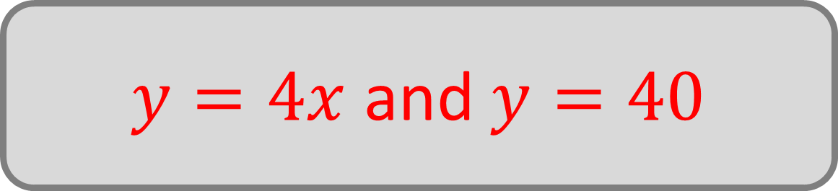
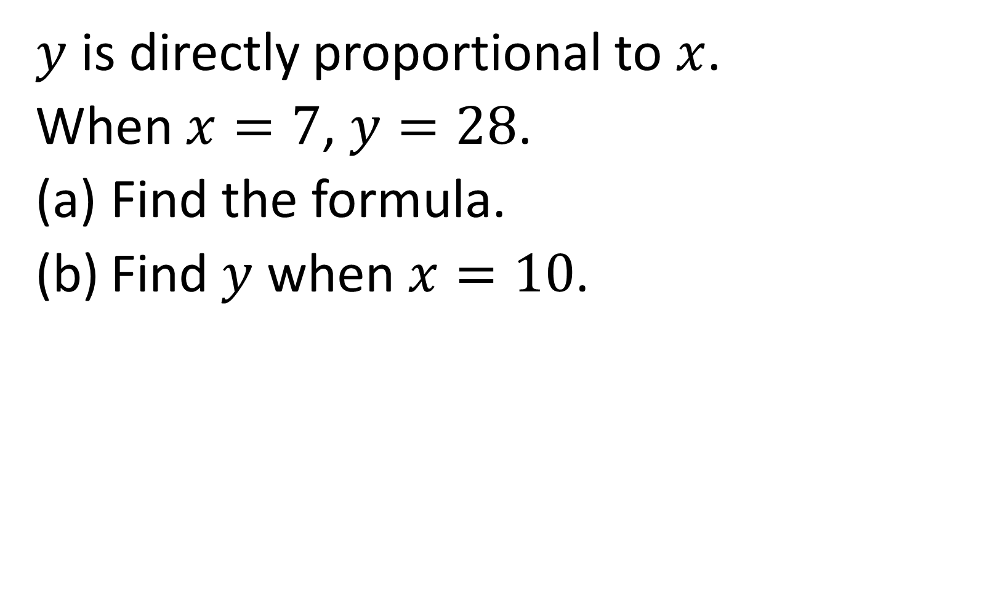
$y$ is directly proportional to $x$.
When $x=7$, $y=28$.
Find the formula.
Find $y$ when $x=10$.
$y=4x$ and $y=40$

Slide 10
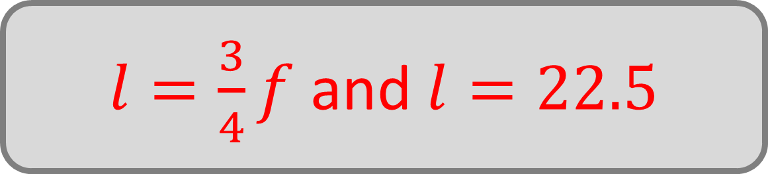

$$f∝l$$
When $f=12$, $l=9$.
Find the formula.
Find $l$ when $f=30$.
$l=\frac{3}{4}f$ and $l=22.5$

Slide 11
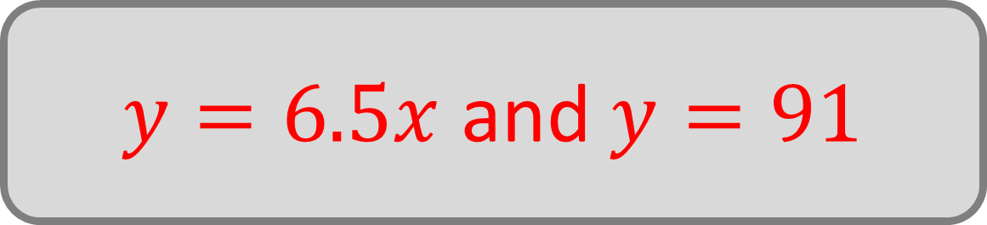
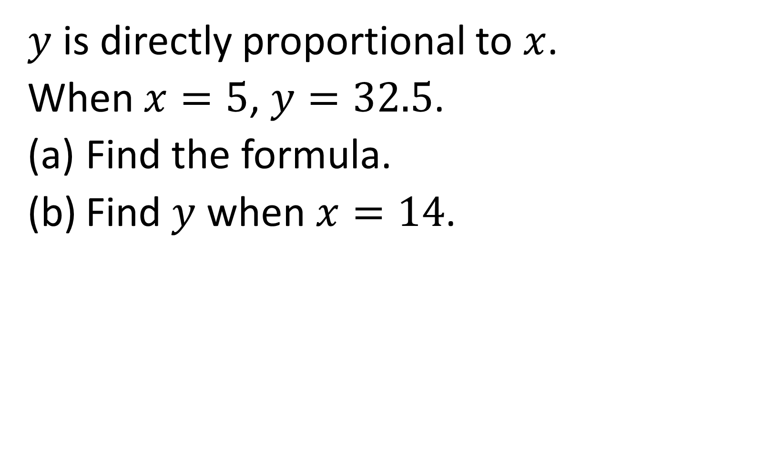
$y$ is directly proportional to $x$.
When $x=5$, $y=32.5$.
Find the formula.
Find $y$ when $x=14$.
$y=6.5x$ and $y=91$

Slide 12
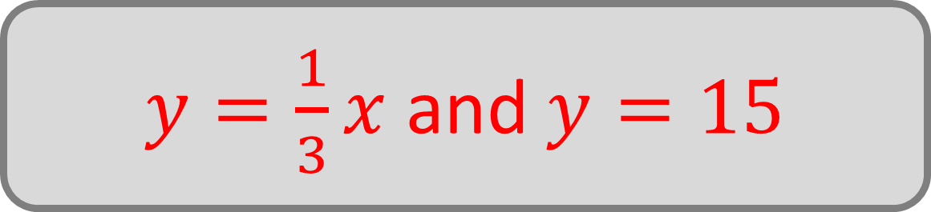
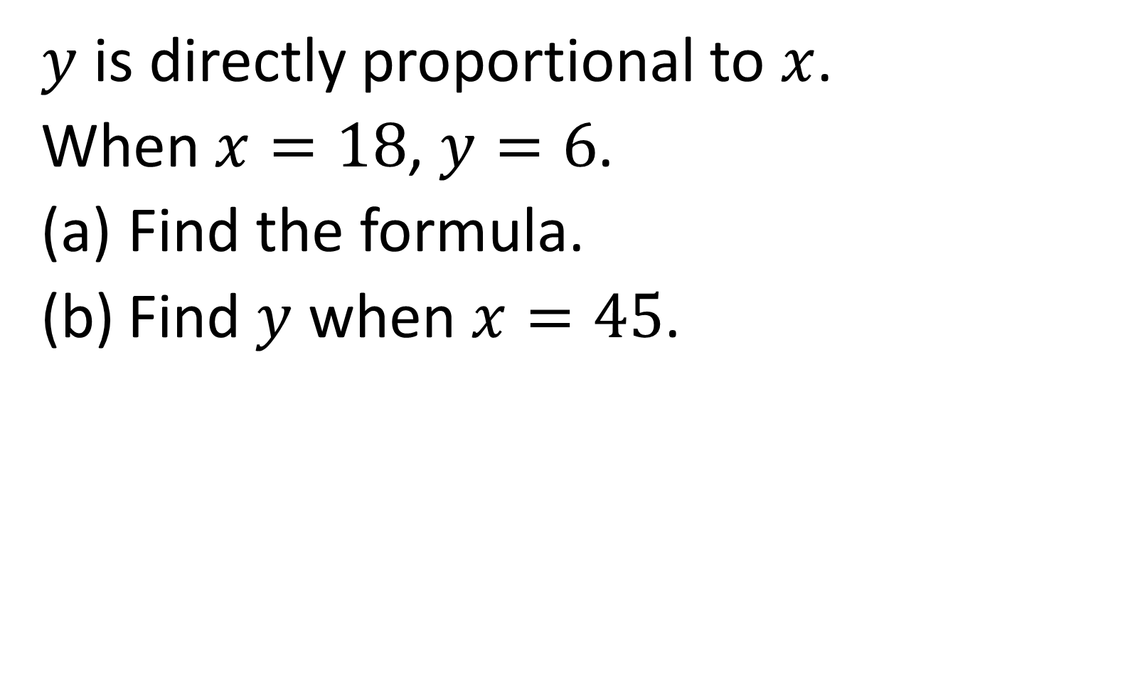
$y$ is directly proportional to $x$.
When $x=18$, $y=6$.
Find the formula.
Find $y$ when $x=45$.
$y=\frac{1}{3}x$ and $y=15$

Slide 13
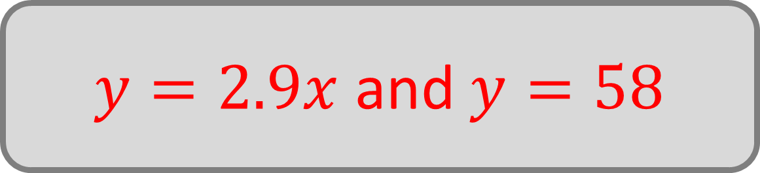
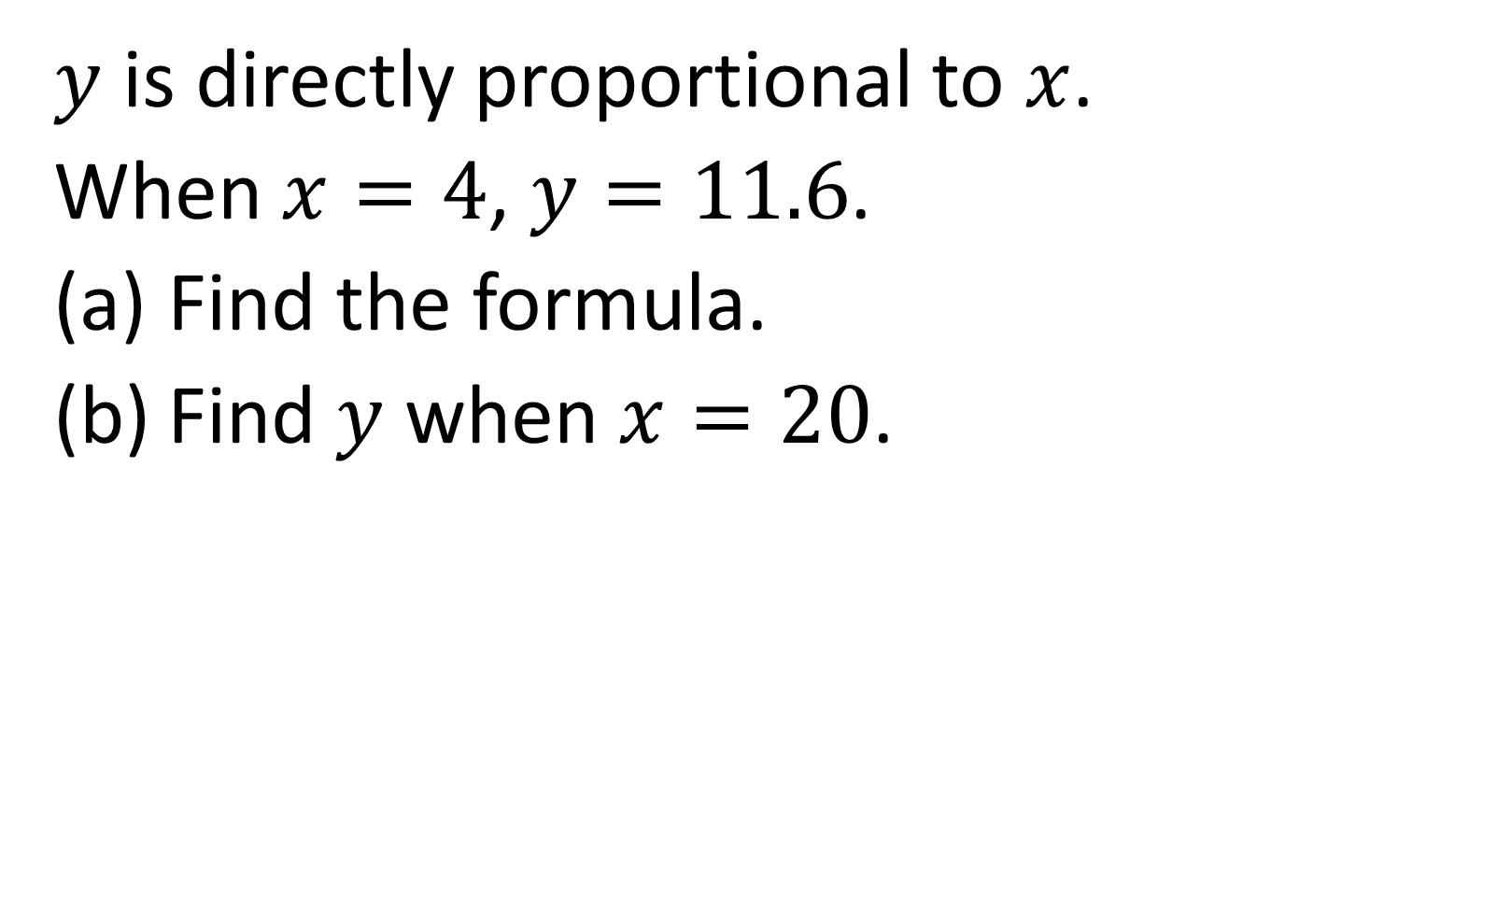
$y$ is directly proportional to $x$.
When $x=4$, $y=11.6$.
Find the formula.
Find $y$ when $x=20$.
$y=2.9x$ and $y=58$

Slide 14
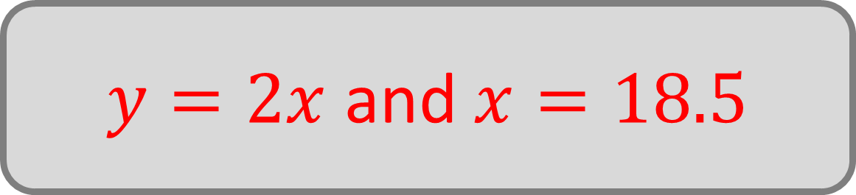
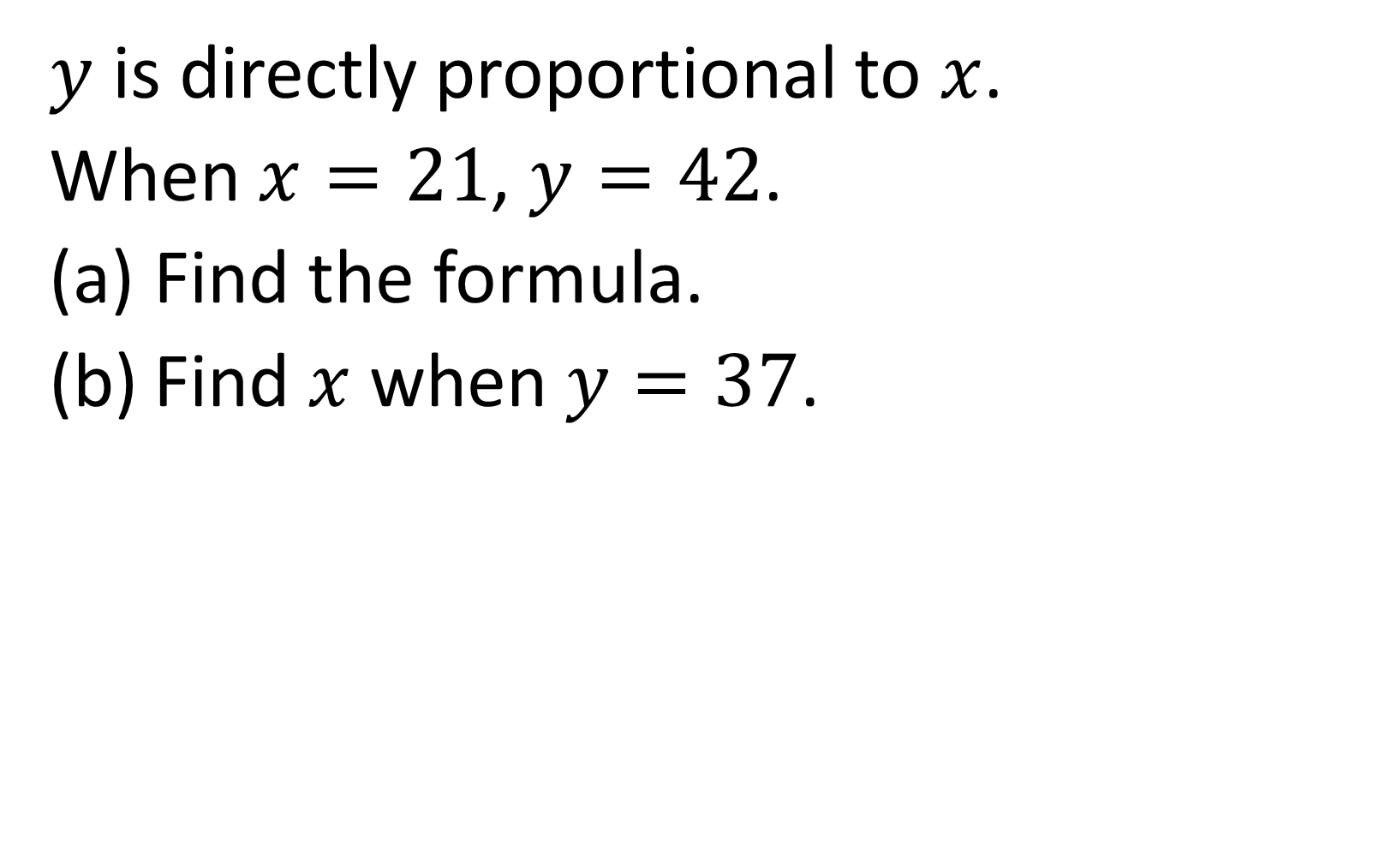
$y$ is directly proportional to $x$.
When $x=21$, $y=42$.
Find the formula.
Find $x$ when $y=37$.
$y=2x$ and $x=18.5$

Slide 15
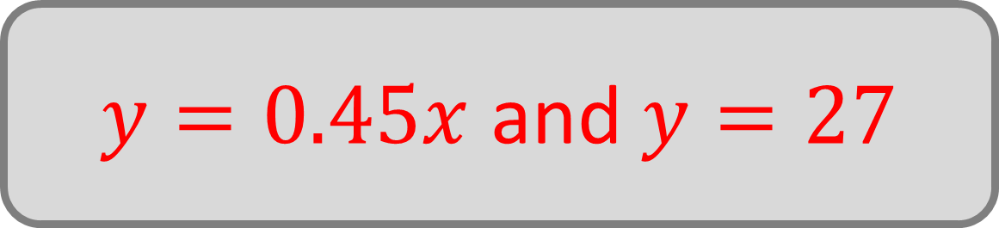
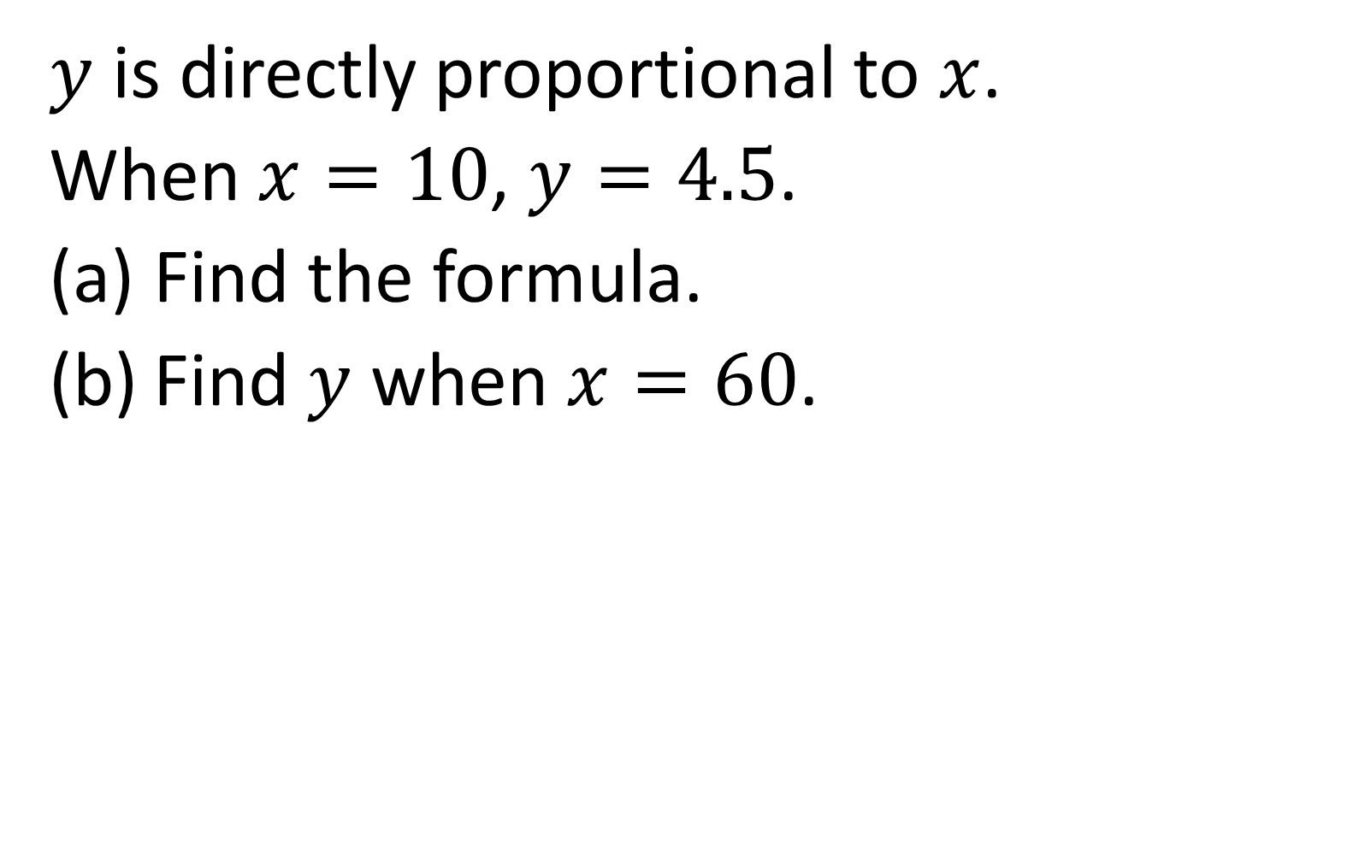
$y$ is directly proportional to $x$.
When $x=10$, $y=4.5$.
Find the formula.
Find $y$ when $x=60$.
$y=0.45x$ and $y=27$

Slide 16

True or false:
If $y$ is directly proportional to $x$, then doubling $x$will always double $y$.
True

Slide 17
True or false:
The graph of two variables in direct proportion is a straight line.
True

Slide 18

True or false:
A graph of a direct proportion can cross the $y$‑axis at a value other than zero.
False

Slide 19

True or false:
If $y=kx$ with a positive constant $k$, then negative values of $x$ produce negative values of $y$.
True

Slide 20

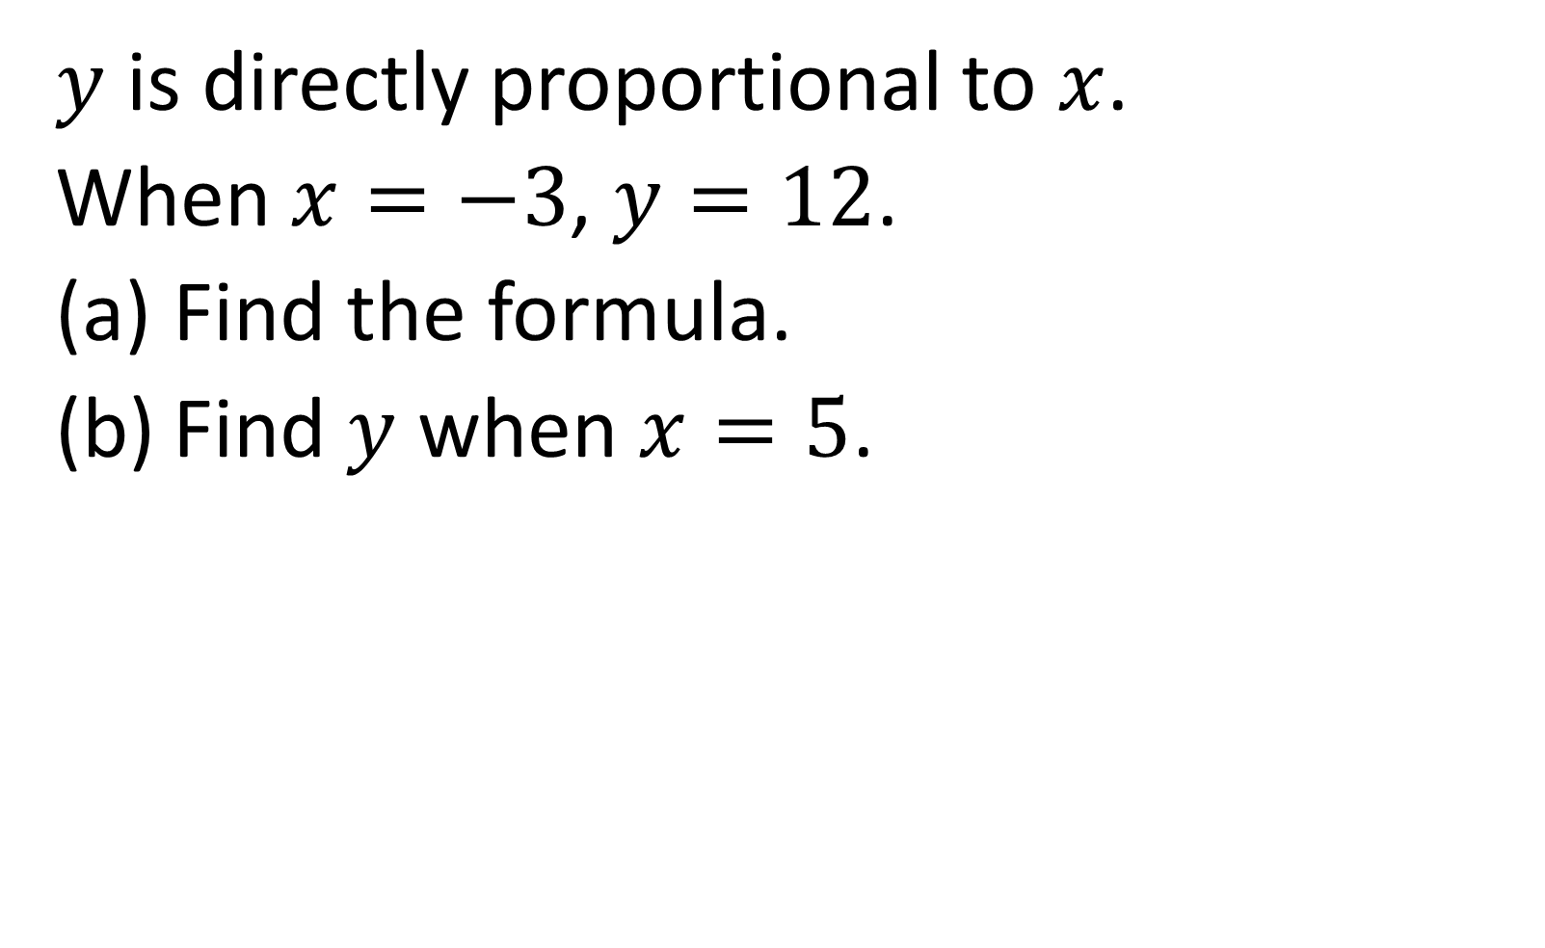
$y$ is directly proportional to $x$.
When $x=−3$, $y=12$.
Find the formula.
Find $y$ when $x=5$.
$$y=−4x$$
$$y=−20$$

Slide 21

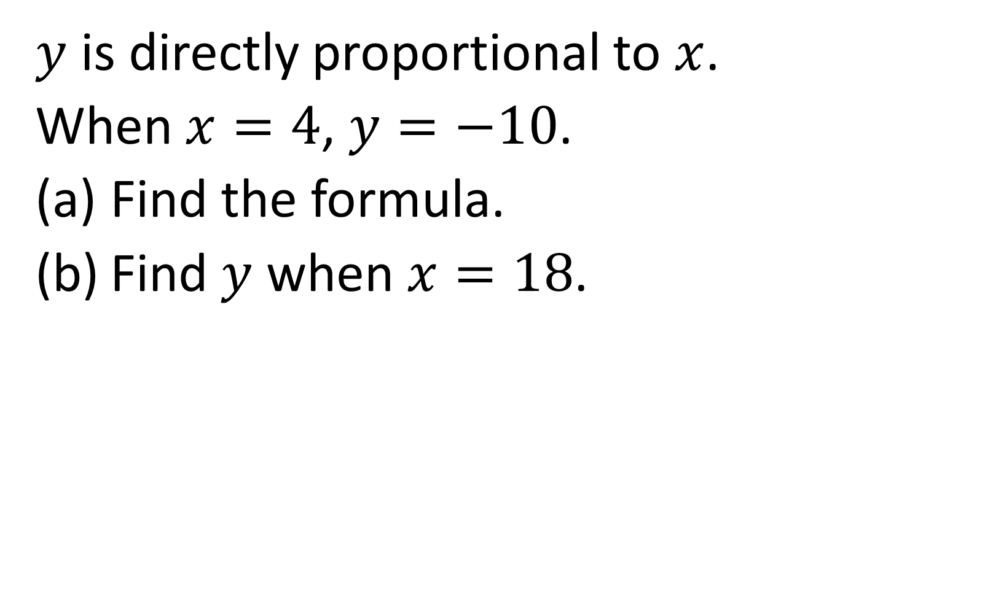
$y$ is directly proportional to $x$.
When $x=4$, $y=−10$.
Find the formula.
Find $y$ when $x=18$.
$$y=−2.5x$$
$$y=−45$$

