Slide 1
Frequency Tables
28 June 2026

Slide 2

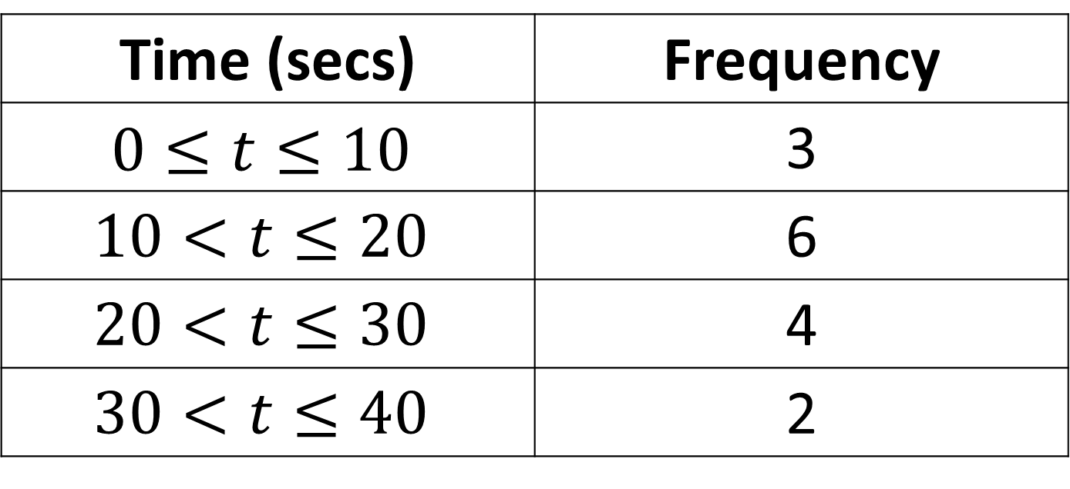
In which group would 22.5 go?
Time (secs) | Frequency
$$0≤t≤10$$ | 3
$$10<t≤20$$ | 6
$$20<t≤30$$ | 4
$$30<t≤40$$ | 2
$$20<t≤30$$

Slide 3

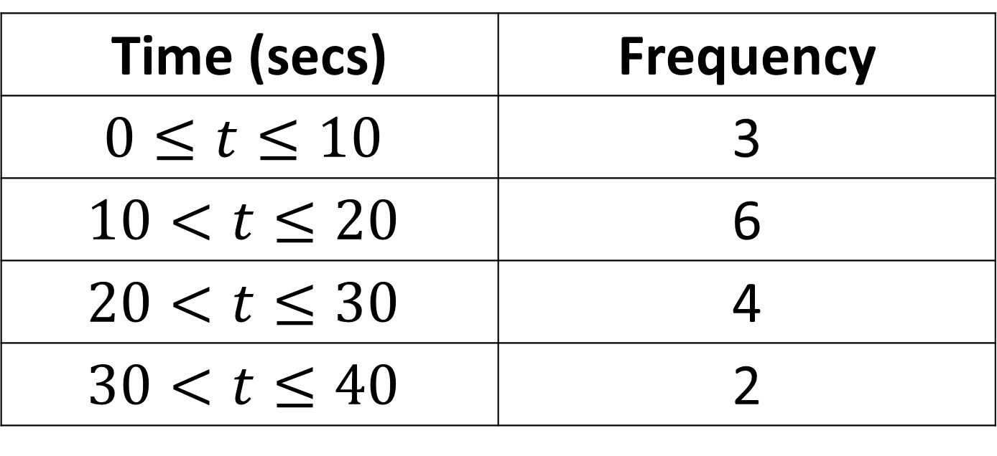
In which group would 19.8 go?
Time (secs) | Frequency
$$0≤t≤10$$ | 3
$$10<t≤20$$ | 6
$$20<t≤30$$ | 4
$$30<t≤40$$ | 2
$$10<t≤20$$

Slide 4

In which group would 1.98 go?
Time (secs) | Frequency
$$0≤t≤10$$ | 3
$$10<t≤20$$ | 6
$$20<t≤30$$ | 4
$$30<t≤40$$ | 2
$$0≤t≤10$$

Slide 5
In which group would 20.00 go?
Time (secs) | Frequency
$$0≤t≤10$$ | 3
$$10<t≤20$$ | 6
$$20<t≤30$$ | 4
$$30<t≤40$$ | 2
$$10<t≤20$$

Slide 6
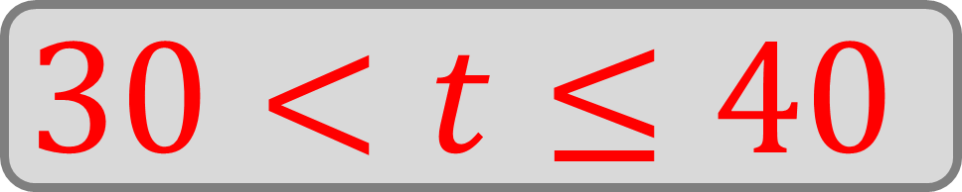
In which group would 30.02 go?
Time (secs) | Frequency
$$0≤t≤10$$ | 3
$$10<t≤20$$ | 6
$$20<t≤30$$ | 4
$$30<t≤40$$ | 2
$$30<t≤40$$

Slide 7
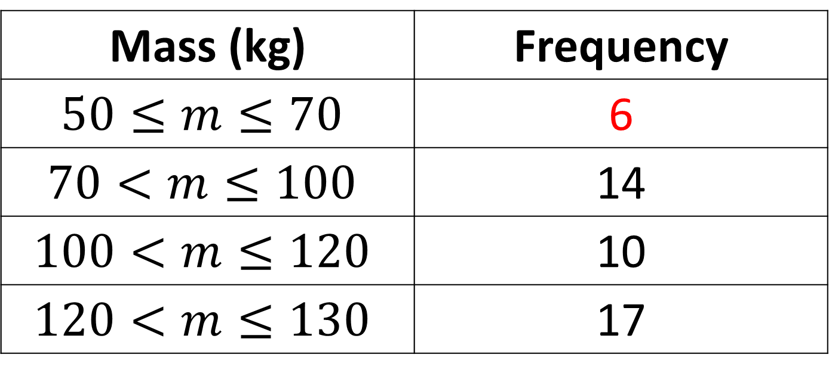
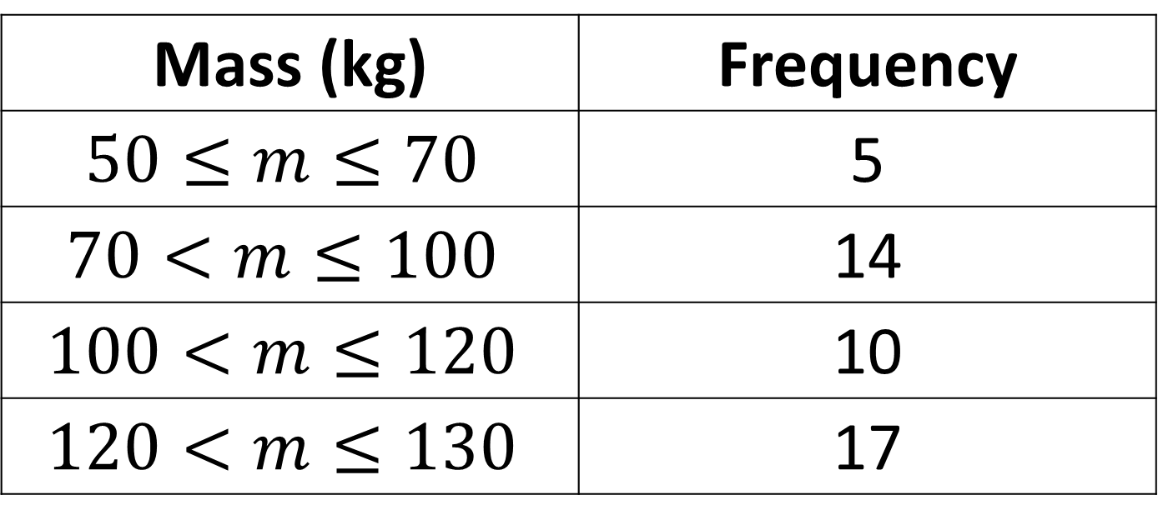
The value 64.3kg is added to the table.
What are the new frequencies?
Mass (kg) | Frequency
$$50≤m≤70$$ | 5
$$70<m≤100$$ | 14
$$100<m≤120$$ | 10
$$120<m≤130$$ | 17
Mass (kg) | Frequency
$$50≤m≤70$$ | 6
$$70<m≤100$$ | 14
$$100<m≤120$$ | 10
$$120<m≤130$$ | 17

Slide 8
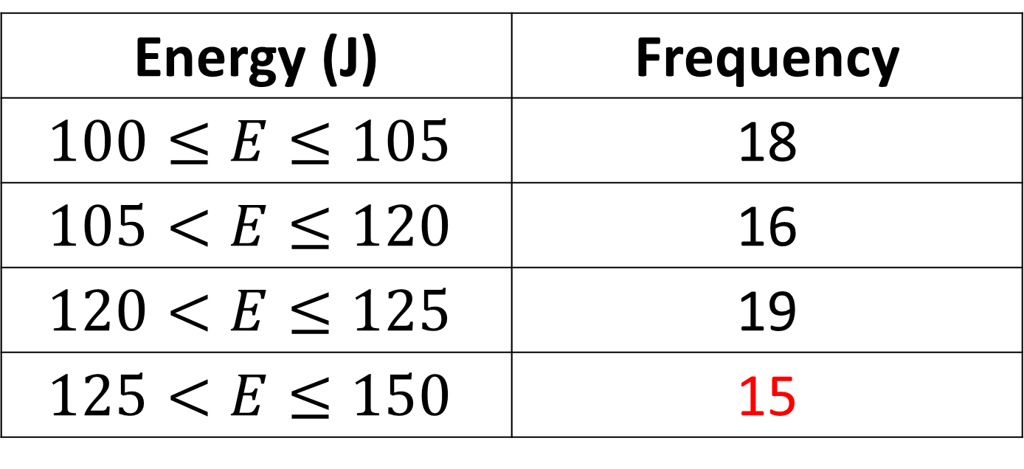
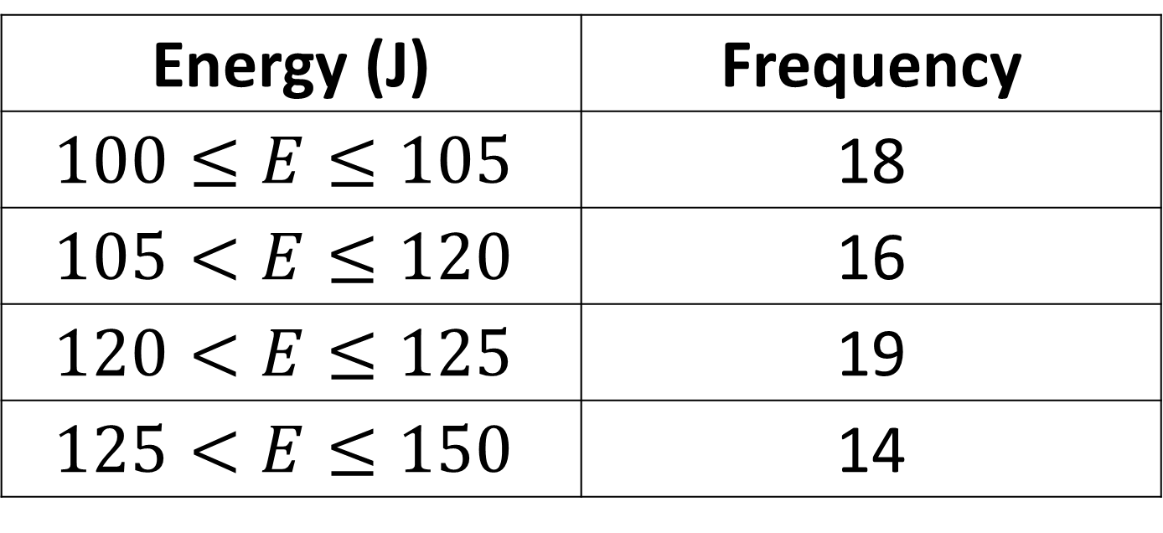
The value 128J is added to the table.
What are the new frequencies?
Energy (J) | Frequency
$$100≤E≤105$$ | 18
$$105<E≤120$$ | 16
$$120<E≤125$$ | 19
$$125<E≤150$$ | 14
Energy (J) | Frequency
$$100≤E≤105$$ | 18
$$105<E≤120$$ | 16
$$120<E≤125$$ | 19
$$125<E≤150$$ | 15

Slide 9
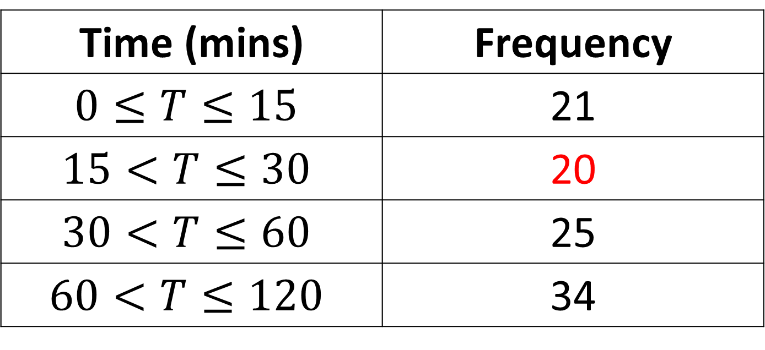
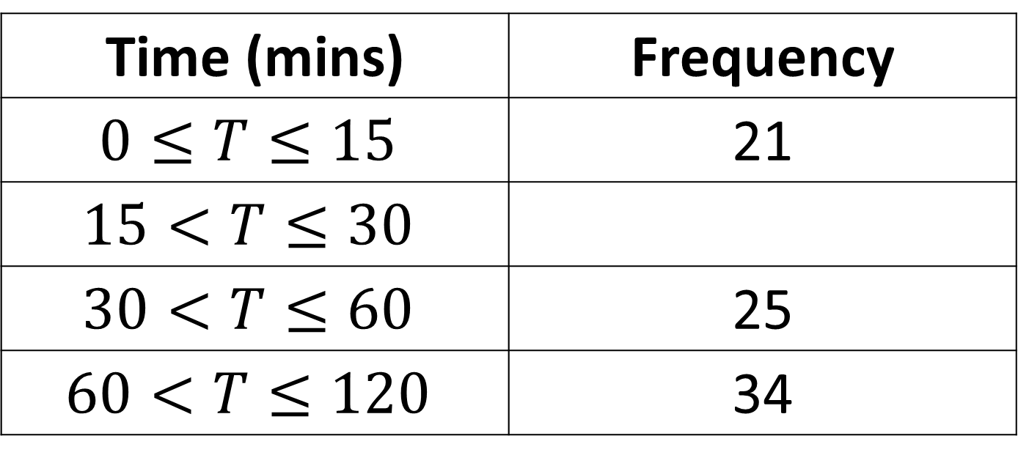
A scientist collects results for 100 samples.
Fill in the missing value.
Time (mins) | Frequency
$$0≤T≤15$$ | 21
$$15<T≤30$$
$$30<T≤60$$ | 25
$$60<T≤120$$ | 34
Time (mins) | Frequency
$$0≤T≤15$$ | 21
$$15<T≤30$$ | 20
$$30<T≤60$$ | 25
$$60<T≤120$$ | 34

Slide 10
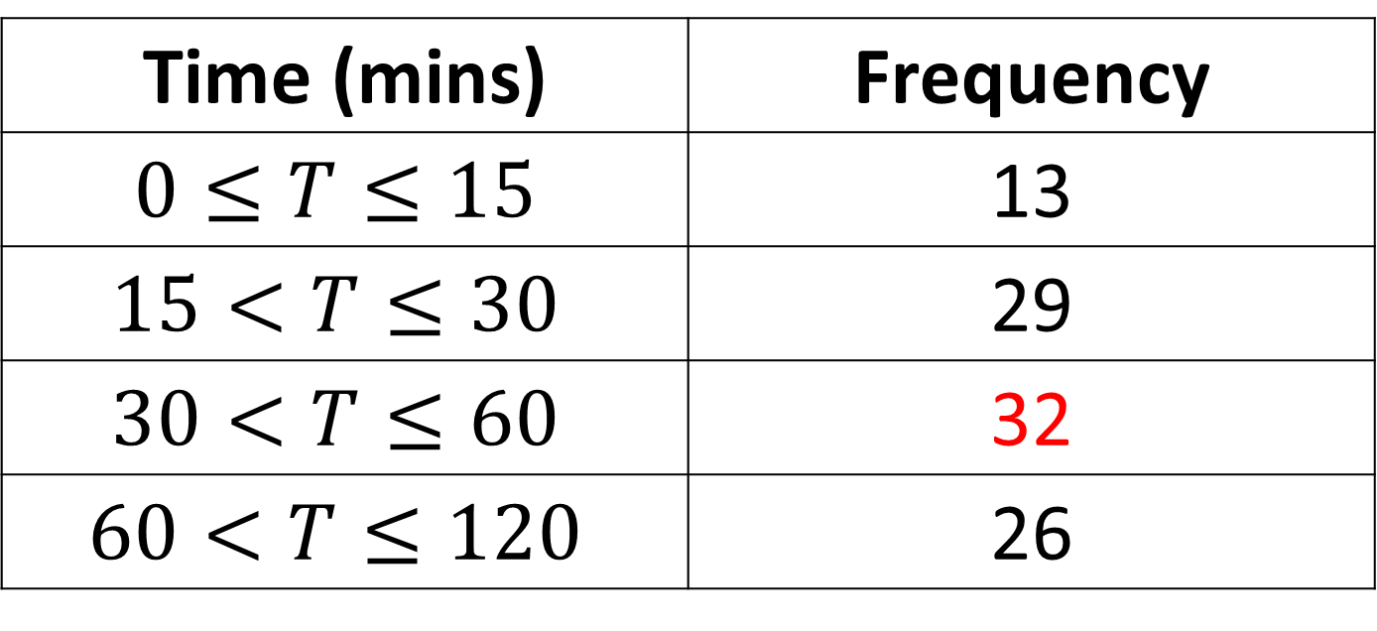
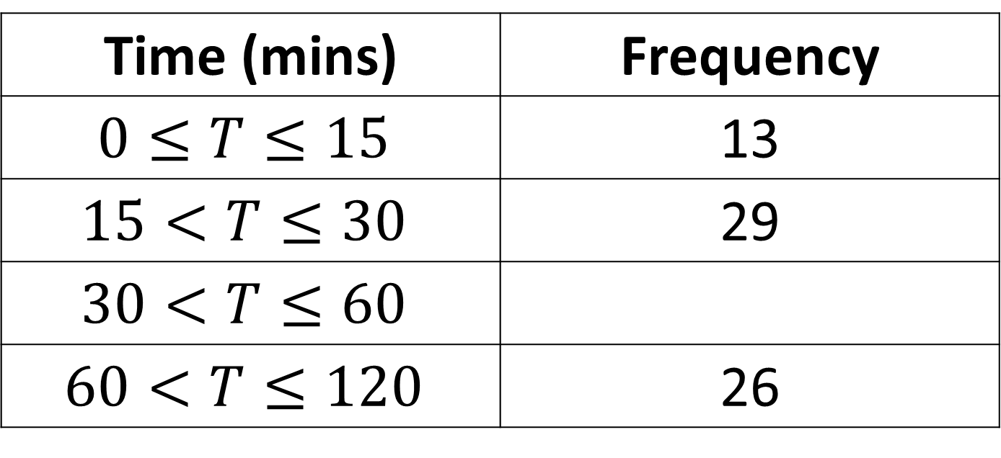
A scientist collects results for 100 samples.
Fill in the missing value.
Time (mins) | Frequency
$$0≤T≤15$$ | 13
$$15<T≤30$$ | 29
$$30<T≤60$$
$$60<T≤120$$ | 26
Time (mins) | Frequency
$$0≤T≤15$$ | 13
$$15<T≤30$$ | 29
$$30<T≤60$$ | 32
$$60<T≤120$$ | 26

Slide 11
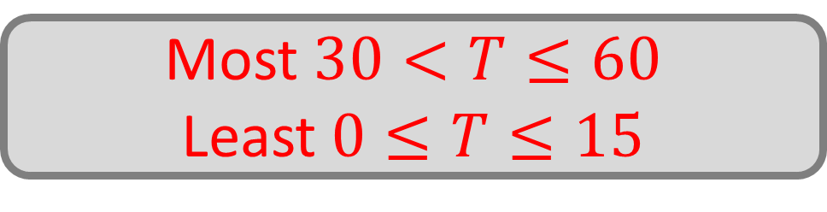
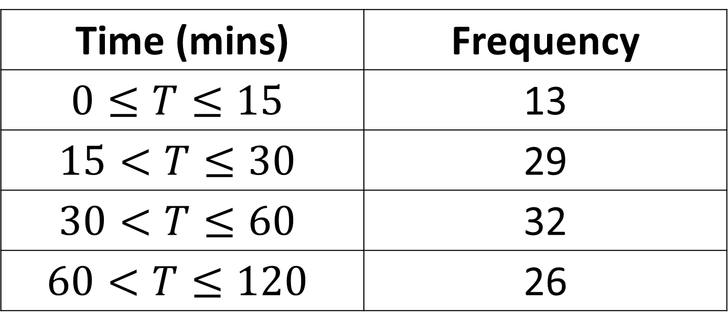
Which group contains most of the data?
Which group contains the least?
Time (mins) | Frequency
$$0≤T≤15$$ | 13
$$15<T≤30$$ | 29
$$30<T≤60$$ | 32
$$60<T≤120$$ | 26
Most $30<T≤60$
Least $0≤T≤15$

Slide 12
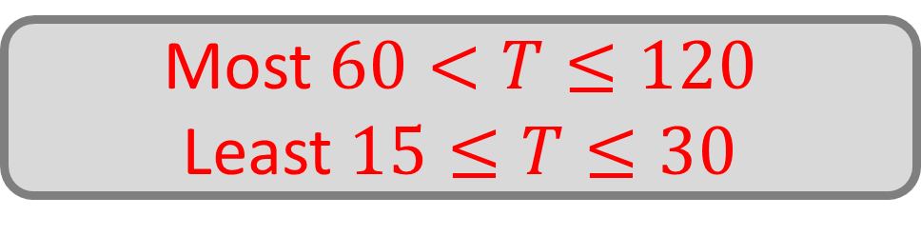
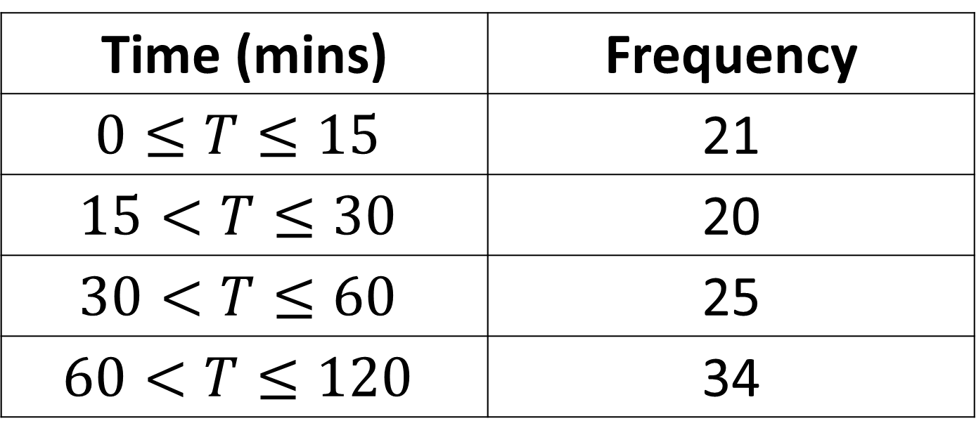
Which group contains most of the data?
Which group contains the least?
Time (mins) | Frequency
$$0≤T≤15$$ | 21
$$15<T≤30$$ | 20
$$30<T≤60$$ | 25
$$60<T≤120$$ | 34
Most $60<T≤120$
Least $15≤T≤30$

Slide 13

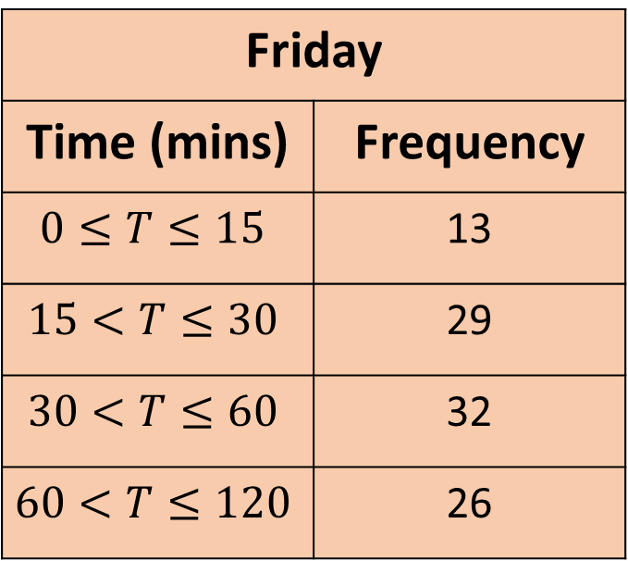
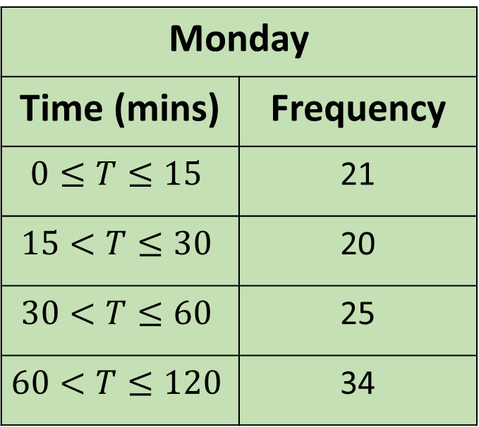
A scientist repeats an experiment on Friday and Monday. Which group showed the biggest change?
Friday
Time (mins) | Frequency
$$0≤T≤15$$ | 13
$$15<T≤30$$ | 29
$$30<T≤60$$ | 32
$$60<T≤120$$ | 26
Monday
Time (mins) | Frequency
$$0≤T≤15$$ | 21
$$15<T≤30$$ | 20
$$30<T≤60$$ | 25
$$60<T≤120$$ | 34
$$15<T≤30$$
Down by $9$

Slide 14

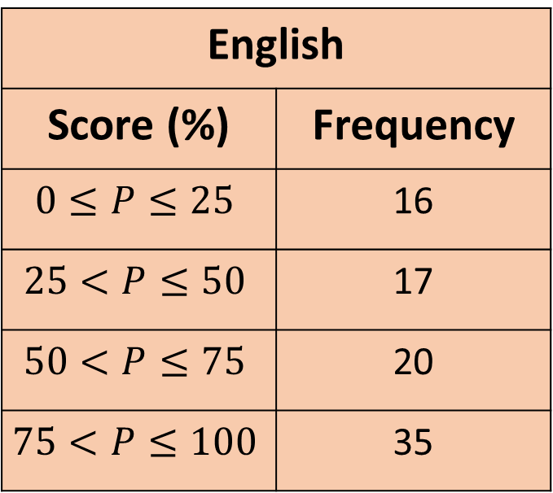
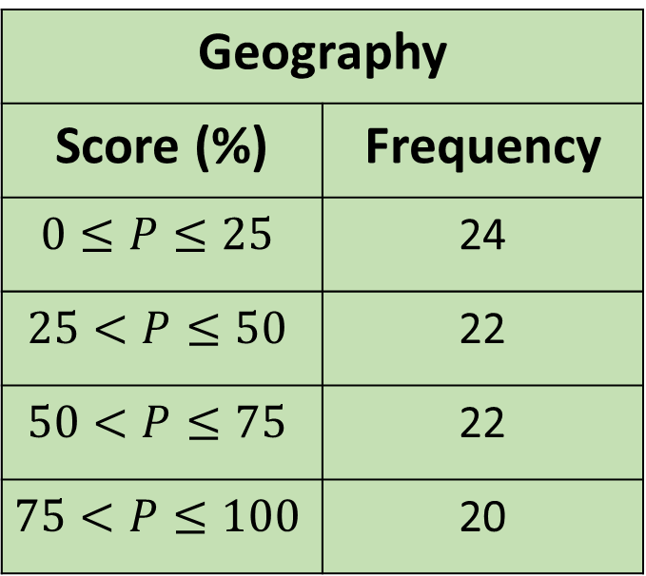
A teacher compares scores for English and Geography. Which group showed the biggest change?
English
Score (%) | Frequency
$$0≤P≤25$$ | 16
$$25<P≤50$$ | 17
$$50<P≤75$$ | 20
$$75<P≤100$$ | 35
Geography
Score (%) | Frequency
$$0≤P≤25$$ | 24
$$25<P≤50$$ | 22
$$50<P≤75$$ | 22
$$75<P≤100$$ | 20
$$75≤P≤100$$

Slide 15
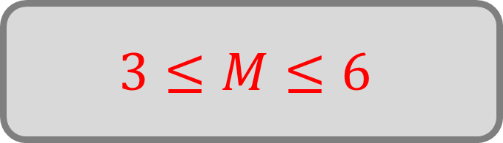
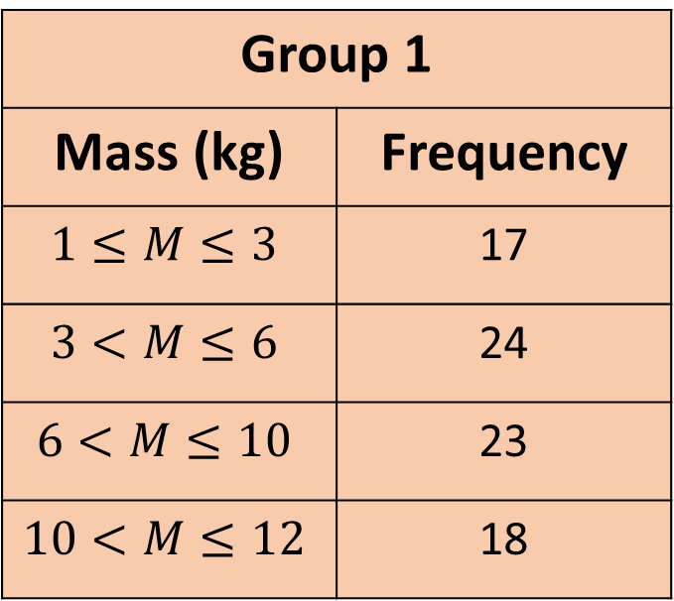
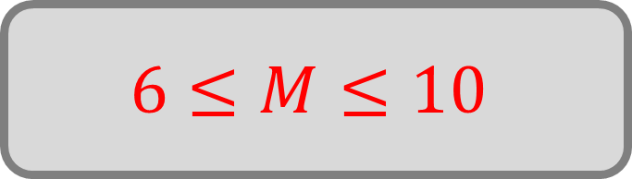
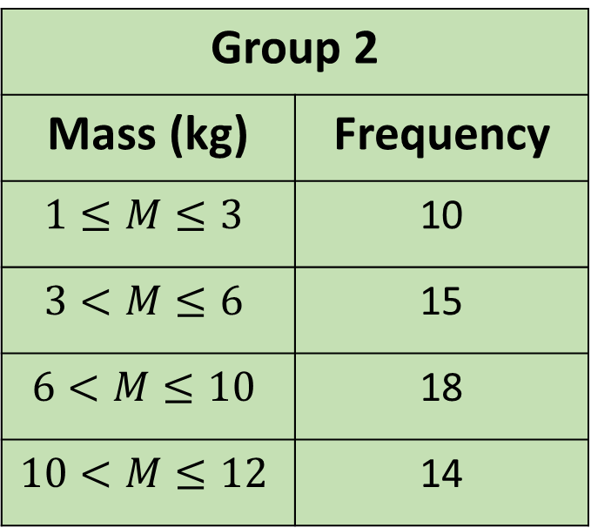
A zookeeper weighed two groups of monkeys.
What is the modal class of each group?
Group 1
Mass (kg) | Frequency
$$1≤M≤3$$ | 17
$$3<M≤6$$ | 24
$$6<M≤10$$ | 23
$$10<M≤12$$ | 18
Group 2
Mass (kg) | Frequency
$$1≤M≤3$$ | 10
$$3<M≤6$$ | 15
$$6<M≤10$$ | 18
$$10<M≤12$$ | 14
$$3≤M≤6$$
$$6≤M≤10$$

Slide 16
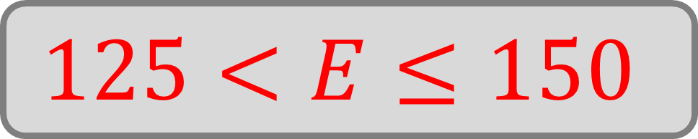
Which group has the largest class width?
Energy (J) | Frequency
$$100≤E≤105$$ | 18
$$105<E≤120$$ | 16
$$120<E≤125$$ | 19
$$125<E≤150$$ | 14
$$125<E≤150$$

Slide 17
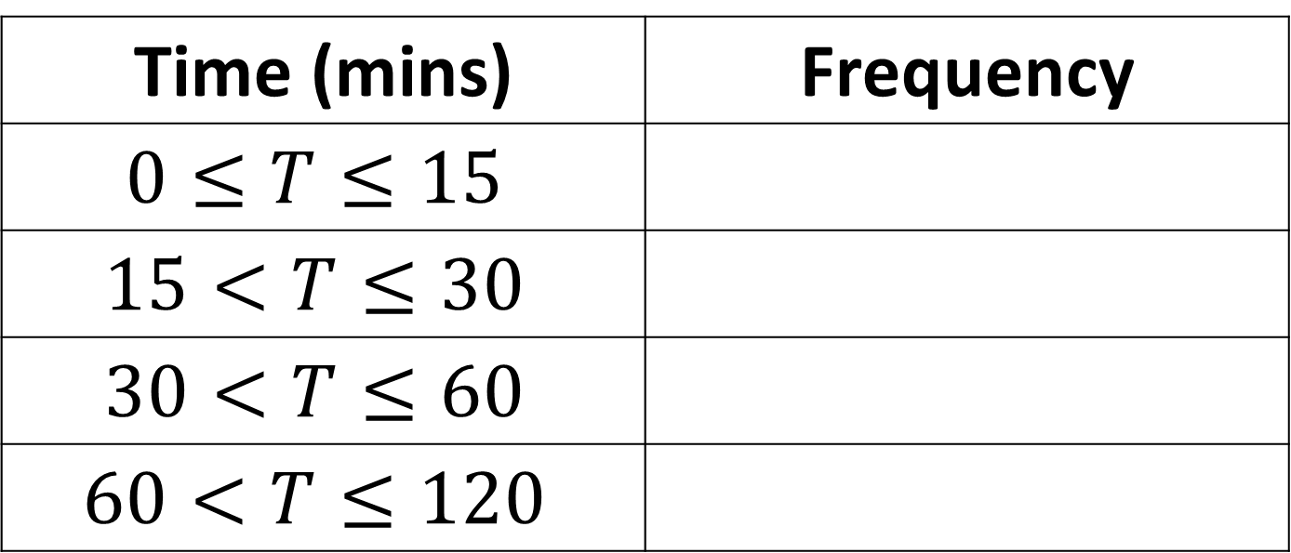
True or false:
Each group has the same class width?
Time (mins) | Frequency
$$0≤T≤15$$
$$15<T≤30$$
$$30<T≤60$$
$$60<T≤120$$
False

Slide 18
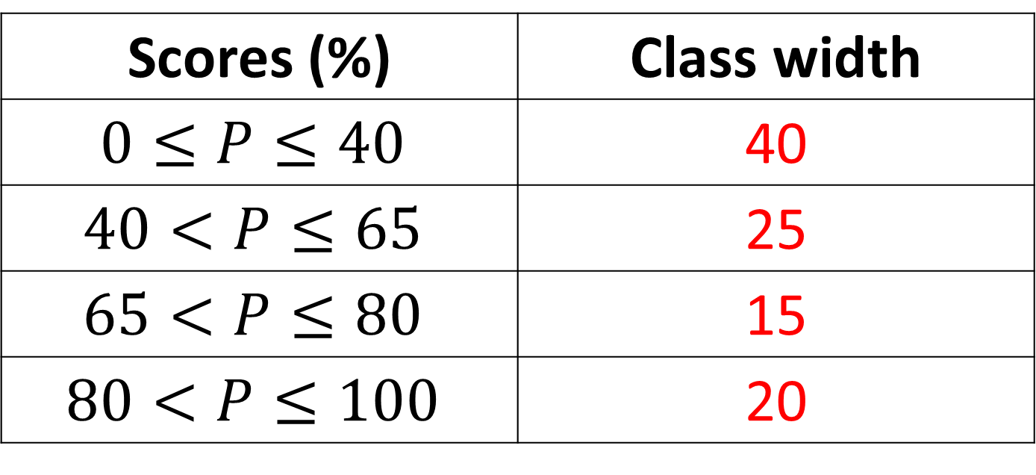
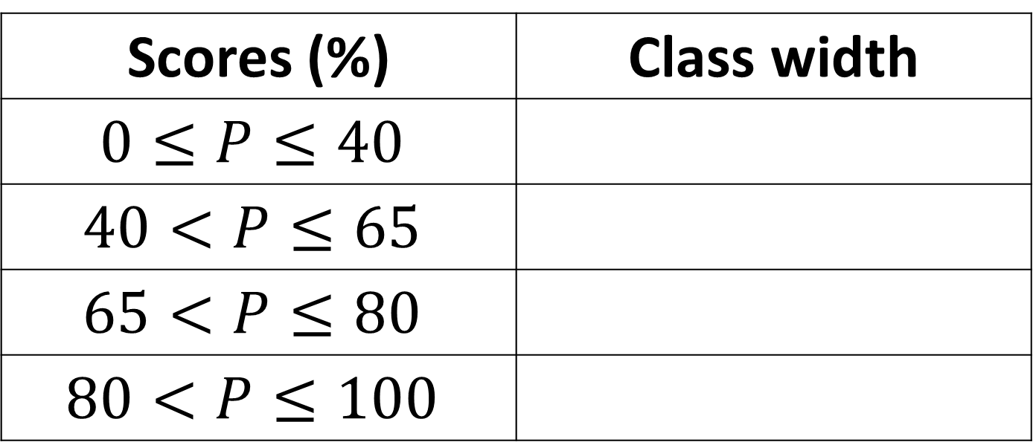
What is the class width of each group?
Scores (%) | Class width
$$0≤P≤40$$
$$40<P≤65$$
$$65<P≤80$$
$$80<P≤100$$
Scores (%) | Class width
$$0≤P≤40$$ | 40
$$40<P≤65$$ | 25
$$65<P≤80$$ | 15
$$80<P≤100$$ | 20

Slide 19
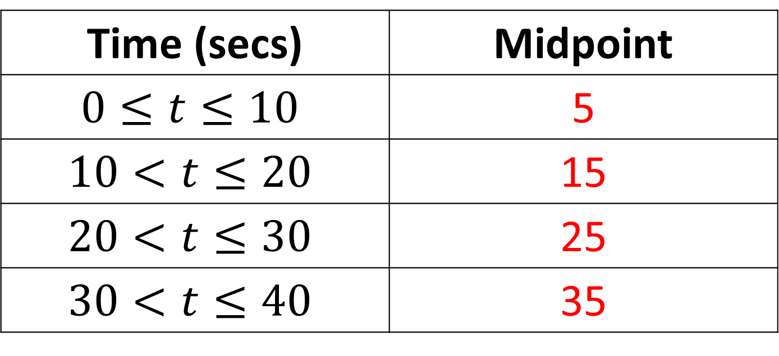
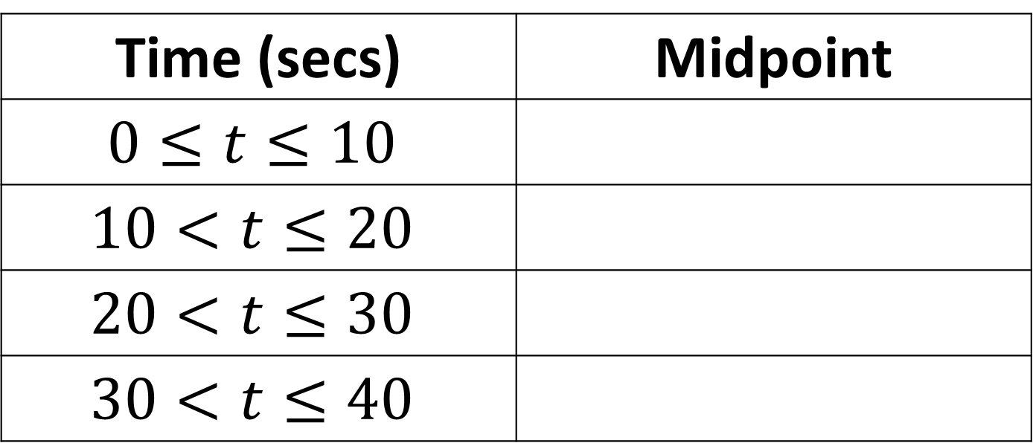
Find the midpoint of each class.
Time (secs) | Midpoint
$$0≤t≤10$$
$$10<t≤20$$
$$20<t≤30$$
$$30<t≤40$$
Time (secs) | Midpoint
$$0≤t≤10$$ | 5
$$10<t≤20$$ | 15
$$20<t≤30$$ | 25
$$30<t≤40$$ | 35

Slide 20
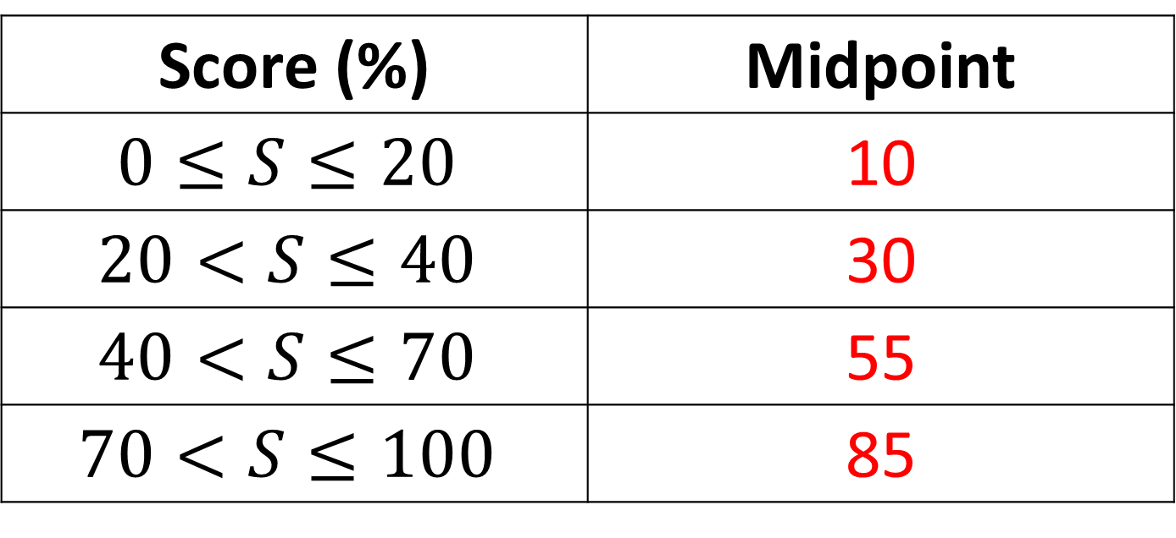
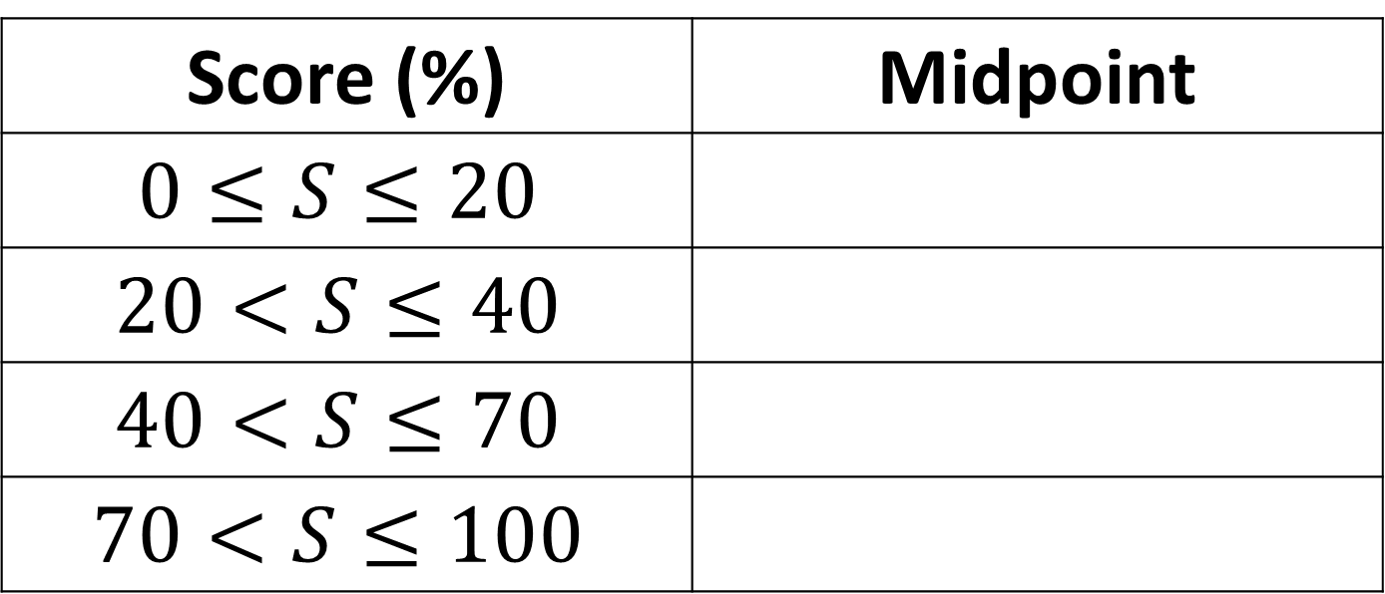
Find the midpoint of each class.
Score (%) | Midpoint
$$0≤S≤20$$
$$20<S≤40$$
$$40<S≤70$$
$$70<S≤100$$
Score (%) | Midpoint
$$0≤S≤20$$ | 10
$$20<S≤40$$ | 30
$$40<S≤70$$ | 55
$$70<S≤100$$ | 85

Slide 21
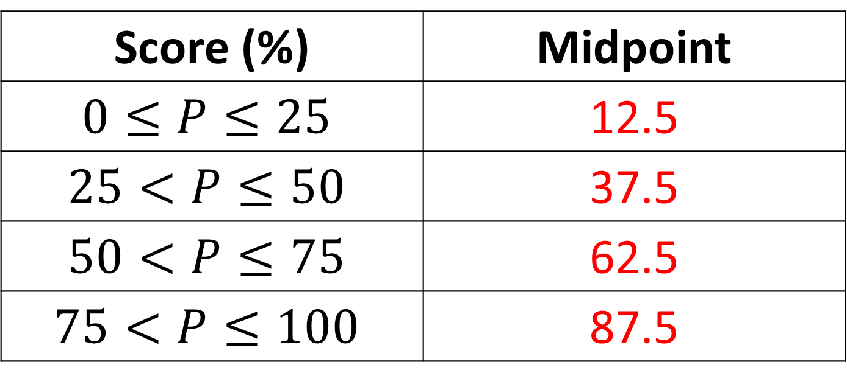
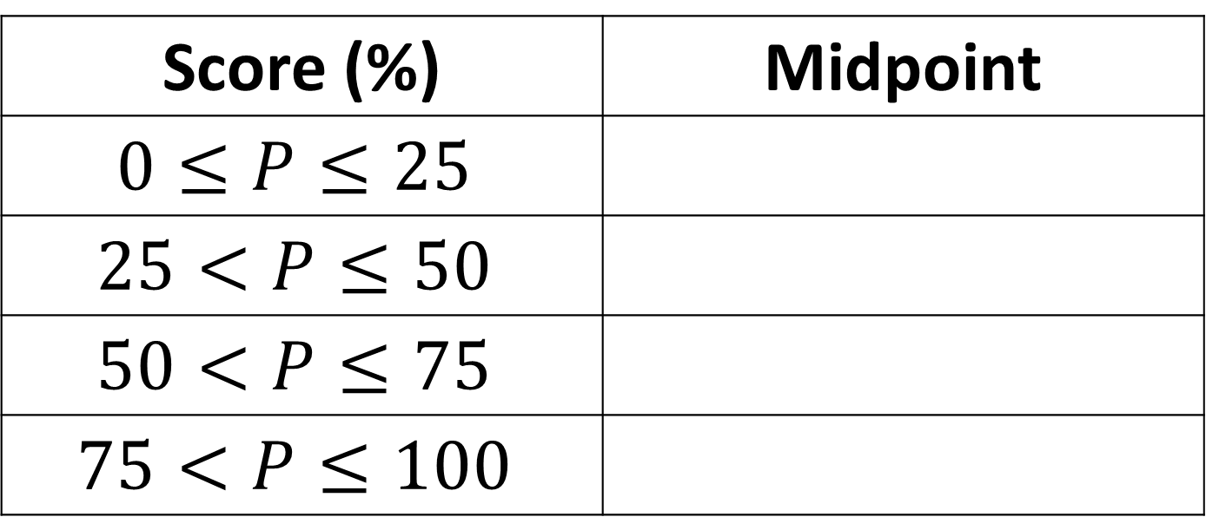
Find the midpoint of each class.
Score (%) | Midpoint
$$0≤P≤25$$
$$25<P≤50$$
$$50<P≤75$$
$$75<P≤100$$
Score (%) | Midpoint
$$0≤P≤25$$ | 12.5
$$25<P≤50$$ | 37.5
$$50<P≤75$$ | 62.5
$$75<P≤100$$ | 87.5

