Slide 1
Frequency Tables
02 June 2026

Slide 2

How many pupils are there in total?
Shoe Size | Frequency
4 | 3
5 | 6
6 | 4
7 | 2
$$15$$

Slide 3

What is the mode score?
Score | Frequency
1 | 1
2 | 7
3 | 3
4 | 1
5 | 4
$$2$$

Slide 4

How many more chose football than tennis?
Sport | Frequency
Football | 12
Basketball | 5
Tennis | 8
Cricket | 3
$$4$$

Slide 5

How many are in class C?
Class | Frequency
A | 6
B | 9
C
D | 3
Total | 25
$$7$$

Slide 6

How many pupils are aged 12 or younger?
Age | Frequency
11 | 4
12 | 7
13 | 5
14 | 10
$$11$$

Slide 7

How many pupils scored more than 3?
Score | Frequency
1 | 2
2 | 2
3 | 3
4 | 5
5 | 1
$$6$$

Slide 8

How many people selected chocolate?
Flavour | Frequency
Pineapple | 11
Chocolate
Cherry | 19
Toffee | 8
Total | 50
$$12$$

Slide 9

How many are between 5 cm and 15 cm?
Length | Frequency
2 cm | 14
5 cm | 7
8 cm | 11
12 cm | 6
16 cm | 10
$$24$$

Slide 10

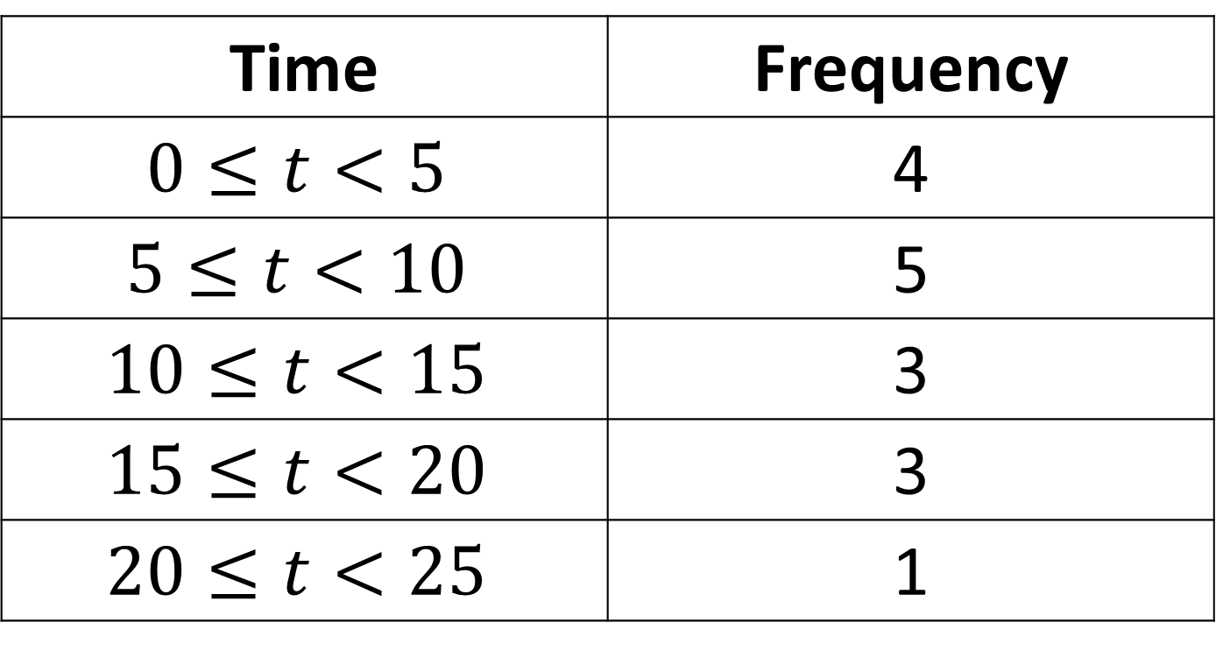
What is the modal class?
Time | Frequency
$$0≤t<5$$ | 4
$$5≤t<10$$ | 5
$$10≤t<15$$ | 3
$$15≤t<20$$ | 3
$$20≤t<25$$ | 1
$$5≤t<10$$

Slide 11

What is the total value of the 20p coins?
Coins | Frequency
5p | 3
10p | 5
20p | 6
50p | 3
£1 | 2
$$£1.20$$

Slide 12

What is the total value of the coins?
Coins | Frequency
5p | 3
10p | 5
20p | 6
50p | 3
£1 | 2
$$£5.15$$

Slide 13
How many people selected brown?
Colour | Frequency
Red | 10
Black | 6
Brown
Blue | 17
Total | 45
$$12$$

Slide 14

How many more pupils scored 4 than 1?
Score | Frequency
1 | 11
2 | 13
3 | 15
4 | 14
5 | 21
$$3$$

Slide 15

How many pupils are aged 12 or older?
Age | Frequency
11 | 10
12 | 15
13 | 14
14 | 7
$$36$$

Slide 16

What fraction of pupils are 11?
Age | Frequency
11 | 10
12 | 15
13 | 14
14 | 7
$${10}/{36}$$

Slide 17

Which class is the mode?
Class | Frequency
A | 13
B | 15
C | 20
D | 12
Total | 60
$$C$$

Slide 18
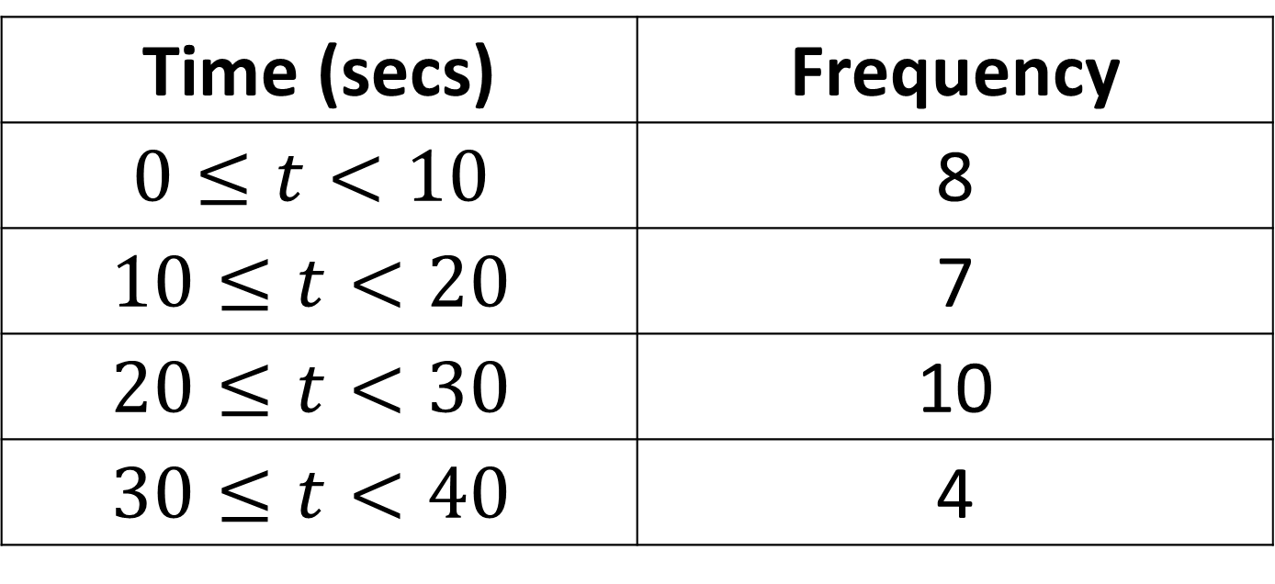

How many pupils are there in total?
Time (secs) | Frequency
$$0≤t<10$$ | 8
$$10≤t<20$$ | 7
$$20≤t<30$$ | 10
$$30≤t<40$$ | 4
$$29$$

Slide 19

How many pupils took between 10 to 30 seconds?
Time (secs) | Frequency
$$0≤t<10$$ | 8
$$10≤t<20$$ | 7
$$20≤t<30$$ | 10
$$30≤t<40$$ | 4
$$17$$

Slide 20
True or false:
Most students took longer than 20 seconds?
Time (secs) | Frequency
$$0≤t<10$$ | 8
$$10≤t<20$$ | 7
$$20≤t<30$$ | 10
$$30≤t<40$$ | 4
False

Slide 21

What is the mode score?
Score | Frequency
1 | 7
2 | 5
3 | 3
4 | 2
5 | 6
$$1$$

