Slide 1
Inverse Proportion
04 June 2026

Slide 2


$y$ is inversely proportional to $x$.
When $x=4$, $y=9$.
Write a formula for $y$ in terms of $x$.
$$y=\frac{36}{x}$$

Slide 3


$$t∝\frac{1}{p}$$
When $p=6$, $t=12$.
Write a formula for $t$ in terms of $p$.
$$t=\frac{72}{p}$$

Slide 4


$m$ varies inversely with $n$.
When $m=20$, $n=3$.
Write a formula for $m$ in terms of $n$.
$$m=\frac{60}{n}$$

Slide 5


$k$ is inversely proportional to $r$.
When $k=7$, $r=10$.
Write a formula for $r$ in terms of $k$.
$$r=\frac{70}{k}$$

Slide 6


$d$ is inversely proportional to $C$.
When $C=3.1$, $d=0.5.$
Write a formula for $C$ in terms of $d$.
$$C=\frac{1.55}{d}$$

Slide 7

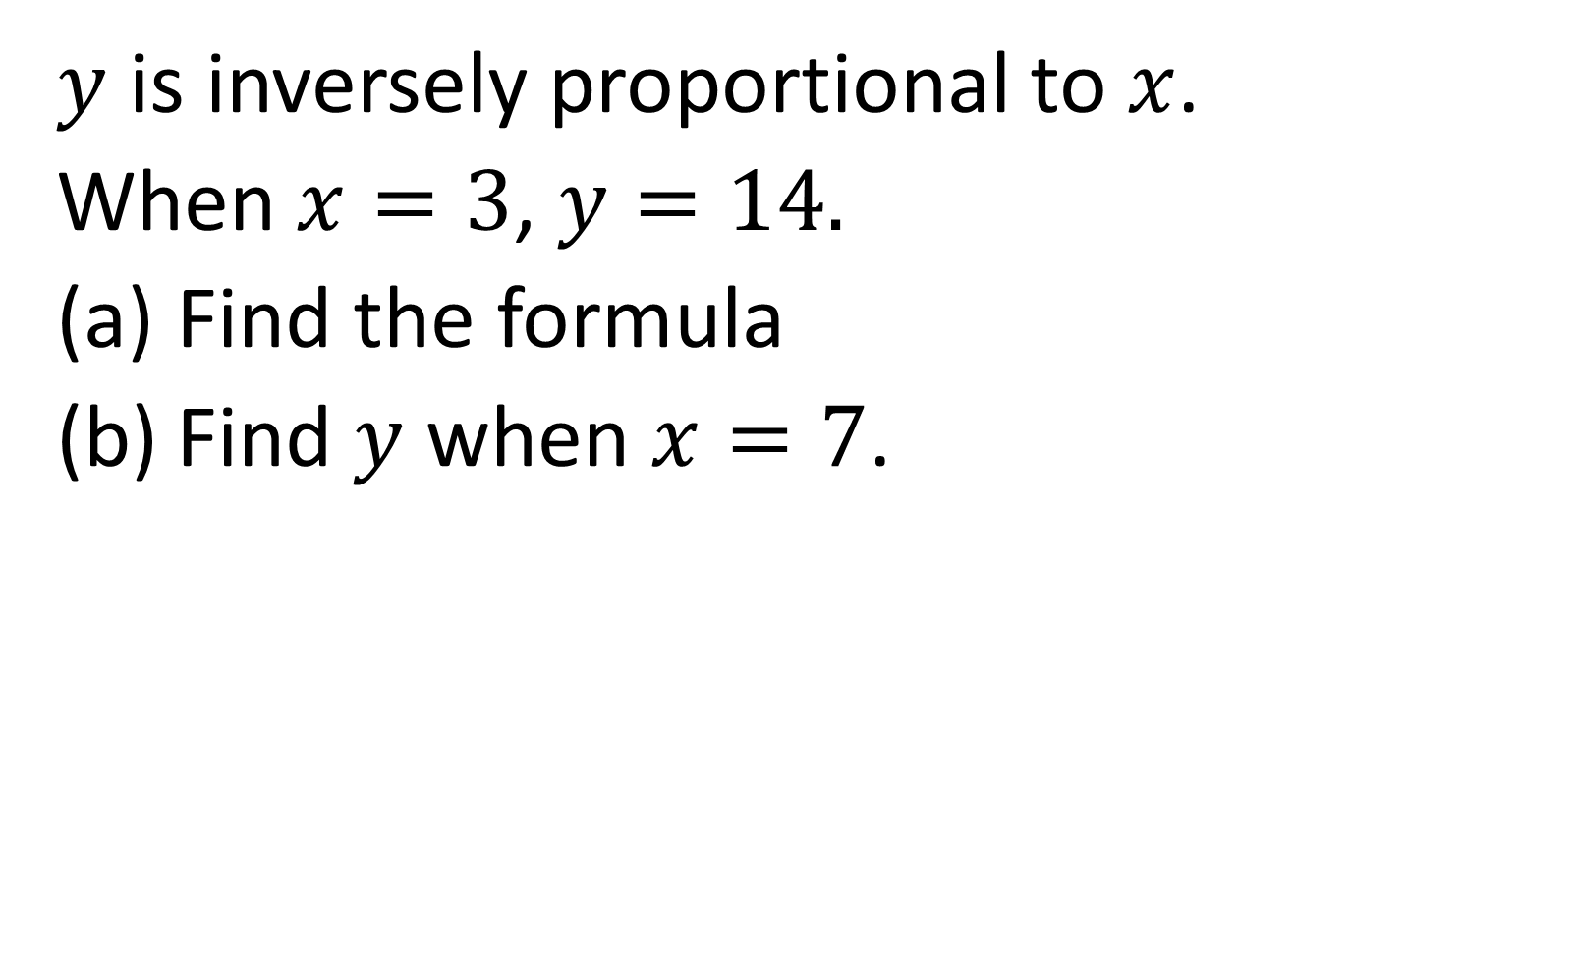
$y$ is inversely proportional to $x$.
When $x=3$, $y=14.$
Find the formula
Find $y$ when $x=7$.
$$y=\frac{42}{x}$$
$$y=6$$

Slide 8

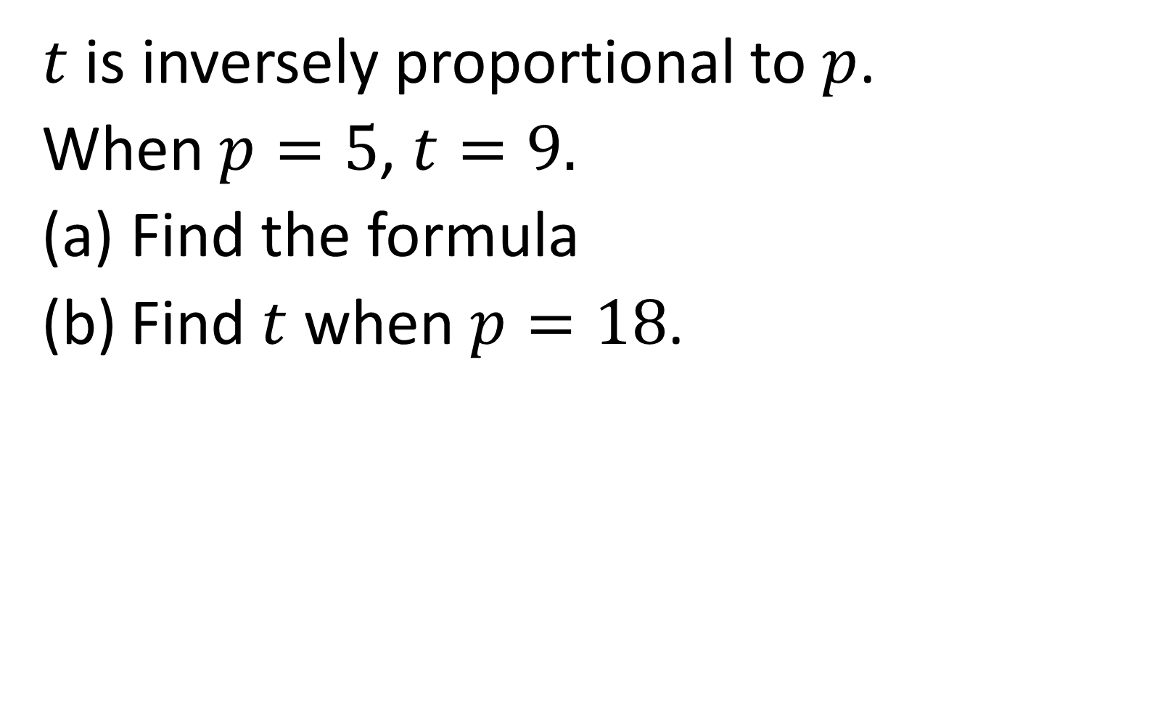
$t$ is inversely proportional to $p$.
When $p=5$, $t=9.$
Find the formula
Find $t$ when $p=18$.
$$t=\frac{45}{p}$$
$$t=2.5$$

Slide 9


$v$ varies inversely with $n$.
When $n=2$, $v=30.$
Find the formula
Find $v$ when $n=10$.
$$v=\frac{60}{n}$$
$$v=6$$

Slide 10


$x$ is inversely proportional to $t$.
When $x=7$, $t=21.$
Find the formula
Find $x$ when $t=3$.
$$x=\frac{147}{t}$$
$$x=49$$

Slide 11


$c$ is inversely proportional to $z$.
When $c=16$, $z=5.$
Find the formula
Find $c$ when $z=4$.
$$c=\frac{80}{z}$$
$$c=20$$

Slide 12

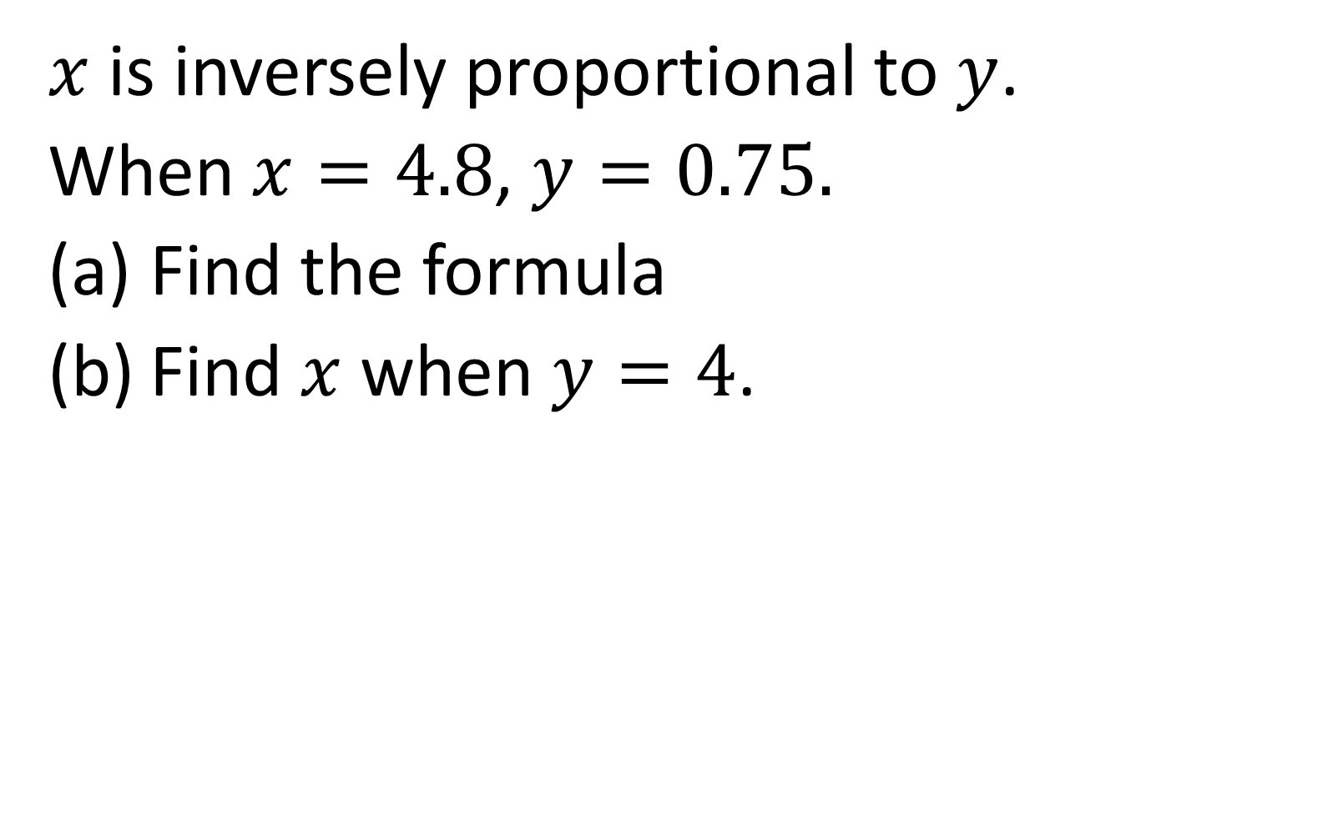
$x$ is inversely proportional to $y$.
When $x=4.8$, $y=0.75.$
Find the formula
Find $x$ when $y=4$.
$$x=\frac{3.6}{y}$$
$$x=0.9$$

Slide 13
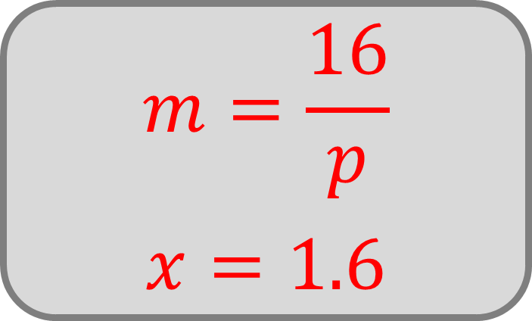
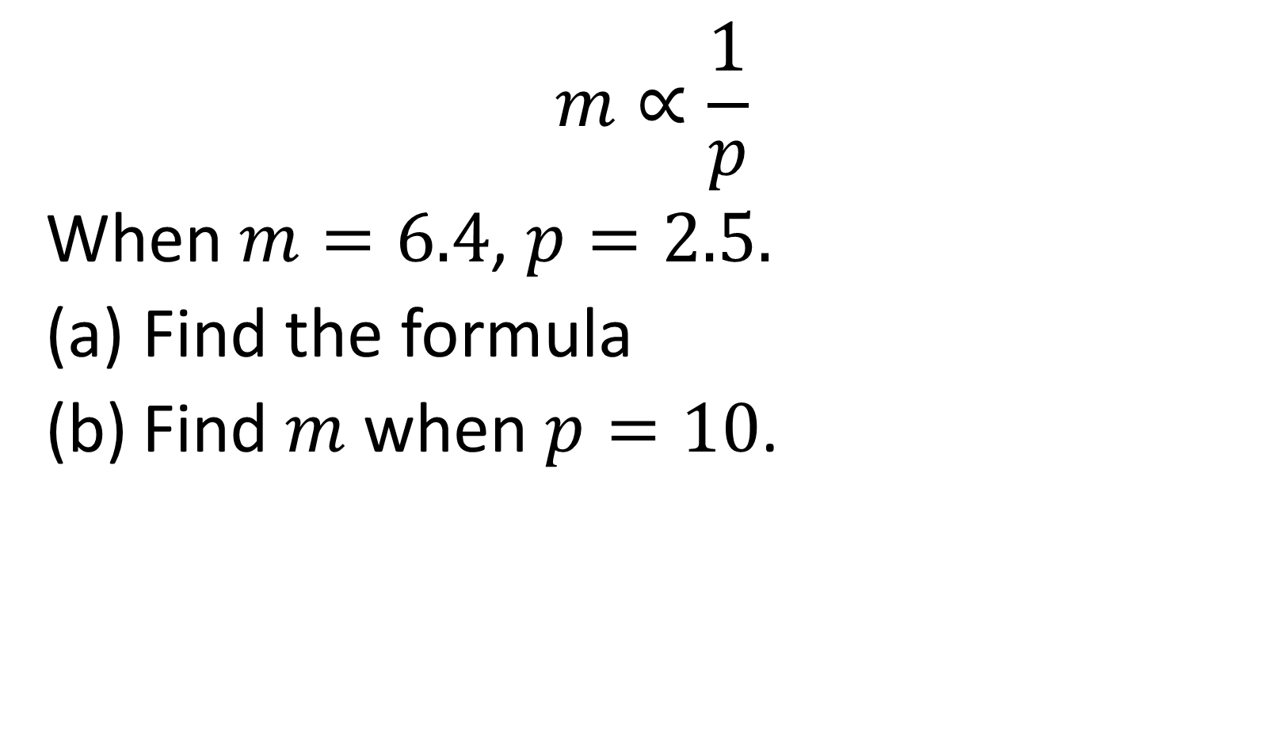
$$m∝\frac{1}{p}$$
When $m=6.4$, $p=2.5.$
Find the formula
Find $m$ when $p=10$.
$$m=\frac{16}{p}$$
$$x=1.6$$

Slide 14


$h$ and $t$ are inversely proportional.
When $h=12$, $t=0.9$
Find the formula
Find $t$ when $h=9$.
$$t=\frac{10.8}{h}$$
$$t=1.2$$

Slide 15
True or false:
If two quantities are inversely proportional, then when one increases, the other must decrease.
True

Slide 16
True or false:
If two variables are inversely proportional, neither of them can ever be zero.
True

Slide 17


$y$ is inversely proportional to $x$.
When $x=4$, $y=−6.$
Write a formula for $x$ in terms of $y$.
$$x=\frac{−24}{y}$$

Slide 18

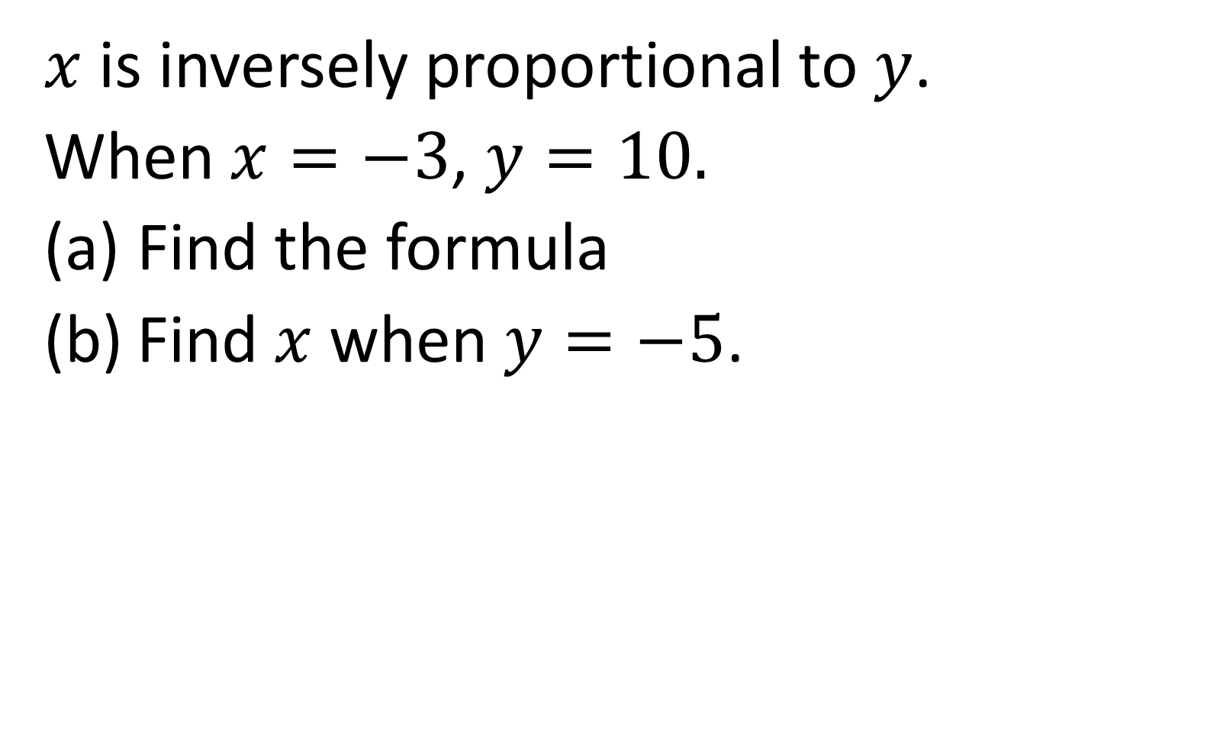
$x$ is inversely proportional to $y$.
When $x=−3$, $y=10.$
Find the formula
Find $x$ when $y=−5$.
$$x=\frac{−30}{y}$$
$$x=6$$

Slide 19

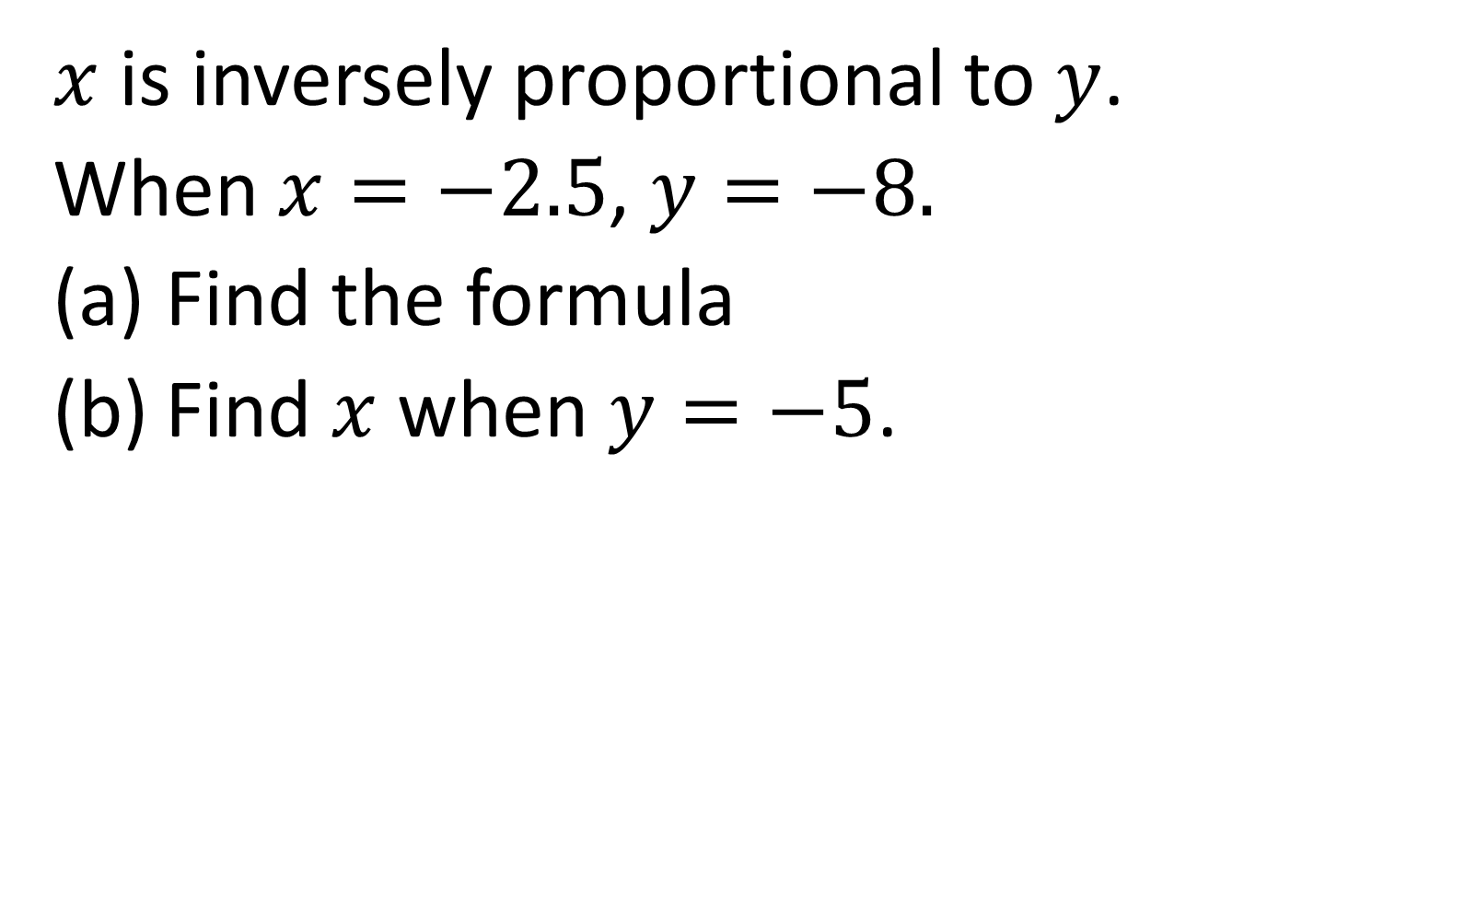
$x$ is inversely proportional to $y$.
When $x=−2.5$, $y=−8.$
Find the formula
Find $x$ when $y=−5$.
$$x=\frac{20}{y}$$
$$x=−4$$

Slide 20


True or false:
The graph shows an inversely proportional relationship.
$$y$$
$$x$$
False

Slide 21
Sketch a graph showing an inversely proportional relationship.
$$y$$
$$x$$

