Slide 1
Simultaneous Equations
09 June 2026

Slide 2
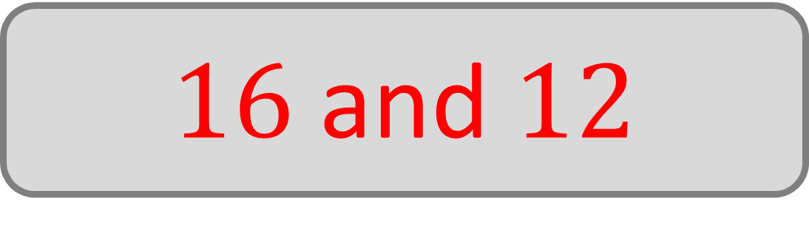
Bill and Ben each think of a number.
The sum of their numbers is 28.
The difference of their numbers is 4.
What numbers did they think of?
$16$ and $12$

Slide 3
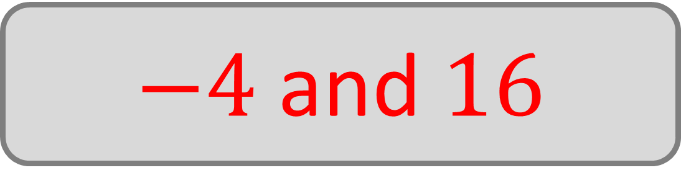
Bill and Ben each think of a number.
The sum of their numbers is 12.
The difference of their numbers is 20.
What numbers did they think of?
$−4$ and $16$

Slide 4

Bill and Ben each think of a number.
The sum of their numbers is 17.
The product of their numbers is 72.
What numbers did they think of?
$8$ and $9$

Slide 5
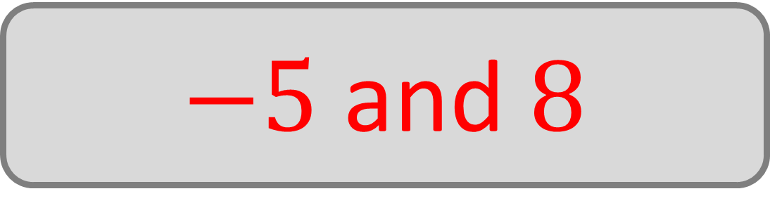
Bill and Ben each think of a number.
The sum of their numbers is 3.
The product of their numbers is –40.
What numbers did they think of?
$−5$ and $8$

Slide 6

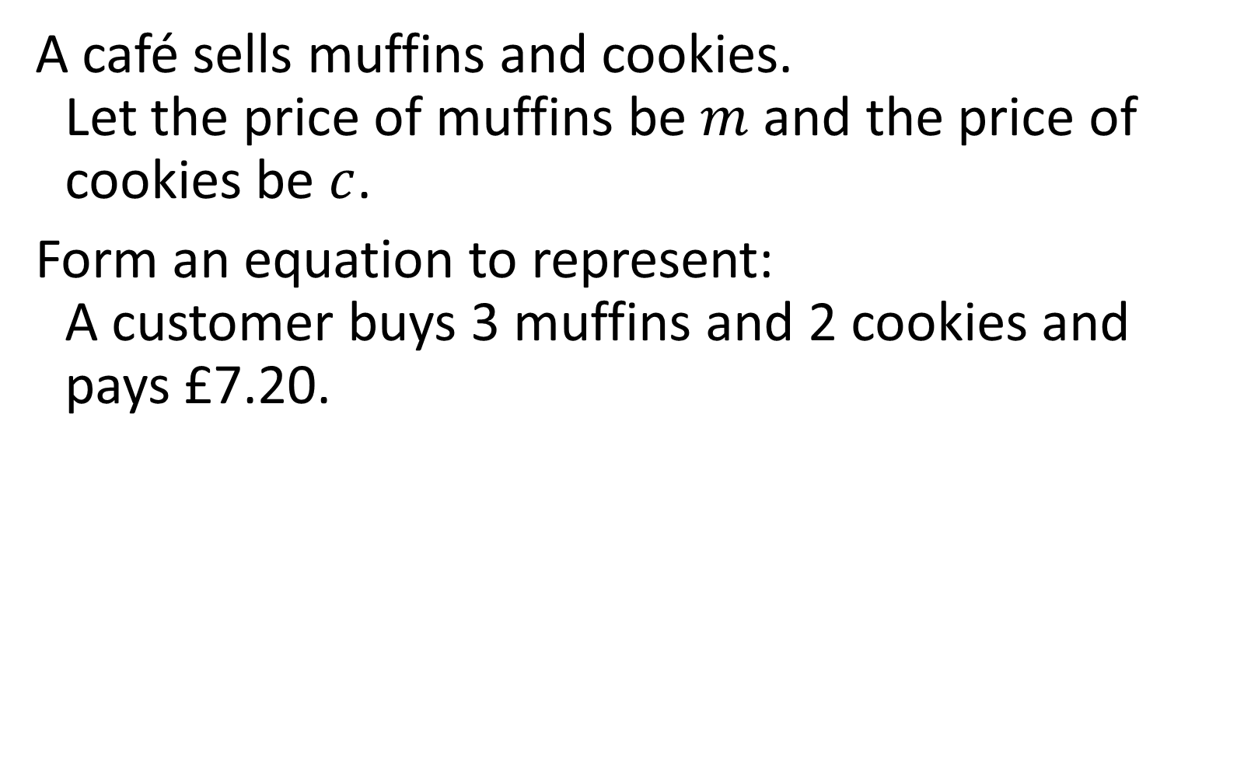
A café sells muffins and cookies.
Let the price of muffins be $m$ and the price of cookies be $c$.
Form an equation to represent:
A customer buys 3 muffins and 2 cookies and pays £7.20.
$$3m+2c=7.2$$

Slide 7

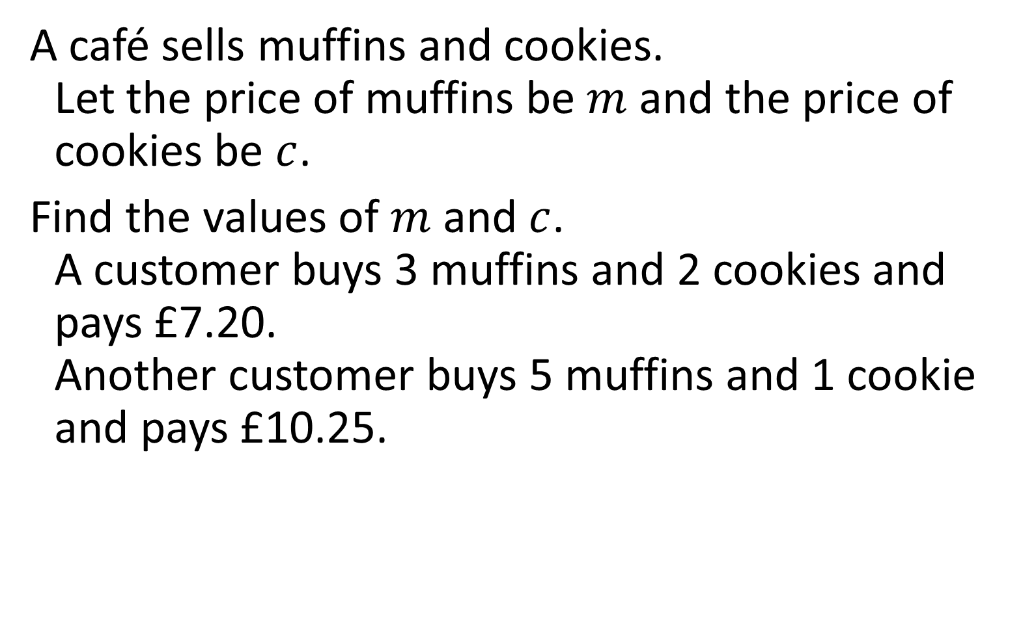

A café sells muffins and cookies.
Let the price of muffins be $m$ and the price of cookies be $c$.
Find the values of $m$ and $c$.
A customer buys 3 muffins and 2 cookies and pays £7.20.
Another customer buys 5 muffins and 1 cookie and pays £10.25.
$$m=1.90$$
$$c=0.75$$

Slide 8
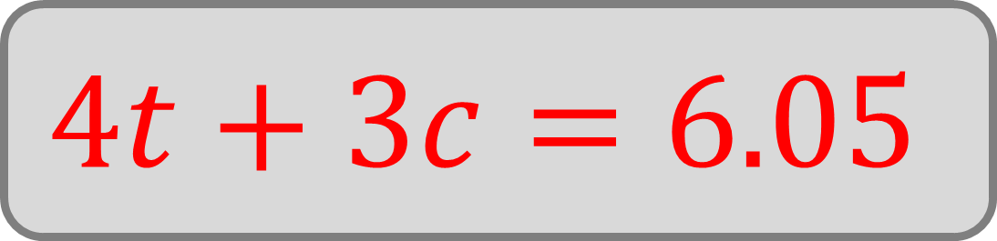
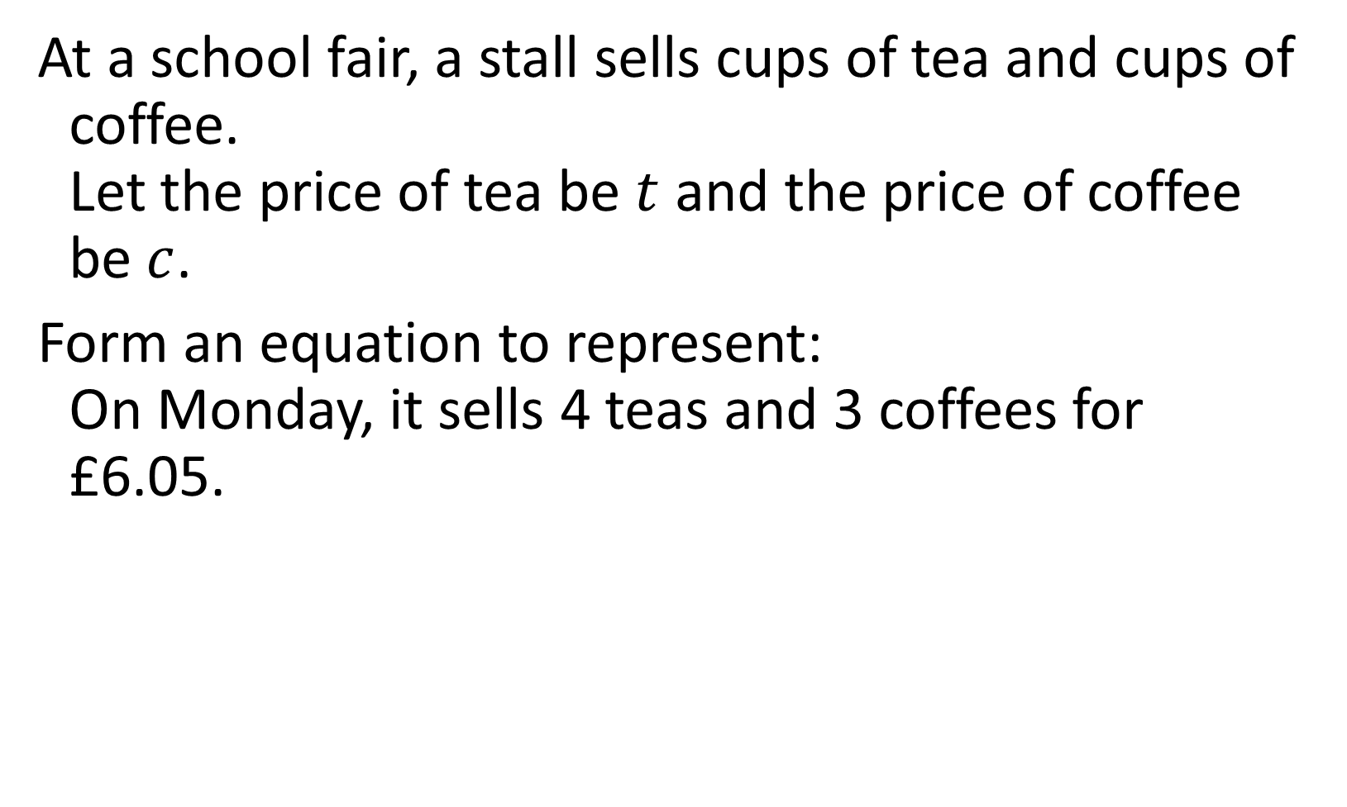
At a school fair, a stall sells cups of tea and cups of coffee.
Let the price of tea be $t$ and the price of coffee be $c$.
Form an equation to represent:
On Monday, it sells 4 teas and 3 coffees for £6.05.
$$4t+3c=6.05$$

Slide 9

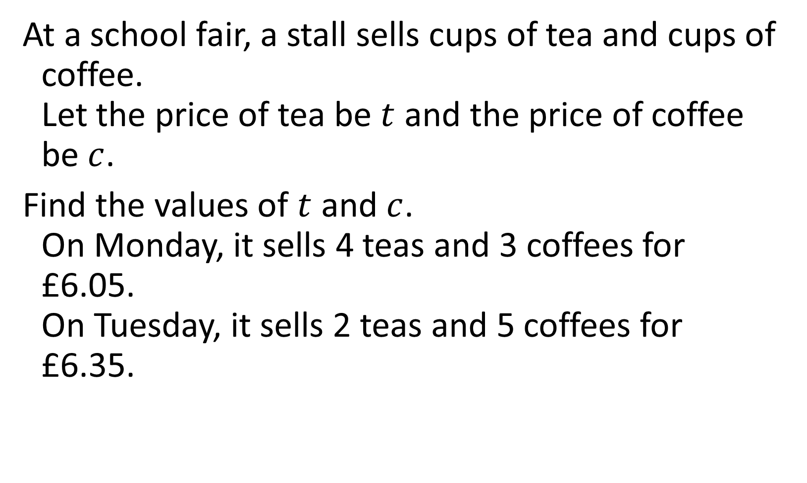

At a school fair, a stall sells cups of tea and cups of coffee.
Let the price of tea be $t$ and the price of coffee be $c$.
Find the values of $t$ and $c$.
On Monday, it sells 4 teas and 3 coffees for £6.05.
On Tuesday, it sells 2 teas and 5 coffees for £6.35.
$$t=0.80$$
$$c=0.95$$

Slide 10

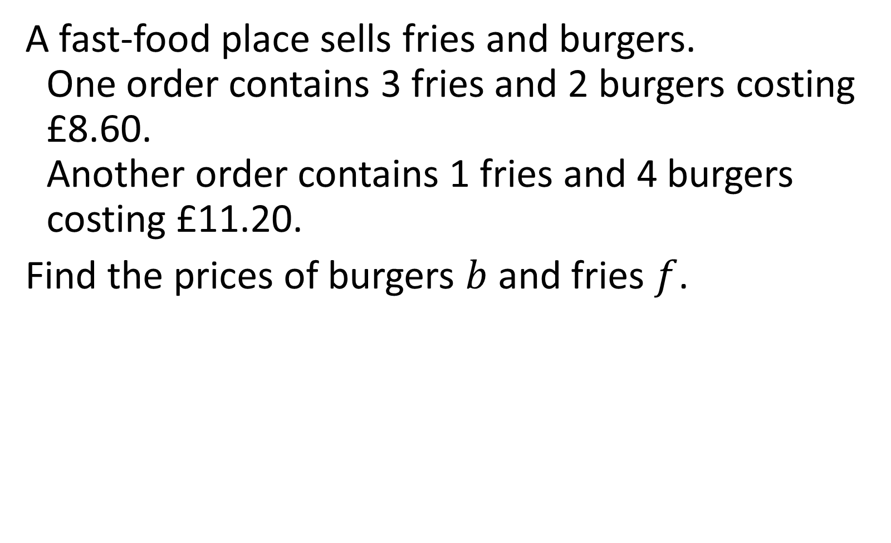

A fast‑food place sells fries and burgers.
One order contains 3 fries and 2 burgers costing £8.60.
Another order contains 1 fries and 4 burgers costing £11.20.
Find the prices of burgers $b$ and fries $f$.
$$b=2.50$$
$$f=1.20$$

Slide 11

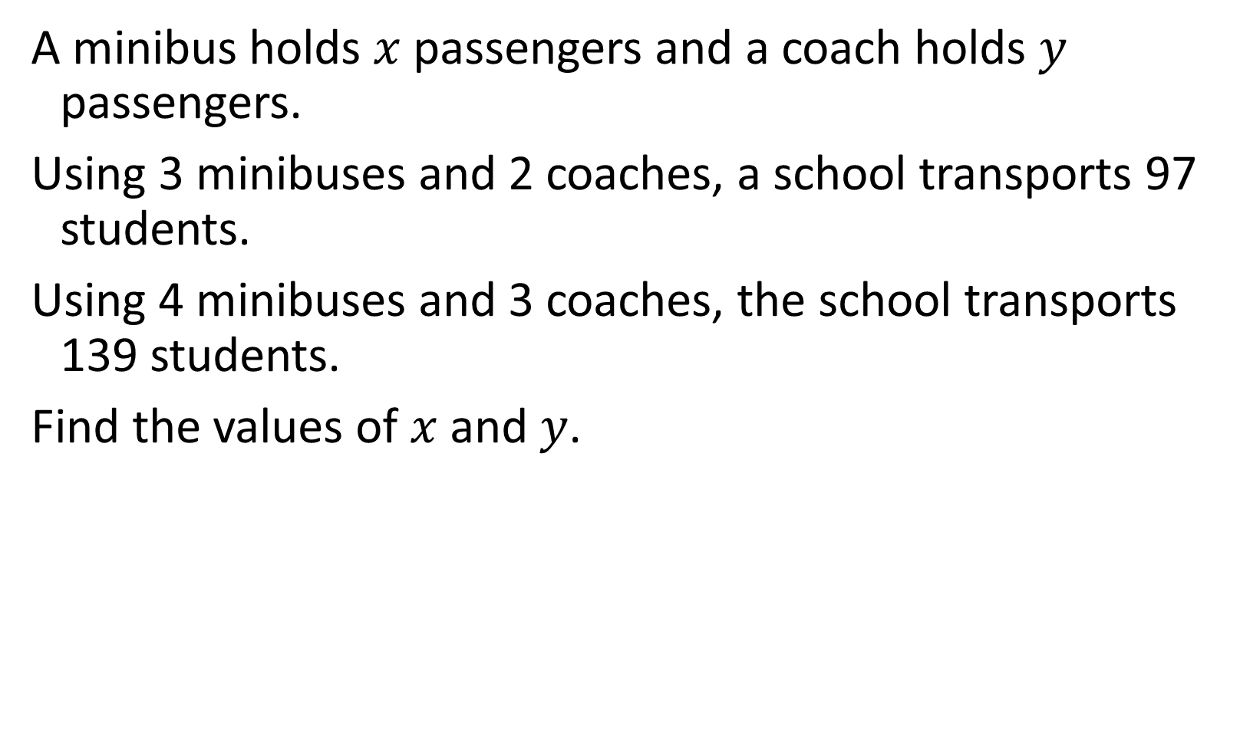

A minibus holds $x$ passengers and a coach holds $y$ passengers.
Using 3 minibuses and 2 coaches, a school transports 97 students.
Using 4 minibuses and 3 coaches, the school transports 139 students.
Find the values of $x$ and $y$.
$$x=13$$
$$y=29$$

Slide 12


A builder uses red bricks and grey blocks to build walls.
A wall section using 120 red bricks and 40 grey blocks weighs 840 kg.
Another section using 150 red bricks and 20 grey blocks weighs 780 kg.
Find the mass of a single red brick and a single grey block.
$$r=4$$
$$g=9$$

Slide 13


Two different components in a physics experiment each release a certain amount of energy when activated.
In one experiment, a setup uses 2 of Component A and 5 of Component B, releasing a total of 309 joules.
In another experiment, a setup uses 4 of Component A and 3 of Component B, releasing 289 joules.
Form and solve simultaneous equations to determine the energy released by each component.
$$A=37$$
$$B=47$$

Slide 14
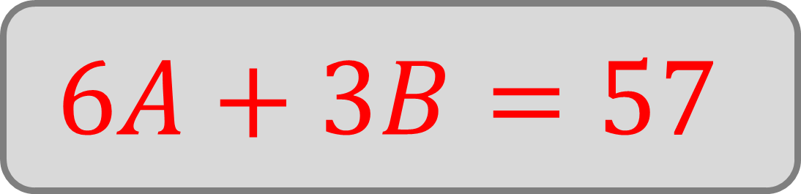
Two robots, A and B, travel in straight lines at constant speeds.
In one test, Robot A travels for 6 seconds and Robot B for 3 seconds, covering a combined total of 57 metres.
Form an equation to represent the test.
$$6A+3B=57$$

Slide 15


Two robots, A and B, travel in straight lines at constant speeds.
In one test, Robot A travels for 6 seconds and Robot B for 3 seconds, covering a combined total of 57 metres.
In a second test, Robot A travels for 8 seconds, while Robot B travels for 5 seconds, and Robot A travels 31 metres further than Robot B.
Find the speeds of the robots.
$$A=7$$
$$B=5$$

Slide 16

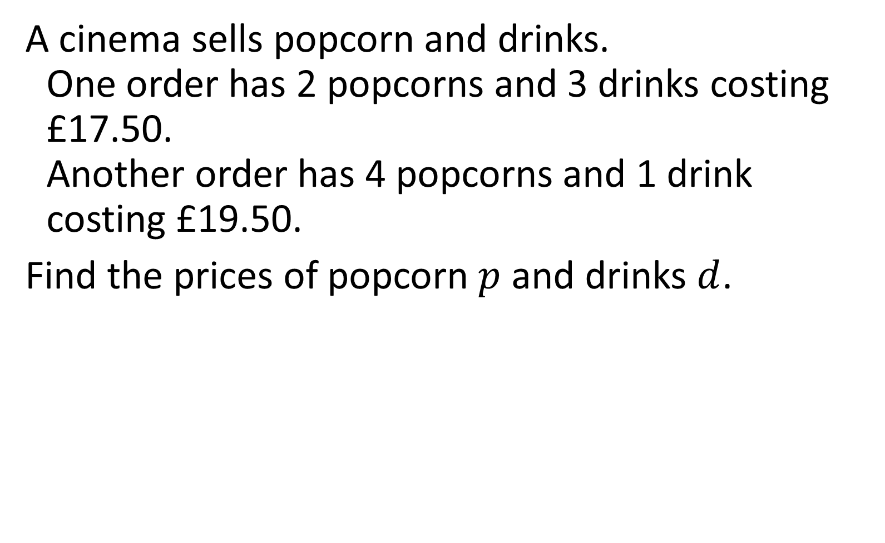

A cinema sells popcorn and drinks.
One order has 2 popcorns and 3 drinks costing £17.50.
Another order has 4 popcorns and 1 drink costing £19.50.
Find the prices of popcorn $p$ and drinks $d$.
$$p=£4.10$$
$$d=3.10$$

Slide 17

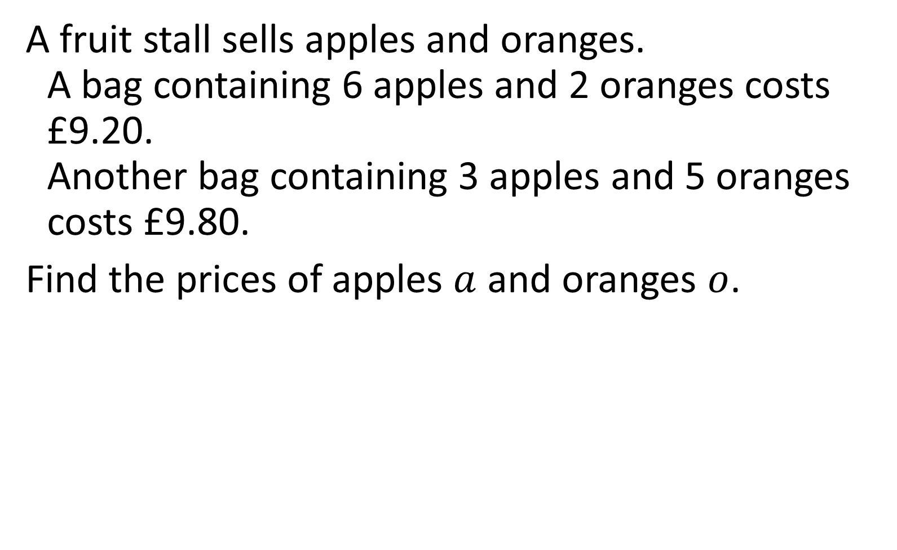

A fruit stall sells apples and oranges.
A bag containing 6 apples and 2 oranges costs £9.20.
Another bag containing 3 apples and 5 oranges costs £9.80.
Find the prices of apples $a$ and oranges $o$.
$$a=1.10$$
$$o=1.30$$

Slide 18






Given that the perimeter of the rectangle
is $40 cm$ – find the values of $x$ and $y$.
$$2x+3y$$
$$x+y$$
$$4x−y$$
$$x=4$$
$$y=2$$

Slide 19



Amira is $x$ years old and Ben is $y$ years old.
Together, their ages add up to 33.
Ben is 6 years older than twice Amira’s age.
Find the ages of Amira and Ben.
$$x=9$$
$$y=24$$

Slide 20

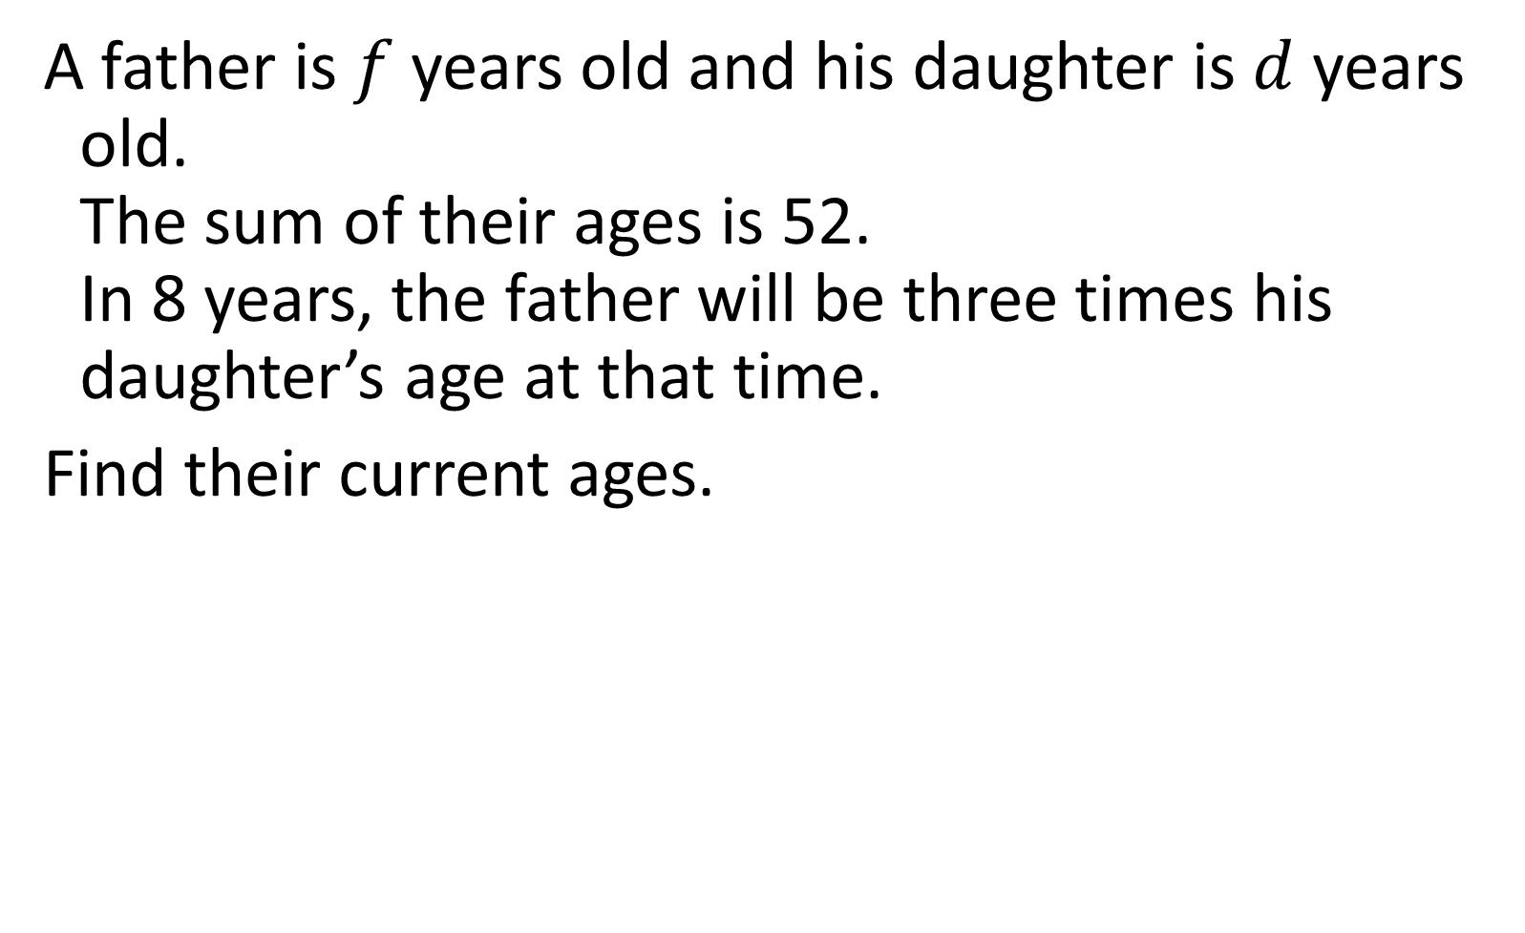

A father is $f$ years old and his daughter is $d$ years old.
The sum of their ages is 52.
In 8 years, the father will be three times his daughter’s age at that time.
Find their current ages.
$$f=43$$
$$d=9$$

Slide 21



Callum and Priya, are $c$ and $p$ years old.
Callum is 4 years younger than three times Priya’s age.
In 5 years, the total of their ages will be 58.
Find their current ages.
$$c=35$$
$$p=13$$

