Slide 1
Mean
24 June 2026

Slide 2
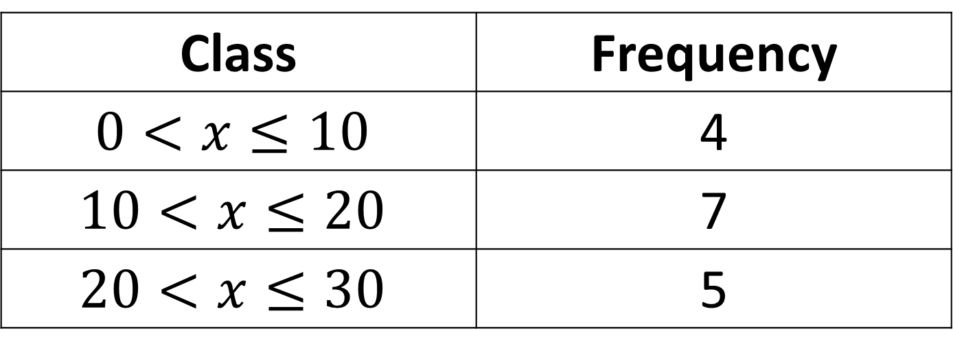

Estimate the mean to one decimal place:
Class | Frequency
$$0<x≤10$$ | 4
$$10<x≤20$$ | 7
$$20<x≤30$$ | 5
$$15.6$$

Slide 3
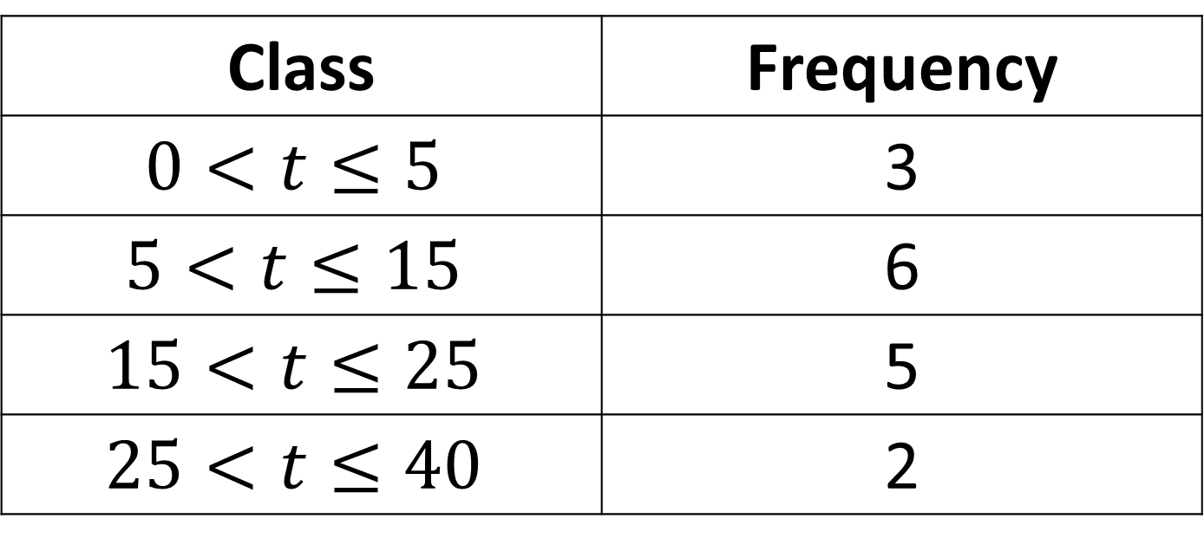

Estimate the mean to one decimal place:
Class | Frequency
$$0<t≤5$$ | 3
$$5<t≤15$$ | 6
$$15<t≤25$$ | 5
$$25<t≤40$$ | 2
$$14.5$$

Slide 4
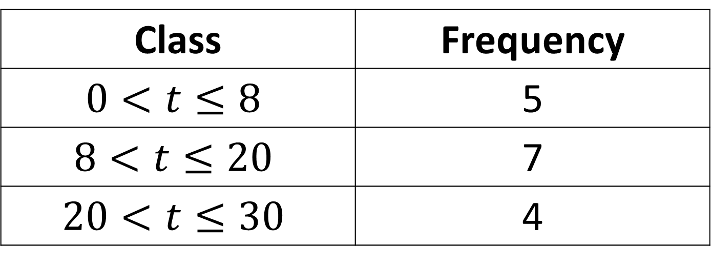

Estimate the mean to one decimal place:
Class | Frequency
$$0<t≤8$$ | 5
$$8<t≤20$$ | 7
$$20<t≤30$$ | 4
$$13.6$$

Slide 5
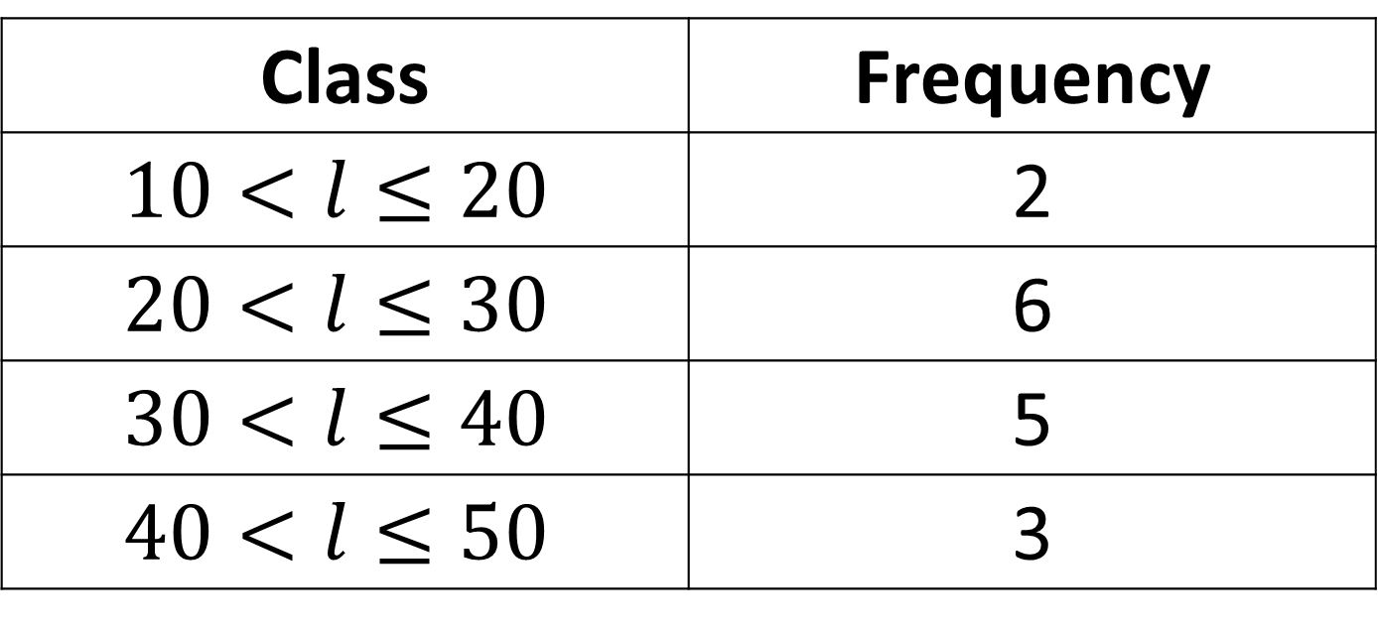

Estimate the mean to one decimal place:
Class | Frequency
$$10<l≤20$$ | 2
$$20<l≤30$$ | 6
$$30<l≤40$$ | 5
$$40<l≤50$$ | 3
$$30.6$$

Slide 6
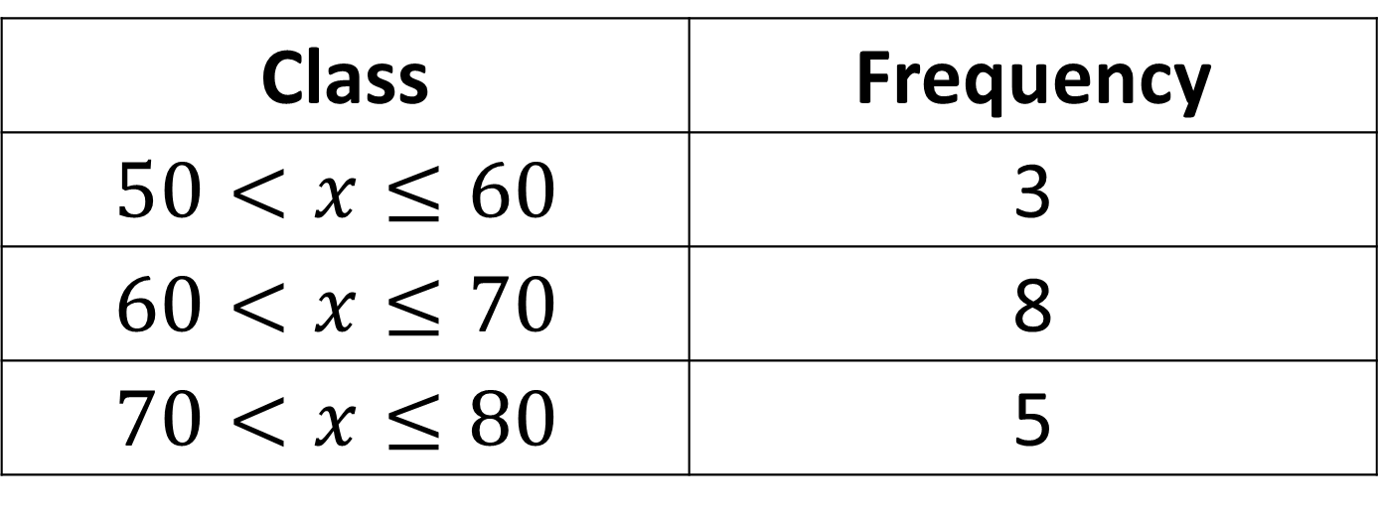

Estimate the mean to one decimal place:
Class | Frequency
$$50<x≤60$$ | 3
$$60<x≤70$$ | 8
$$70<x≤80$$ | 5
$$66.3$$

Slide 7
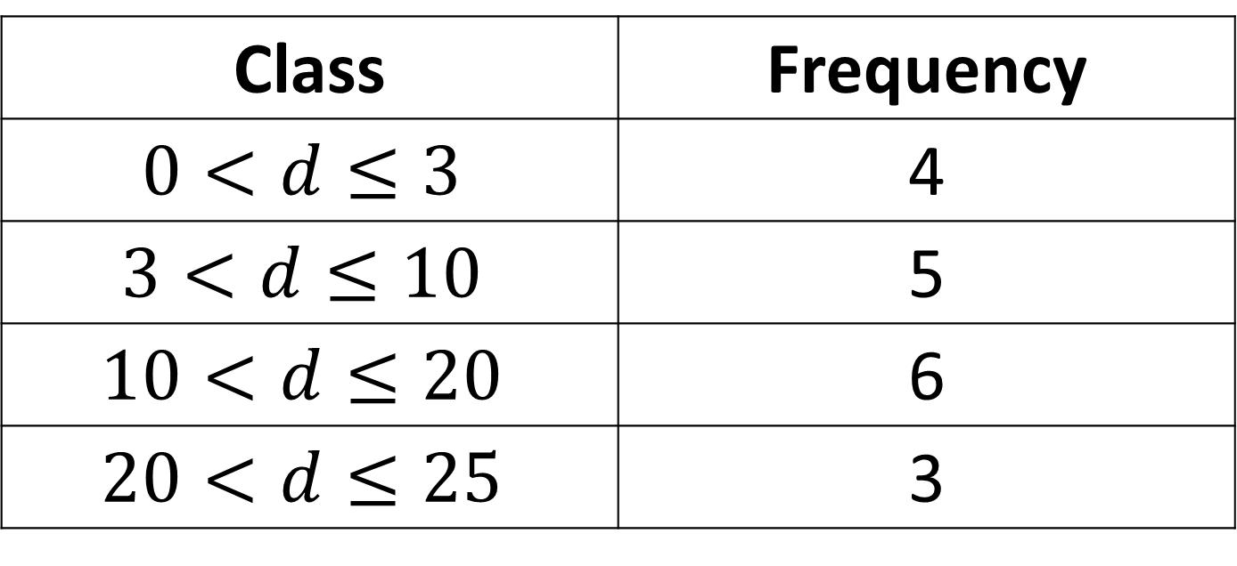

Estimate the mean to one decimal place:
Class | Frequency
$$0<d≤3$$ | 4
$$3<d≤10$$ | 5
$$10<d≤20$$ | 6
$$20<d≤25$$ | 3
$$10.9$$

Slide 8
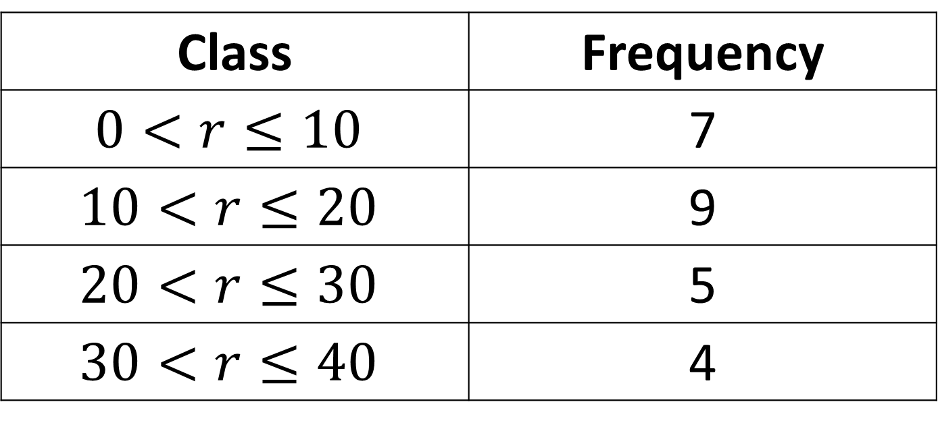

Estimate the mean to one decimal place:
Class | Frequency
$$0<r≤10$$ | 7
$$10<r≤20$$ | 9
$$20<r≤30$$ | 5
$$30<r≤40$$ | 4
$$17.4$$

Slide 9
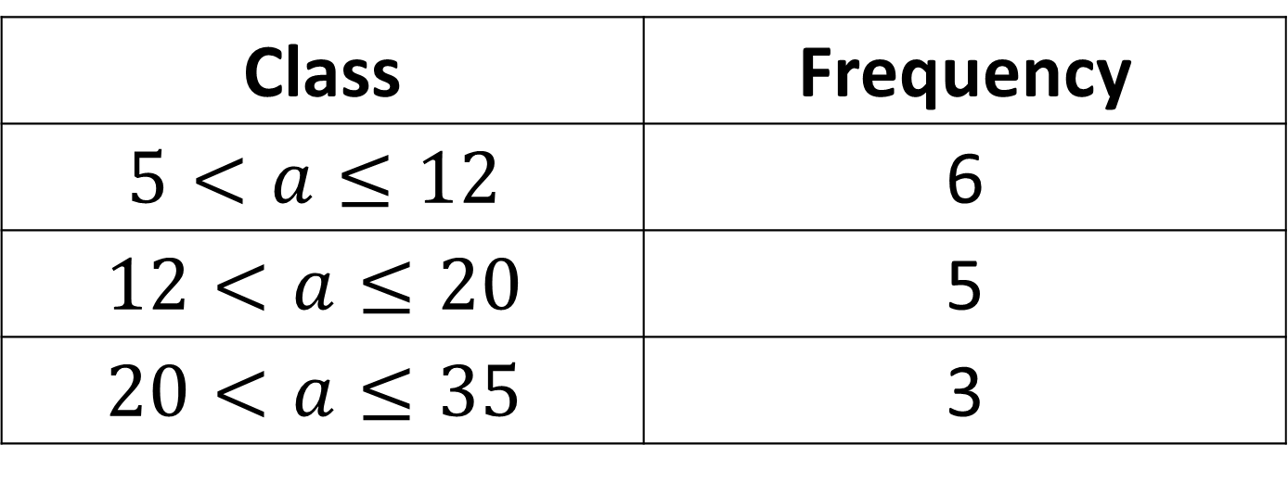

Estimate the mean to one decimal place:
Class | Frequency
$$5<a≤12$$ | 6
$$12<a≤20$$ | 5
$$20<a≤35$$ | 3
$$15.3$$

Slide 10
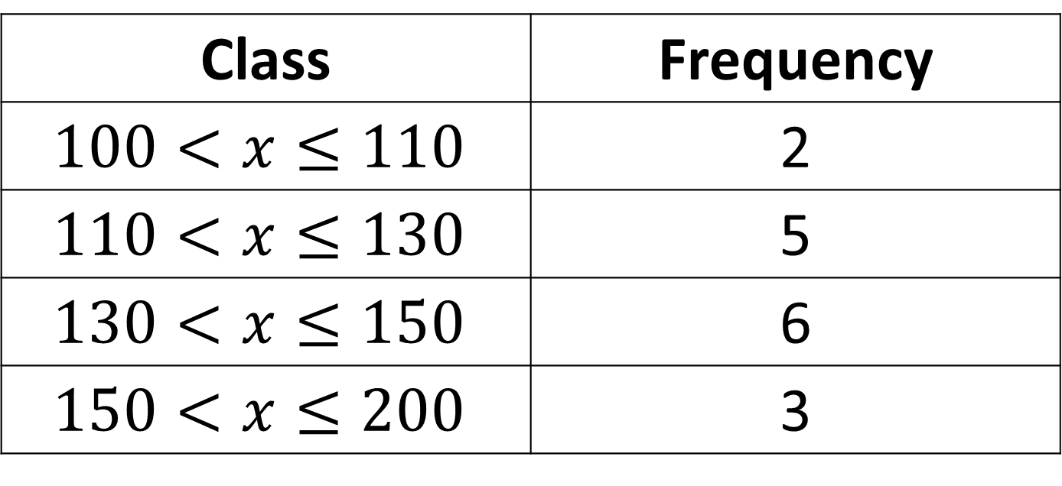

Estimate the mean to one decimal place:
Class | Frequency
$$100<x≤110$$ | 2
$$110<x≤130$$ | 5
$$130<x≤150$$ | 6
$$150<x≤200$$ | 3
$$135.9$$

Slide 11
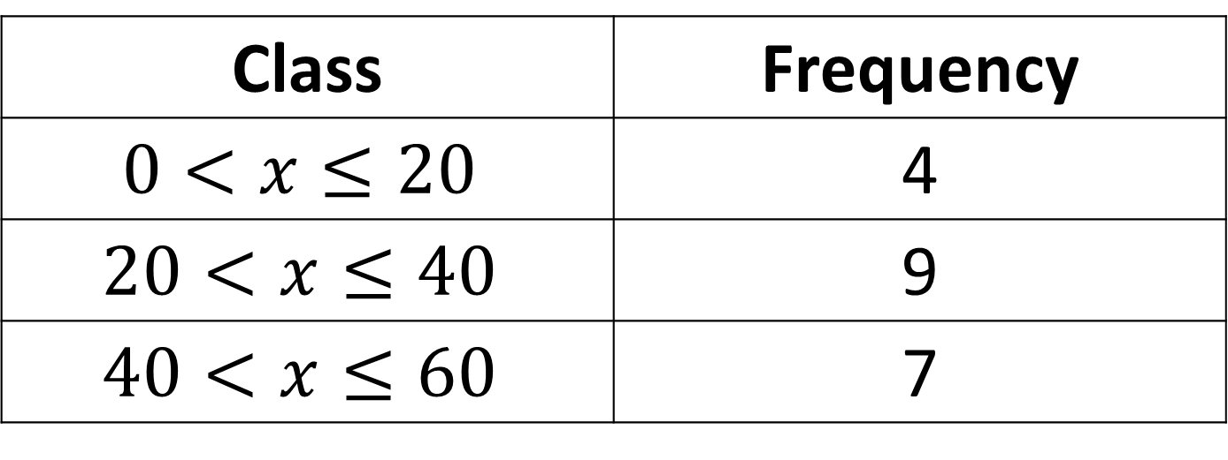

Estimate the mean to one decimal place:
Class | Frequency
$$0<x≤20$$ | 4
$$20<x≤40$$ | 9
$$40<x≤60$$ | 7
$$33.0$$

Slide 12
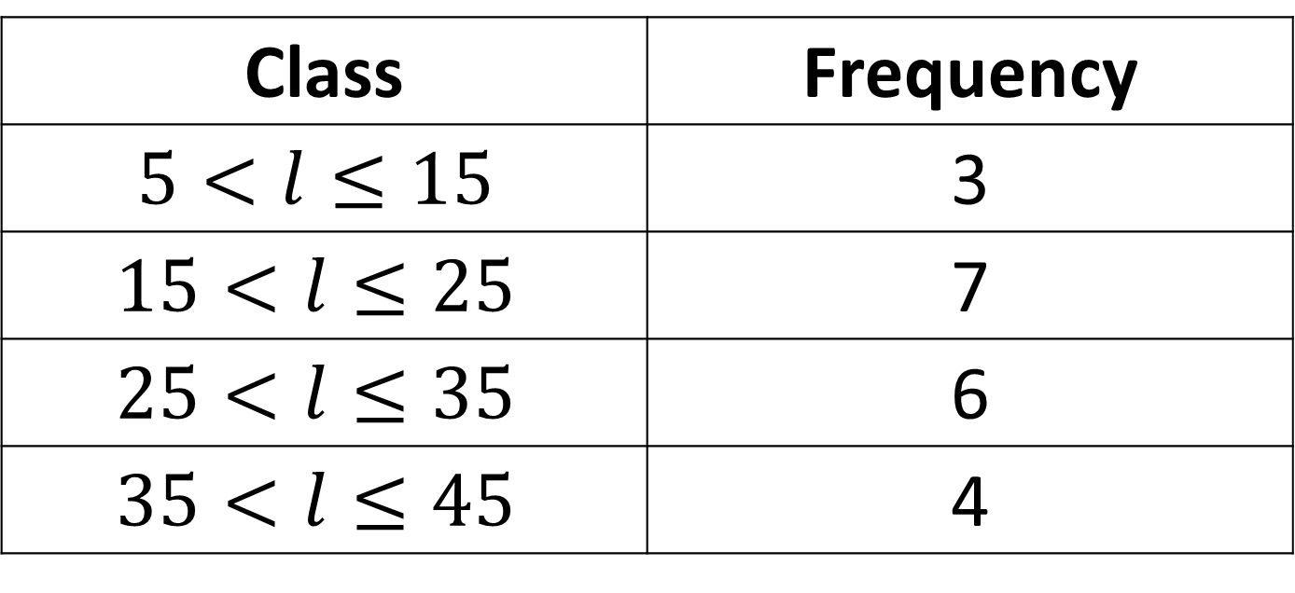

Estimate the mean to one decimal place:
Class | Frequency
$$5<l≤15$$ | 3
$$15<l≤25$$ | 7
$$25<l≤35$$ | 6
$$35<l≤45$$ | 4
$$25.5$$

Slide 13
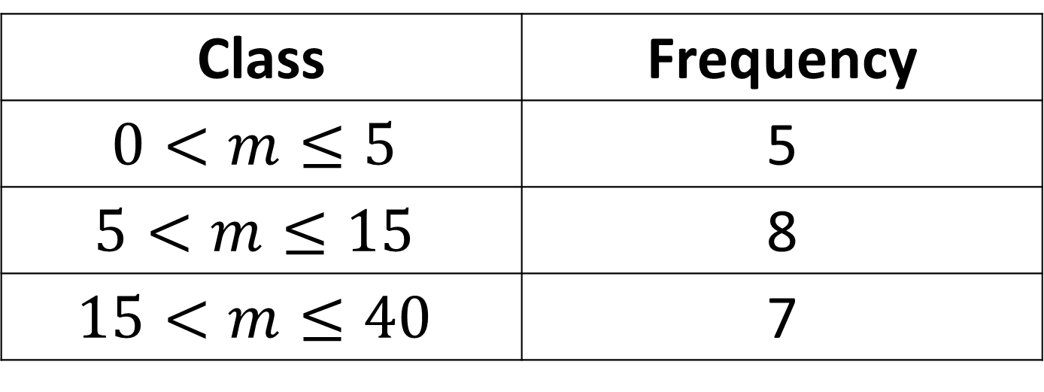

Estimate the mean to one decimal place:
Class | Frequency
$$0<m≤5$$ | 5
$$5<m≤15$$ | 8
$$15<m≤40$$ | 7
$$14.3$$

Slide 14
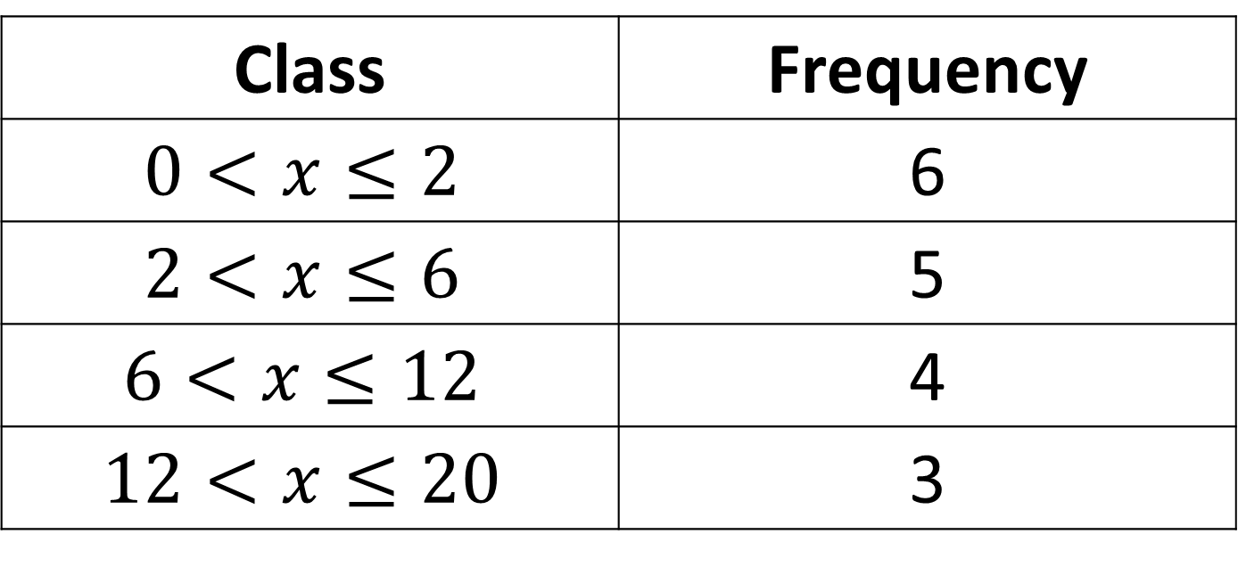

Estimate the mean to one decimal place:
Class | Frequency
$$0<x≤2$$ | 6
$$2<x≤6$$ | 5
$$6<x≤12$$ | 4
$$12<x≤20$$ | 3
$$6.1$$

Slide 15
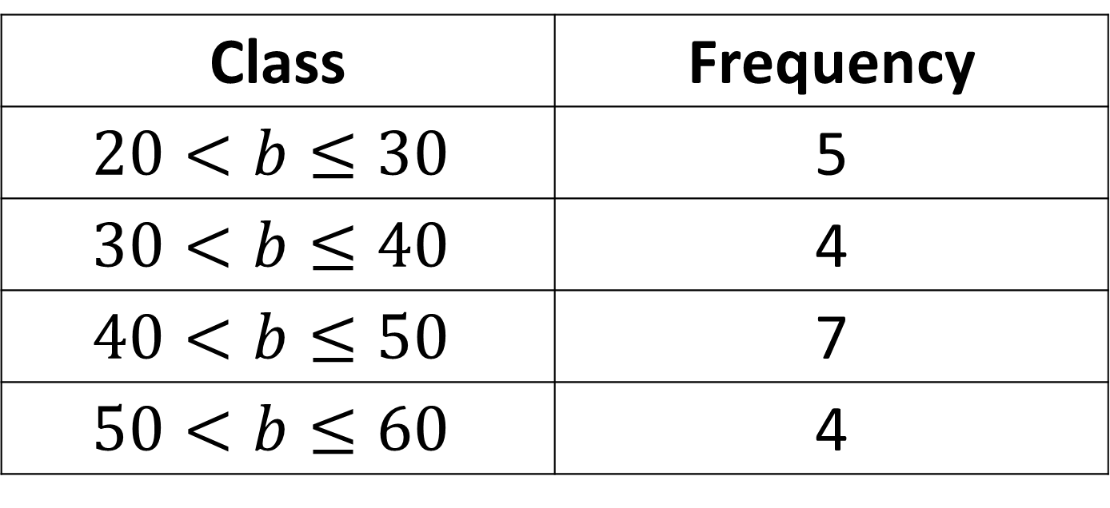

Estimate the mean to one decimal place:
Class | Frequency
$$20<b≤30$$ | 5
$$30<b≤40$$ | 4
$$40<b≤50$$ | 7
$$50<b≤60$$ | 4
$$40.0$$

Slide 16
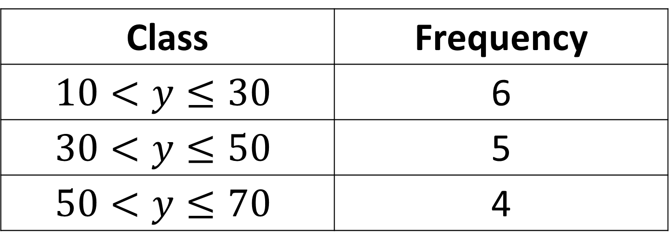

Estimate the mean to one decimal place:
Class | Frequency
$$10<y≤30$$ | 6
$$30<y≤50$$ | 5
$$50<y≤70$$ | 4
$$37.3$$

Slide 17
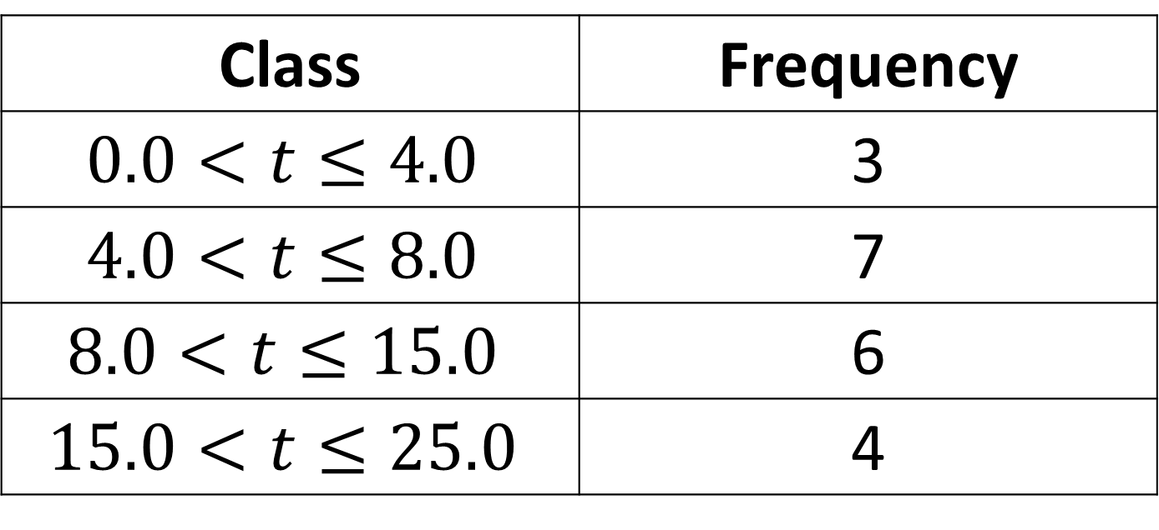

Estimate the mean to one decimal place:
Class | Frequency
$$0.0<t≤4.0$$ | 3
$$4.0<t≤8.0$$ | 7
$$8.0<t≤15.0$$ | 6
$$15.0<t≤25.0$$ | 4
$$9.9$$

Slide 18
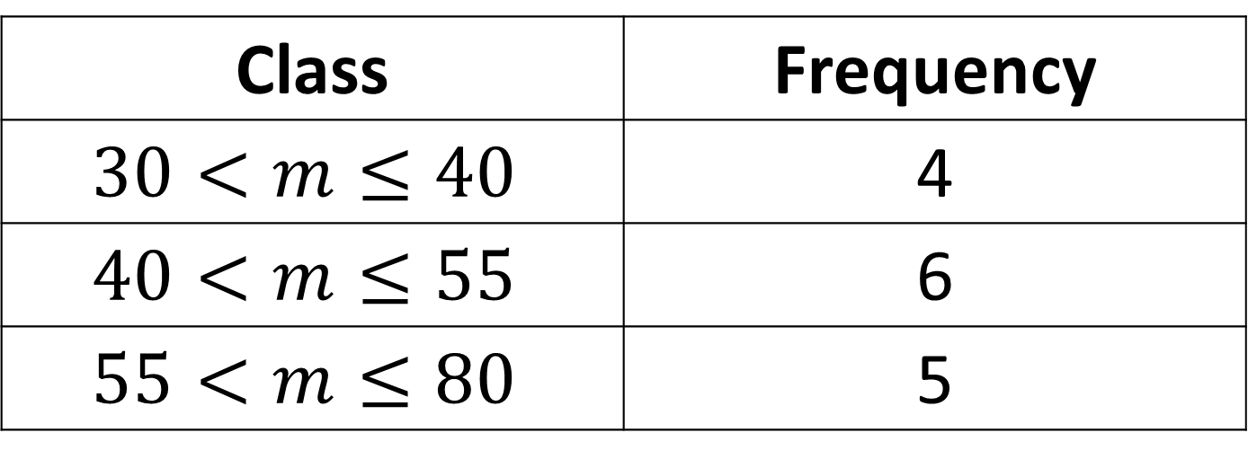

Estimate the mean to one decimal place:
Class | Frequency
$$30<m≤40$$ | 4
$$40<m≤55$$ | 6
$$55<m≤80$$ | 5
$$50.8$$

Slide 19
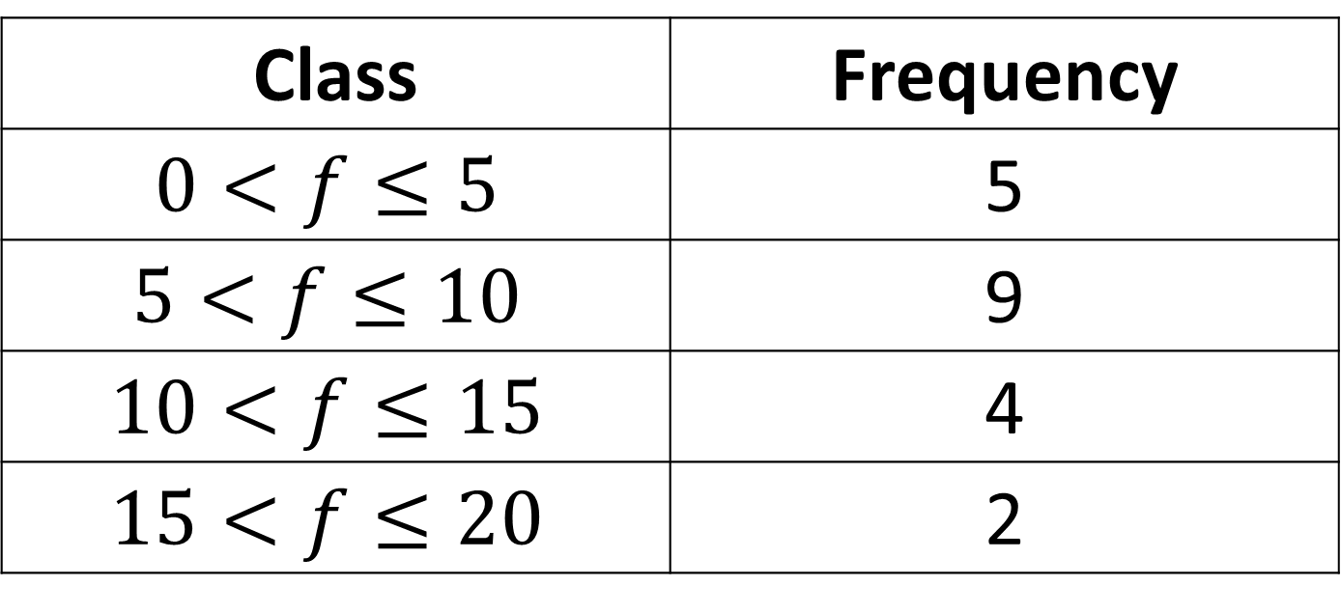

Estimate the mean to one decimal place:
Class | Frequency
$$0<f≤5$$ | 5
$$5<f≤10$$ | 9
$$10<f≤15$$ | 4
$$15<f≤20$$ | 2
$$8.3$$

Slide 20
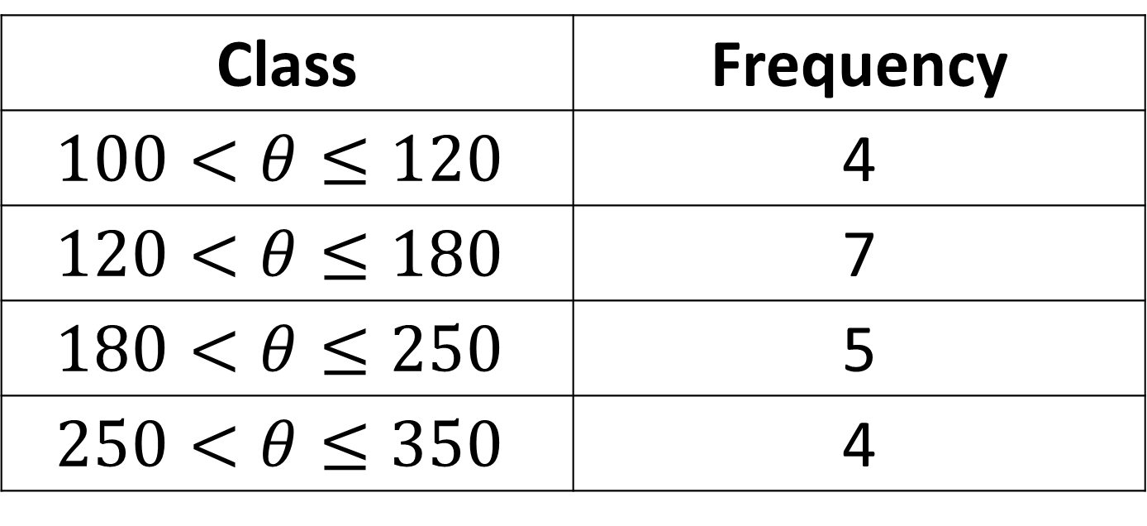

Estimate the mean to the nearest integer:
Class | Frequency
$$100<θ≤120$$ | 4
$$120<θ≤180$$ | 7
$$180<θ≤250$$ | 5
$$250<θ≤350$$ | 4
$$188$$

Slide 21
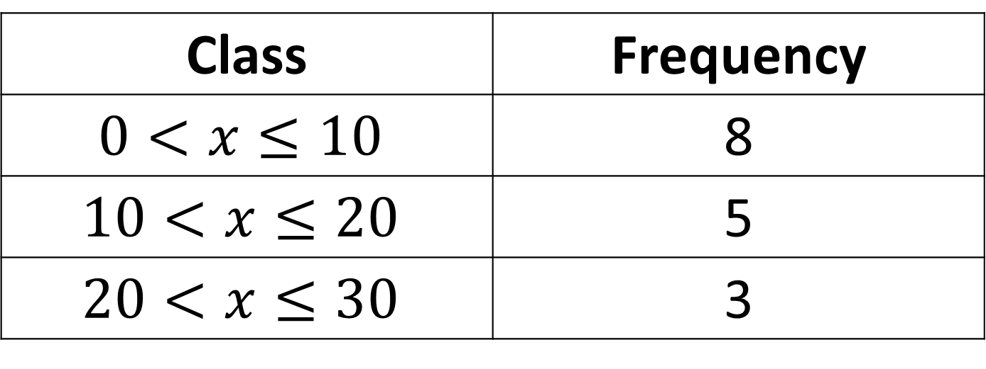

Estimate the mean to one decimal place:
Class | Frequency
$$0<x≤10$$ | 8
$$10<x≤20$$ | 5
$$20<x≤30$$ | 3
$$11.9$$

