Slide 1
Mode
24 June 2026

Slide 2
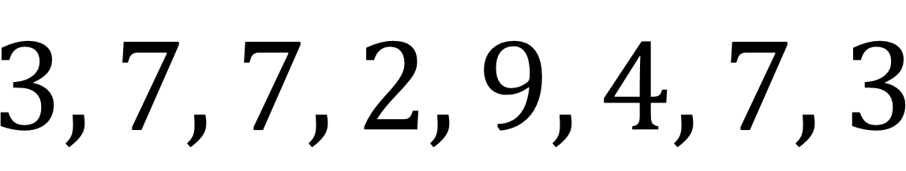

Identify the mode:
$$3, 7, 7, 2, 9, 4, 7, 3$$
$$7$$

Slide 3
True or False:
A data set can have more than one mode.
True

Slide 4
True or False:
Grouped data never has a mode.
False

Slide 5
Identify the mode:
Chicken

Slide 6

Identify the mode:
Value | Frequency
3 | 2
5 | 6
8 | 4
$$5$$

Slide 7
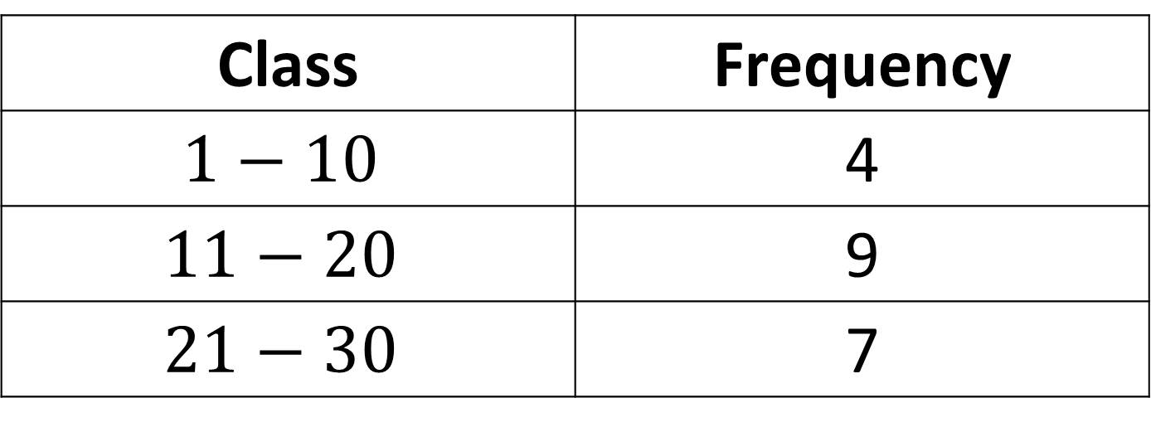

Identify the modal class:
Class | Frequency
$$1−10$$ | 4
$$11−20$$ | 9
$$21−30$$ | 7
$$11−20$$

Slide 8
Identify the mode:
One

Slide 9
Identify the mode:
Red

Slide 10
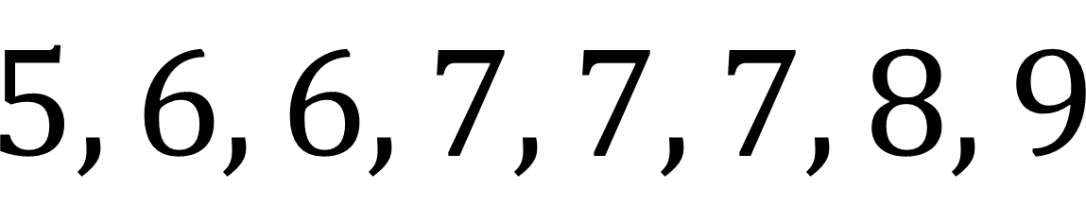
The shoe sizes sold today were:
Find the mode.
$$5, 6, 6, 7, 7, 7, 8, 9$$
$$7$$

Slide 11

Identify the mode:
Value | Frequency
1 | 2
2 | 2
3 | 5
4 | 1
$$3$$

Slide 12
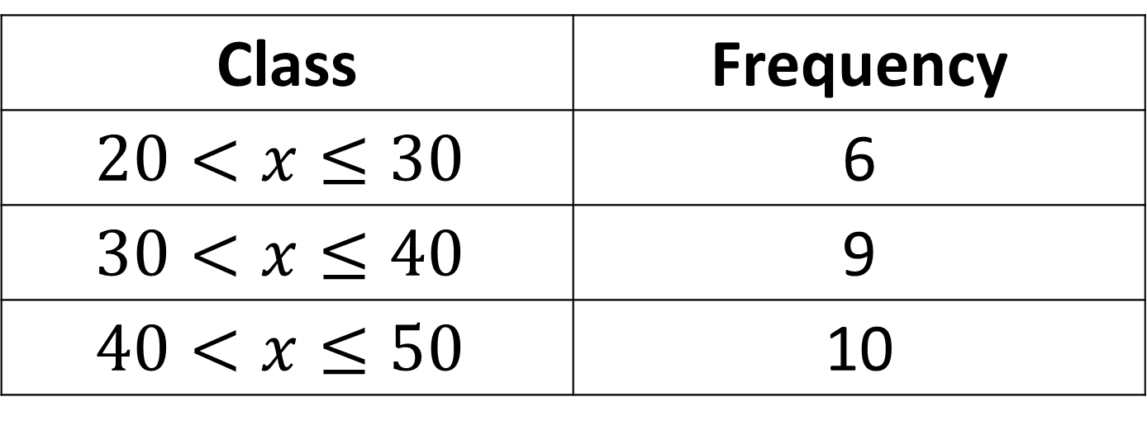
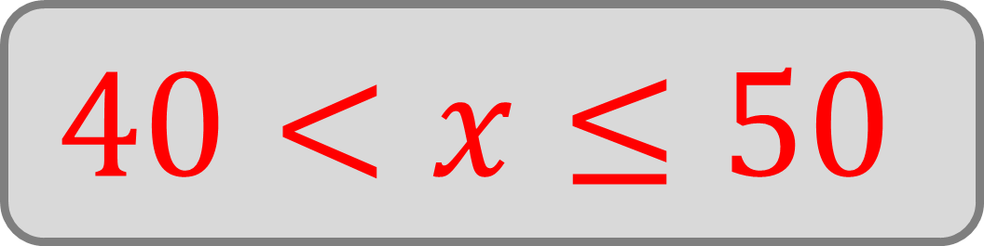
Identify the modal class:
Class | Frequency
$$20<x≤30$$ | 6
$$30<x≤40$$ | 9
$$40<x≤50$$ | 10
$$40<x≤50$$

Slide 13
Identify the mode:
Bus

Slide 14


Identify the mode:
$$12, 14, 12, 15,$$
$$16, 14, 12$$
$$12$$

Slide 15
Identify the mode:
Flavour | Frequency
Chocolate | 4
Banana | 4
Strawberry | 2
Chocolate and Banana

Slide 16
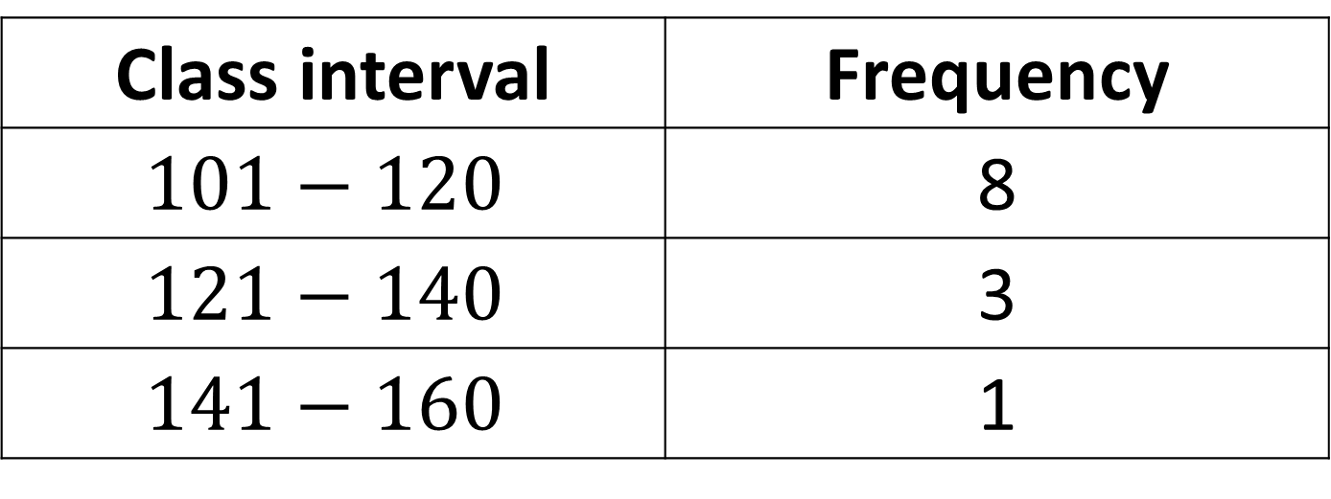
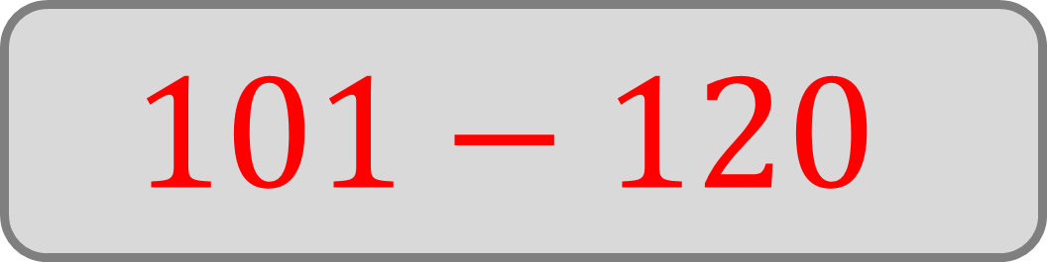
Identify the modal class:
Class interval | Frequency
$$101−120$$ | 8
$$121−140$$ | 3
$$141−160$$ | 1
$$101−120$$

Slide 17

Identify the mode:
$$C$$

Slide 18
Identify the mode:
Cheese

Slide 19
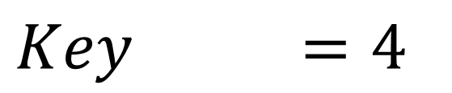
Identify the mode:
Colour
Red
Blue
Black
Green
$$Key =4$$
Red

Slide 20
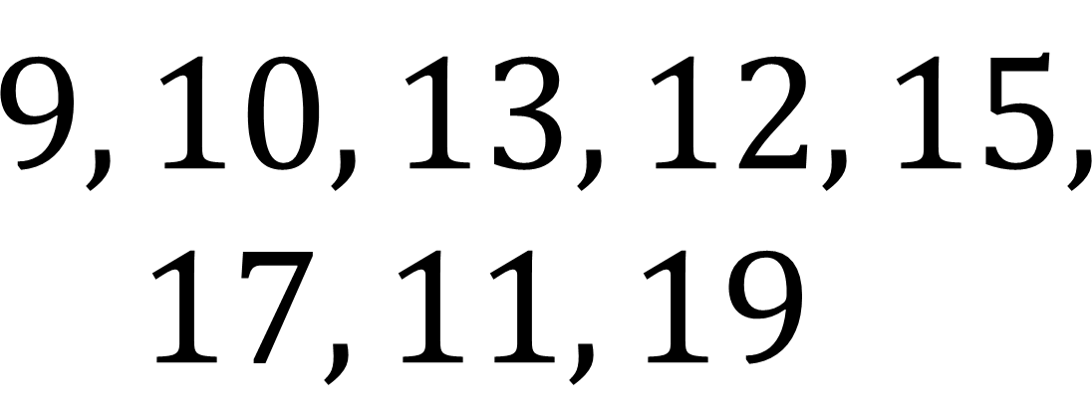
Identify the mode:
$$9, 10, 13, 12, 15,$$
$$17, 11, 19$$
No mode

Slide 21
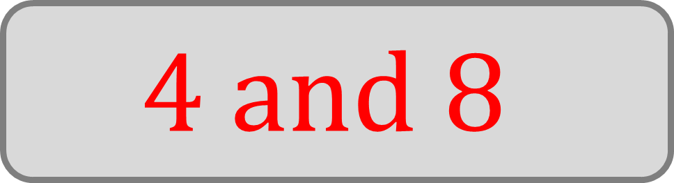
Identify the mode:
Value | Frequency
2 | 1
4 | 5
6 | 3
8 | 5
$$4 and 8$$

