Slide 1
Probability
08 June 2026

Slide 2


Calculate the probability of choosing a red counter from the bag.
× 5
× 3
$$\frac{5}{8}$$

Slide 3

Calculate the probability of choosing a red counter from the bag.
× 7
× 3
$$\frac{7}{10}$$

Slide 4

Calculate the probability of choosing a red counter from the bag.
× 7
× 5
$$\frac{7}{12}$$

Slide 5

Calculate the probability of choosing a blue counter from the bag.
× 7
× 5
$$\frac{5}{15}$$
× 3

Slide 6

Calculate the probability of choosing a blue or red counter from the bag.
× 6
× 2
$$\frac{8}{12}$$
× 4

Slide 7

Calculate the probability of choosing a red counter from the bag.
× 10
× 6
$$\frac{0}{20}$$
× 4

Slide 8

Calculate the probability of choosing a star counter from the bag.
× 10
× 6
$$\frac{10}{20}$$
× 4

Slide 9

Calculate the probability of choosing a blue counter from the bag.
× 10
× 6
$$\frac{20}{20}$$
× 4

Slide 10


A fair six-sided die is rolled.
Find the probability of rolling a four.
$$\frac{1}{6}$$

Slide 11

A fair six-sided die is rolled.
Find the probability of rolling a 5 or 6.
$$\frac{2}{6}$$

Slide 12

A fair six-sided die is rolled.
Find the probability of not rolling a 2.
$$\frac{5}{6}$$

Slide 13
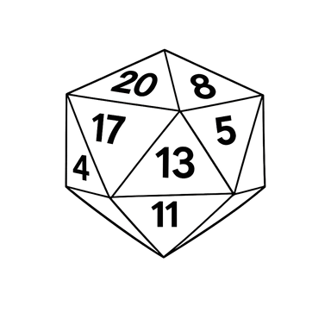

A fair twenty-sided die is rolled.
Find the probability of rolling a number less than 10.
$$\frac{9}{20}$$

Slide 14

A fair twenty-sided die is rolled.
Find the probability of rolling a prime number.
$$\frac{8}{20}$$

Slide 15

A fair twenty-sided die is rolled.
Find the probability of rolling a multiple of three.
$$\frac{6}{20}$$

Slide 16

A fair twenty-sided die is rolled.
Find the probability of rolling a factor of 360.
$$\frac{12}{20}$$

Slide 17

A class of 30 students has 18 girls.
A student is chosen at random.
What is the probability it is a boy?
$$\frac{12}{30}$$

Slide 18

A raffle has 50 tickets.
You buy 4.
What is the probability your ticket is chosen?
$$\frac{4}{50}$$

Slide 19

A bag contains 9 counters: 2 are purple.
What is the probability of not picking a purple counter?
$$\frac{7}{9}$$

Slide 20

A spinner has 4 equal sections:
red, red, blue, yellow.
What is the probability of landing on red?
$$\frac{2}{4}$$

Slide 21

A card is chosen from a set of 10 cards labelled A to J.
What is the probability of choosing a vowel?
$$\frac{3}{10}$$

