Slide 1
Probability
11 June 2026

Slide 2
A student spins a biased spinner; the probabilities are in the table below.
Fill in the blank.
A | B | C | D
0.3 | 0.2 | 0.1
0.4

Slide 3
A student spins a biased spinner; the probabilities are in the table below.
Fill in the blank.
A | B | C | D
0.25 | 0.2 | 0.25
0.3

Slide 4
A student spins a biased spinner; the probabilities are in the table below.
Fill in the blank.
A | B | C | D
0.17 | 0.12 | 0.37
0.34

Slide 5
A student spins a biased spinner; the probabilities are in the table below.
Fill in the blank.
A | B | C | D
0.55 | 0.36 | 0.07
0.02

Slide 6
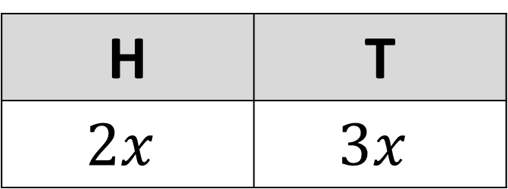


A student flips a biased coin; the probabilities are in the table below.
Find the value of $x$.
H | T
$$2x$$ | $$3x$$
$$x=0.2$$

Slide 7
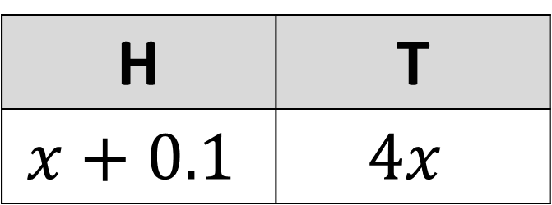

A student flips a biased coin; the probabilities are in the table below.
Find the value of $x$.
H | T
$$x+0.1$$ | $$4x$$
$$x=0.18$$

Slide 8
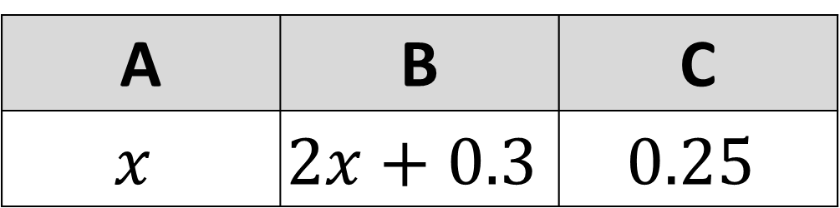


A student spins a biased spinner; the probabilities are in the table below.
Find the value of $x$.
A | B | C
$$x$$ | $$2x+0.3$$ | $$0.25$$
$$x=0.15$$

Slide 9


A student spins a biased spinner; the probabilities are in the table below.
Find the value of $x$.
A | B | C
$$x$$ | $$x−0.2$$ | $$2x$$
$$x=0.3$$

Slide 10
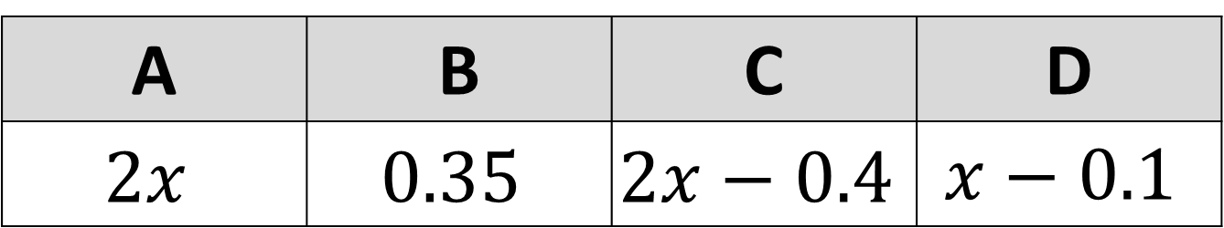

A student spins a biased spinner; the probabilities are in the table below.
Find the value of $x$.
A | B | C | D
$$2x$$ | $$0.35$$ | $$2x−0.4$$ | $$x−0.1$$
$$x=0.23$$

Slide 11
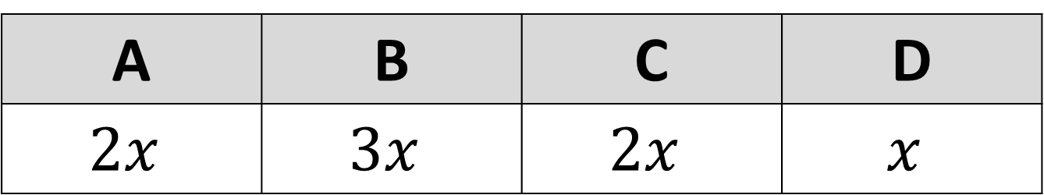

A student spins a biased spinner; the probabilities are in the table below.
Find the value of $x$.
A | B | C | D
$$2x$$ | $$3x$$ | $$2x$$ | $$x$$
$$x=0.125$$

Slide 12

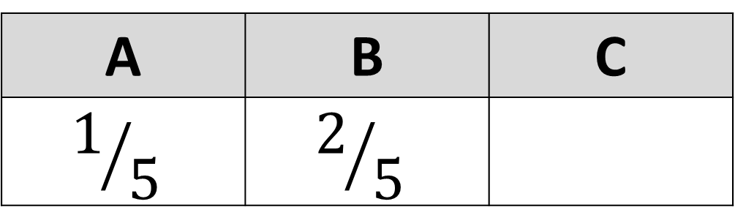
A student spins a biased spinner; the probabilities are in the table below.
Fill in the blank.
A | B | C
$$1/5$$ | $$2/5$$
$$2/5$$

Slide 13

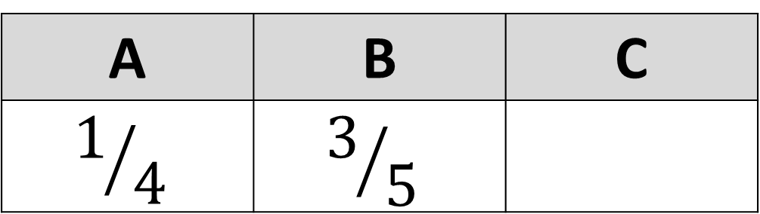
A student spins a biased spinner; the probabilities are in the table below.
Fill in the blank.
A | B | C
$$1/4$$ | $$3/5$$
$$3/{20}$$

Slide 14

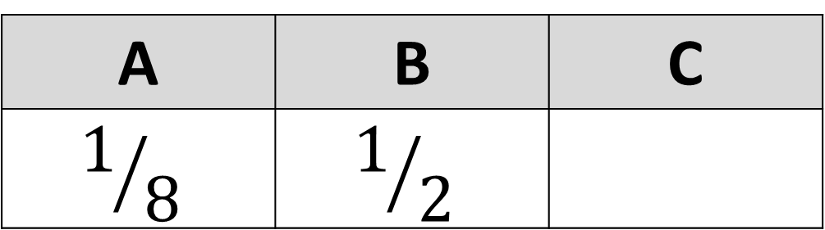
A student spins a biased spinner; the probabilities are in the table below.
Fill in the blank.
A | B | C
$$1/8$$ | $$1/2$$
$$3/8$$

Slide 15


A student spins a biased spinner; the probabilities are in the table below.
Fill in the blank.
A | B | C
$$1/4$$ | $$1/4$$
$$7/{12}$$

Slide 16


A student spins a biased spinner; the probabilities are in the table below.
Fill in the blank.
A | B | C
$$1/{12}$$ | $$1/2$$
$$5/{12}$$

Slide 17

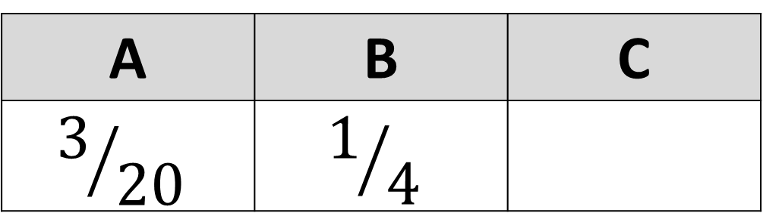
A student spins a biased spinner; the probabilities are in the table below.
Fill in the blank.
A | B | C
$$3/{20}$$ | $$1/4$$
$$9/{20}$$

Slide 18
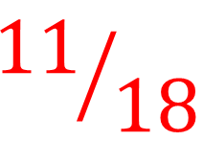

A student spins a biased spinner; the probabilities are in the table below.
Fill in the blank.
A | B | C
$$5/{18}$$ | $$1/9$$
$${11}/{18}$$

Slide 19

A student spins a biased spinner; the probabilities are in the table below.
Fill in the blank.
A | B | C
$$1/{10}$$ | $$1/2$$
$$2/5$$

Slide 20

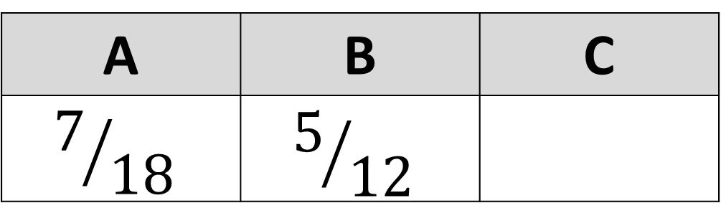
A student spins a biased spinner; the probabilities are in the table below.
Fill in the blank.
A | B | C
$$7/{18}$$ | $$5/{12}$$
$$1/9$$

Slide 21
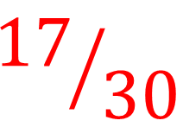
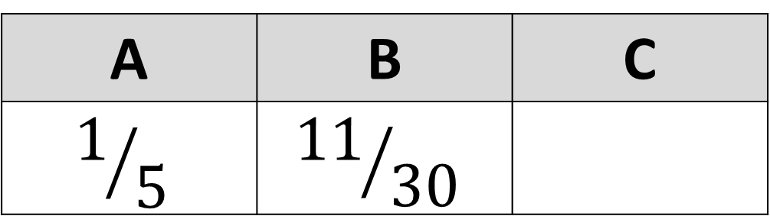
A student spins a biased spinner; the probabilities are in the table below.
Fill in the blank.
A | B | C
$$1/5$$ | $${11}/{30}$$
$${17}/{30}$$

