Slide 1
Probability
10 June 2026

Slide 2






A student checks the weather forecast for Monday and Tuesday.
The probability it snows on Monday is 0.1
The probability it snows on Tuesday is 0.2
Complete the probability tree diagram.
Monday
Tuesday
$$0.2$$
Snow
$$0.1$$
Snow
$$0.8$$
Clear
$$0.2$$
Snow
$$0.9$$
Clear
$$0.8$$
Clear

Slide 3









A student checks the weather forecast for Monday and Tuesday.
The probability it snows on Monday is 0.1
The probability it snows on Tuesday is 0.2
What is the probability it snows on both days?
Monday
Tuesday
$$0.2$$
Snow
$$0.1×0.2=0.02$$
$$0.1$$
Snow
$$0.8$$
Clear
$$0.1×0.8=0.08$$
$$0.2$$
Snow
$$0.9×0.2=0.18$$
$$0.9$$
Clear
$$0.02$$
$$0.8$$
Clear
$$0.9×0.8=0.72$$

Slide 4






An owner is playing catch with their dog.
The probability they catch the ball is 0.3
They throw the ball twice.
Complete the probability tree diagram.
1st
2nd
$$0.3$$
Catch
$$0.3$$
Catch
$$0.7$$
Miss
$$0.3$$
Catch
$$0.7$$
Miss
$$0.7$$
Miss

Slide 5






An owner is playing catch with their dog.
The probability they catch the ball is 0.3
They throw the ball twice.
Calculate the dog misses then catches the ball
1st
2nd
$$0.3$$
Catch
$$0.3$$
Catch
$$0.7$$
Miss
$$0.3$$
Catch
$$0.7×0.3=0.21$$
$$0.7$$
Miss
$$0.21$$
$$0.7$$
Miss

Slide 6


An owner is playing catch with their dog.
The probability they catch the ball is 0.3
They throw the ball twice.
Calculate the catches the ball once
1st
2nd
$$0.3$$
Catch
$$0.3$$
Catch
$$0.7$$
Miss
$$0.3×0.7=0.21$$
$$0.3$$
Catch
$$0.7×0.3=0.21$$
$$0.7$$
Miss
$$0.41$$
$$0.7$$
Miss

Slide 7






A student flips a biased coin twice.
The probability it shows heads is 0.6
Complete the probability tree diagram.
1st
2nd
$$0.6$$
Heads
$$0.6$$
Heads
$$0.4$$
Tails
$$0.6$$
Heads
$$0.4$$
Tails
$$0.4$$
Tails

Slide 8




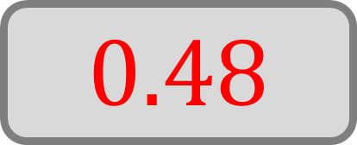


A student flips a biased coin twice.
The probability it shows heads is 0.6
What is the probability they get exactly one heads?
1st
2nd
$$0.6$$
Heads
$$0.6$$
Heads
$$0.4$$
Tails
$$0.6×0.4=0.24$$
$$0.6$$
Heads
$$0.4×0.6=0.24$$
$$0.4$$
Tails
$$0.48$$
$$0.4$$
Tails

Slide 9






A contest on a game-show has a probability of 0.8 to win a prize.
They spin the wheel twice.
Complete the probability tree diagram.
1st
2nd
$$0.8$$
Prize
$$0.8$$
Prize
$$0.2$$
No prize
$$0.8$$
Prize
No
prize
$$0.2$$
$$0.2$$
No prize

Slide 10





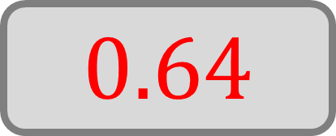
A contest on a game-show has a probability of 0.8 to win a prize.
They spin the wheel twice.
Calculate the probability they win two prizes
1st
2nd
$$0.8$$
Prize
$$0.8×0.8=0.64$$
$$0.8$$
Prize
$$0.2$$
No prize
$$0.8$$
Prize
No
prize
$$0.2$$
$$0.64$$
$$0.2$$
No prize

Slide 11






A pupil is either late or on-time.
The probability they are late on Wednesday is 0.25
The probability they are on-time on Friday is 0.85
Complete the probability tree diagram.
Wednesday
Friday
$$0.15$$
Late
$$0.25$$
Late
$$0.85$$
On-time
$$0.15$$
Late
$$0.75$$
On-time
$$0.85$$
On-time

Slide 12





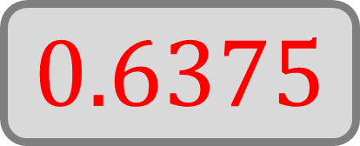
A pupil is either late or on-time.
The probability they are late on Wednesday is 0.25
The probability they are on-time on Friday is 0.85
What is the probability they are on-time on both days?
Wednesday
Friday
$$0.15$$
Late
$$0.25$$
Late
$$0.85$$
On-time
$$0.15$$
Late
$$0.75$$
On-time
$$0.75×0.85=0.6375$$
$$0.6375$$
$$0.85$$
On-time

Slide 13




A student has a history exam and a science exam.
The probability they pass their history exam is 0.8
The probability they pass their science exam is 0.7
Complete the probability tree diagram.
History
Science
$$0.7$$
Pass
$$0.8$$
Pass
$$0.3$$
Fail
$$0.7$$
Pass
$$0.2$$
Fail
$$0.3$$
Fail

Slide 14




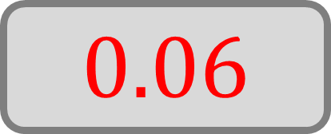
A student has a history exam and a science exam.
The probability they pass their history exam is 0.8
The probability they pass their science exam is 0.7
Calculate the probability they fail both exams?
History
Science
$$0.7$$
Pass
$$0.8$$
Pass
$$0.3$$
Fail
$$0.7$$
Pass
$$0.2$$
Fail
$$0.2×0.3=0.06$$
$$0.06$$
$$0.3$$
Fail

Slide 15

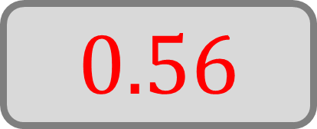
A student has a history exam and a science exam.
The probability they pass their history exam is 0.8
The probability they pass their science exam is 0.7
Calculate the probability they pass both exams?
History
Science
$$0.7$$
Pass
$$0.8×0.7=0.56$$
$$0.8$$
Pass
$$0.3$$
Fail
$$0.7$$
Pass
$$0.2$$
Fail
$$0.56$$
$$0.3$$
Fail

Slide 16




A student plays a game of chess and a volleyball match.
The probability they win at chess is 0.6
The probability they win volleyball is 0.1
Complete the probability tree diagram.
Chess
Volleyball
$$0.1$$
Win
$$0.6$$
Win
$$0.9$$
Lose
$$0.1$$
Win
$$0.4$$
Lose
$$0.9$$
Lose

Slide 17

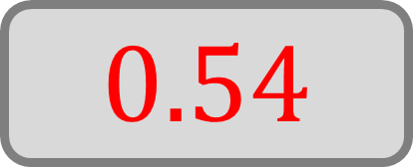






A student plays a game of chess and a volleyball match.
The probability they win at chess is 0.6
The probability they win volleyball is 0.1
What is the probability of the most likely outcome.
Chess
Volleyball
$$0.1$$
Win
$$0.6×0.1=0.6$$
$$0.6$$
Win
$$0.9$$
Lose
$$0.6×0.9=0.54$$
$$0.1$$
Win
$$0.4×0.1=0.04$$
$$0.4$$
Lose
$$0.54$$
$$0.9$$
Lose
$$0.4×0.9=0.36$$

Slide 18




A salesman has two customers; the probability they make a sale is 0.25
Complete the probability tree diagram.
Customer 1
Customer 2
$$0.25$$
Sale
$$0.25$$
Sale
$$0.75$$
No sale
$$0.25$$
Sale
No
sale
$$0.75$$
$$0.75$$
No sale

Slide 19

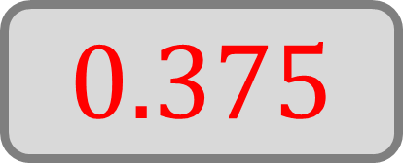

A salesman has two customers; the probability they make a sale is 0.25
What is the probability they sell one item?
Customer 1
Customer 2
$$0.25$$
Sale
$$0.25$$
Sale
$$0.25×0.75=0.1875$$
$$0.75$$
No sale
$$0.25$$
Sale
No
sale
$$0.25×0.75=0.1875$$
$$0.75$$
$$0.375$$
$$0.75$$
No sale

Slide 20






A student has a chemistry test and a geography test.
The probability they pass their chemistry test is 0.4
The probability they pass their geography test is 0.65
Complete the probability tree diagram.
Chemistry
Geography
$$0.65$$
Pass
$$0.4$$
Pass
$$0.35$$
Fail
$$0.65$$
Pass
$$0.6$$
Fail
$$0.35$$
Fail

Slide 21


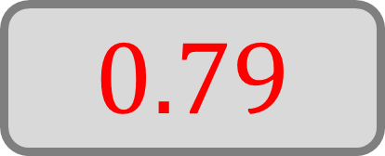






A student has a chemistry test and a geography test.
The probability they pass their chemistry test is 0.4
The probability they pass their geography test is 0.65
What is the probability they pass at least one of their tests?
Chemistry
Geography
$$0.65$$
Pass
$$0.4×0.65=0.26$$
$$0.4$$
Pass
$$0.35$$
Fail
$$0.4×0.35=0.14$$
$$0.65$$
Pass
$$0.6×0.65=0.39$$
$$0.6$$
Fail
$$0.79$$
$$0.35$$
Fail
$$0.6×0.35=0.21$$

