Slide 1
Angles
08 June 2026

Slide 2




Label the lines AB and CD to show they are parallel.
$$A$$
$$B$$
$$C$$
$$D$$

Slide 3



Find the value of $x$.
State the angle fact you used.
$$x°$$
$$114°$$
Alternate

Slide 4


Find the value of $x$.
State the angle fact you used.
$$x°$$
$$72°$$
Corresponding

Slide 5




Find the value of $x$.
State the angle fact you used.
$$129°$$
$$51°$$
$$x°$$
$$x=51°$$
Alternate

Slide 6


Find the value of $x$.
State the angle fact you used.
$$x°$$
$$61°$$
Vertically opposite

Slide 7


Find the value of $x$.
State the angle fact you used.
$$43°$$
$$x°$$
Co-interior

Slide 8


Find the value of $x$.
State the angle fact you used.
$$x°$$
$$130°$$
Corresponding

Slide 9

Find the value of $x$.
State the angle fact you used.
$$x°$$
$$79°$$
Co-interior

Slide 10



Find the value of $x$.
State the angle fact you used.
$$x°$$
$$129°$$
$$51°$$
$$x=78°$$
Corresponding

Slide 11


Find the value of $x$.
State the angle fact you used.
$$125°$$
$$x°$$
Angles on straight line

Slide 12

Find the value of $x$.
State the angle fact you used.
$$107°$$
$$x°$$
Alternate

Slide 13

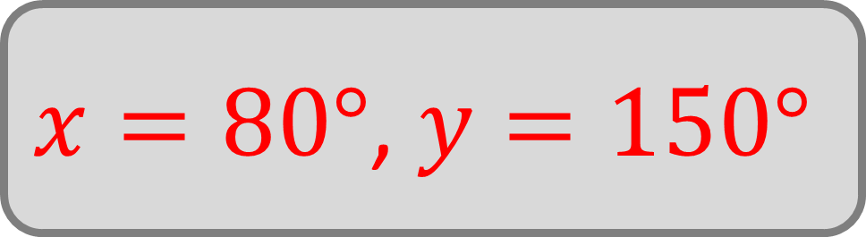








Calculate the values of $x$ and $y$ in trapezium $ABCD$.
$$A$$
$$B$$
$$100°$$
$$y°$$
$$x°$$
$$110−x°$$
$$D$$
$$C$$
$$x=80°\text{,} y=150°$$

Slide 14

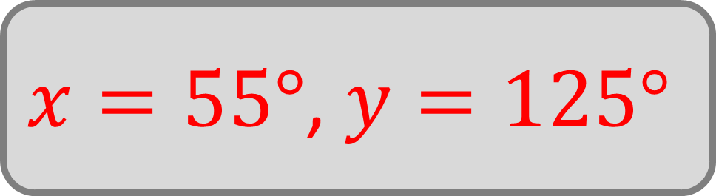







Calculate the values of $x$ and $y$ in isosceles trapezium $ABCD$.
$$A$$
$$B$$
$$125°$$
$$y°$$
$$x°$$
$$D$$
$$C$$
$$x=55°\text{,} y=125°$$

Slide 15






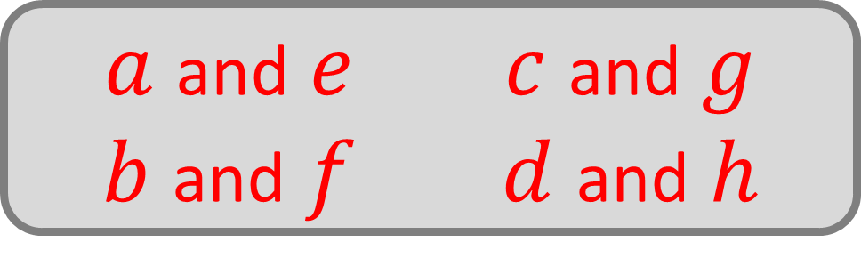


State a pair of angles that are corresponding:
$$a$$
$$b$$
$$d$$
$$c$$
$$e$$
$$f$$
$$h$$
$$g$$
$a$ and $e$
$b$ and $f$
$c$ and $g$
$d$ and $h$

Slide 16






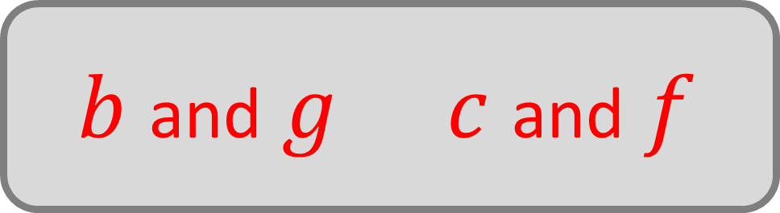


State a pair of angles that are alternate:
$$a$$
$$b$$
$$c$$
$$d$$
$$e$$
$$f$$
$$g$$
$$h$$
$b$ and $g$
$c$ and $f$

Slide 17
True or false:
There are four pairs of vertically opposite angles.
$$a$$
$$b$$
$$c$$
$$d$$
$$e$$
$$f$$
$$g$$
$$h$$
True

Slide 18





True or false:
Angles $b$ and $g$ are alternate
$$a$$
$$b$$
$$c$$
$$d$$
$$e$$
$$f$$
$$g$$
$$h$$
False

Slide 19




True or false:
$x=141°$
$$141°$$
$$x°$$
$$37°$$
False

Slide 20


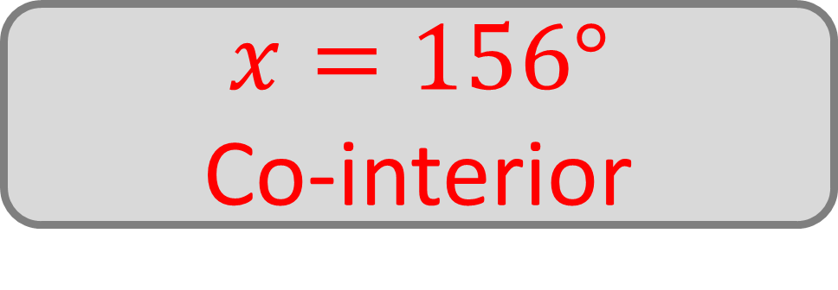

Find the value of $x$.
State the angle fact you used.
$$18°$$
$$24°$$
$$x°$$
$$x=156°$$
Co-interior

Slide 21












Which pair of line segments are parallel?
$$F$$
$$A$$
$$H$$
$$C$$
$$21°$$
$$21°$$
$$B$$
$$107°$$
$$E$$
$$D$$
$$107°$$
$$G$$
EF and GH

