Slide 1
Trigonometry
16 June 2026

Slide 2

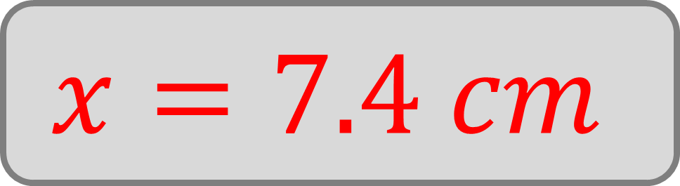




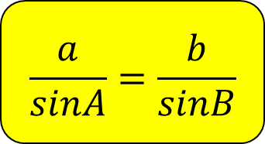
Find the length $x$.
Give your answer to one decimal place.
$$60°$$
$$x$$
$$\frac{a}{sinA}=\frac{b}{sinB}$$
$$40°$$
$$10 cm$$
$$x=7.4 cm$$
Not drawn
accurately

Slide 3

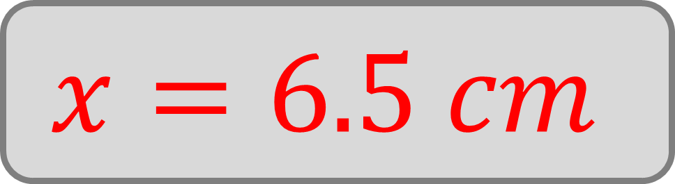

Find the length $x$.
Give your answer to one decimal place.
$$10 cm$$
$$x$$
$$\frac{a}{sinA}=\frac{b}{sinB}$$
$$80°$$
$$40°$$
$$x=6.5 cm$$
Not drawn
accurately

Slide 4

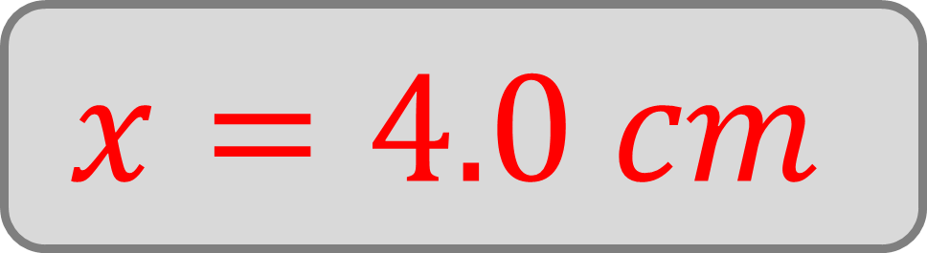



Find the length $x$.
Give your answer to one decimal place.
$$85°$$
$$x$$
$$\frac{a}{sinA}=\frac{b}{sinB}$$
$$25°$$
$$9.4 cm$$
$$x=4.0 cm$$
Not drawn
accurately

Slide 5

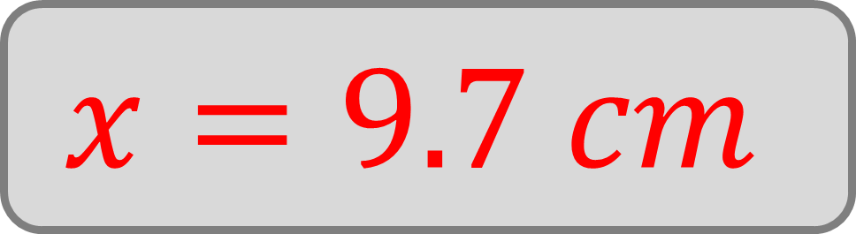



Find the length $x$.
Give your answer to one decimal place.
$$3.1 cm$$
$$x$$
$$\frac{a}{sinA}=\frac{b}{sinB}$$
$$45°$$
$$13°$$
$$x=9.7 cm$$
Not drawn
accurately

Slide 6

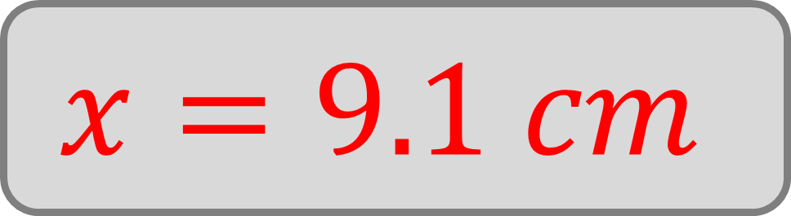



Find the length $x$.
Give your answer to one decimal place.
$$51°$$
$$x$$
$$\frac{a}{sinA}=\frac{b}{sinB}$$
$$62°$$
$$8 cm$$
$$x=9.1 cm$$
Not drawn
accurately

Slide 7

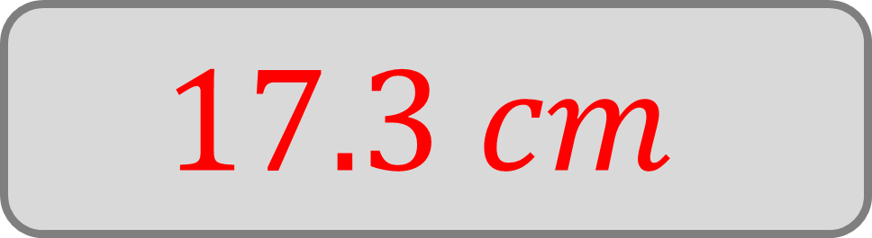






$AC$ is $13 cm$. Find the length $BC$.
Give your answer to one decimal place.
$$A$$
$$55°$$
$$\frac{a}{sinA}=\frac{b}{sinB}$$
$$B$$
$$87°$$
$$38°$$
$$C$$
$$17.3 cm$$
Not drawn
accurately

Slide 8








$BC$ is $6.8 cm$. Find the length $AC$.
Give your answer to one decimal place.
$$A$$
$$53°$$
$$\frac{a}{sinA}=\frac{b}{sinB}$$
$$C$$
$$105°$$
$$22°$$
$$B$$
$$8.2 cm$$
Not drawn
accurately

Slide 9

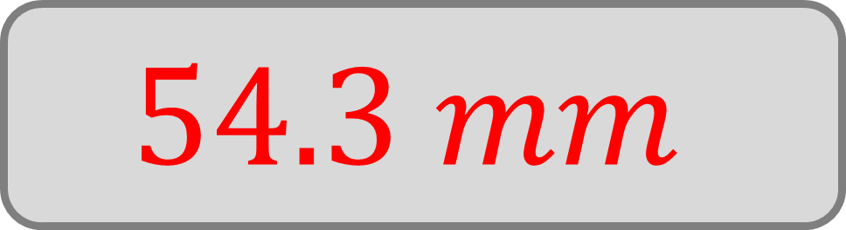






$BA$ is $31 mm$. Find the length $AC$.
Give your answer to one decimal place.
$$A$$
$$117°$$
$$\frac{a}{sinA}=\frac{b}{sinB}$$
$$B$$
$$41°$$
$$C$$
$$22°$$
$$54.3 mm$$
Not drawn
accurately

Slide 10

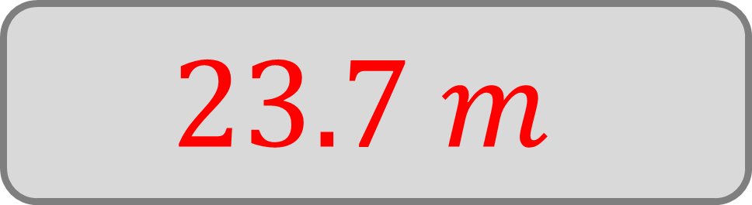





$AB$ is $16 m$. Find the length $CA$.
Give your answer to one decimal place.
$$A$$
$$\frac{a}{sinA}=\frac{b}{sinB}$$
$$38°$$
$$C$$
$$66°$$
$$B$$
$$23.7 m$$
Not drawn
accurately

Slide 11







$AB$ is $2.7 cm$. Find the length $BC$.
Give your answer to one decimal place.
$$C$$
$$75°$$
$$B$$
$$\frac{a}{sinA}=\frac{b}{sinB}$$
$$40°$$
$$2.5 cm$$
$$A$$
Not drawn
accurately

Slide 12
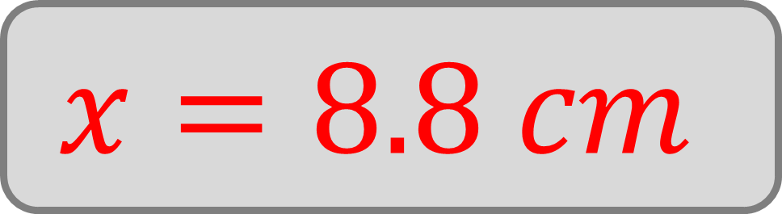


Find the length $x$.
Give your answer to one decimal place.
$$54°$$
$$x$$
$$\frac{a}{sinA}=\frac{b}{sinB}$$
$$8 cm$$
$$x=8.8 cm$$
Not drawn
accurately

Slide 13
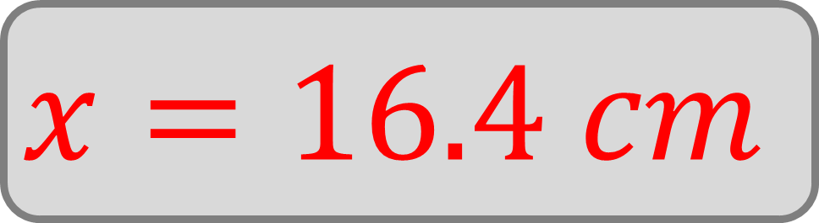



Find the length $x$.
Give your answer to one decimal place.
$$78°$$
$$13 cm$$
$$\frac{a}{sinA}=\frac{b}{sinB}$$
$$x$$
$$x=16.4 cm$$
Not drawn
accurately

Slide 14

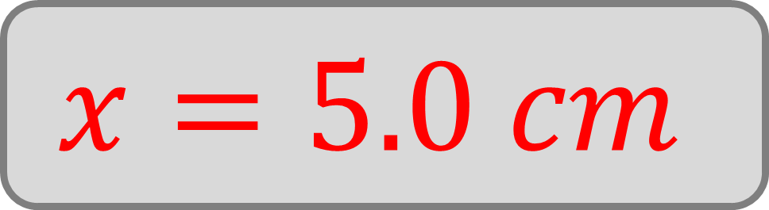






$PQS$ is a straight line. Find the length $PQ$.
Give your answer to one decimal place.
$$R$$
$$5.9 cm$$
$$\frac{a}{sinA}=\frac{b}{sinB}$$
$$115°$$
$$P$$
$$Q$$
$$S$$
$$x=5.0 cm$$
Not drawn
accurately

Slide 15

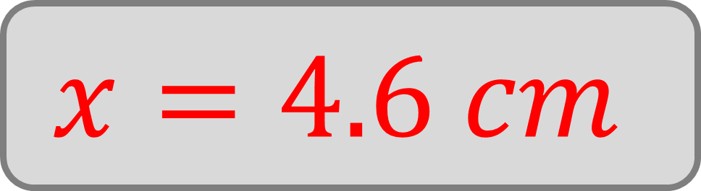



Find the length $x$.
Give your answer to one decimal place.
$$94°$$
$$\frac{a}{sinA}=\frac{b}{sinB}$$
$$x$$
$$153°$$
$$10 cm$$
$$x=4.6 cm$$
Not drawn
accurately

Slide 16

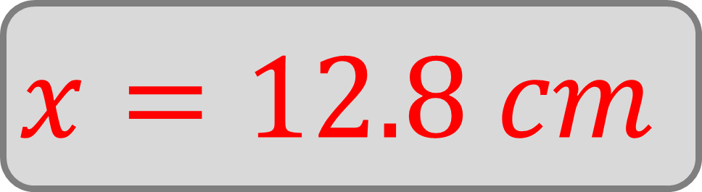



Find the length $x$.
Give your answer to one decimal place.
$$8.5 cm$$
$$\frac{a}{sinA}=\frac{b}{sinB}$$
$$35°$$
$$x$$
$$140°$$
$$x=12.8 cm$$
Not drawn
accurately

Slide 17
True or false:
The sine rule does not work for right-angled triangles.
$$\frac{a}{sinA}=\frac{b}{sinB}$$
False

Slide 18










Which length is greater $x$ or $y$.
$$x$$
$$60°$$
$$10 cm$$
$$60°$$
$$\frac{a}{sinA}=\frac{b}{sinB}$$
$$40°$$
$$40°$$
$$10 cm$$
$$y$$
$$y$$
Not drawn
accurately

Slide 19


Find the exact value of $xy$.
$$x$$
$$60°$$
$$10 cm$$
$$60°$$
$$\frac{a}{sinA}=\frac{b}{sinB}$$
$$40°$$
$$40°$$
$$10 cm$$
$$y$$
$$100$$
Not drawn
accurately

Slide 20


Find the value of $x/y$
Give your answer to two decimal places.
$$x$$
$$60°$$
$$10 cm$$
$$60°$$
$$\frac{a}{sinA}=\frac{b}{sinB}$$
$$40°$$
$$40°$$
$$10 cm$$
$$y$$
$$0.55$$
Not drawn
accurately

Slide 21





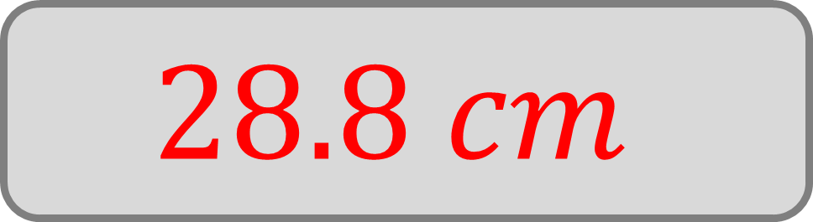


Find the perimeter of triangle $ABC$.
Give your answer to one decimal place.
$$C$$
$$60°$$
$$\frac{a}{sinA}=\frac{b}{sinB}$$
$$40°$$
$$A$$
$$10 cm$$
$$B$$
$$28.8 cm$$
Not drawn
accurately

