Slide 1
Accuracy
23 September 2026

Slide 2

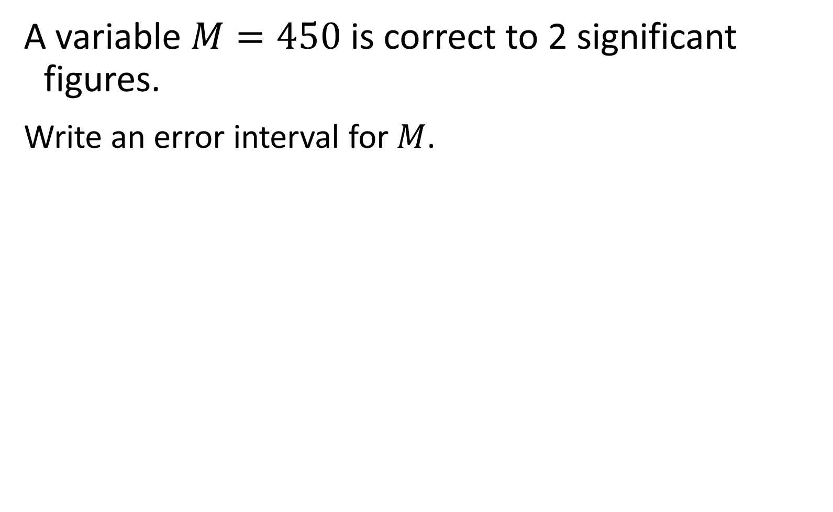
A variable $M=450$ is correct to 2 significant figures.
Write an error interval for $M$.
$$445≤M<455$$

Slide 3
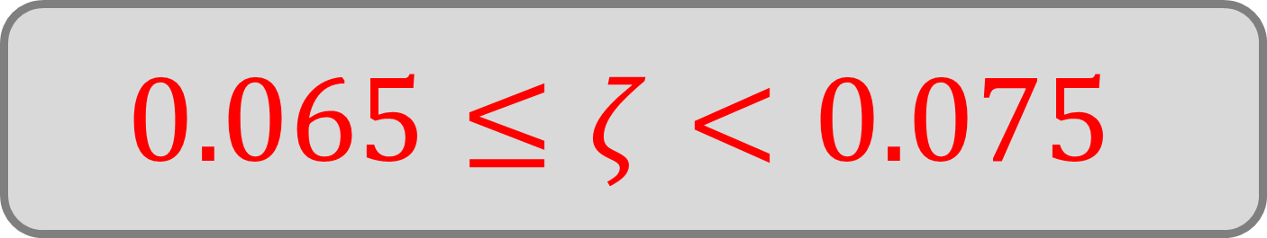
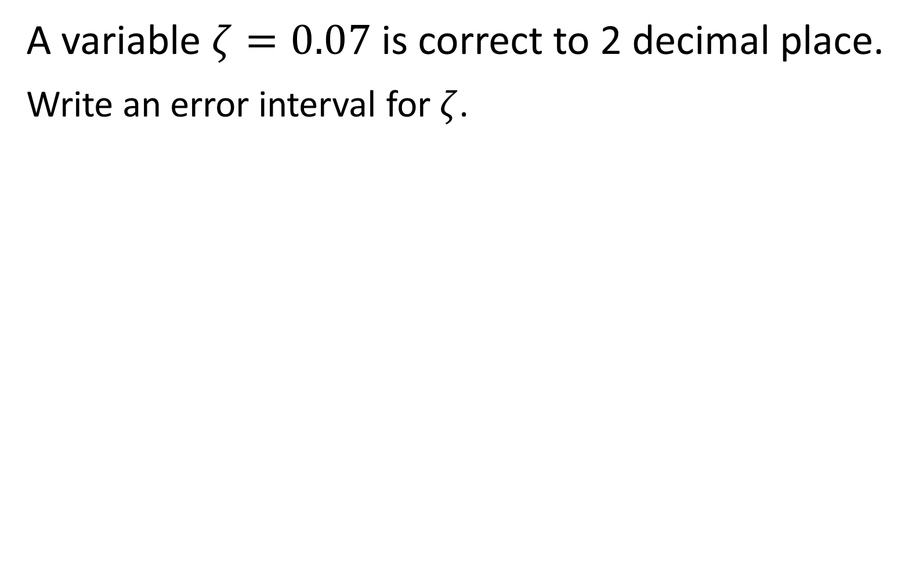
A variable $ζ=0.07$ is correct to 2 decimal place.
Write an error interval for $ζ$.
$$0.065≤ζ<0.075$$

Slide 4
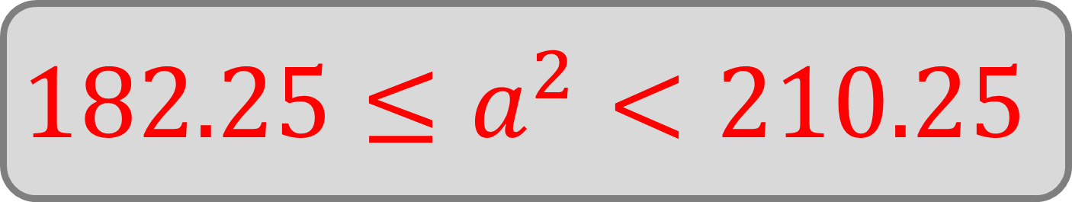
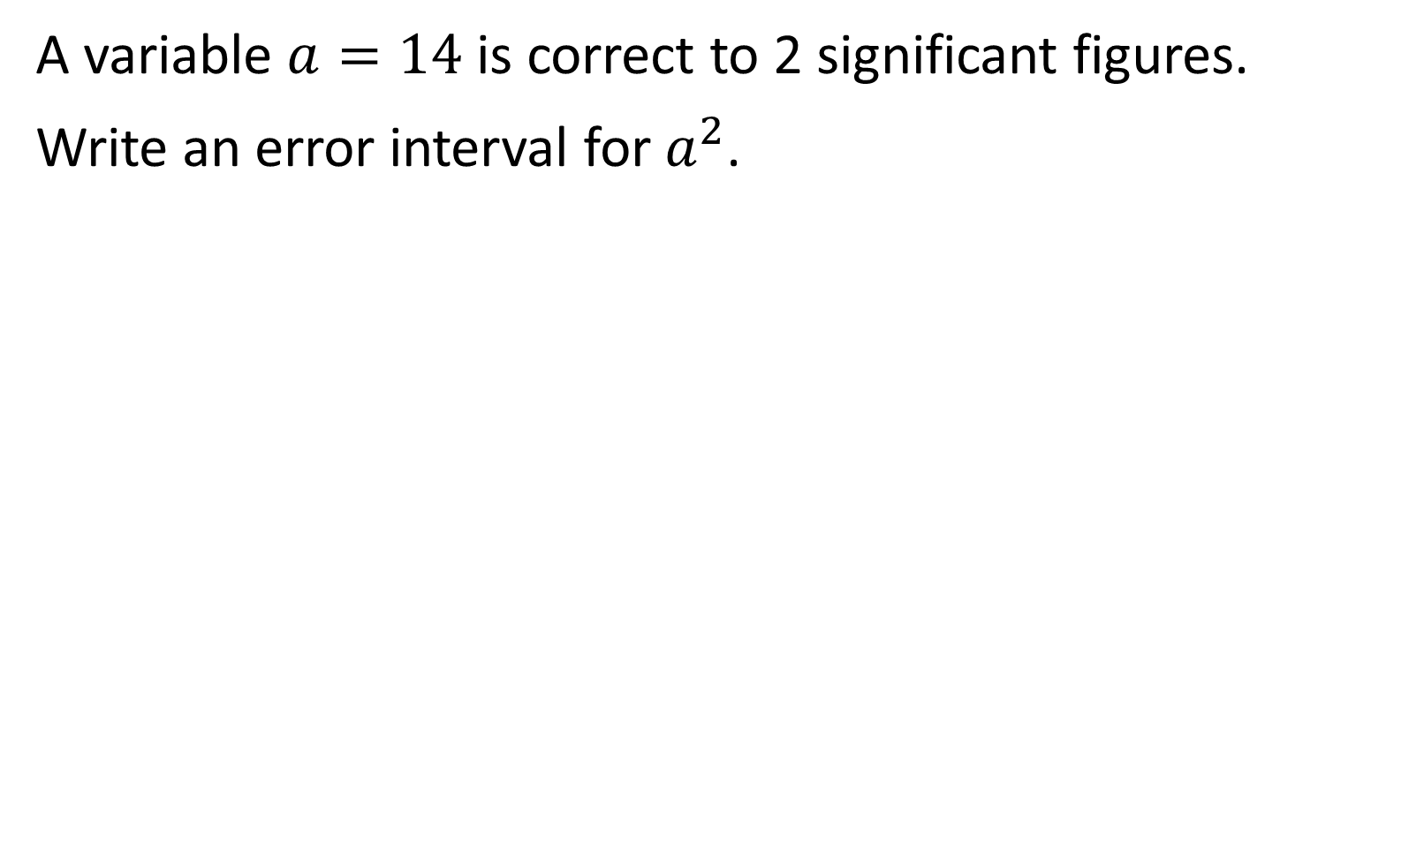
A variable $a=14$ is correct to 2 significant figures.
Write an error interval for $a^{2}$.
$$182.25≤a^{2}<210.25$$

Slide 5

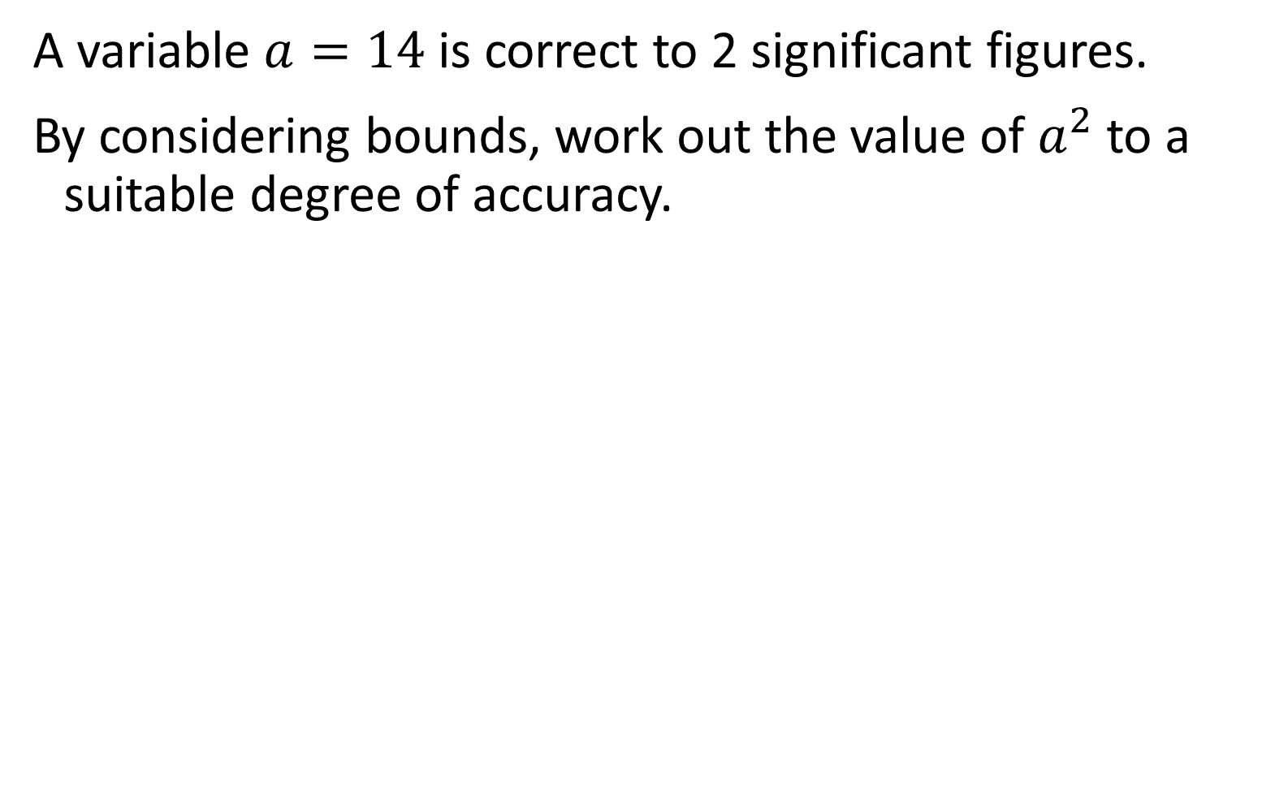
A variable $a=14$ is correct to 2 significant figures.
By considering bounds, work out the value of $a^{2}$ to a suitable degree of accuracy.
$$a^{2}=200$$

Slide 6
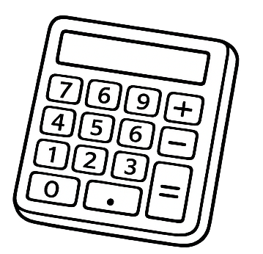

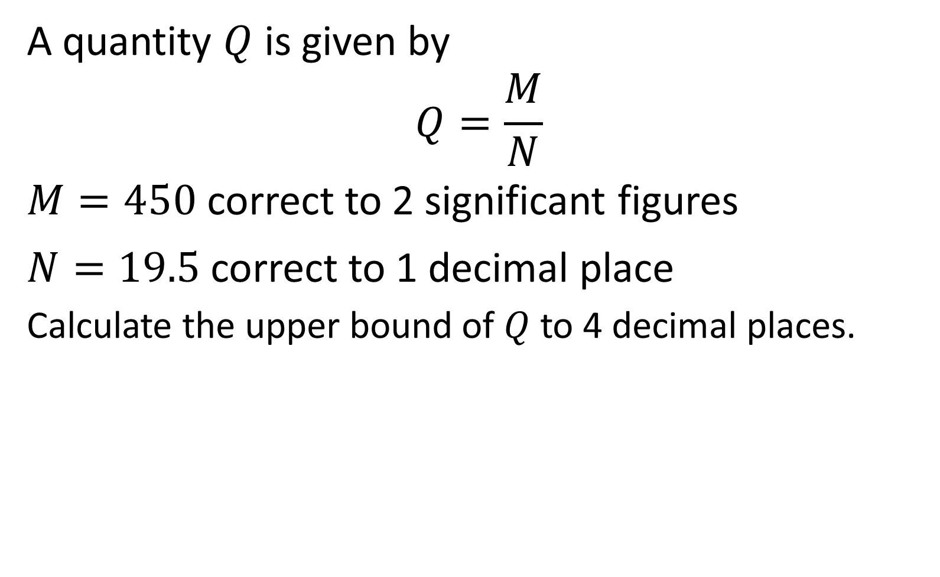
A quantity $Q$ is given by
$$Q=\frac{M}{N}$$
$M=450$ correct to 2 significant figures
$N=19.5$ correct to 1 decimal place
Calculate the upper bound of $Q$ to 4 decimal places.
$$23.3933$$

Slide 7

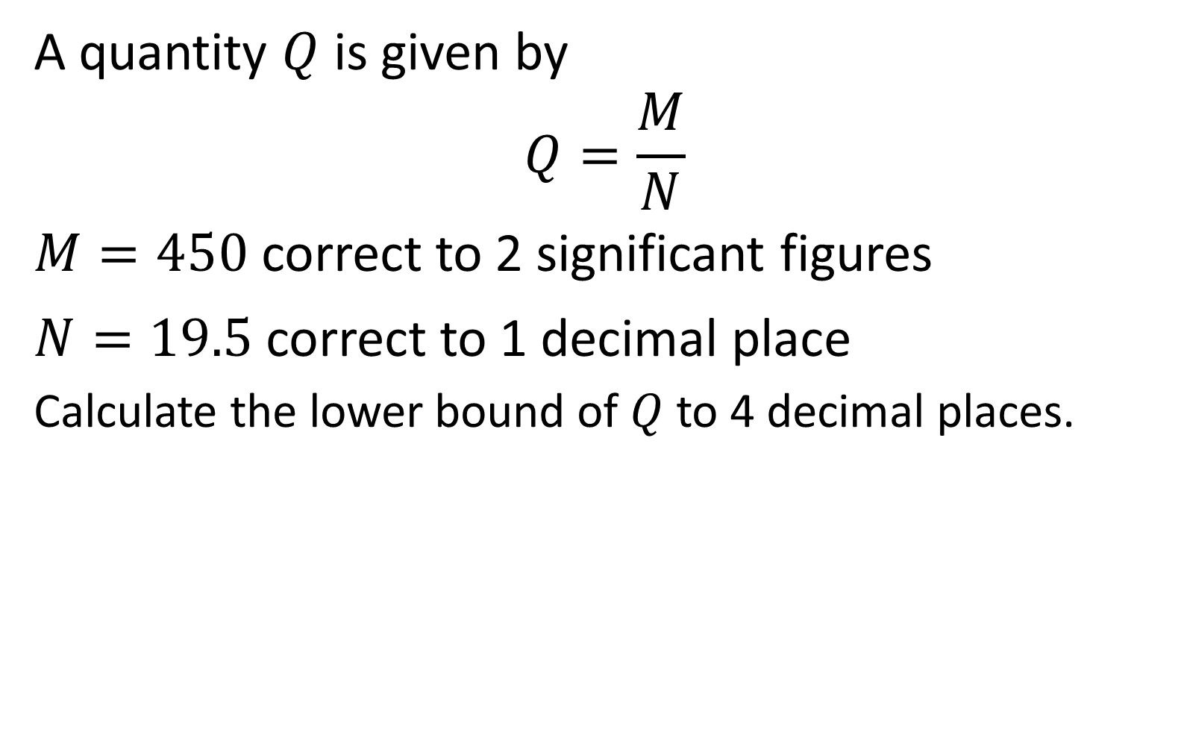
A quantity $Q$ is given by
$$Q=\frac{M}{N}$$
$M=450$ correct to 2 significant figures
$N=19.5$ correct to 1 decimal place
Calculate the lower bound of $Q$ to 4 decimal places.
$$22.7621$$

Slide 8

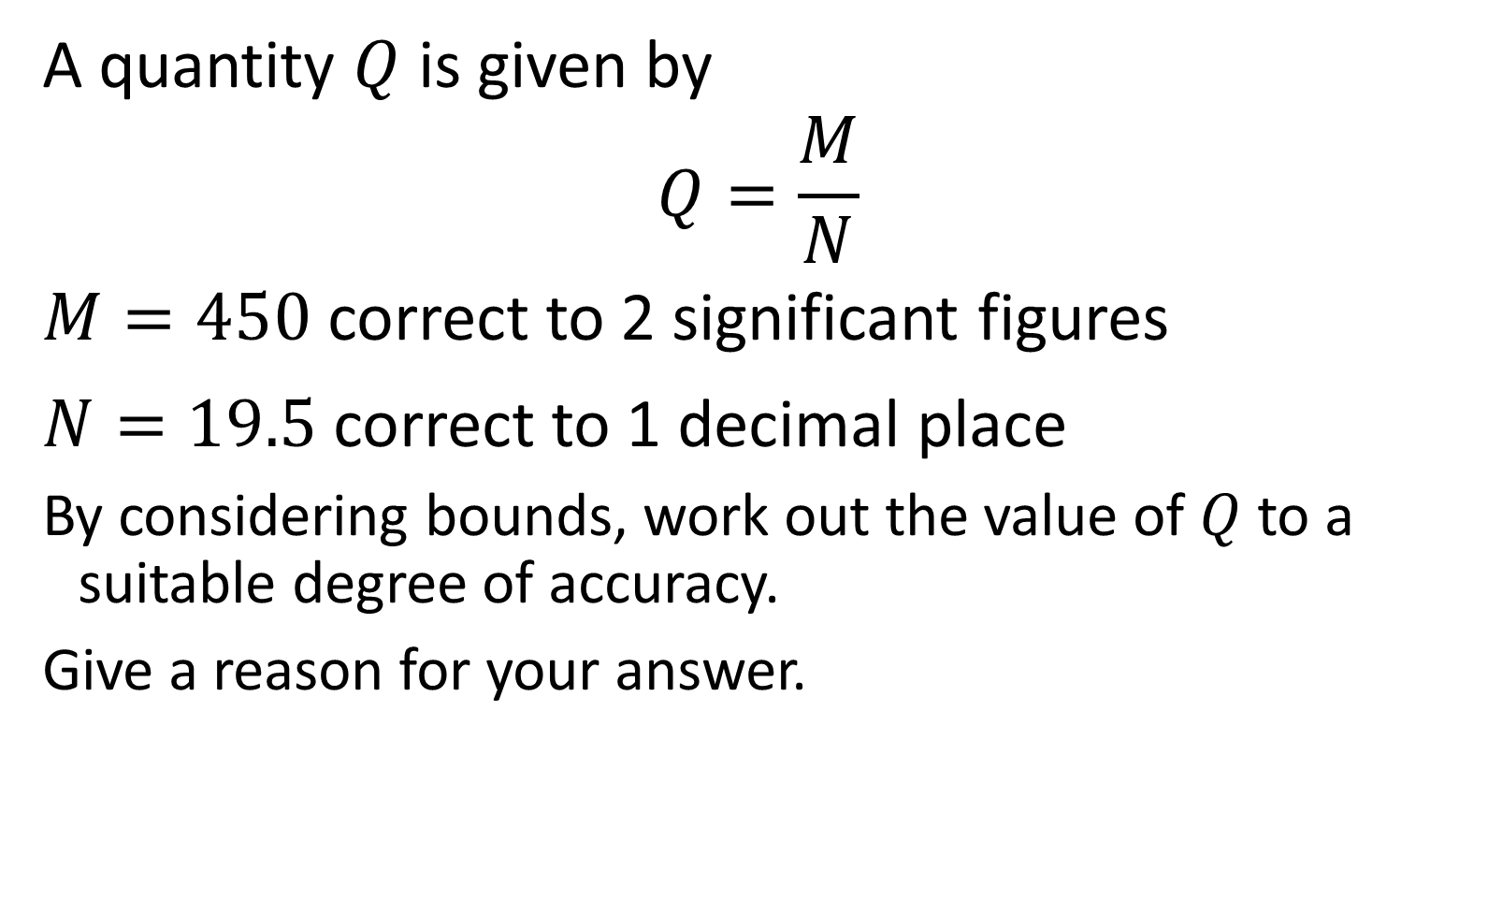
A quantity $Q$ is given by
$$Q=\frac{M}{N}$$
$M=450$ correct to 2 significant figures
$N=19.5$ correct to 1 decimal place
By considering bounds, work out the value of $Q$ to a suitable degree of accuracy.
Give a reason for your answer.
$$23$$

Slide 9

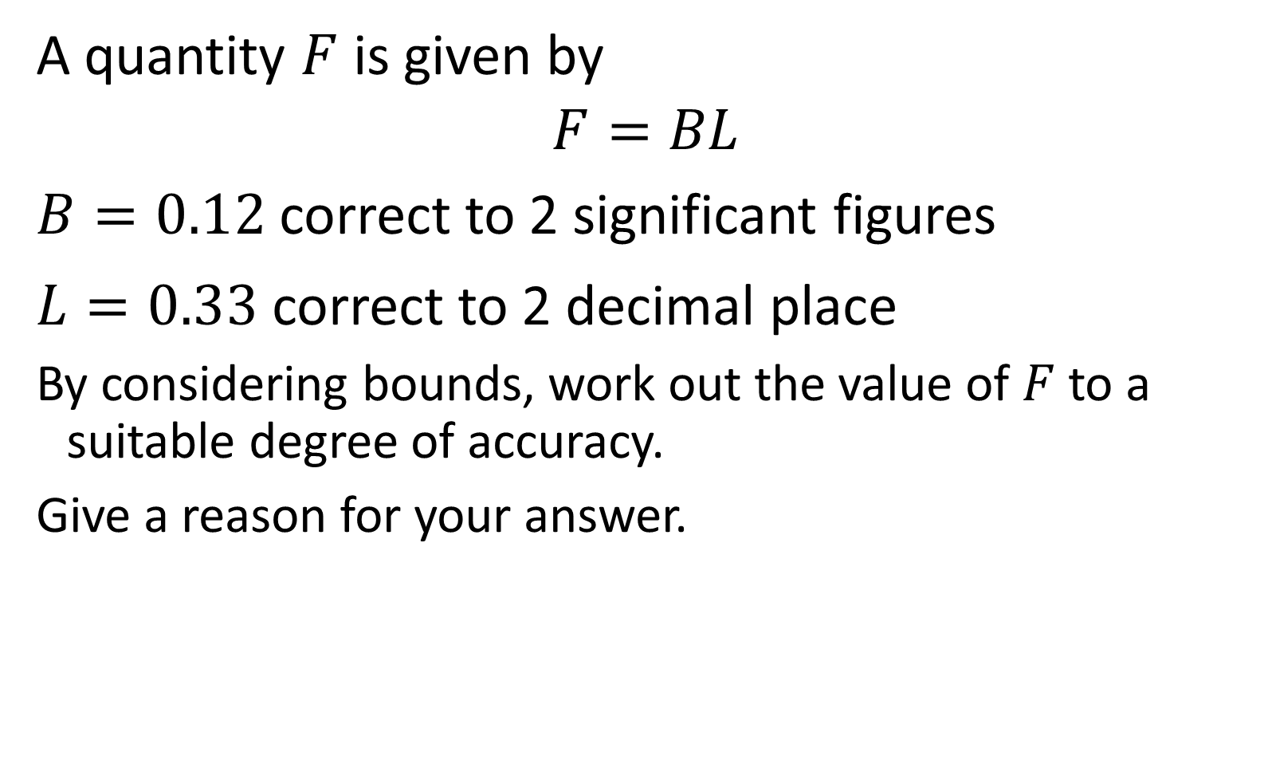
A quantity $F$ is given by
$$F=BL$$
$B=0.12$ correct to 2 significant figures
$L=0.33$ correct to 2 decimal place
By considering bounds, work out the value of $F$ to a suitable degree of accuracy.
Give a reason for your answer.
$$0.04$$

Slide 10

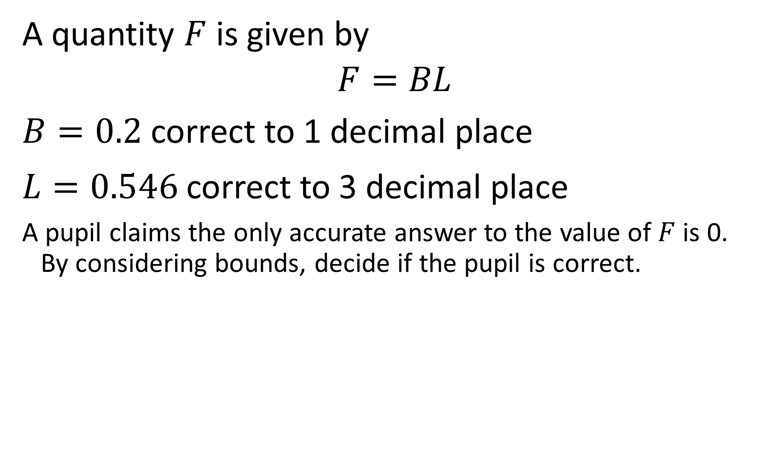
A quantity $F$ is given by
$$F=BL$$
$B=0.2$ correct to 1 decimal place
$L=0.546$ correct to 3 decimal place
A pupil claims the only accurate answer to the value of $F$ is 0.
By considering bounds, decide if the pupil is correct.
$$0.1$$

Slide 11
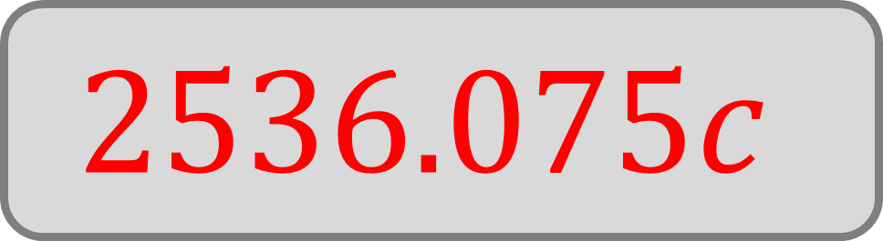
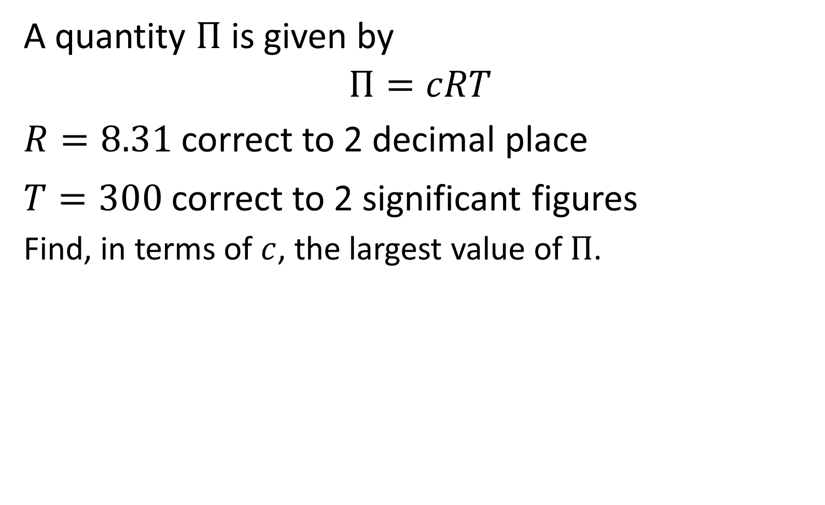
A quantity $Π$ is given by
$$Π=cRT$$
$R=8.31$ correct to 2 decimal place
$T=300$ correct to 2 significant figures
Find, in terms of $c$, the largest value of $Π$.
$$2536.075c$$

Slide 12

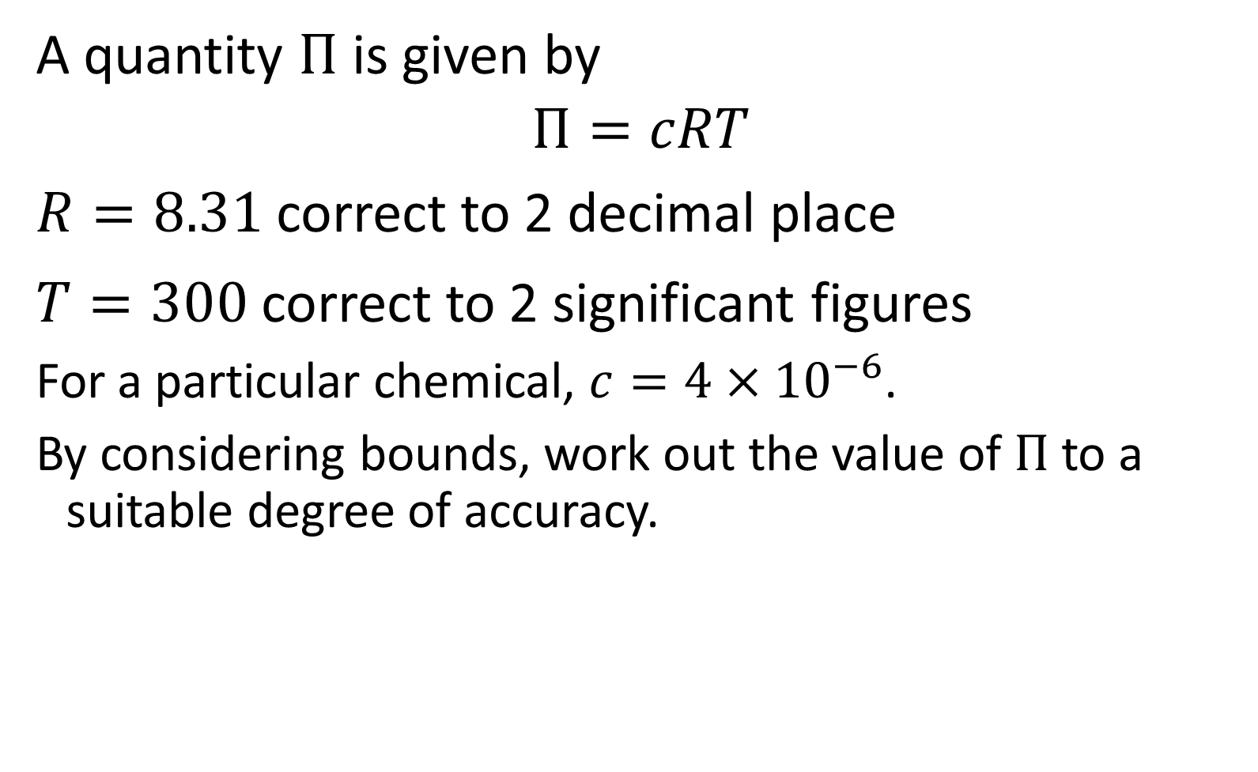
A quantity $Π$ is given by
$$Π=cRT$$
$R=8.31$ correct to 2 decimal place
$T=300$ correct to 2 significant figures
For a particular chemical, $c=4×{10}^{−6}$.
By considering bounds, work out the value of $Π$ to a suitable degree of accuracy.
$$0.01$$

Slide 13

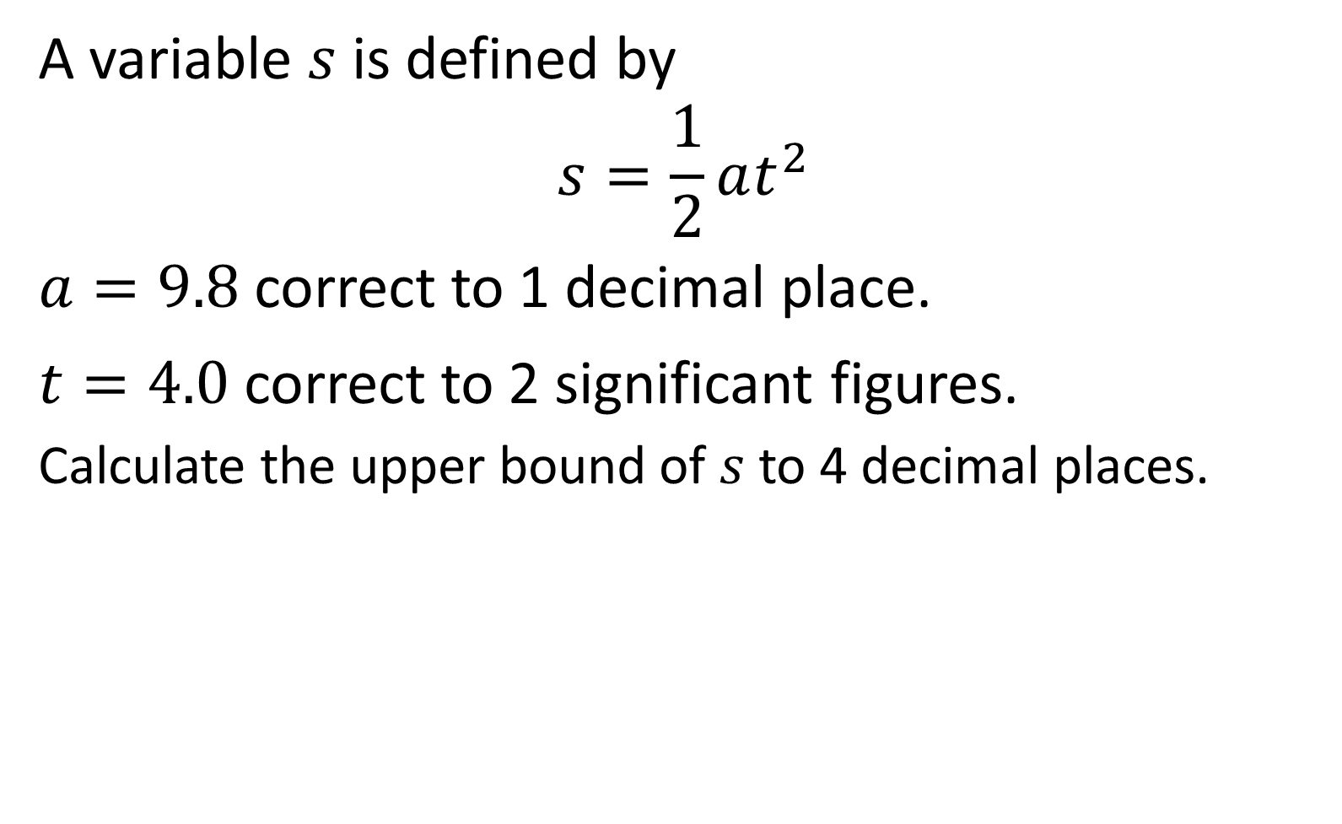
A variable $s$ is defined by
$$s=\frac{1}{2}at^{2}$$
$a=9.8$ correct to 1 decimal place.
$t=4.0$ correct to 2 significant figures.
Calculate the upper bound of $s$ to 4 decimal places.
$$80.7823$$

Slide 14

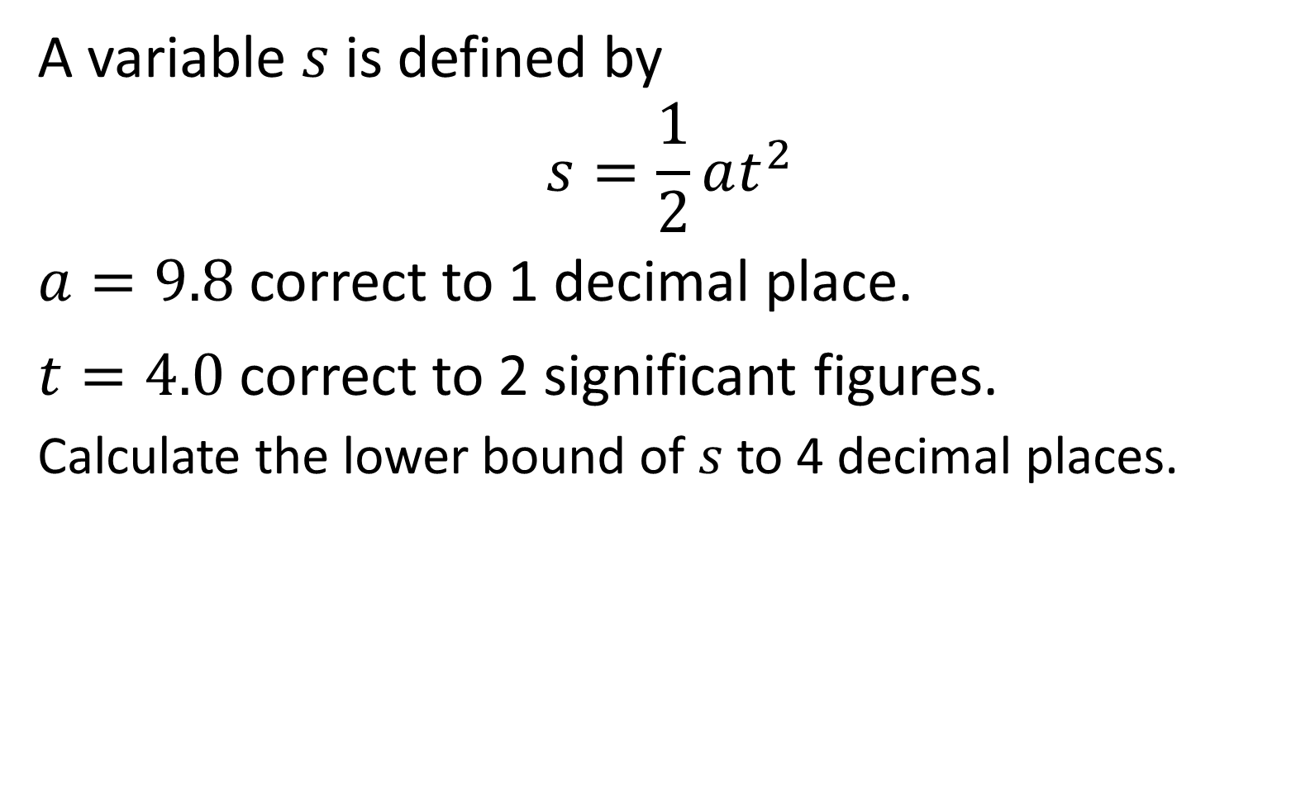
A variable $s$ is defined by
$$s=\frac{1}{2}at^{2}$$
$a=9.8$ correct to 1 decimal place.
$t=4.0$ correct to 2 significant figures.
Calculate the lower bound of $s$ to 4 decimal places.
$$76.0622$$

Slide 15

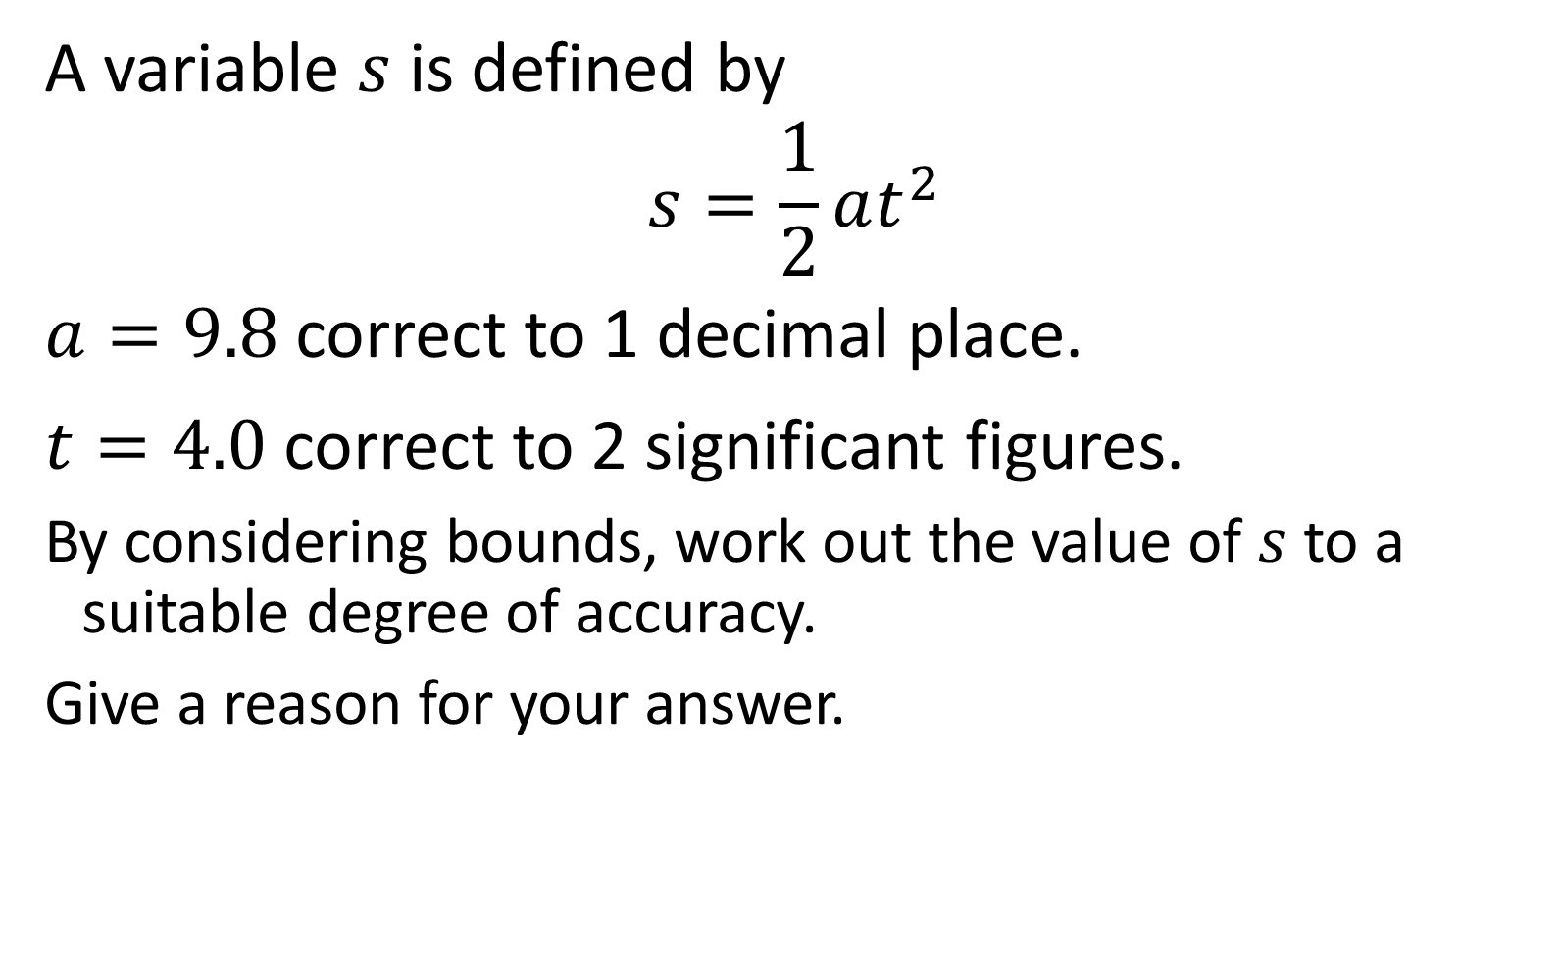
A variable $s$ is defined by
$$s=\frac{1}{2}at^{2}$$
$a=9.8$ correct to 1 decimal place.
$t=4.0$ correct to 2 significant figures.
By considering bounds, work out the value of $s$ to a suitable degree of accuracy.
Give a reason for your answer.
$$80$$

Slide 16

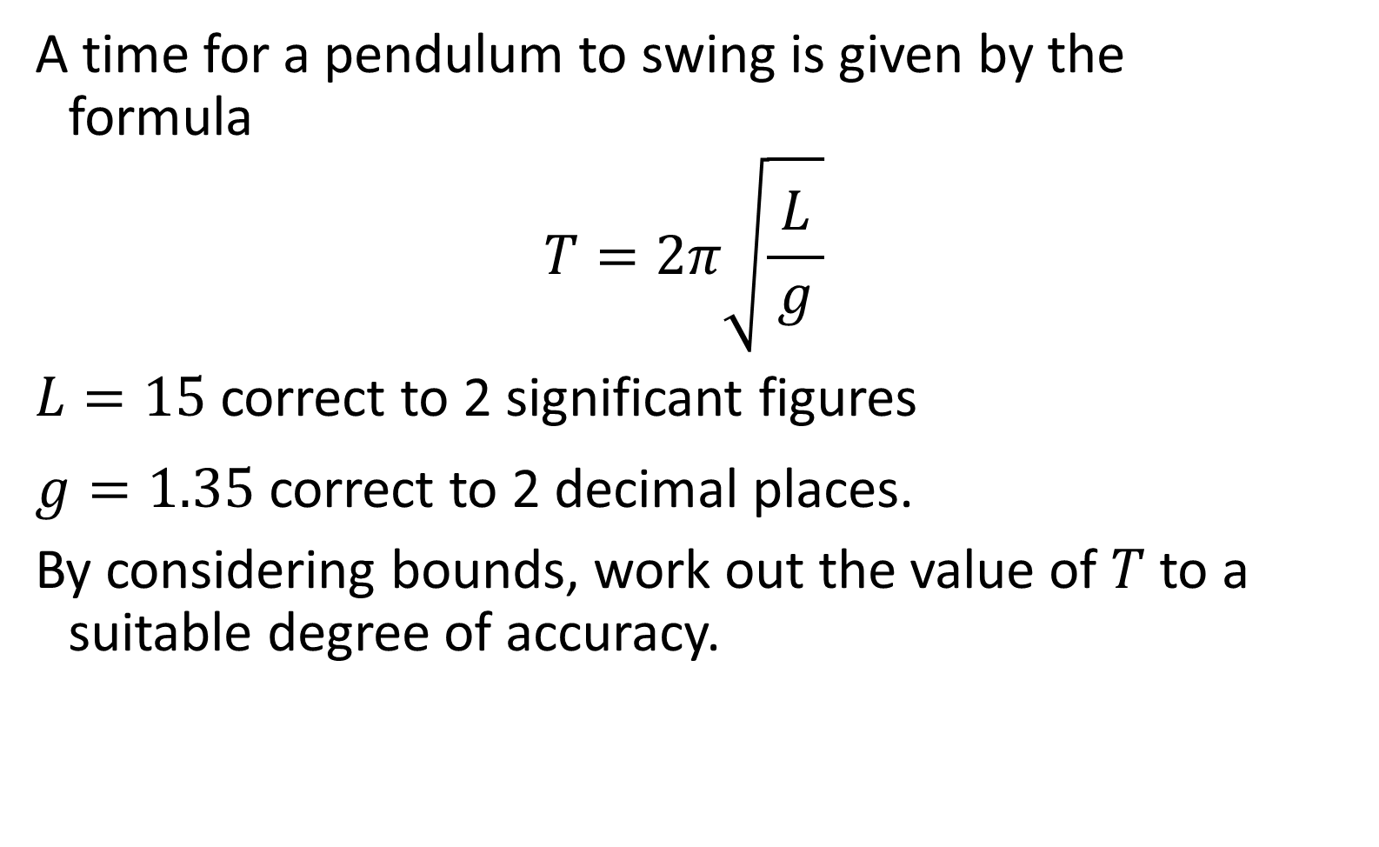
A time for a pendulum to swing is given by the
formula
$$T=2π\sqrt{\frac{ L }{g}}$$
$L=15$ correct to 2 significant figures
$g=1.35$ correct to 2 decimal places.
By considering bounds, work out the value of $T$ to a suitable degree of accuracy.
$$21$$

Slide 17

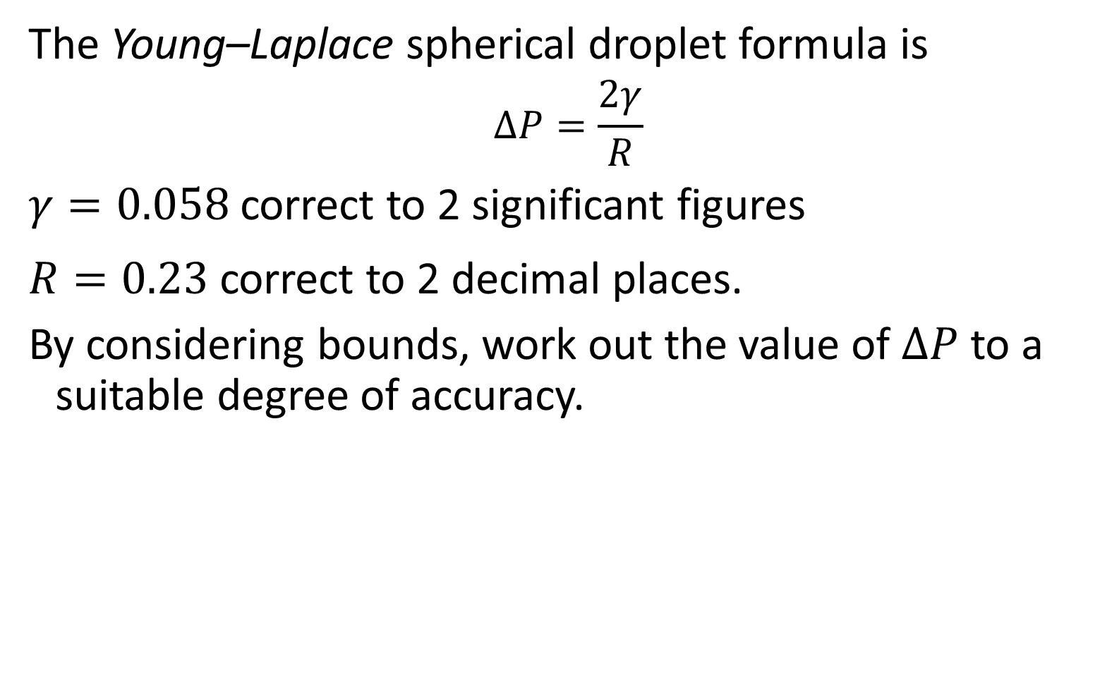
The Young–Laplace spherical droplet formula is
$$ΔP=\frac{2γ}{R}$$
$γ=0.058$ correct to 2 significant figures
$R=0.23$ correct to 2 decimal places.
By considering bounds, work out the value of $ΔP$ to a suitable degree of accuracy.
$$0.5$$

Slide 18
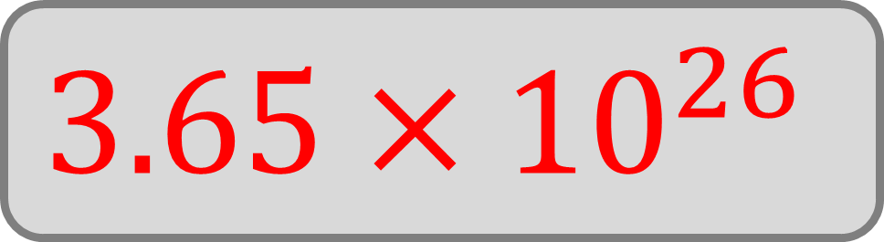
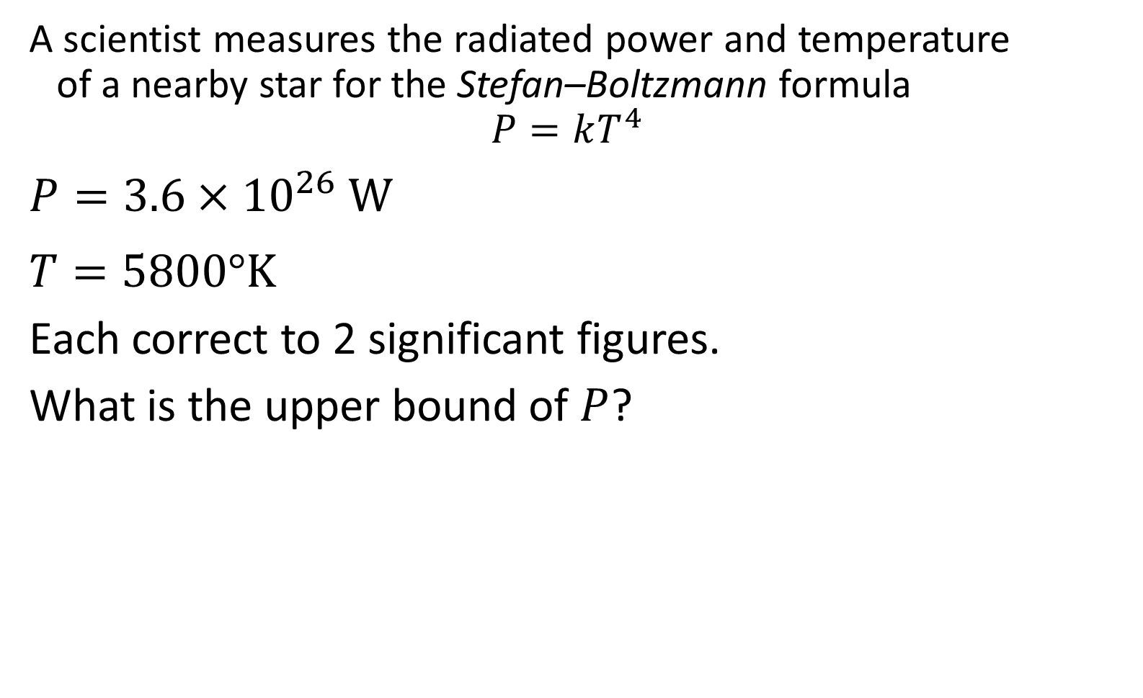
A scientist measures the radiated power and temperature
of a nearby star for the Stefan–Boltzmann formula
$$P=kT^{4}$$
$P=3.6×{10}^{26} W$
$T=5800°K$
Each correct to 2 significant figures.
What is the upper bound of $P$?
$$3.65×{10}^{26}$$

Slide 19

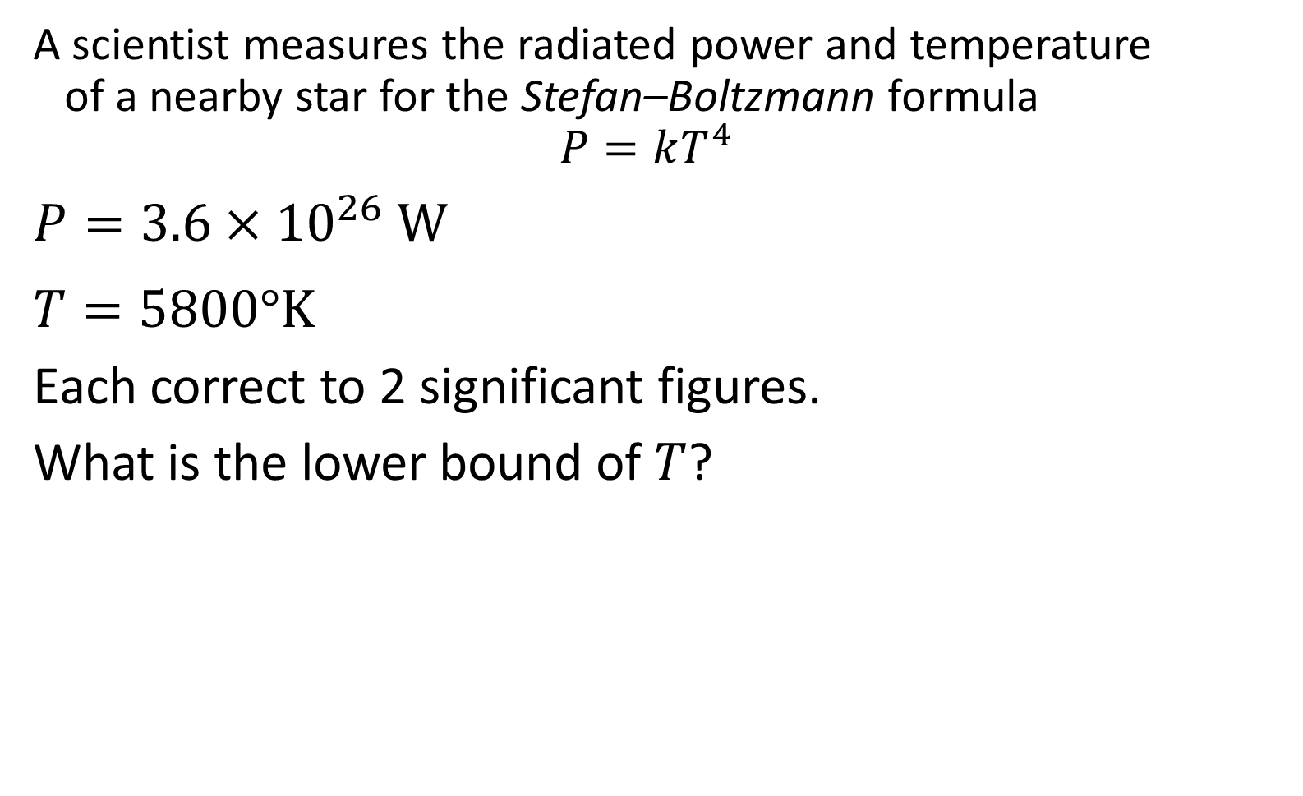
A scientist measures the radiated power and temperature
of a nearby star for the Stefan–Boltzmann formula
$$P=kT^{4}$$
$P=3.6×{10}^{26} W$
$T=5800°K$
Each correct to 2 significant figures.
What is the lower bound of $T$?
$$5750$$

Slide 20

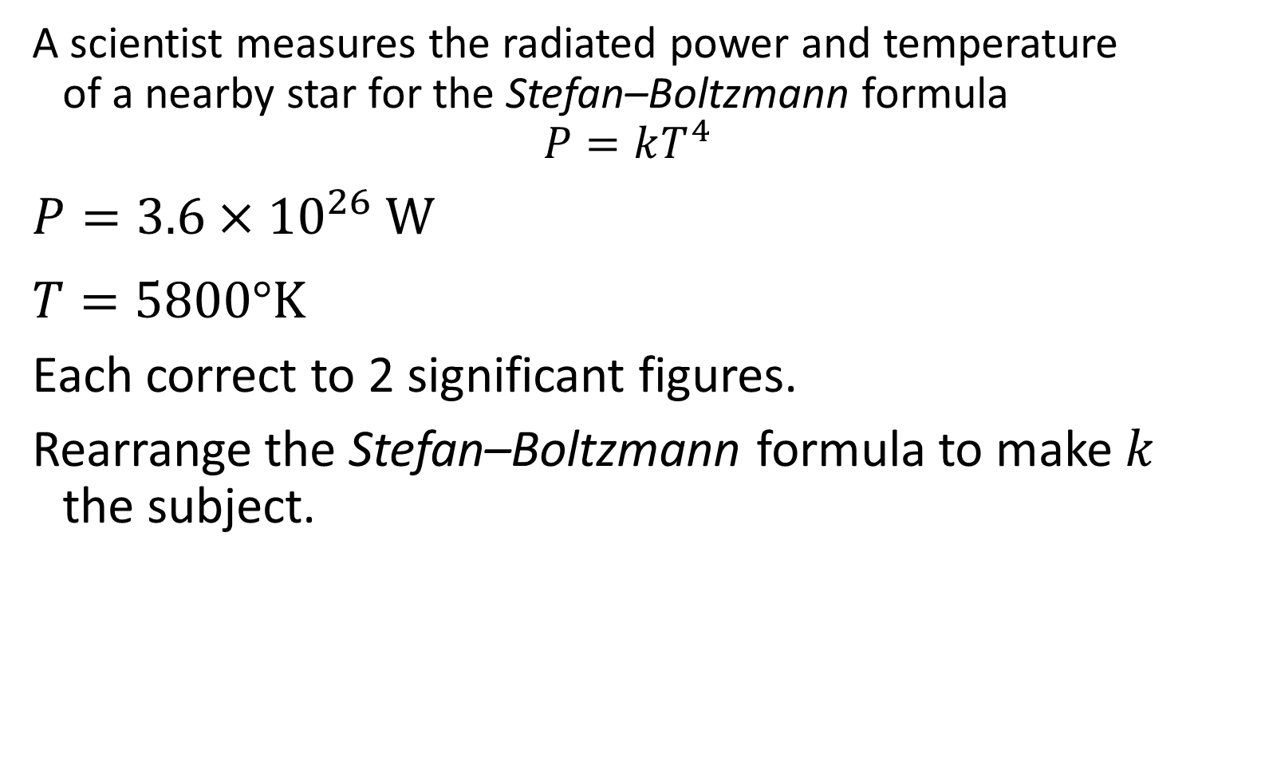
A scientist measures the radiated power and temperature
of a nearby star for the Stefan–Boltzmann formula
$$P=kT^{4}$$
$P=3.6×{10}^{26} W$
$T=5800°K$
Each correct to 2 significant figures.
Rearrange the Stefan–Boltzmann formula to make $k$
the subject.
$$k=\frac{P}{T^{4}}$$

Slide 21
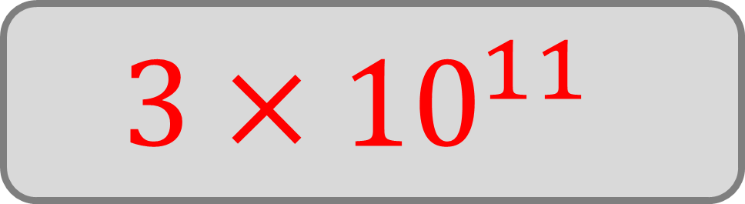
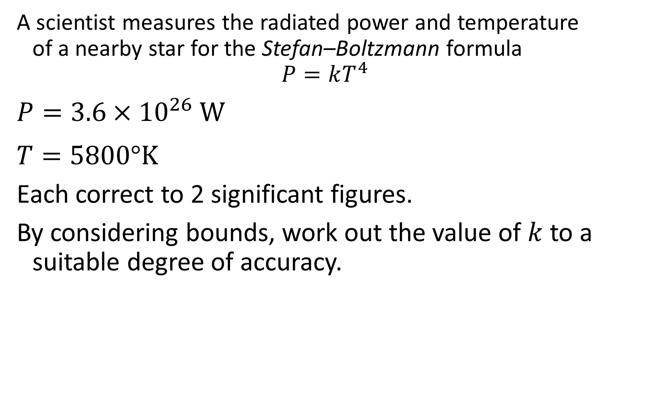
A scientist measures the radiated power and temperature
of a nearby star for the Stefan–Boltzmann formula
$$P=kT^{4}$$
$P=3.6×{10}^{26} W$
$T=5800°K$
Each correct to 2 significant figures.
By considering bounds, work out the value of $k$ to a suitable degree of accuracy.
$$3×{10}^{11}$$

