Slide 1
Addition and Subtraction
17 July 2026

Slide 2
Fill in the blanks:
 | 3 | 4
+ | 1 | 8
 | 5 | 2

Slide 3
Fill in the blanks:
 | 3 | 2 | 6
+ | 4 | 8 | 0
 | 8 | 0 | 6

Slide 4
Fill in the blanks:
 | 3 | 4 | 9
+ | 1 | 2 | 9
 | 4 | 7 | 8

Slide 5
Fill in the blanks:
 | 8 | 2 | 5
+ | 0 | 9 | 6
 | 9 | 2 | 1

Slide 6
Fill in the blanks:
 | 4 | 5 | 5
+ | 4 | 4 | 5
 | 9 | 0 | 0

Slide 7
Fill in the blanks:
 | 4 | 3 | 7
+ | 6 | 9 | 8
1 | 1 | 3 | 5

Slide 8
Fill in the blanks:
 | 2 | 7 | 4
+ | 4 | 5 | 7
 | 7 | 3 | 1

Slide 9
Fill in the blanks:
 | 6 | 1 | 2
– | 3 | 3 | 5
 | 2 | 7 | 7

Slide 10
Fill in the blanks:
 | 6 | 8 | 4
– | 2 | 4 | 5
 | 4 | 3 | 9

Slide 11
Fill in the blanks:
 | 4 | 0 | 2
– | 1 | 7 | 8
 | 2 | 2 | 4

Slide 12
Fill in the blanks:
 | 6 | 3 | 1
– | 2 | 8 | 4
 | 3 | 4 | 7

Slide 13
Fill in the blanks:
 | 5 | 1 | 4
– | 2 | 9 | 7
 | 2 | 1 | 7

Slide 14
Fill in the blanks:
 | 8 | 4 | 2
– | 3 | 2 | 1
 | 5 | 2 | 1

Slide 15
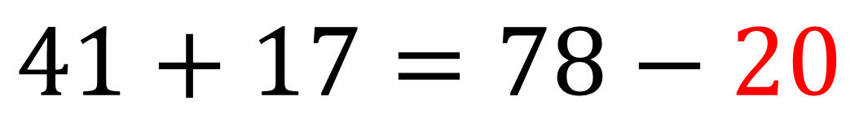
Fill in the blank:
$$41+17=78−20$$

Slide 16
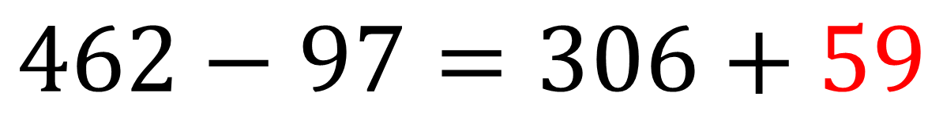
Fill in the blank:
$$462−97=306+59$$

Slide 17
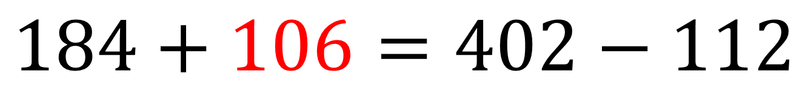
Fill in the blank:
$$184+106=402−112$$

Slide 18
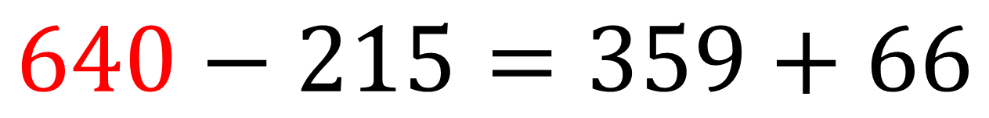
Fill in the blank:
$$640−215=359+66$$

Slide 19
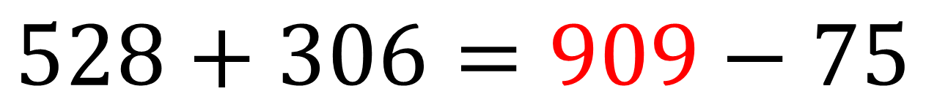
Fill in the blank:
$$528+306=909−75$$

Slide 20
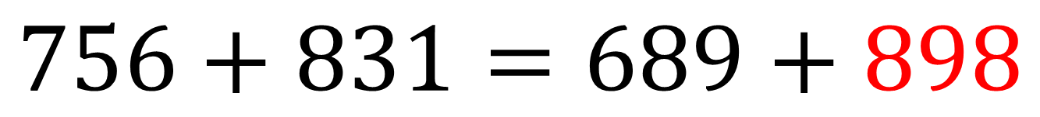
Fill in the blank:
$$756+831=689+898$$

Slide 21
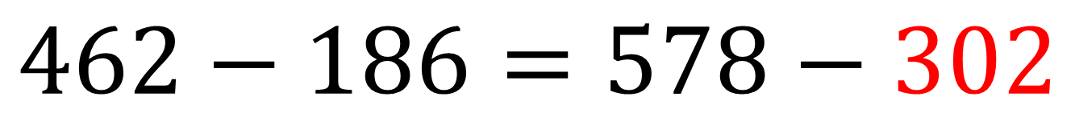
Fill in the blank:
$$462−186=578−302$$

