Slide 1
Ratio
02 July 2026

Slide 2

Divide £48 in the ratio 2 : 1
$$£32 :£16$$

Slide 3

Divide 63 sweets in the ratio 3 : 4
$$27 :36$$

Slide 4

Divide £90 in the ratio 5 : 4
$$£50 :£40$$

Slide 5

Divide 72 counters in the ratio 1 : 2
$$24 :48$$

Slide 6

Divide £35 in the ratio 3 : 2
$$£21 :£14$$

Slide 7

Divide 84 stickers in the ratio 4 : 3
$$48 :36$$

Slide 8
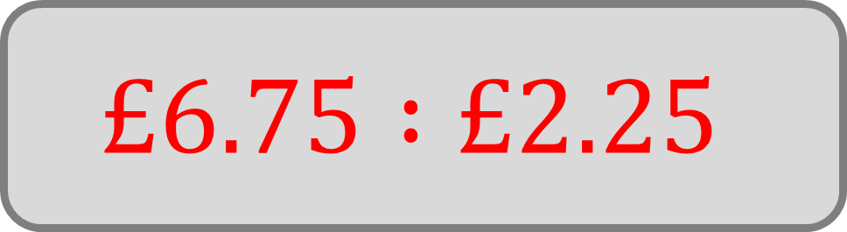
Divide £9 stickers in the ratio 3 : 1
$$£6.75 :£2.25$$

Slide 9

Divide £60 in the ratio 7 : 3
$$£42 :£18$$

Slide 10

Divide 45 pencils in the ratio 2 : 3
$$18 :27$$

Slide 11

Divide £54 in the ratio 5 : 1
$$£45 :£9$$

Slide 12

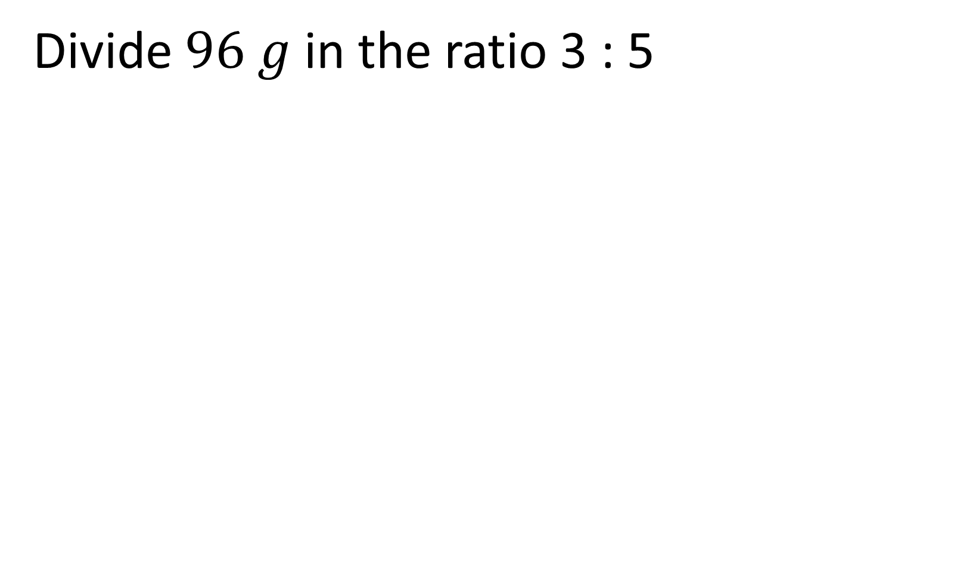
Divide $96 g$ in the ratio 3 : 5
$$36 g :60 g$$

Slide 13

A school trip collects £55 from selling programmes.
Two teachers, Ms Patel and Mr Jones, agree to split the money in the ratio 3 : 2 to buy supplies for different activities.
How much does each teacher receive?
$$£33 :£22$$

Slide 14

A box contains forty-nine apples.
The canteen gives apples to Year 7 and Year 8 in the ratio 5 : 2.
How many apples does each year group get?
$$35 :14$$

Slide 15

A quiz team wins £60.
Two members, Sam and Priya, agree that Sam should get twice as much as Priya because he answered more questions.
How much does each person receive?
$$£40 :£20$$

Slide 16

Leo spends 90 minutes revising.
He spends half as long on English as he does on maths.
How many minutes does he spend on each subject?
$30 minutes$ English
$60 minutes$ Maths

Slide 17
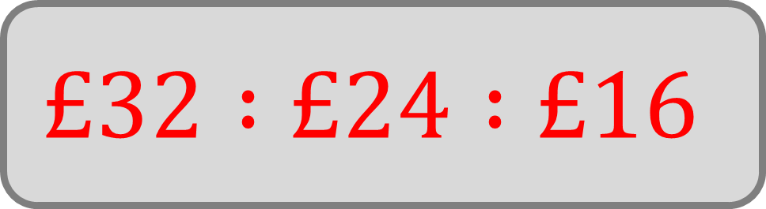
Share £72 pencils in the ratio 4 : 3 : 2
$$£32 :£24 :£16$$

Slide 18
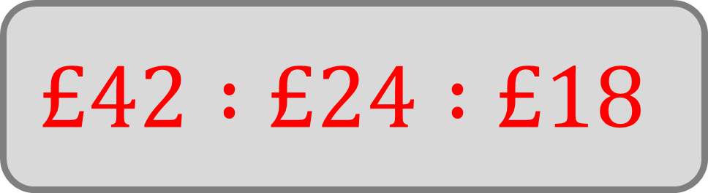
Share £84 pencils in the ratio 7 : 4 : 3
$$£42 :£24 :£18$$

Slide 19
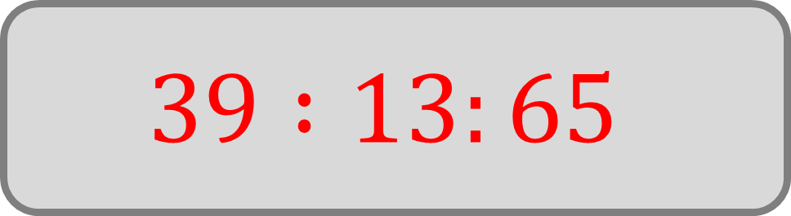
A teacher buys 117 art pencils for three classes:
7A, 7B, and 7C.
They share the pencils in the ratio 3 : 1 : 5.
How many pencils does each class get?
$$39 :13:65$$

Slide 20

A school raises £100 during a charity day.
The money is split between three causes:
the local food bank – three parts
an animal shelter – two parts
a children’s hospital – five parts
How much money does each cause receive?
$$£30 :£20 :£50$$

Slide 21
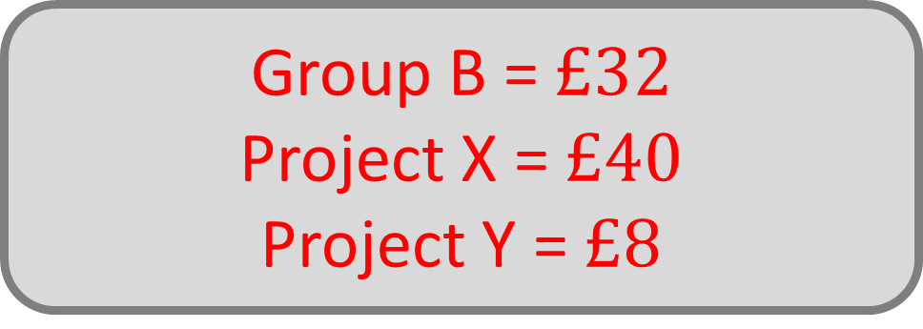
A team of students raise £80 for charity.
They first split the money between Group A and Group B in the ratio 3 : 2.
Group A then decides to split its share between two smaller projects, Project X and Project Y, in the ratio 5 : 1.
How much money does Group B receive, and how much do Project X and Project Y receive?
Group B = $£32$
Project X = $£40$
Project Y = $£8$

