Slide 1
Standard Form
16 September 2026

Slide 2
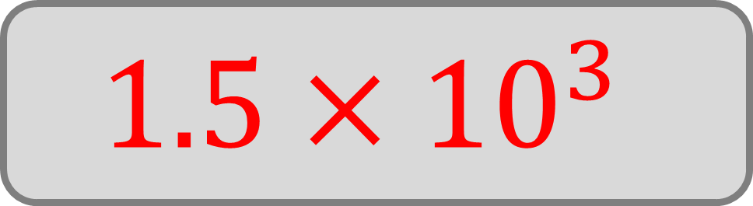
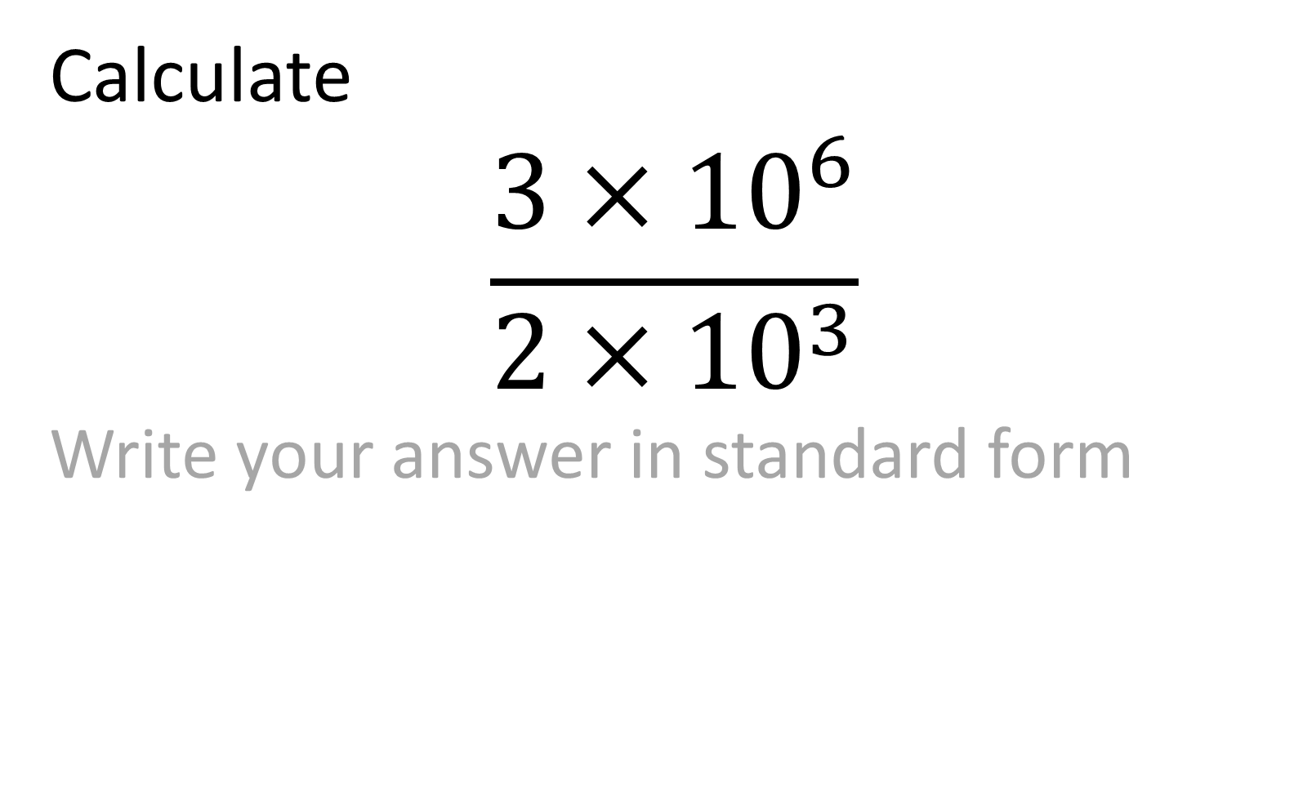
Calculate
$$\frac{3×{10}^{6}}{2×{10}^{3}}$$
Write your answer in standard form
$$1.5×{10}^{3}$$

Slide 3
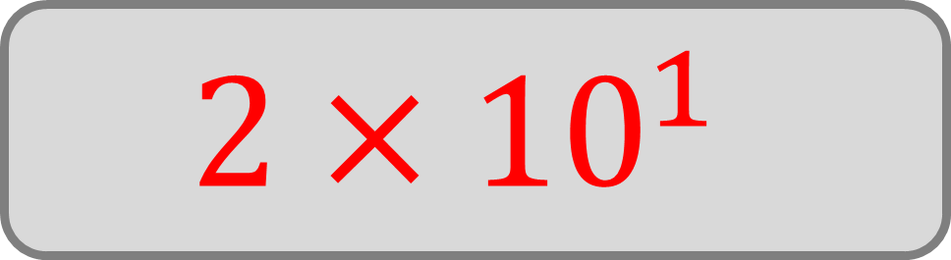

Calculate
$$\frac{8×{10}^{5}}{4×{10}^{4}}$$
Write your answer in standard form
$$2×{10}^{1}$$

Slide 4
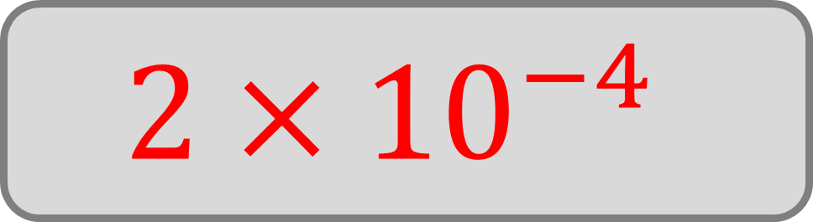

Calculate
$$\frac{6×{10}^{3}}{3×{10}^{7}}$$
Write your answer in standard form
$$2×{10}^{−4}$$

Slide 5
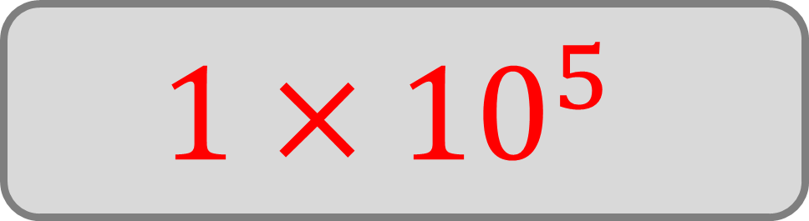

Calculate
$$\frac{3×{10}^{8}}{3×{10}^{3}}$$
Write your answer in standard form
$$1×{10}^{5}$$

Slide 6
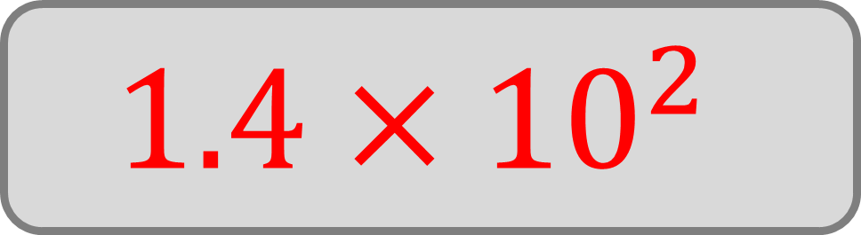
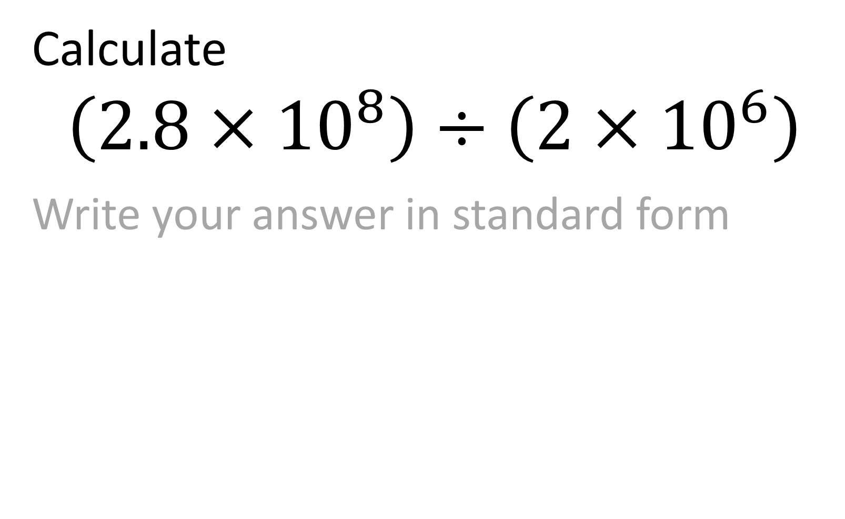
Calculate
$$\left(2.8×{10}^{8}\right)÷\left(2×{10}^{6}\right)$$
Write your answer in standard form
$$1.4×{10}^{2}$$

Slide 7
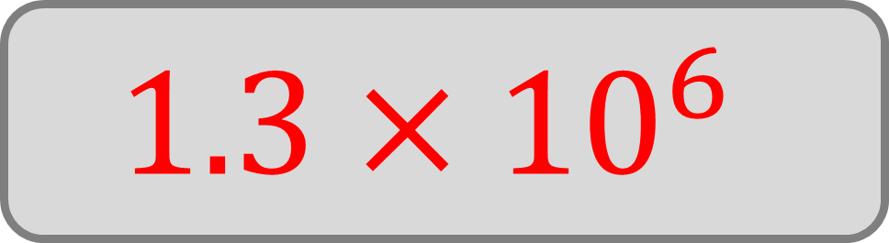

Calculate
$$\left(9.1×{10}^{8}\right)÷\left(7×{10}^{2}\right)$$
Write your answer in standard form
$$1.3×{10}^{6}$$

Slide 8


Calculate
$$\left(3.5×{10}^{6}\right)÷\left(5×{10}^{2}\right)$$
Write your answer in standard form
$$7×{10}^{3}$$

Slide 9
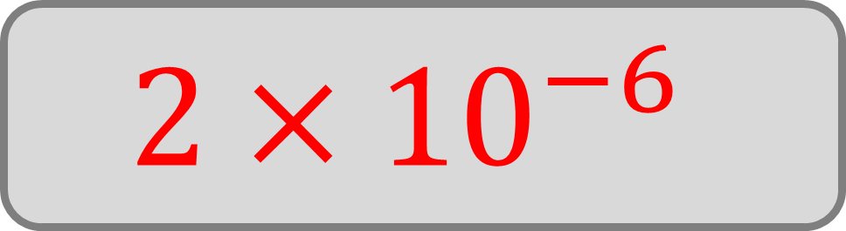
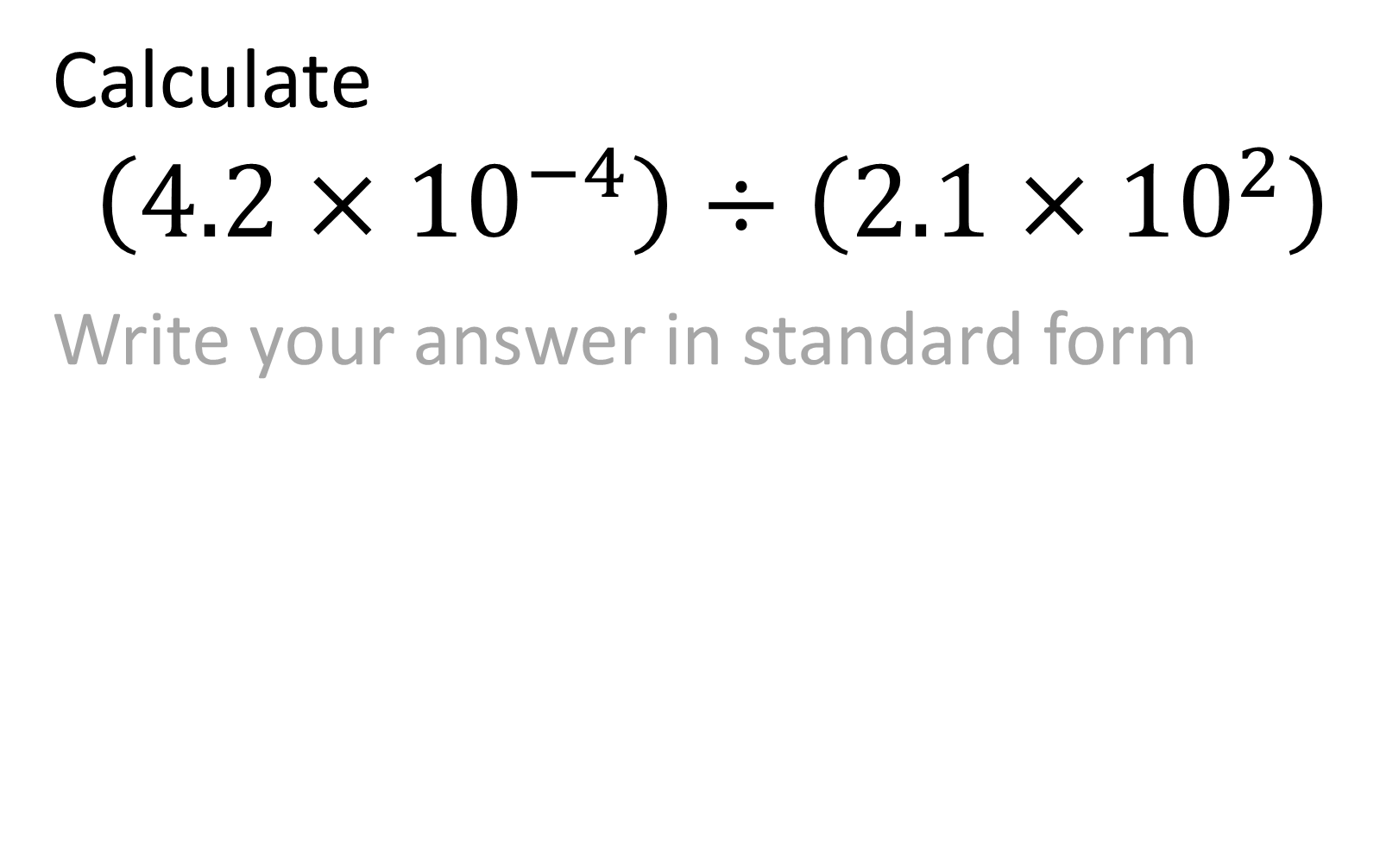
Calculate
$$\left(4.2×{10}^{−4}\right)÷\left(2.1×{10}^{2}\right)$$
Write your answer in standard form
$$2×{10}^{−6}$$

Slide 10
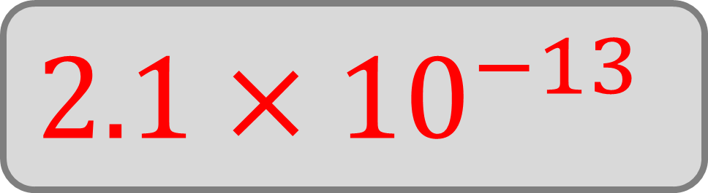

Calculate
$$\left(6.3×{10}^{−9}\right)÷\left(3×{10}^{4}\right)$$
Write your answer in standard form
$$2.1×{10}^{−13}$$

Slide 11
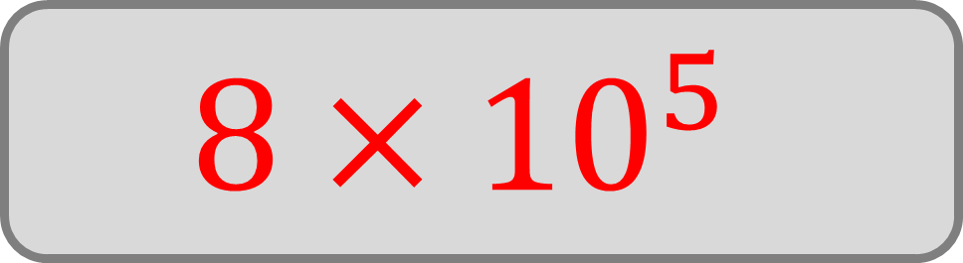

Calculate
$$\left(6.4×{10}^{9}\right)÷\left(8×{10}^{3}\right)$$
Write your answer in standard form
$$8×{10}^{5}$$

Slide 12
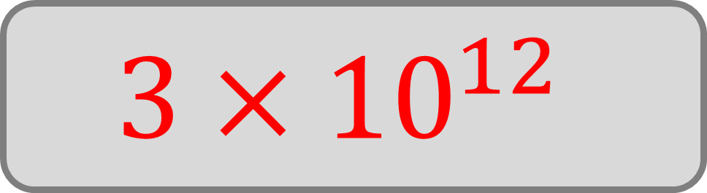

Calculate
$$\left(6×{10}^{4}\right)÷\left(2×{10}^{−8}\right)$$
Write your answer in standard form
$$3×{10}^{12}$$

Slide 13
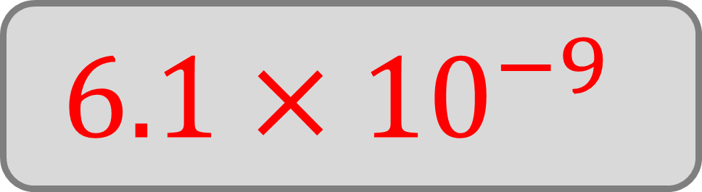
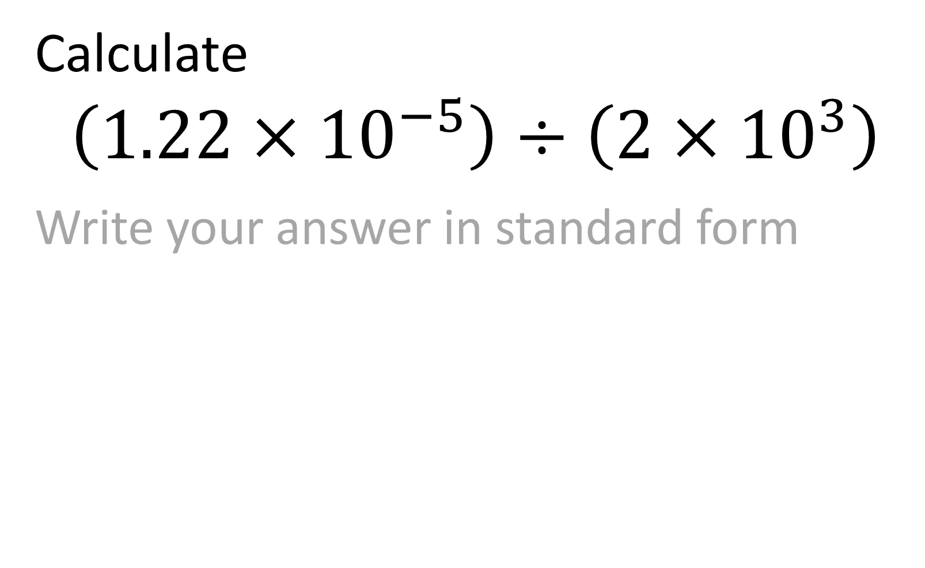
Calculate
$$\left(1.22×{10}^{−5}\right)÷\left(2×{10}^{3}\right)$$
Write your answer in standard form
$$6.1×{10}^{−9}$$

Slide 14
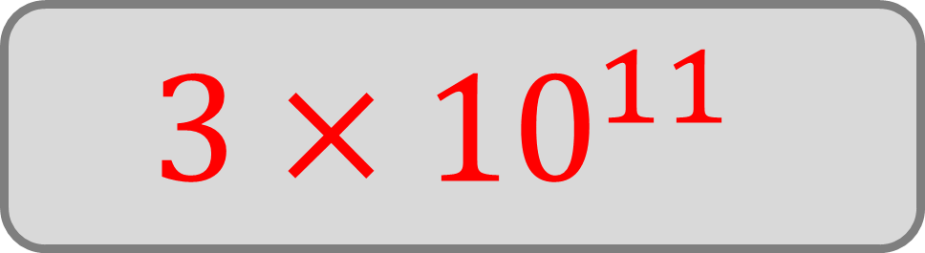

Calculate
$$\left(7.5×{10}^{15}\right)÷\left(2.5×{10}^{4}\right)$$
Write your answer in standard form
$$3×{10}^{11}$$

Slide 15
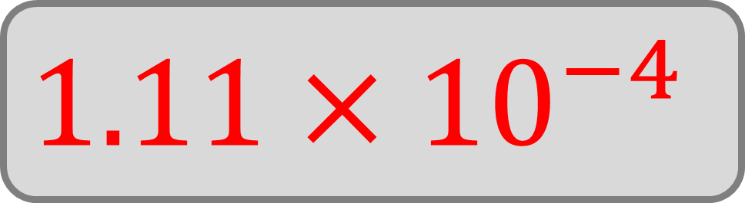
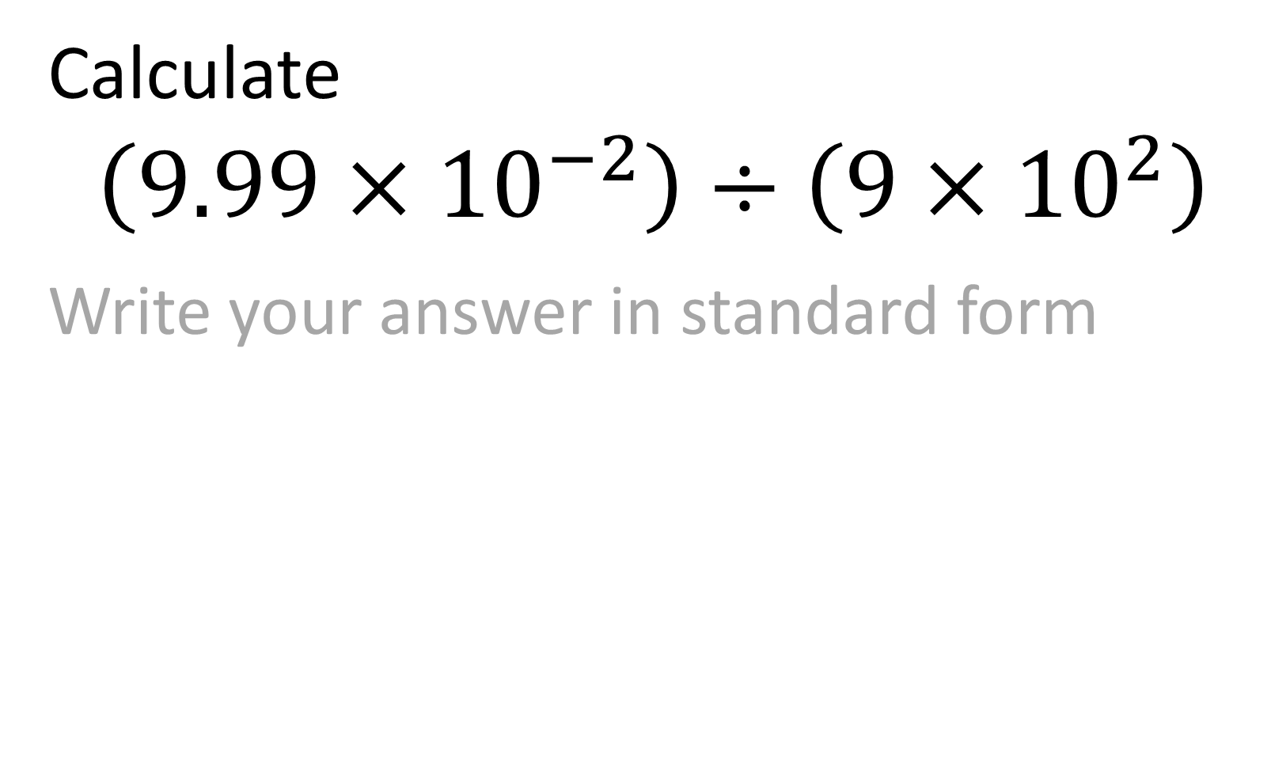
Calculate
$$\left(9.99×{10}^{−2}\right)÷\left(9×{10}^{2}\right)$$
Write your answer in standard form
$$1.11×{10}^{−4}$$

Slide 16
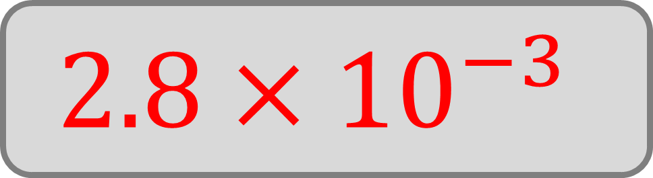

Calculate
$$\left(4.2×{10}^{−5}\right)÷\left(1.5×{10}^{−2}\right)$$
Write your answer in standard form
$$2.8×{10}^{−3}$$

Slide 17
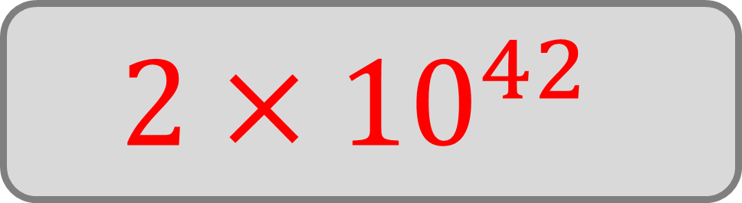

Calculate
$$\left(1.4×{10}^{65}\right)÷\left(7×{10}^{22}\right)$$
Write your answer in standard form
$$2×{10}^{42}$$

Slide 18
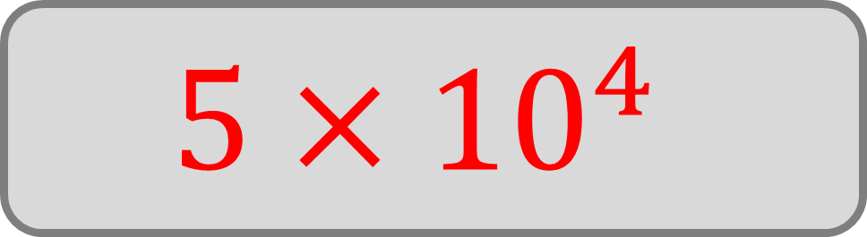

Calculate
$$\left(6.5×{10}^{−11}\right)÷\left(1.3×{10}^{−15}\right)$$
Write your answer in standard form
$$5×{10}^{4}$$

Slide 19
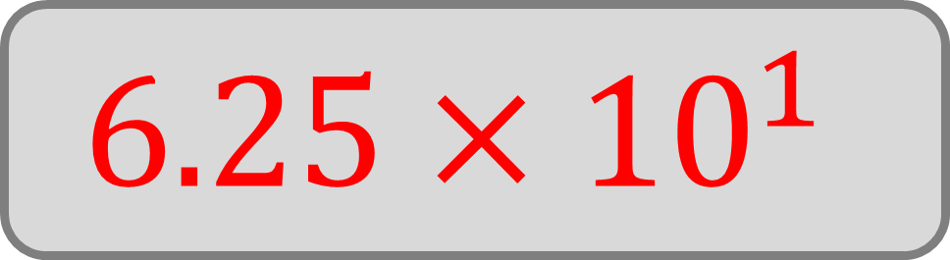
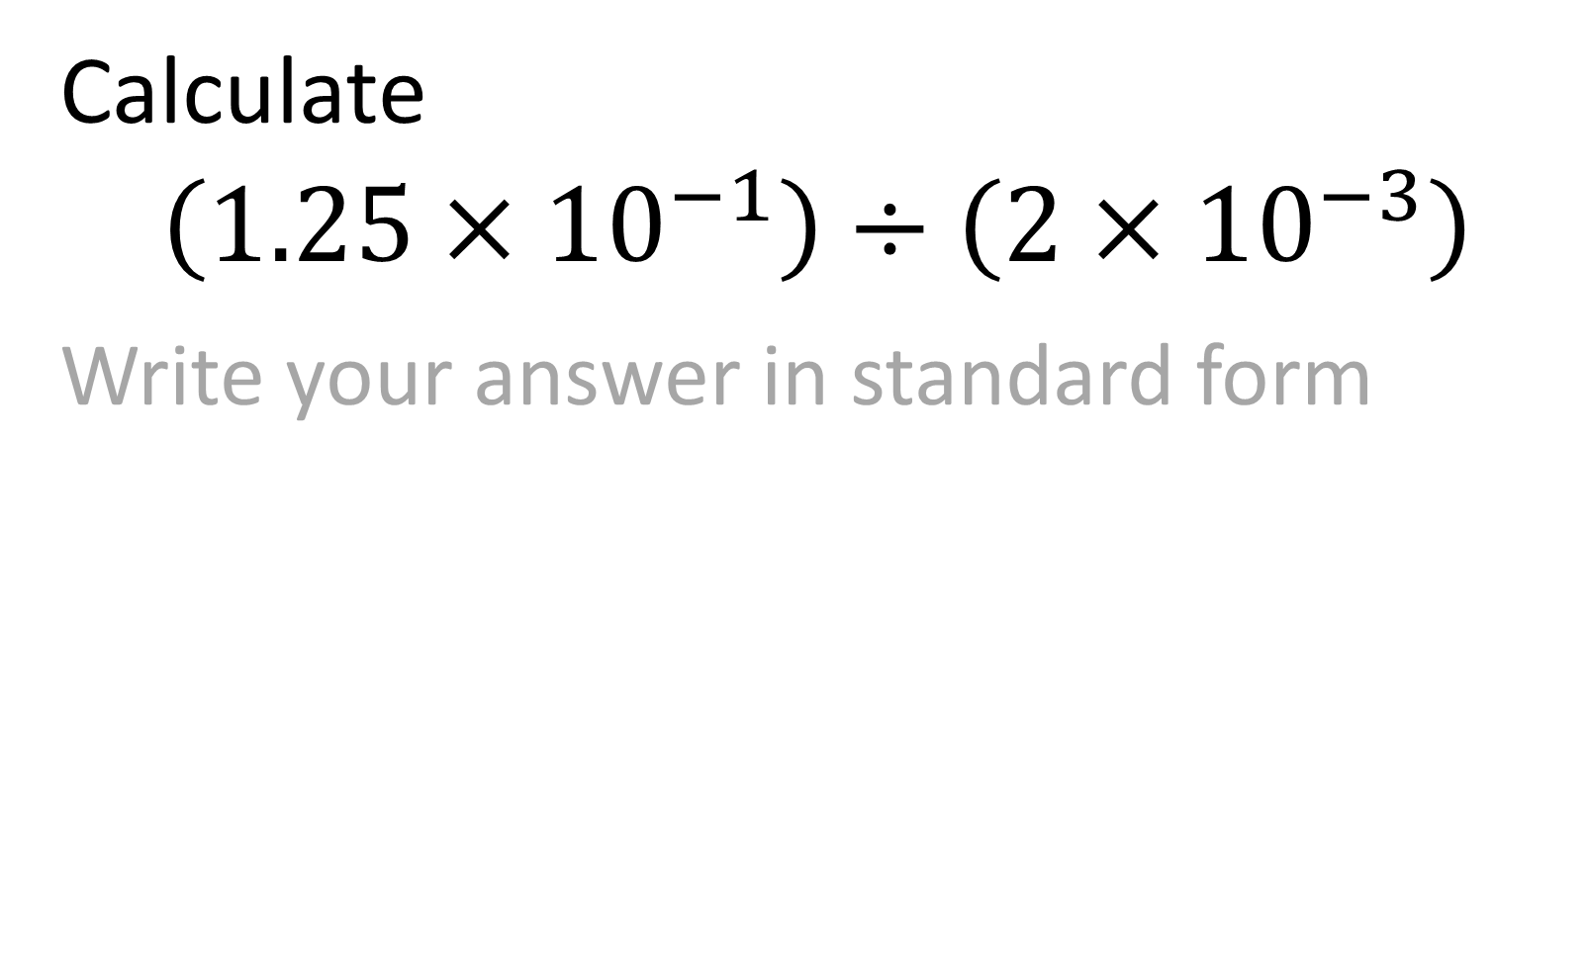
Calculate
$$\left(1.25×{10}^{−1}\right)÷\left(2×{10}^{−3}\right)$$
Write your answer in standard form
$$6.25×{10}^{1}$$

Slide 20
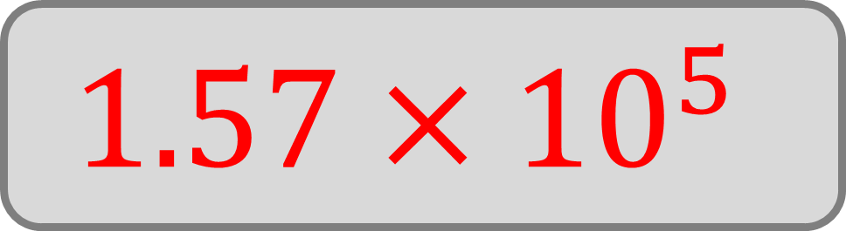

Calculate
$$\left(7.85×{10}^{3}\right)÷\left(5×{10}^{−2}\right)$$
Write your answer in standard form
$$1.57×{10}^{5}$$

Slide 21
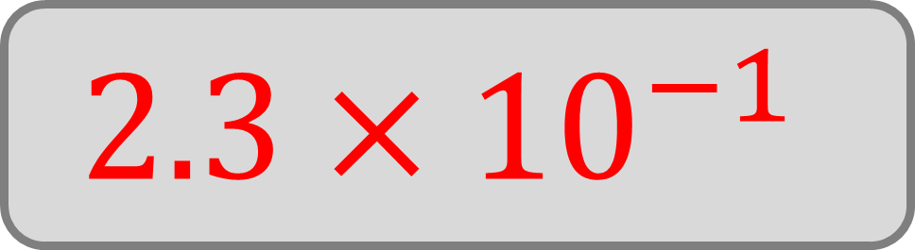

Calculate
$$\left(2.07×{10}^{−7}\right)÷\left(9×{10}^{−7}\right)$$
Write your answer in standard form
$$2.3×{10}^{−1}$$

