Slide 1
GEMS
04 July 2026

Slide 2
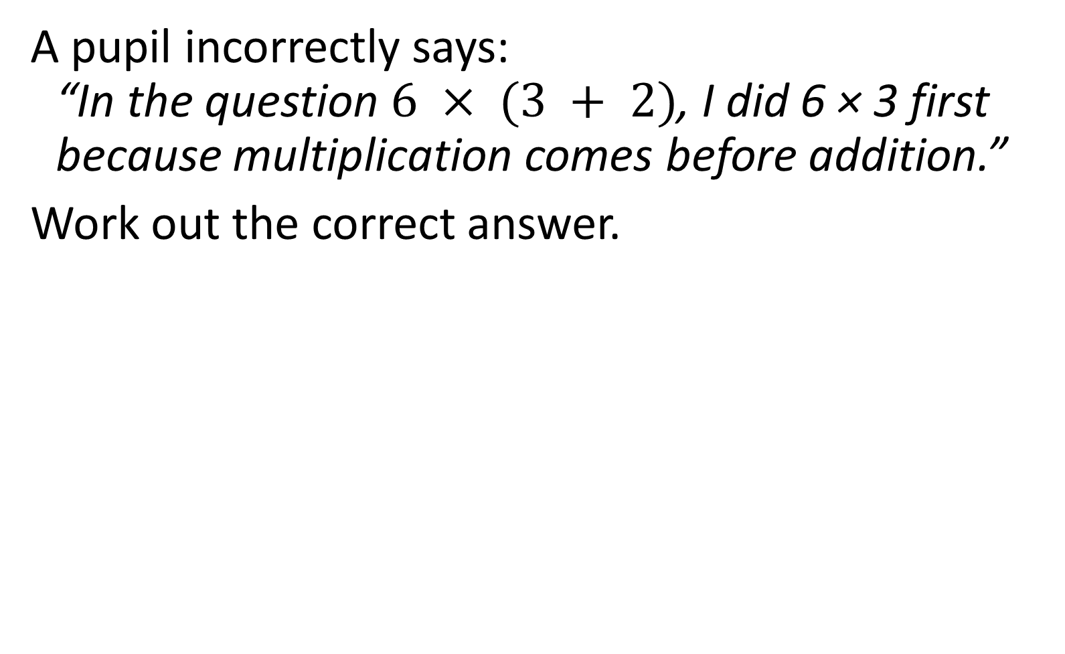

A pupil incorrectly says:
“In the question $6 × (3 + 2)$, I did 6 × 3 first because multiplication comes before addition.”
Work out the correct answer.
$$30$$

Slide 3
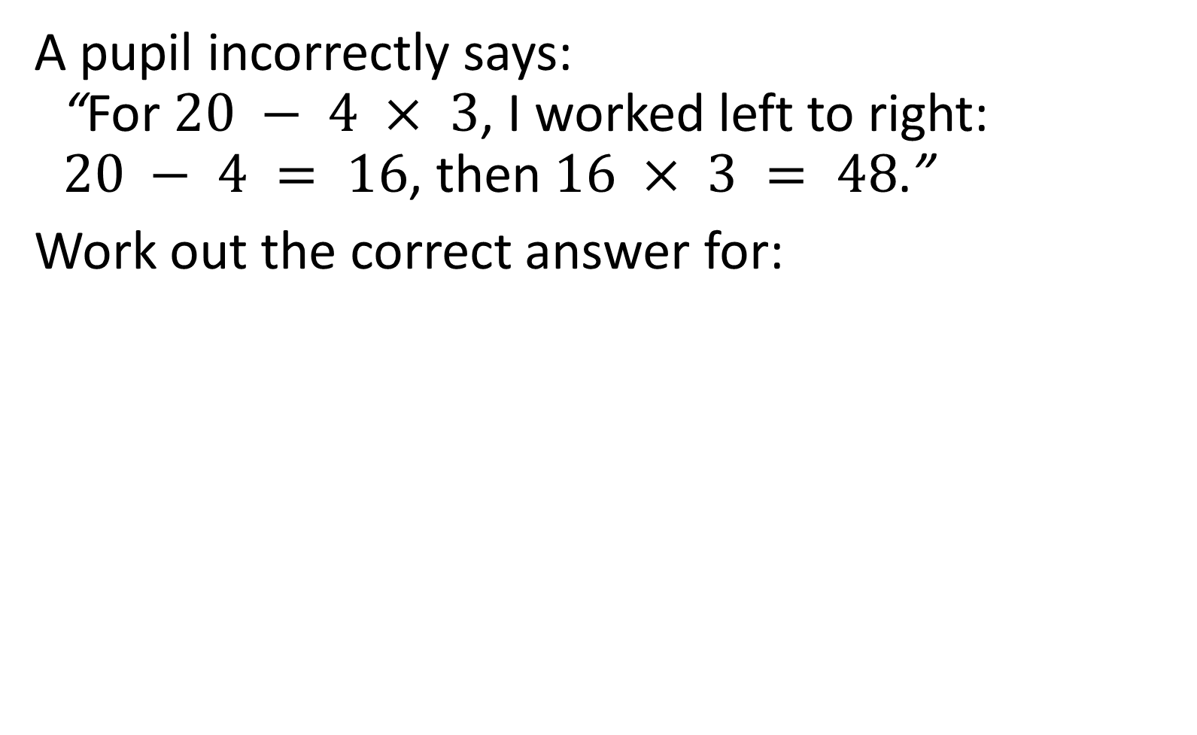
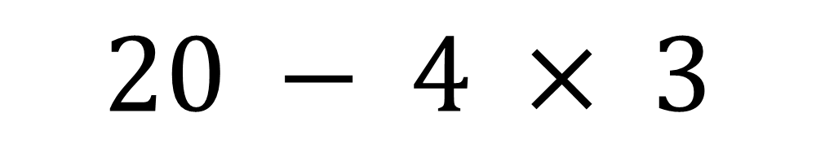

A pupil incorrectly says:
“For $20 − 4 × 3$, I worked left to right:
$20 − 4 = 16$, then $16 × 3 = 48$.”
Work out the correct answer for:
$$20 − 4 × 3$$
$$8$$

Slide 4



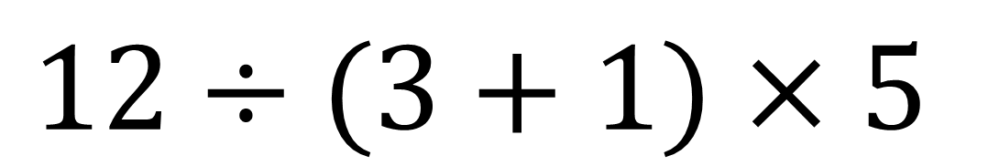
Calculate:
$$\text{12 ÷ (3 + 1) × 5}$$
$$\text{12 ÷}\text{ 4}\text{ × 5}$$
$$\text{3}\text{× 5}$$
$$15$$

Slide 5



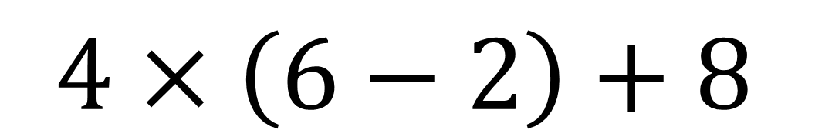
Calculate:
$$4×\left(6−2\right)+8$$
$$\text{4}\text{ × }\text{4 + 8}$$
$$\text{16 + 8}$$
$$24$$

Slide 6



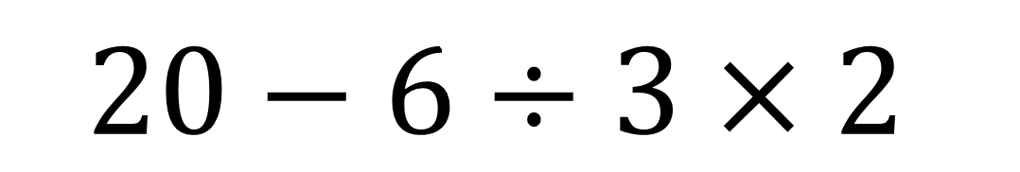
Calculate:
$$20−6÷3×2$$
$$20−2×2$$
$$20−4$$
$$16$$

Slide 7



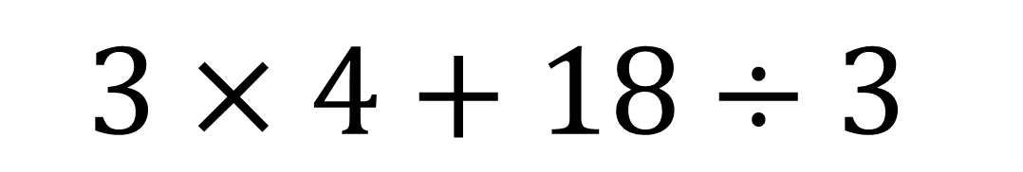
Calculate:
$$3×4+18÷3$$
$$12+18÷3$$
$$12+6$$
$$18$$

Slide 8



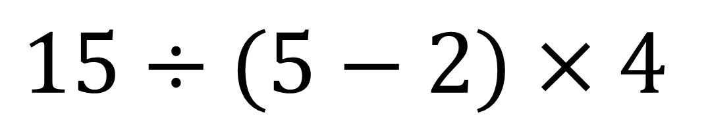
Calculate:
$$15÷(5−2)×4$$
$$15÷3×4$$
$$5×4$$
$$20$$

Slide 9


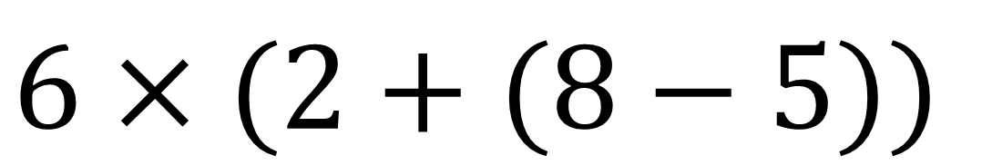
Calculate:
$$6×(2+(8−5))$$
$$6×(2+3)$$
$$6×5$$
$$30$$

Slide 10


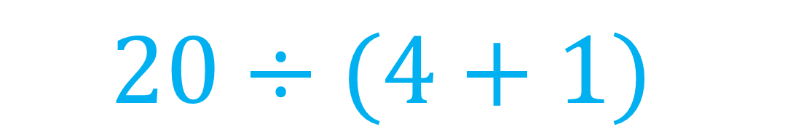
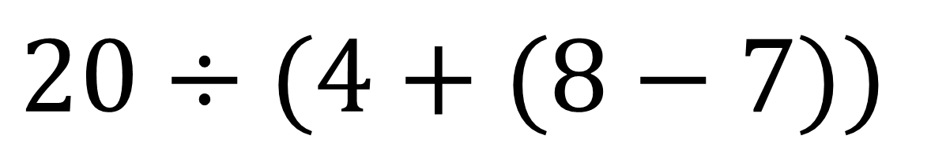
Calculate:
$$20÷(4+(8−7))$$
$$20÷(4+1)$$
$$20÷5$$
$$4$$

Slide 11



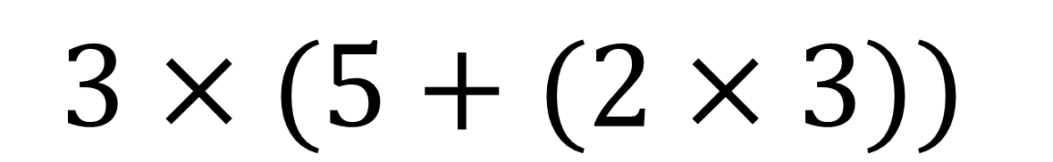
Calculate:
$$3×(5+(2×3))$$
$$3×(5+6)$$
$$3×11$$
$$33$$

Slide 12
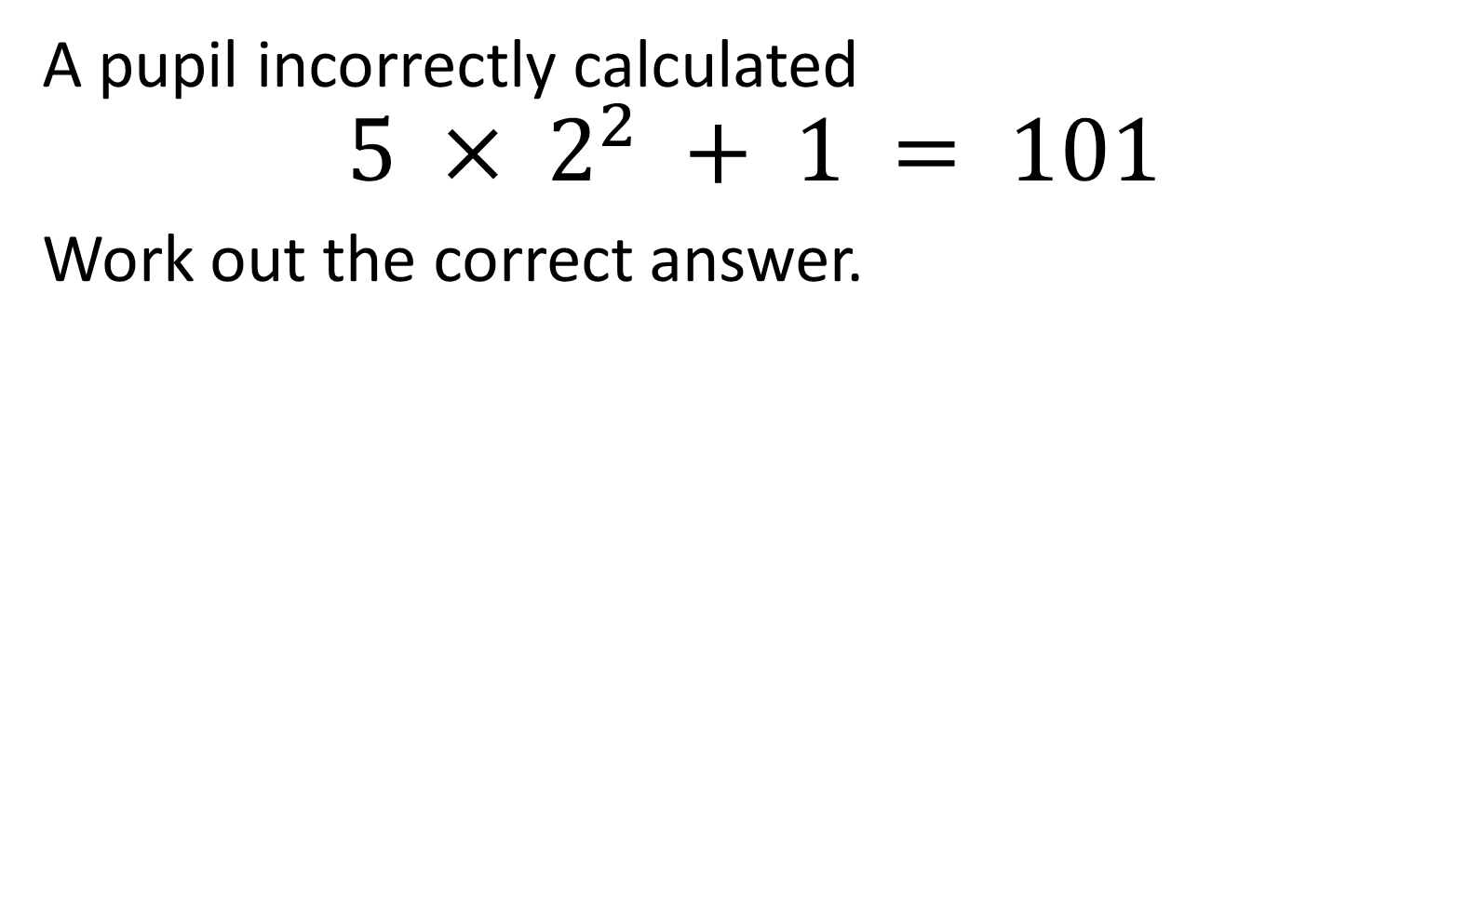

A pupil incorrectly calculated
$$5 × 2^{2} + 1 = 101$$
Work out the correct answer.
$$21$$

Slide 13


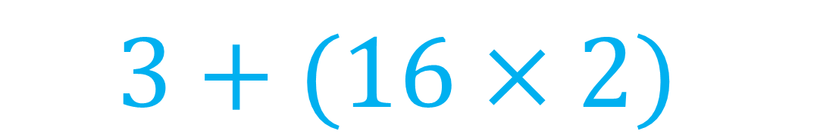

Calculate:
$$3+(4^{2}×2))$$
$$3+(16×2)$$
$$3+32$$
$$35$$

Slide 14



Calculate:
$$6×2^{2}−5$$
$$6×4−5$$
$$24−5$$
$$35$$

Slide 15


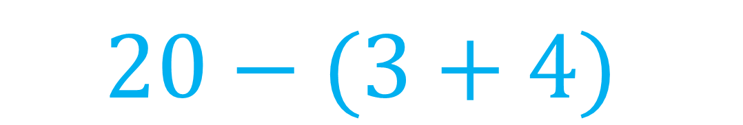
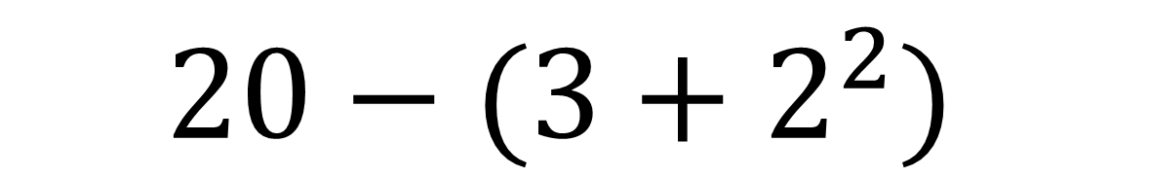
Calculate:
$$20−(3+2^{2})$$
$$20−(3+4)$$
$$20−7$$
$$13$$

Slide 16




Calculate:
$$3^{2}+10÷5$$
$$9+10÷5$$
$$9+2$$
$$11$$

Slide 17




Calculate:
$$25÷5^{2}−1$$
$$25÷25−1$$
$$1−1$$
$$0$$

Slide 18




Calculate:
$$3×{(4+1)}^{2}$$
$$3×5^{2}$$
$$3×25$$
$$75$$

Slide 19



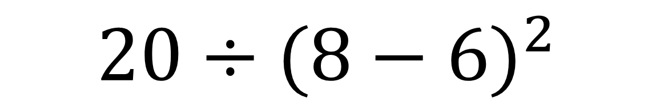
Calculate:
$$20÷{(8−6)}^{2}$$
$$20÷2^{2}$$
$$20÷4$$
$$5$$

Slide 20



Calculate:
$${\left(3+2\right)}^{2}÷5$$
$$5^{2}÷5$$
$$25÷5$$
$$5$$

Slide 21




Calculate:
$${7×\left(4+6\right)}^{2}$$
$$7×{10}^{2}$$
$$7×100$$
$$100$$

