Slide 1
Standard Form
15 June 2026

Slide 2
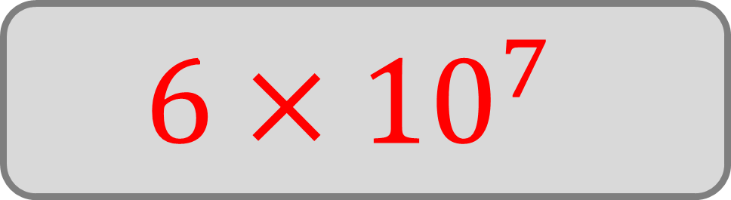
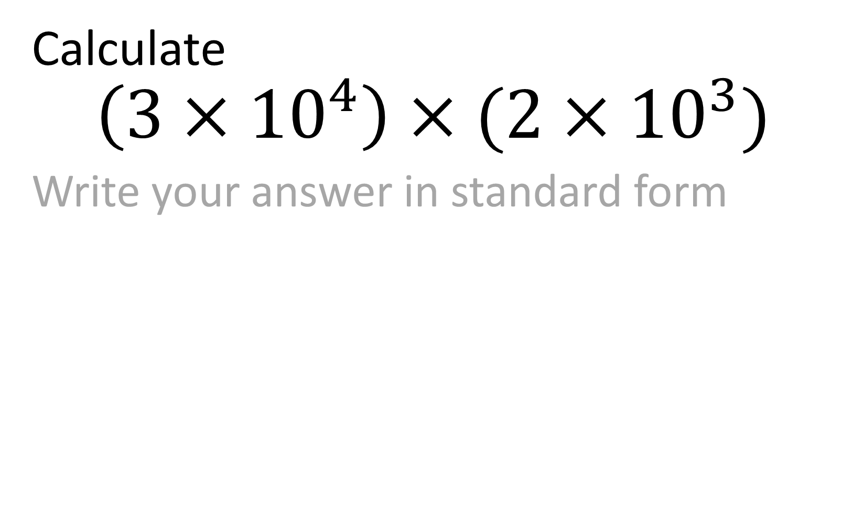
Calculate
$$\left(3×{10}^{4}\right)×(2×{10}^{3})$$
Write your answer in standard form
$$6×{10}^{7}$$

Slide 3
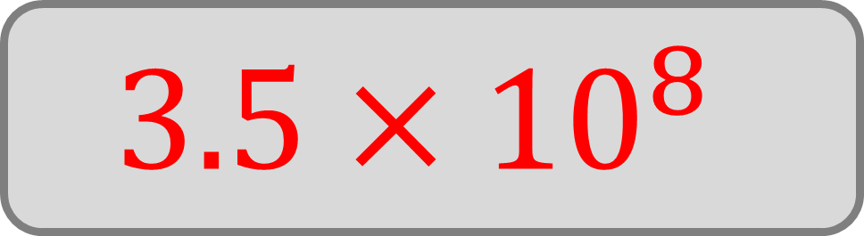
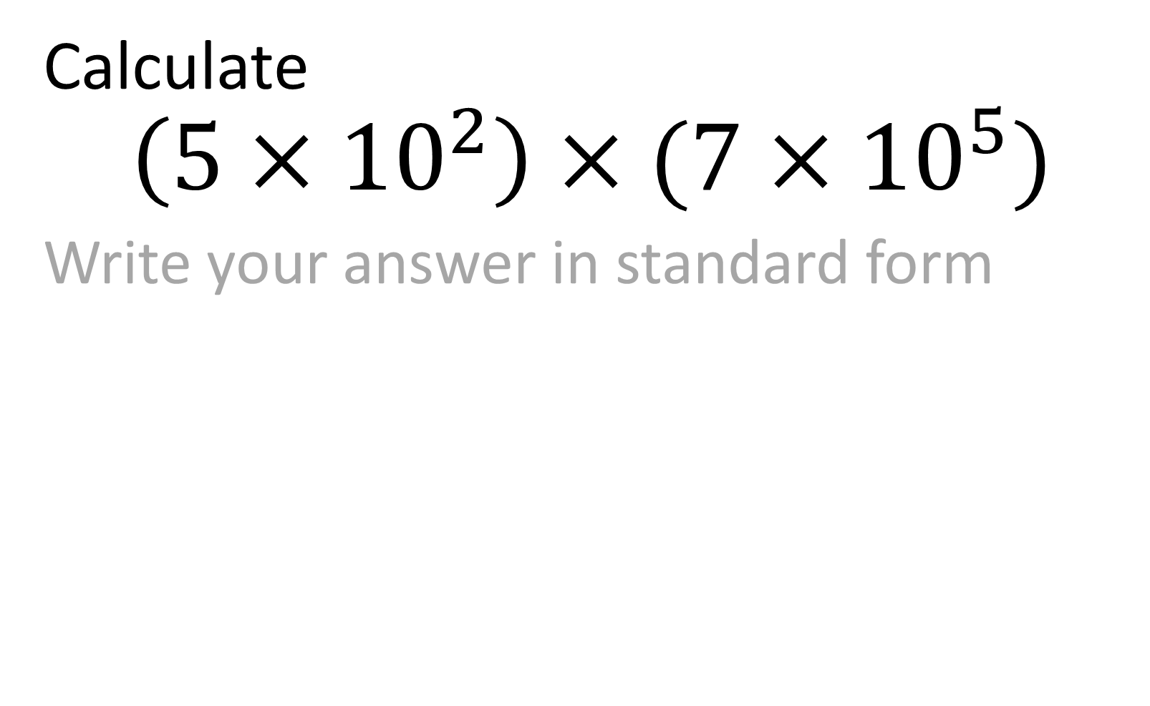
Calculate
$$\left(5×{10}^{2}\right)×(7×{10}^{5})$$
Write your answer in standard form
$$3.5×{10}^{8}$$

Slide 4
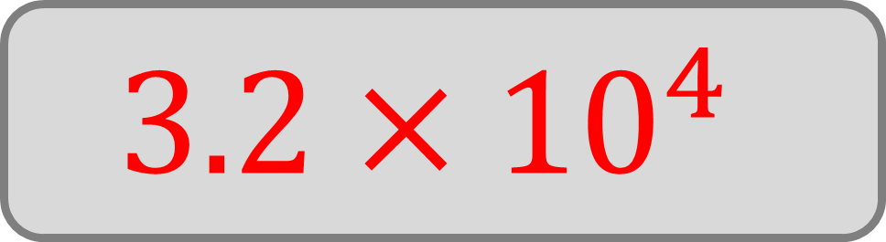

Calculate
$$\left(8×{10}^{6}\right)×(4×{10}^{−3})$$
Write your answer in standard form
$$3.2×{10}^{4}$$

Slide 5
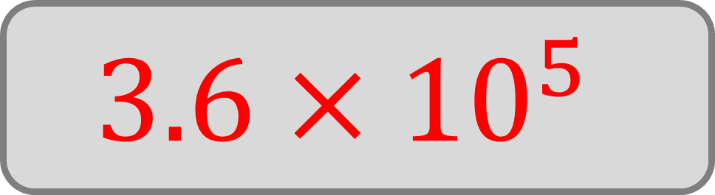

Calculate
$$\left(1.2×{10}^{3}\right)×(3×{10}^{2})$$
Write your answer in standard form
$$3.6×{10}^{5}$$

Slide 6
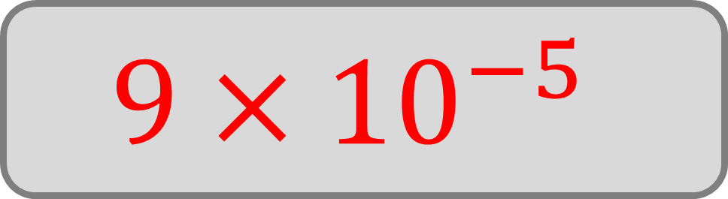

Calculate
$$\left(3×{10}^{−4}\right)×(3×{10}^{−1})$$
Write your answer in standard form
$$9×{10}^{−5}$$

Slide 7
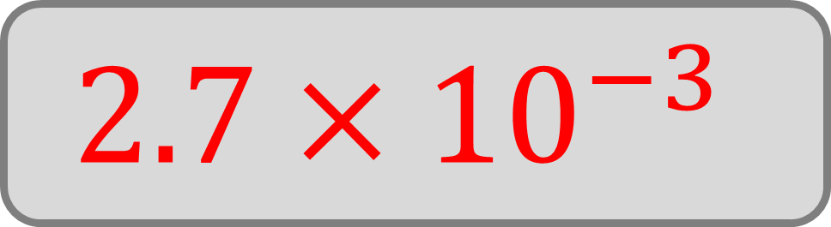

Calculate
$$\left(4.5×{10}^{3}\right)×(6×{10}^{−7})$$
Write your answer in standard form
$$2.7×{10}^{−3}$$

Slide 8
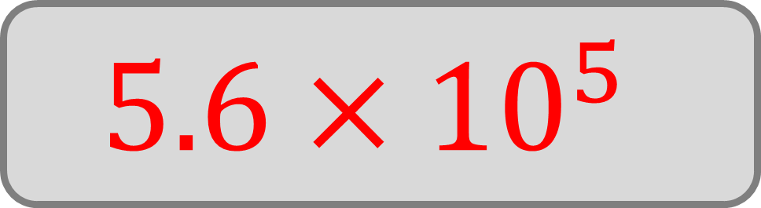

Calculate
$$\left(7×{10}^{2}\right)×(8×{10}^{2})$$
Write your answer in standard form
$$5.6×{10}^{5}$$

Slide 9
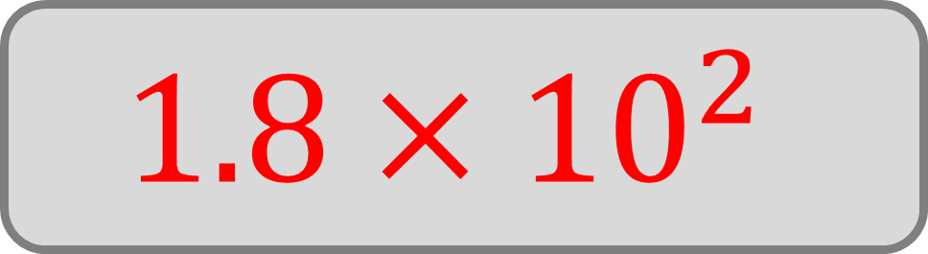

Calculate
$$\left(3.6×{10}^{−3}\right)×(5×{10}^{4})$$
Write your answer in standard form
$$1.8×{10}^{2}$$

Slide 10
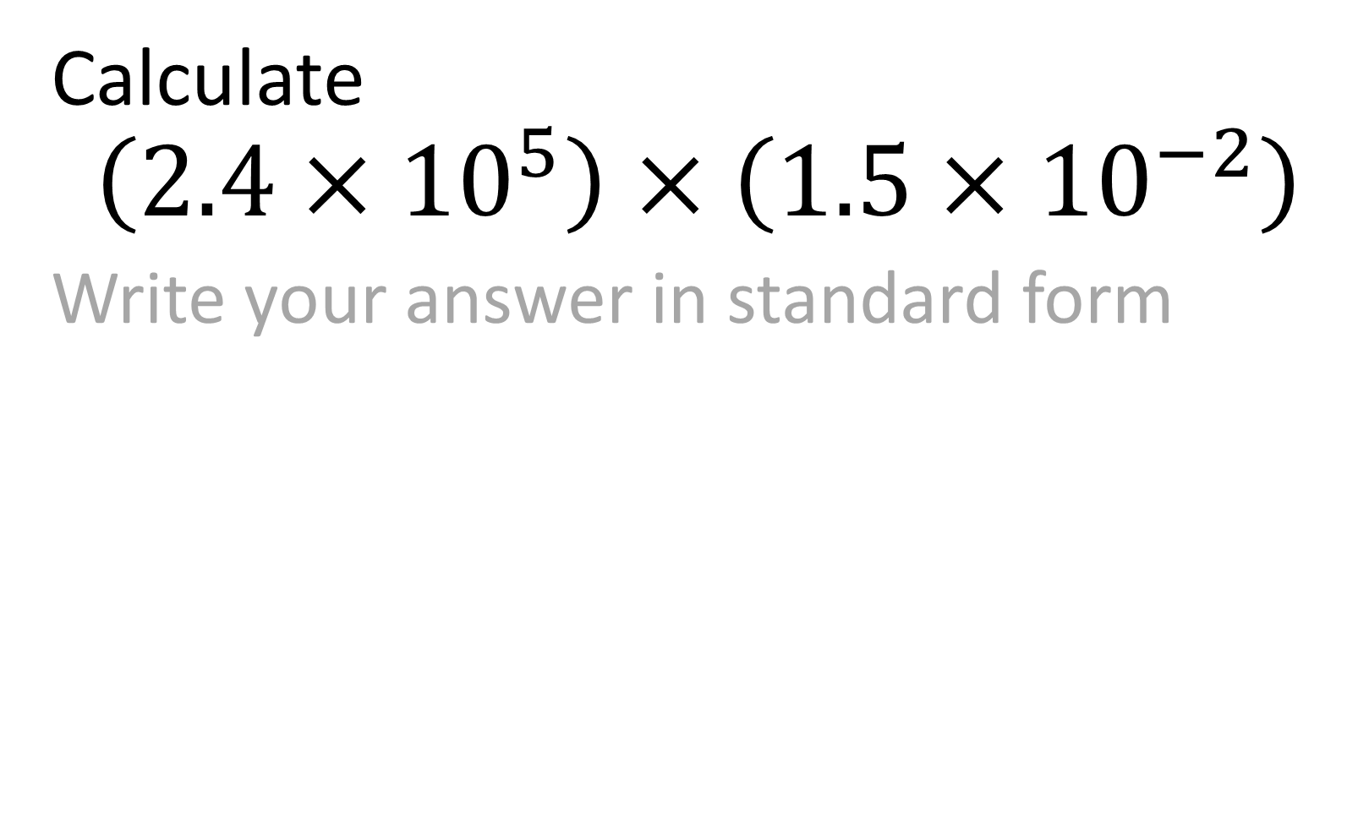
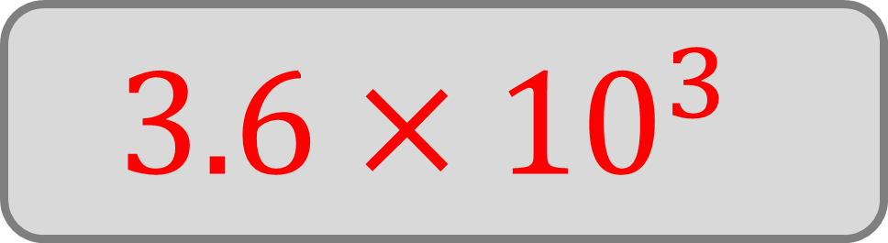
Calculate
$$\left(2.4×{10}^{5}\right)×\left(1.5×{10}^{−2}\right)$$
Write your answer in standard form
$$3.6×{10}^{3}$$

Slide 11

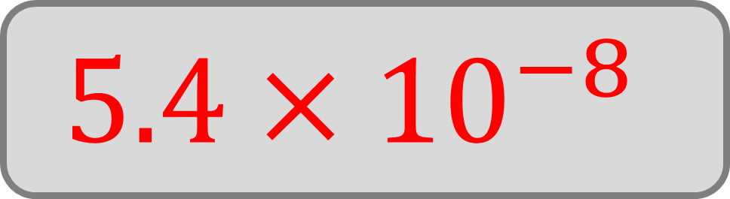
Calculate
$$\left(6×{10}^{−6}\right)×\left(9×{10}^{−3}\right)$$
Write your answer in standard form
$$5.4×{10}^{−8}$$

Slide 12

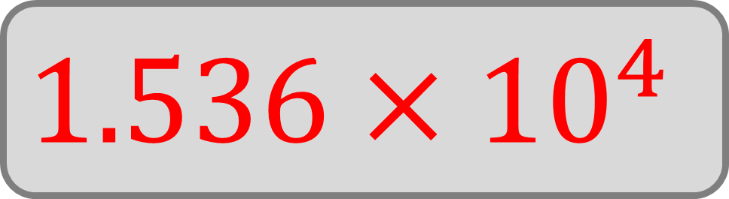
Calculate
$$\left(4.8×{10}^{7}\right)×\left(3.2×{10}^{−4}\right)$$
Write your answer in standard form
$$1.536×{10}^{4}$$

Slide 13

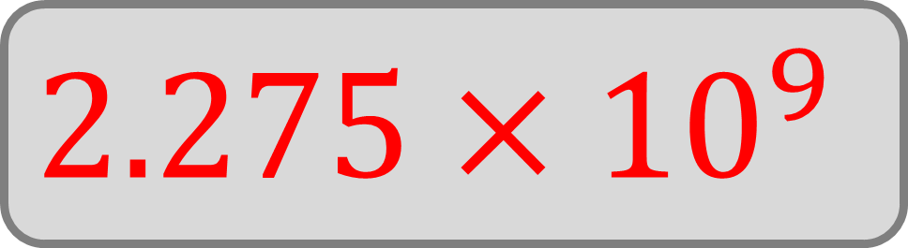
Calculate
$$\left(2.5×{10}^{3}\right)×\left(9.1×{10}^{5}\right)$$
Write your answer in standard form
$$2.275×{10}^{9}$$

Slide 14

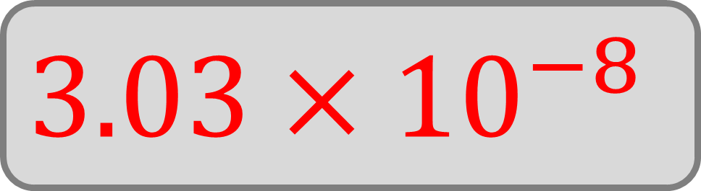
Calculate
$$\left(3×{10}^{7}\right)×\left(1.01×{10}^{−15}\right)$$
Write your answer in standard form
$$3.03×{10}^{−8}$$

Slide 15

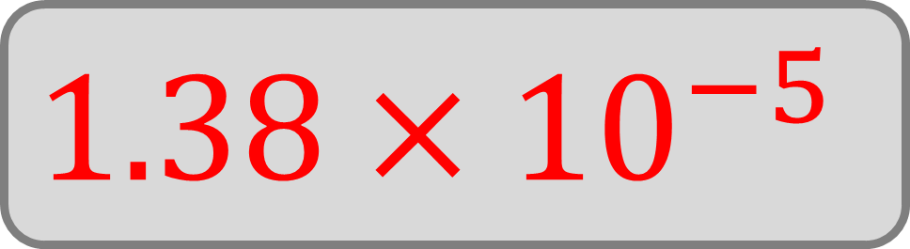
Calculate
$$\left(3×{10}^{−2}\right)×\left(4.6×{10}^{−4}\right)$$
Write your answer in standard form
$$1.38×{10}^{−5}$$

Slide 16

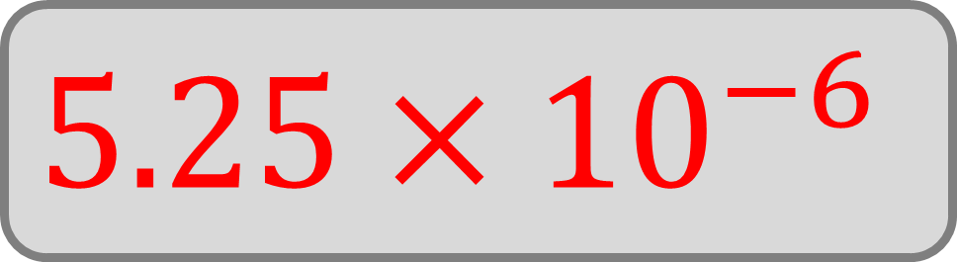
Calculate
$$\left(3.5×{10}^{2}\right)×\left(1.5×{10}^{−8}\right)$$
Write your answer in standard form
$$5.25×{10}^{−6}$$

Slide 17

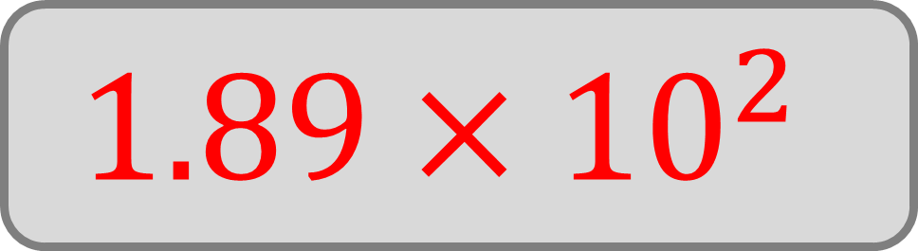
Calculate
$$\left(4.5×{10}^{4}\right)×\left(4.2×{10}^{−3}\right)$$
Write your answer in standard form
$$1.89×{10}^{2}$$

Slide 18

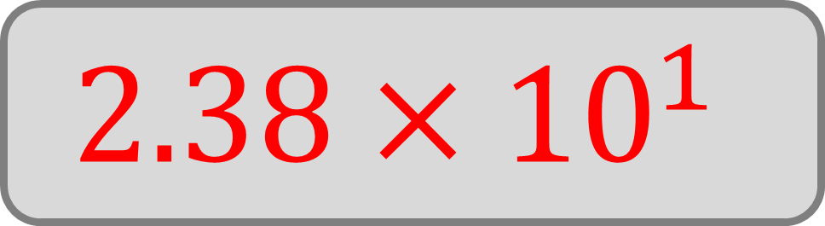
Calculate
$$\left(3.4×{10}^{4}\right)×\left(7×{10}^{−4}\right)$$
Write your answer in standard form
$$2.38×{10}^{1}$$

Slide 19

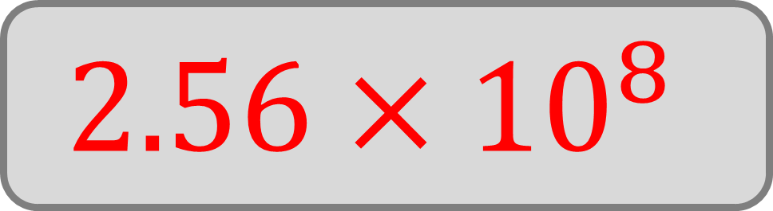
Calculate
$$\left(1.6×{10}^{4}\right)×\left(1.6×{10}^{4}\right)$$
Write your answer in standard form
$$2.56×{10}^{8}$$

Slide 20


Calculate
$${\left(2.5×{10}^{7}\right)}^{2}$$
Write your answer in standard form
$$6.25×{10}^{14}$$

Slide 21
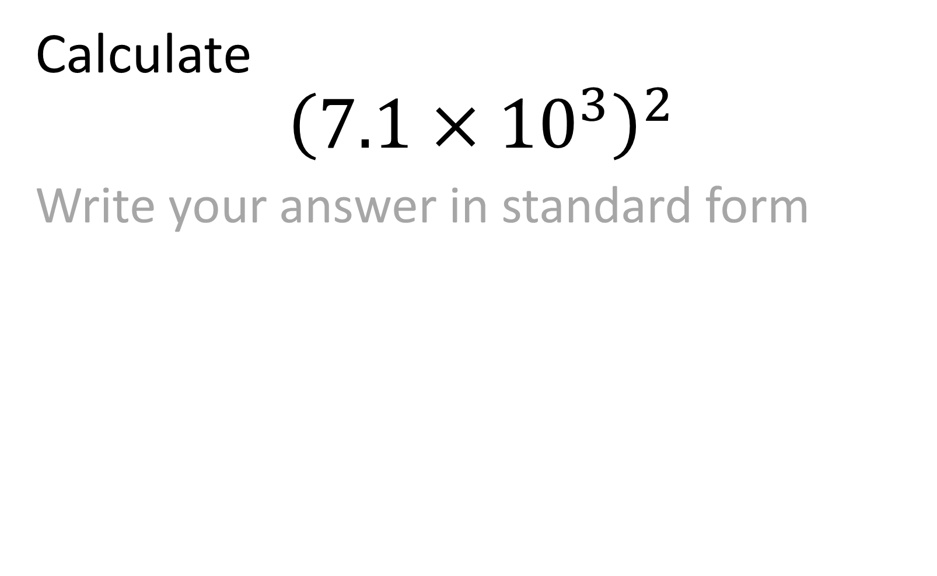
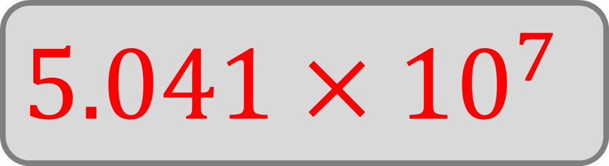
Calculate
$${\left(7.1×{10}^{3}\right)}^{2}$$
Write your answer in standard form
$$5.041×{10}^{7}$$

