Slide 1
Ratio and Fractions
15 September 2026

Slide 2

The ratio of red cubes to blue cubes in a bag is 1 : 3.
What fraction of the cubes are red?
$$1/4$$

Slide 3

The ratio of green marbles to yellow marbles in a bag is 4 : 1.
What fraction of the marbles are yellow?
$$1/5$$

Slide 4

The ratio of cats to dogs is 2 : 5.
What fraction of the animals are cats?
$$2/7$$

Slide 5

Gold medals and silver medals are in a ratio of 7 : 3.
What percentage of the medals are gold?
$$70\%$$

Slide 6
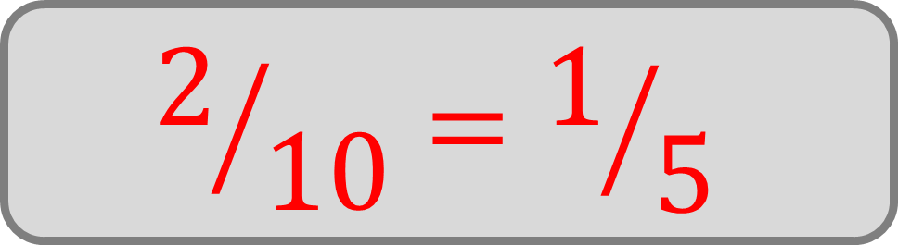
A bag contains red, blue and green counters in the ratio 3 : 2 : 5.
What fraction of the counters are blue?
$$2/{10}=1/5$$

Slide 7

A drink is made by mixing lemonade and orange juice in a ratio of 3 : 1.
What percentage of the drink is lemonade?
$$75\%$$

Slide 8

60% of the beads in a jar are purple, the rest of the beads are green.
Write the ratio of purple beads to green beads.
$$3 :2$$

Slide 9

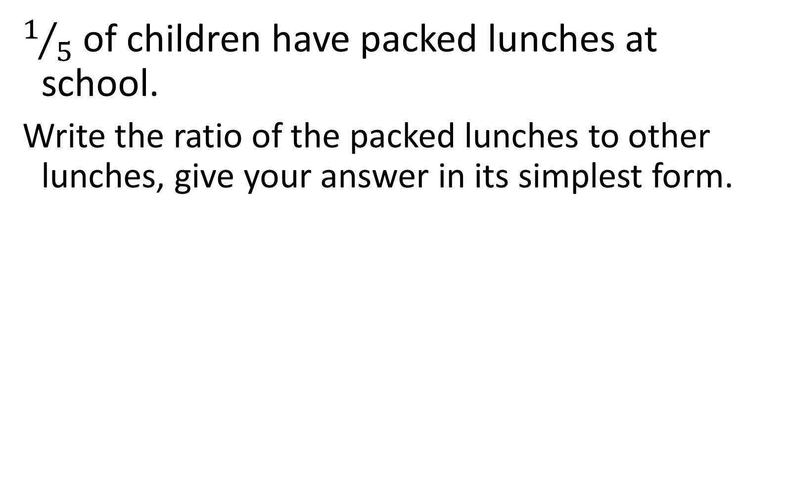
$1/5$ of children have packed lunches at school.
Write the ratio of the packed lunches to other lunches, give your answer in its simplest form.
$$1 :4$$

Slide 10

Marie scored 45% on her most recent exam.
Write the ratio of her correct to incorrect answers.
$$9 :11$$

Slide 11

One third of the pencils in a pot are broken.
What is the ratio of broken to unbroken pencils.
$$1 :2$$

Slide 12

Three-quarters of the students in a club are boys.
In its simplest form, what is the ratio of boys to girls?
$$3 :1$$

Slide 13
Given that a team wins one fifth of their matches, calculate the ratio of matches won to matches lost.
$$1 :4$$

Slide 14

Green and orange sweets are in the ratio 6 : 9.
What percentage of the sweets are orange?
$$60\%$$

Slide 15
There are three times as many pencils than pens in a draw. What fraction of the items are pens?
$$1/4$$

Slide 16

Half the apples in a crate are bruised.
Write the ratio of bruised apples to non-bruised apples.
$$1 :1$$

Slide 17

The ratio of small to medium to large boxes is
2 : 3 : 5.
What fraction of the boxes are large?
$$1/2$$

Slide 18

18% of the books on a shelf are non-fiction.
Write the ratio of fiction to non-fiction books.
$$41 :9$$

Slide 19

A class has boys and girls in the ratio 11 : 14.
What percentage of the class are girls?
$$56\%$$

Slide 20
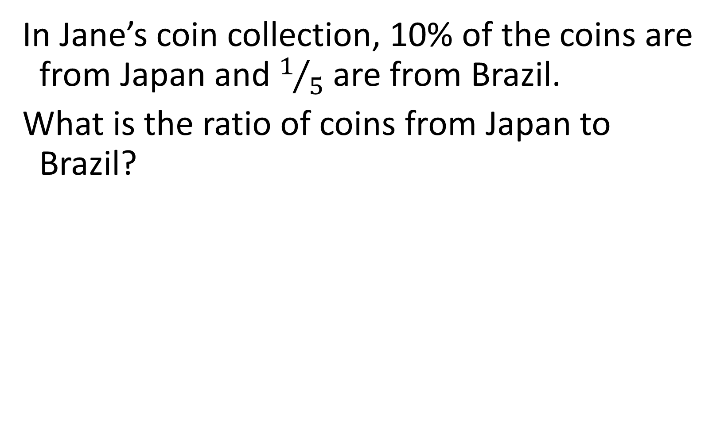
In Jane’s coin collection, 10% of the coins are from Japan and $1/5$ are from Brazil.
What is the ratio of coins from Japan to Brazil?
$$1 :2$$

Slide 21

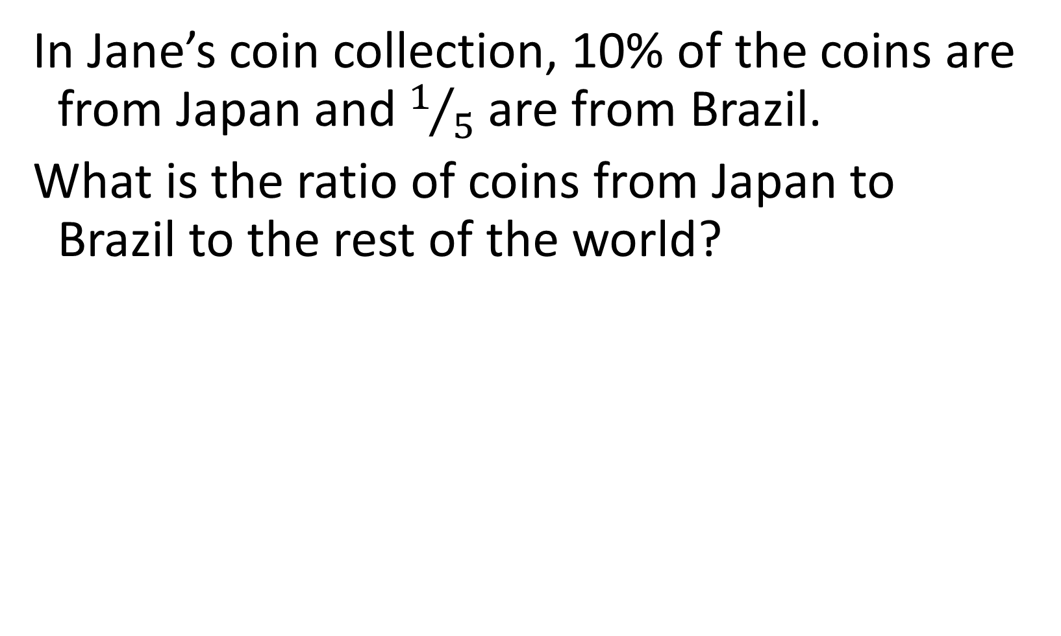
In Jane’s coin collection, 10% of the coins are from Japan and $1/5$ are from Brazil.
What is the ratio of coins from Japan to Brazil to the rest of the world?
$$1 :2 :7$$

