Slide 1
Venn Diagrams
21 June 2026

Slide 2
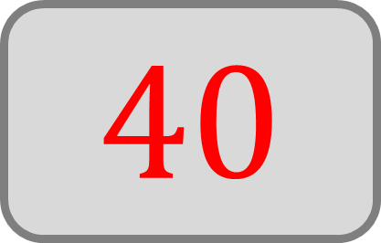
The Venn diagram shows the prime factorisation of two numbers, A and B.
What is the value of A?
A
B
2
2
3
5
2
$$40$$

Slide 3

The Venn diagram shows the prime factorisation of two numbers, A and B.
What is the value of B?
A
B
2
2
3
5
2
$$60$$

Slide 4

The Venn diagram shows the prime factorisation of two numbers, A and B.
What is the HCF of A and B?
A
B
2
2
3
5
2
$$20$$

Slide 5
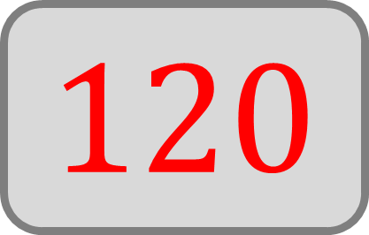
The Venn diagram shows the prime factorisation of two numbers, A and B.
What is the LCM of A and B?
A
B
2
2
3
5
2
$$120$$

Slide 6
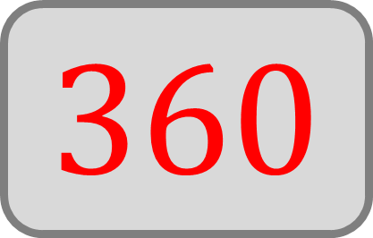
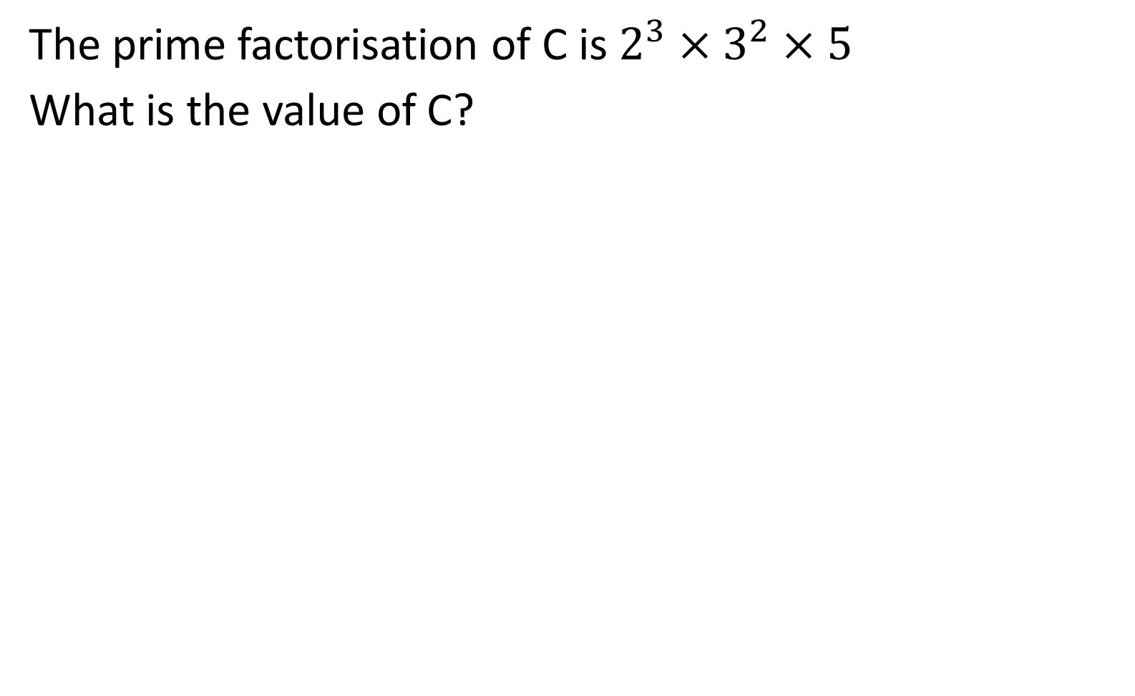
The prime factorisation of C is $2^{3}×3^{2}×5$
What is the value of C?
C
D
$$360$$

Slide 7
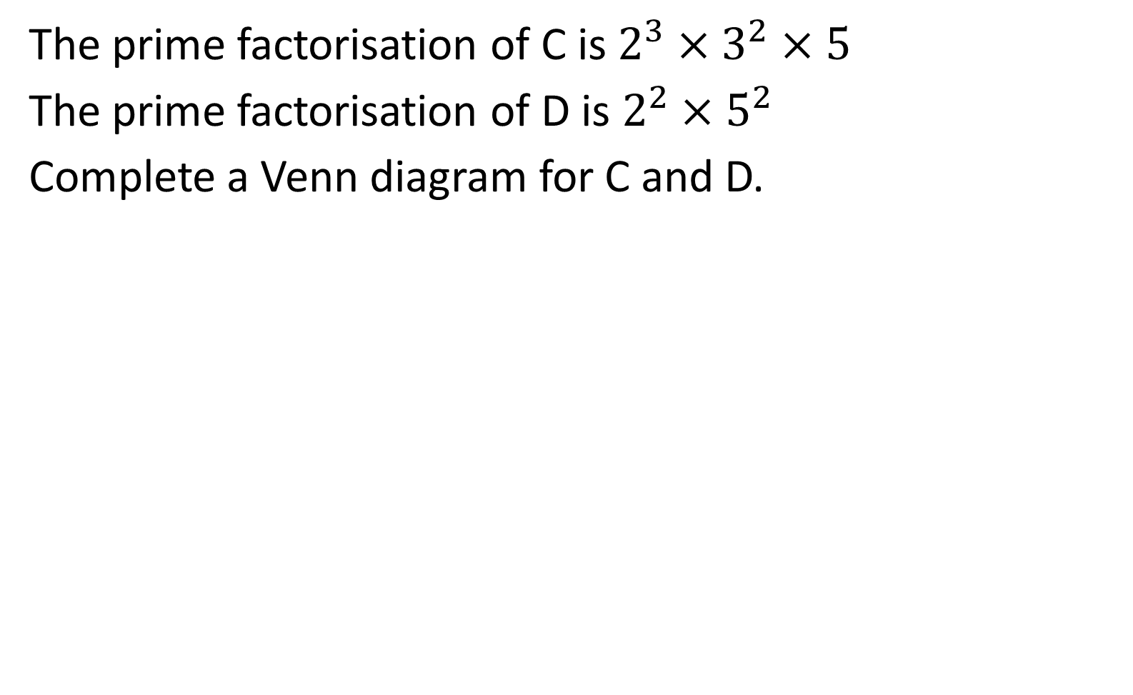
The prime factorisation of C is $2^{3}×3^{2}×5$
The prime factorisation of D is $2^{2}×5^{2}$
Complete a Venn diagram for C and D.
C
D
3
2
2
5
5
3
2

Slide 8
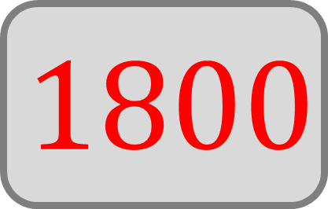
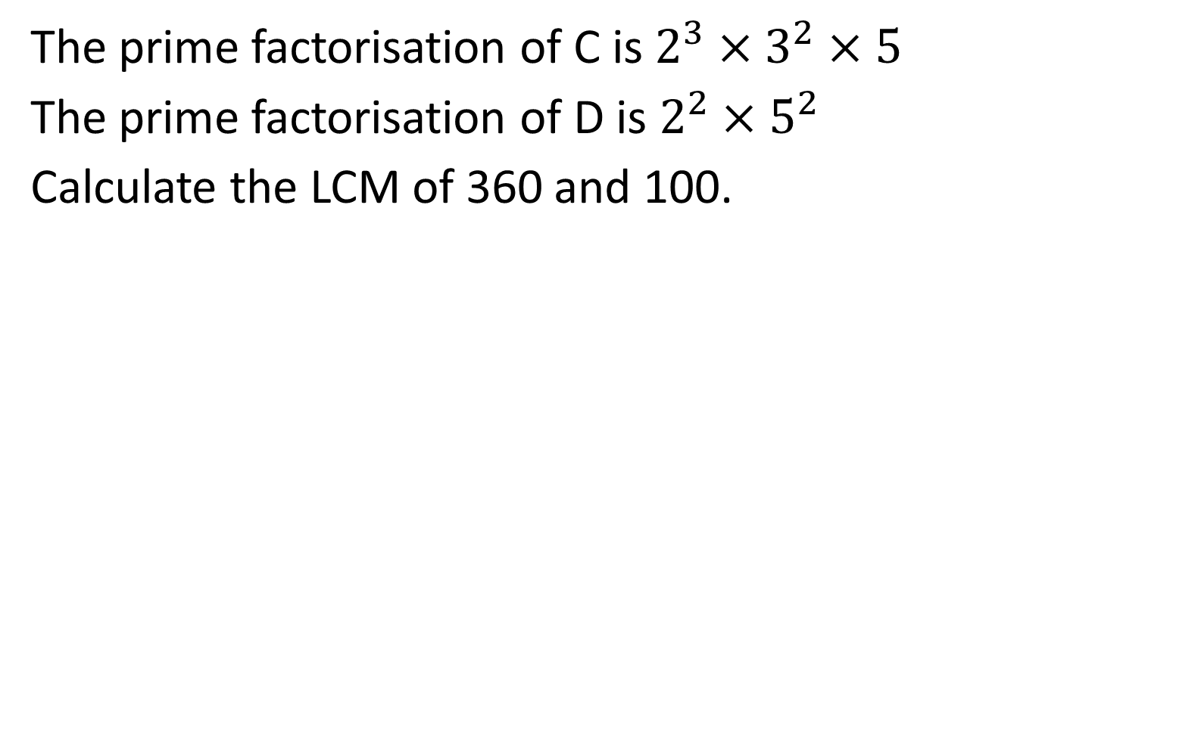
The prime factorisation of C is $2^{3}×3^{2}×5$
The prime factorisation of D is $2^{2}×5^{2}$
Calculate the LCM of 360 and 100.
A
B
3
2
2
5
5
3
2
$$1800$$

Slide 9
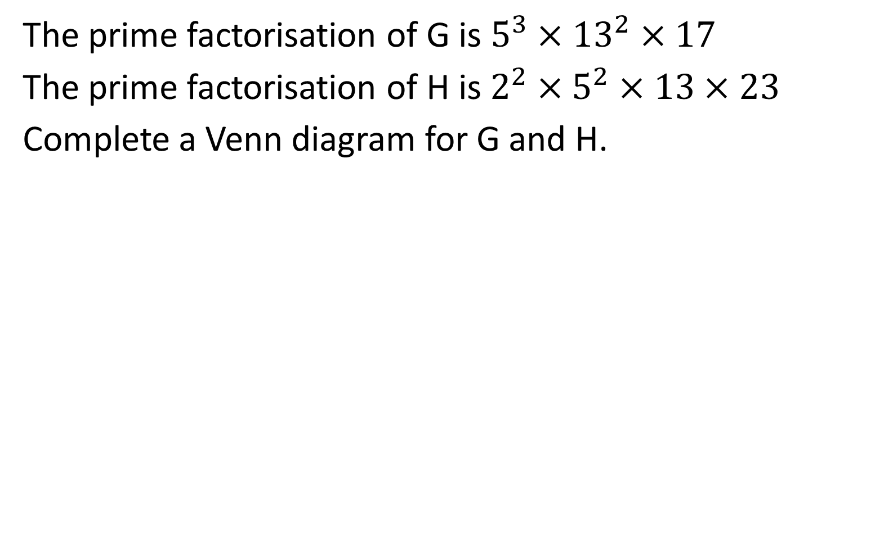
The prime factorisation of G is $5^{3}×{13}^{2}×17$
The prime factorisation of H is $2^{2}×5^{2}×13×23$
Complete a Venn diagram for G and H.
G
H
2
17
13
23
5
13
5
2

Slide 10
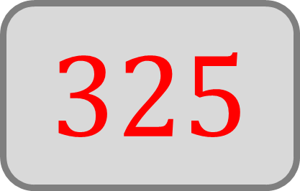
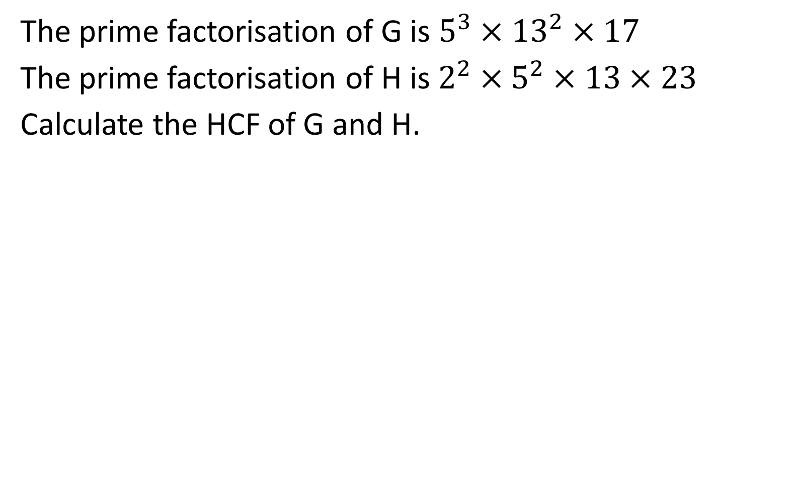
The prime factorisation of G is $5^{3}×{13}^{2}×17$
The prime factorisation of H is $2^{2}×5^{2}×13×23$
Calculate the HCF of G and H.
G
H
2
17
13
23
5
13
5
2
$$325$$

Slide 11
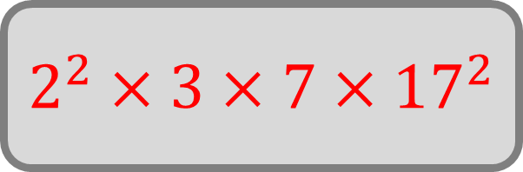
The Venn diagram shows the prime factorisation of two numbers, M and N.
Write M as a product of its prime factors.
M
N
7
13
17
2
3
17
2
23
$$2^{2}×3×7×{17}^{2}$$

Slide 12

The Venn diagram shows the prime factorisation of two numbers, E and F.
What is the HCF of E and F?
E
F
2
3
2
3
2
5
$$1$$
2
5

Slide 13
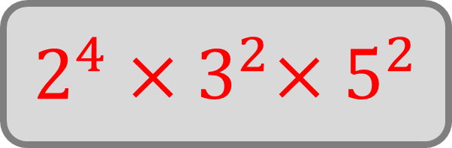
The Venn diagram shows the prime factorisation of two numbers, E and F.
Write the LCM of E and F as a product of primes in
index form.
E
F
2
3
2
3
2
5
2
5
$$2^{4}{×3}^{2}×5^{2}$$

Slide 14
The Venn diagram represents the prime factorisation of two numbers, X and Y.
True or false: X is a multiple of Y
X
Y
2
3
7
5
3
2
True

Slide 15
The Venn diagram represents the prime factorisation of two numbers, X and Y.
True or false: Y is a multiple of X
X
Y
2
3
7
5
3
2
False

Slide 16
The Venn diagram shows the prime factorisation of two numbers, S and T.
What is the HCF of S and T?
S
T
2
2
3
5
3
2
2
5
$$60$$

Slide 17
The Venn diagram shows the prime factorisation of two numbers, S and T.
Write the LCM of S and T as a product of primes in
index form.
S
T
2
2
3
5
3
2
2
5
$$2^{4}{×3}^{2}×5^{2}$$

Slide 18

The Venn diagram shows the prime factorisation of two numbers, K and L.
What is the HCF of K and L?
K
L
7
11
3
3
3
3
11
$$99$$
17

Slide 19
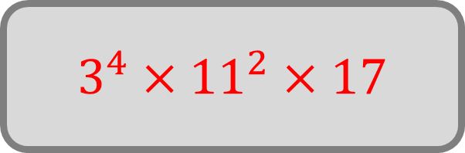
The Venn diagram shows the prime factorisation of two numbers, K and L.
Write L as a product of primes in index form.
K
L
7
11
3
3
3
3
11
17
$$3^{4}×{11}^{2}×17$$

Slide 20
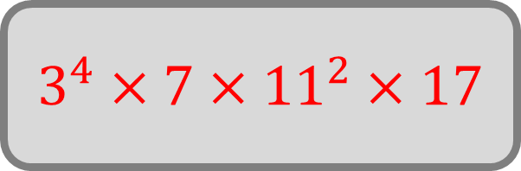
The Venn diagram shows the prime factorisation of two numbers, K and L.
Write the LCM of K and L as a product of primes in
index form.
K
L
7
11
3
3
3
3
11
17
$$3^{4}×7×{11}^{2}×17$$

Slide 21
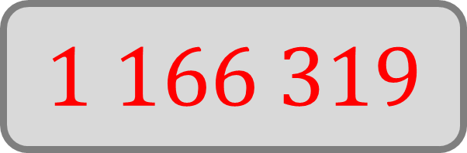
The Venn diagram shows the prime factorisation of two numbers, K and L.
Given that L = 166,617, calculate the value of
the LCM of K and L.
K
L
7
11
3
3
3
3
11
17
$$1 166 319$$

