Slide 1
Volume
30 September 2026

Slide 2
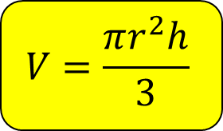



Calculate the volume of the cone with a height 11 cm and radius 6 cm.
Give your answer to 1 decimal place.
Not drawn accurately
$$11 cm$$
$$V=\frac{πr^{2}h}{3}$$
$$6 cm$$
$$414.7 cm^{3}$$

Slide 3



Calculate the volume of the cone with a height 6 cm and radius 11 cm.
Give your answer to 1 decimal place.
Not drawn accurately
$$6 cm$$
$$V=\frac{πr^{2}h}{3}$$
$$11 cm$$
$$760.3 cm^{3}$$

Slide 4


Calculate the volume of the cone with a height 6 cm and diameter 11 cm.
Give your answer to 1 decimal place.
Not drawn accurately
$$6 cm$$
$$V=\frac{πr^{2}h}{3}$$
$$11 cm$$
$$190.1 cm^{3}$$

Slide 5

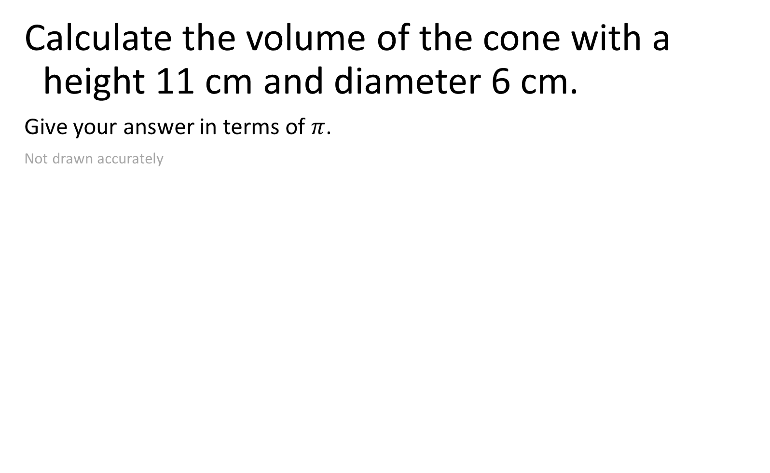

Calculate the volume of the cone with a height 11 cm and diameter 6 cm.
Give your answer in terms of $π$.
Not drawn accurately
$$11 cm$$
$$V=\frac{πr^{2}h}{3}$$
$$6 cm$$
$$33π cm^{3}$$

Slide 6

Calculate the volume of the cone with a height 8 cm and radius 8 cm.
Give your answer to 1 decimal place.
$$V=\frac{πr^{2}h}{3}$$
$$536.2 cm^{3}$$

Slide 7


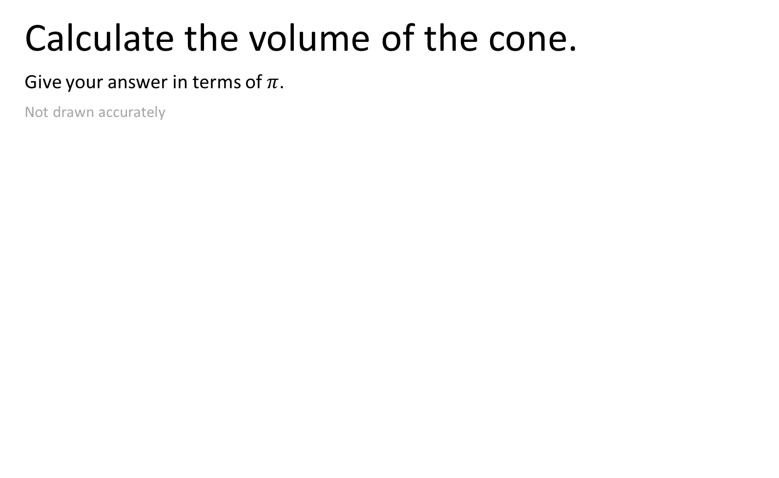


Calculate the volume of the cone.
Give your answer in terms of $π$.
Not drawn accurately
$$13 cm$$
$$5 cm$$
$$V=\frac{πr^{2}h}{3}$$
$$24 cm$$
$$240π cm^{3}$$

Slide 8

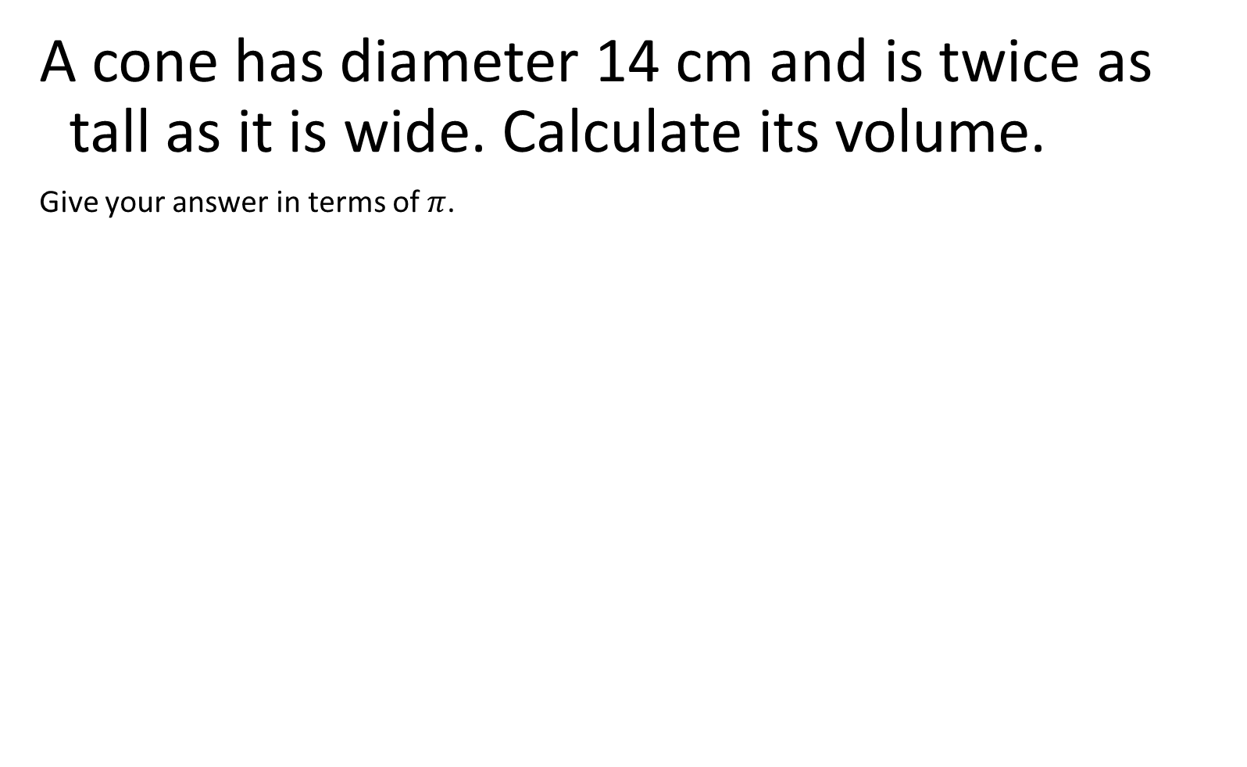
A cone has diameter 14 cm and is twice as tall as it is wide. Calculate its volume.
Give your answer in terms of $π$.
$$V=\frac{πr^{2}h}{3}$$
$$\frac{1372}{3}π {cm}^{3}$$

Slide 9




Estimate the volume of the cone.
Give your answer in terms of $π$.
Not drawn accurately
$$12.2 cm$$
$$V=\frac{πr^{2}h}{3}$$
$$5.3 cm$$
$$100π {cm}^{3}$$

Slide 10

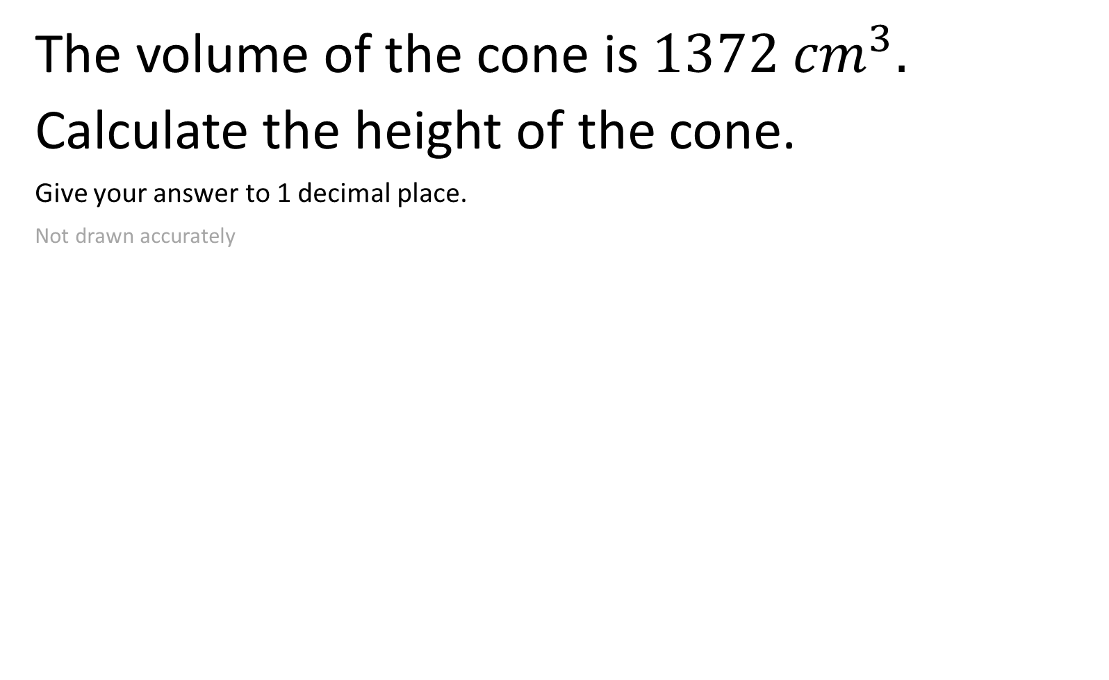


The volume of the cone is $1372 {cm}^{3}.$
Calculate the height of the cone.
Give your answer to 1 decimal place.
Not drawn accurately
$$h cm$$
$$V=\frac{πr^{2}h}{3}$$
$$8 cm$$
$$20.5 cm$$

Slide 11

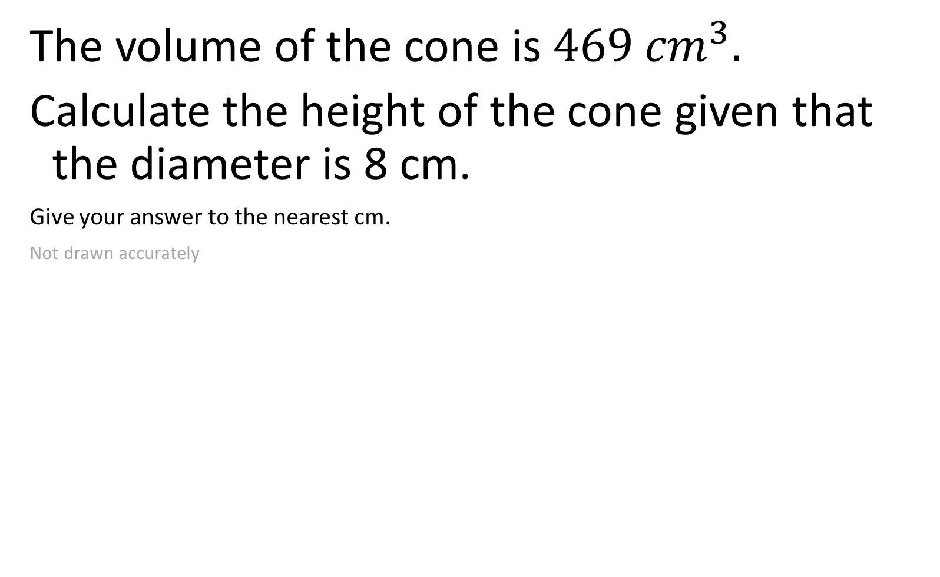


The volume of the cone is $469 {cm}^{3}.$
Calculate the height of the cone given that the diameter is 8 cm.
Give your answer to the nearest cm.
Not drawn accurately
$$h cm$$
$$V=\frac{πr^{2}h}{3}$$
$$8 cm$$
$$28 cm$$

Slide 12




The volume of the cone is $469 {cm}^{3}.$
Calculate the radius of the cone given that the height is 8 cm.
Give your answer to 1 decimal place.
Not drawn accurately
$$8 cm$$
$$V=\frac{πr^{2}h}{3}$$
$$r cm$$
$$7.5 cm$$

Slide 13

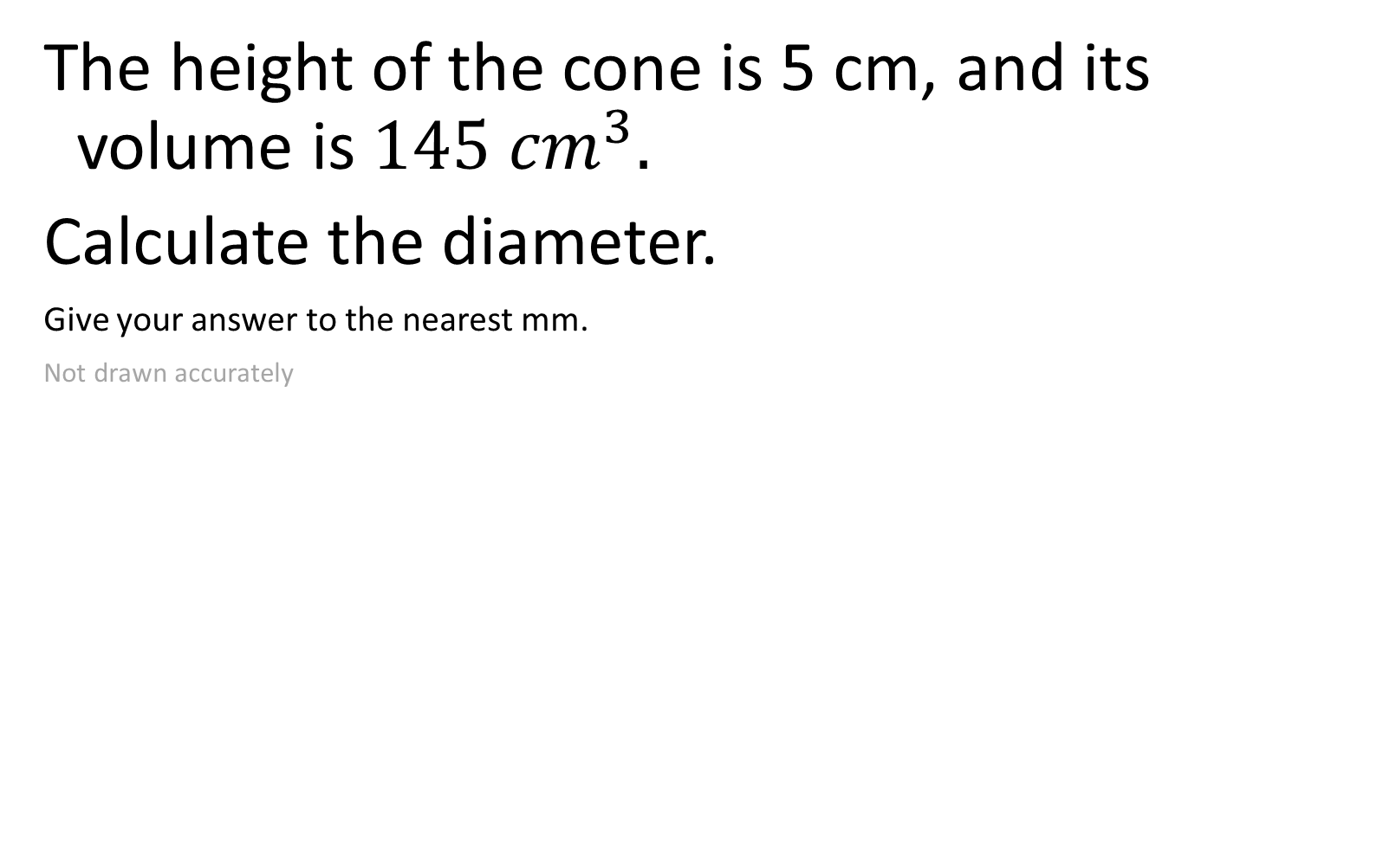


The height of the cone is 5 cm, and its volume is $145 {cm}^{3}.$
Calculate the diameter.
Give your answer to the nearest mm.
Not drawn accurately
$$5 cm$$
$$V=\frac{πr^{2}h}{3}$$
$$d mm$$
$$105 mm$$

Slide 14

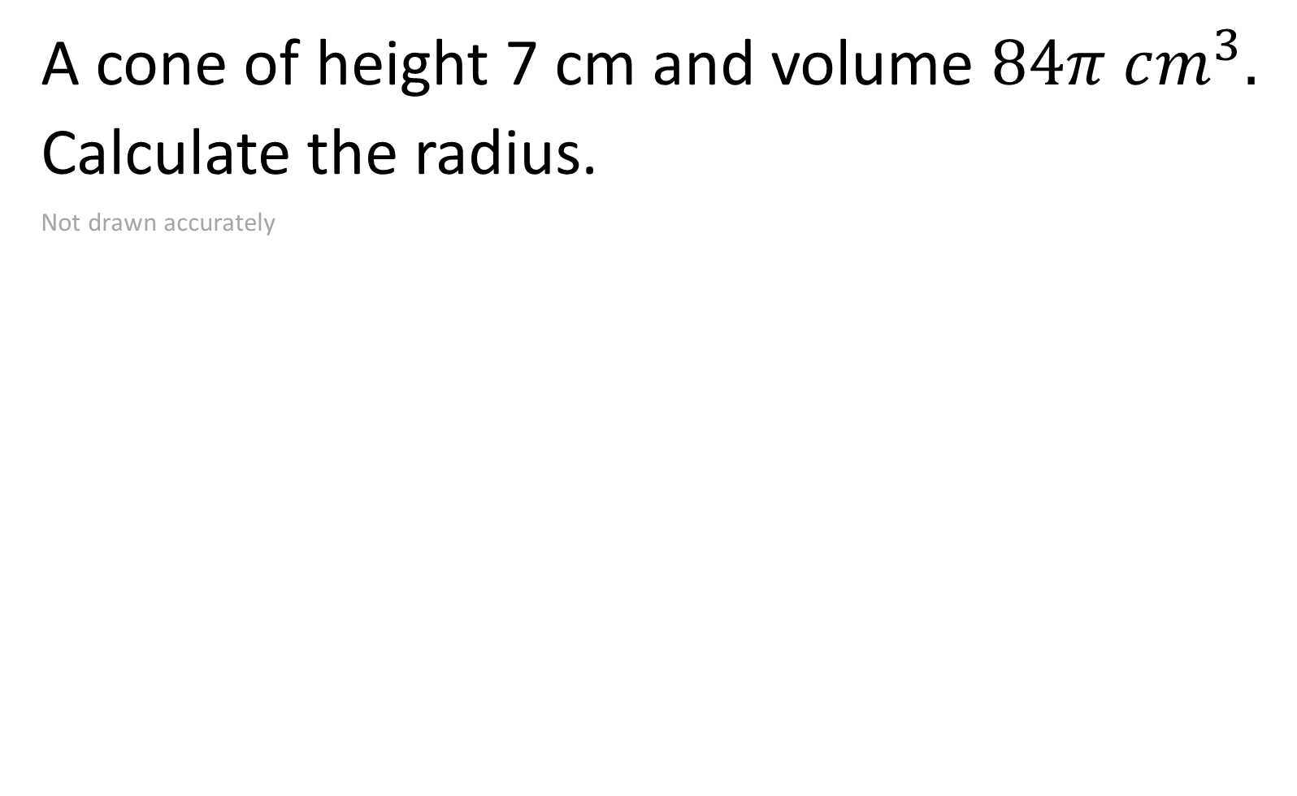

A cone of height 7 cm and volume $84π cm^{3}.$
Calculate the radius.
Not drawn accurately
$$7 cm$$
$$V=\frac{πr^{2}h}{3}$$
$$r cm$$
$$6 cm$$

Slide 15

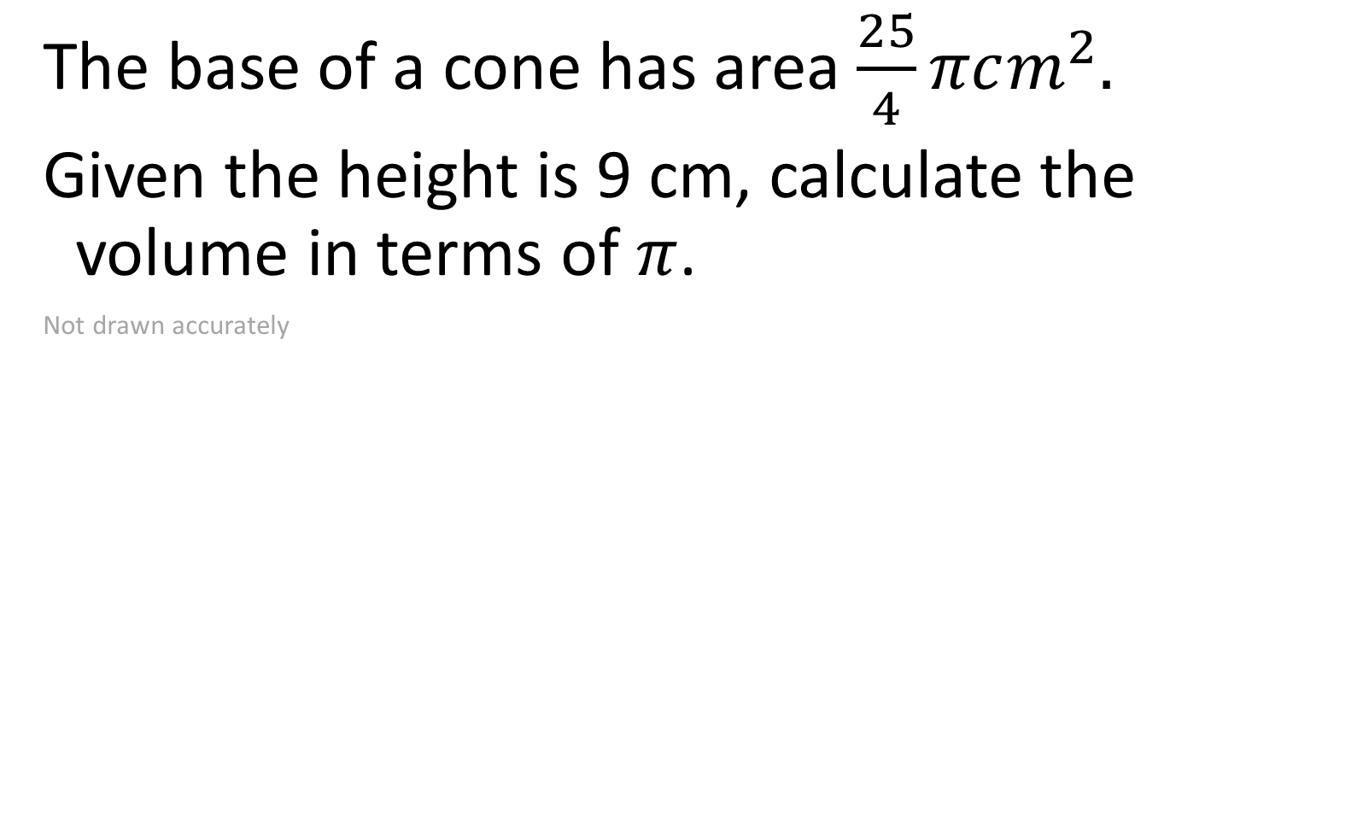
The base of a cone has area $\frac{25}{4}πcm^{2}.$
Given the height is 9 cm, calculate the volume in terms of $π$.
Not drawn accurately
$$7 cm$$
$$V=\frac{πr^{2}h}{3}$$
$$r cm$$
$$\frac{225}{4}π cm^{3}$$

Slide 16

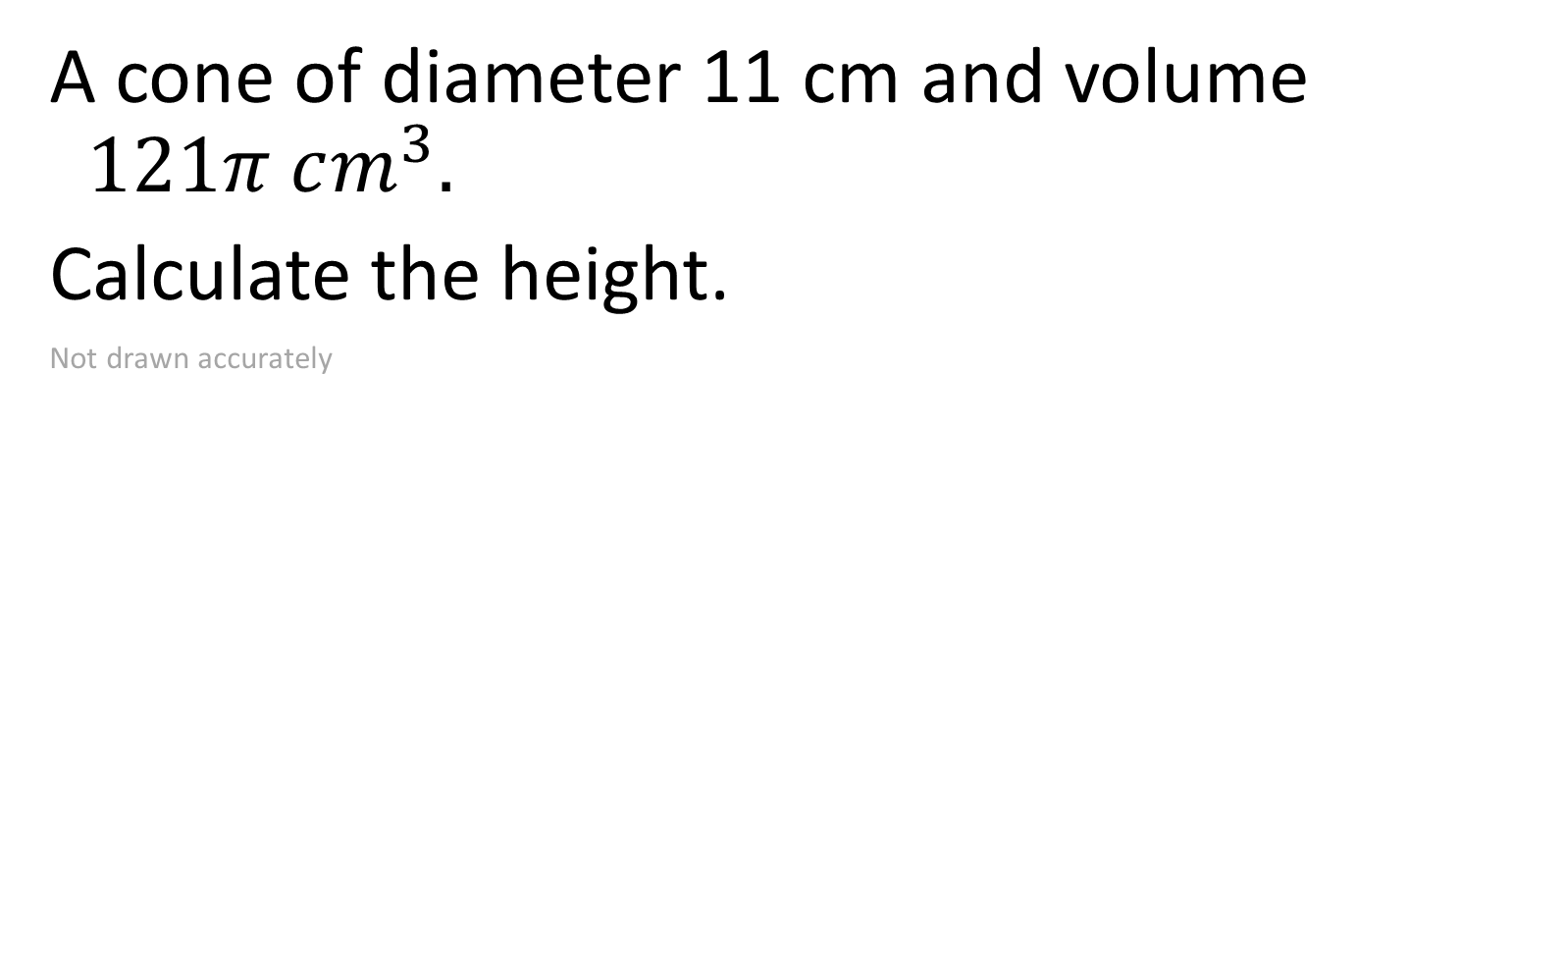
A cone of diameter 11 cm and volume $121π cm^{3}.$
Calculate the height.
Not drawn accurately
$$V=\frac{πr^{2}h}{3}$$
$$12 cm$$

Slide 17


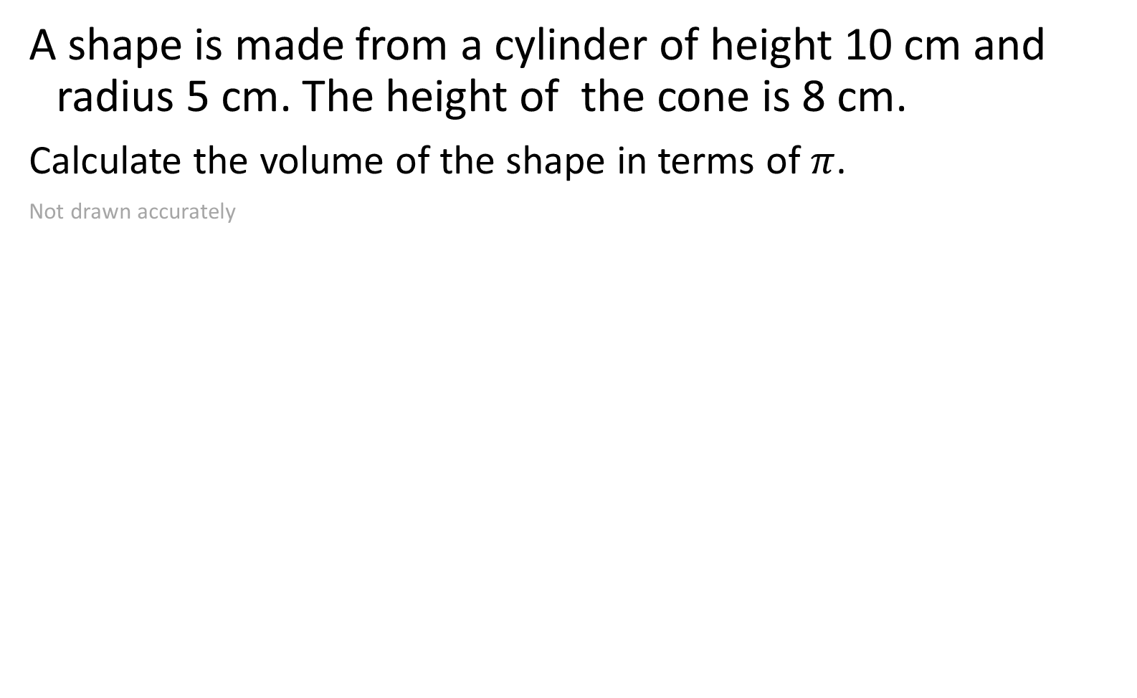


A shape is made from a cylinder of height 10 cm and radius 5 cm. The height of the cone is 8 cm.
Calculate the volume of the shape in terms of $π$.
Not drawn accurately
$$V=\frac{πr^{2}h}{3}$$
$$5 cm$$
$$10 cm$$
$$8 cm$$
$$\frac{950}{3}π cm$$

Slide 18





A shape is made from a cylinder of height 12 cm and diameter 15 cm. The height of the cone is 4 cm.
Calculate the volume of the shape in terms of $π$.
Not drawn accurately
$$V=\frac{πr^{2}h}{3}$$
$$15 cm$$
$$12 cm$$
$$4 cm$$
$$750π cm$$

Slide 19

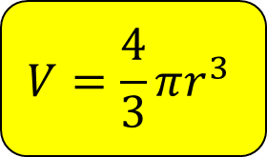
A cone has a height of 15 cm.
A sphere has a radius of 6 cm.
The cone and the sphere have the same volume.
Calculate the radius of the cone.
Give your answer correct to 1 decimal place.
$$V=\frac{πr^{2}h}{3}$$
$$V=\frac{4}{3}πr^{3}$$
$$7.6 cm$$

Slide 20

A cone and sphere each have a radius of 10 cm.
The cone and the sphere have the same volume.
Calculate the height of the cone.
$$V=\frac{πr^{2}h}{3}$$
$$V=\frac{4}{3}πr^{3}$$
$$40 cm$$

Slide 21

A cone has a radius of 10 cm and height 14 cm.
A sphere has the same volume.
Calculate the radius of the sphere.
Give your answer to the nearest cm.
$$V=\frac{πr^{2}h}{3}$$
$$V=\frac{4}{3}πr^{3}$$
$$7 cm$$

