Slide 1
Density
30 September 2026

Slide 2
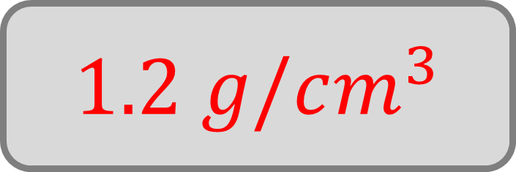
A small block of plastic has a mass of 36 g and a volume of 30 cm³.
Find its density.
 | Mass : | Volume
Plastic | 36 g : | 30 cm³
 | 1.2 g : | 1 cm³
$$1.2 g/cm^{3}$$

Slide 3
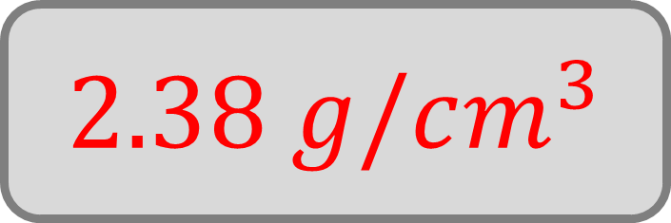
A 95 g pebble has a volume of 40 cm³.
Calculate its density (to 2 dp).
 | Mass : | Volume
Pebble | 95 g : | 40 cm³
 | 2.38 g : | 1 cm³
$$2.38 g/cm^{3}$$

Slide 4
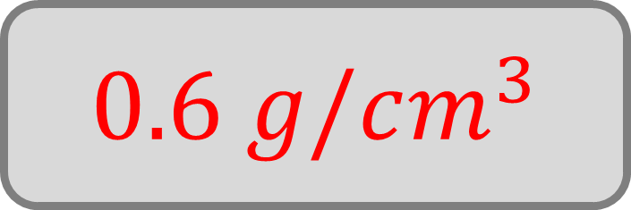
A piece of wood has a volume of 120 cm³ and a mass of 72 g.
Work out the density.
 | Mass : | Volume
Wood | 72 g : | 120 cm³
 | 0.6 g : | 1 cm³
$$0.6 g/cm^{3}$$

Slide 5
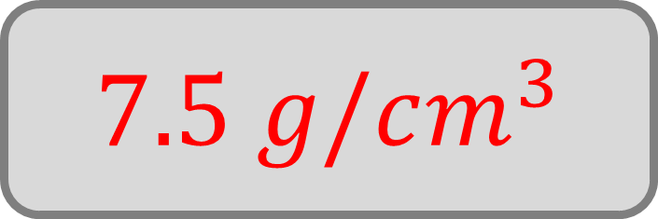
A metal bolt has:
mass – 150 g
volume – 20 cm³
Find the density.
 | Mass : | Volume
 | 150 g : | 20 cm³
 | 7.5 g : | 1 cm³
$$7.5 g/cm^{3}$$

Slide 6
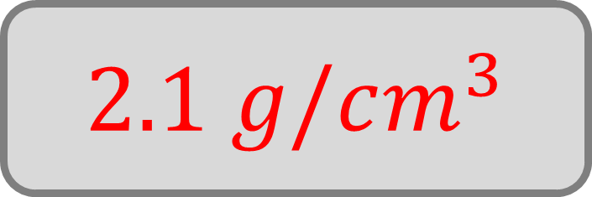
A sample of clay has a mass of 210 g and a volume of 100 cm³.
Calculate the density.
 | Mass : | Volume
Clay | 210 g : | 100 cm³
 | 2.1 g : | 1 cm³
$$2.1 g/cm^{3}$$

Slide 7
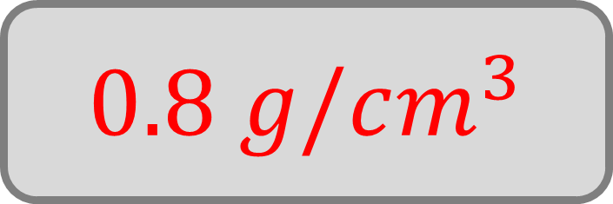
A 60 cm³ cube of wax has a mass of 48 g.
Work out the density.
 | Mass : | Volume
Wax | 48 g : | 60 cm³
 | 0.8 g : | 1 cm³
$$0.8 g/cm^{3}$$

Slide 8
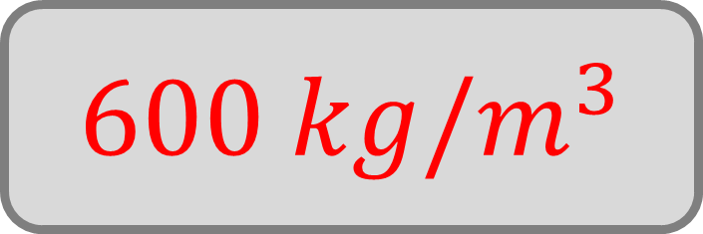
A wooden crate has a mass of 12 kg and a volume of 0.02 m³.
Find the density.
 | Mass : | Volume
Crate | 12 kg : | 0.02 m³
 | 600 kg : | 1 m³
$$600 kg/m^{3}$$

Slide 9
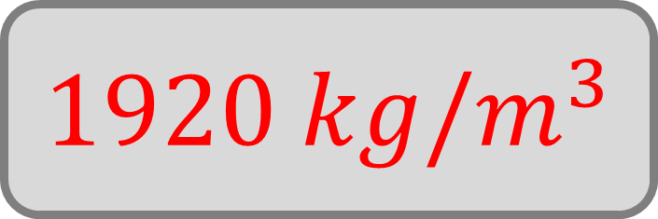
A block of concrete has a mass of 48 kg and a volume of 0.025 m³.
Calculate the density.
 | Mass : | Volume
Concrete | 48 kg : | 0.025 m³
 | 1920 kg : | 1 m³
$$1920 kg/m^{3}$$

Slide 10
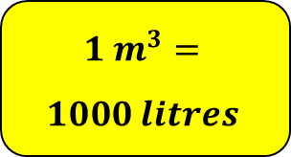
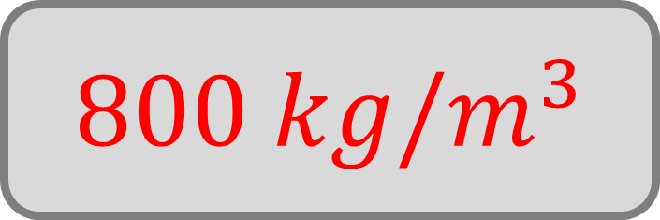
A 900-litre tank of oil has a mass of 720 kg.
Work out the density.
 | Mass : | Volume
Oil | 720 kg : | 0.9 m³
 | 800 kg : | 1 cm³
$$1 m^{3}=$$
$$1000 litres$$
$$800 kg/m^{3}$$

Slide 11
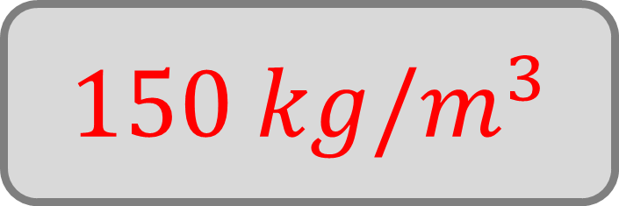
A 0.12 m³ block of foam has a mass of 18 kg.
Work out the density.
 | Mass : | Volume
Foam | 18 kg : | 0.12 m³
 | 150 kg : | 1 m³
$$150 kg/m^{3}$$

Slide 12
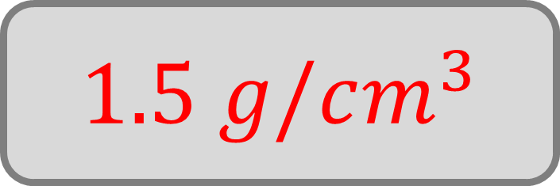
A metal rod has a mass of 0.45 kg and a volume of 300 cm³.
Find the density in g/cm³.
 | Mass : | Volume
Rod | 450 g : | 300 cm³
 | 1.5 g : | 1 cm³
$$1 kg=1000 g$$
$$1.5 g/cm^{3}$$

Slide 13
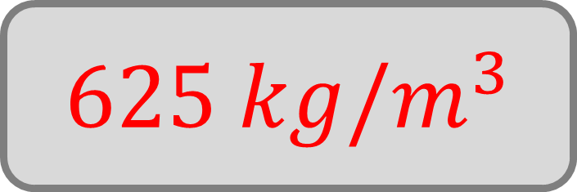
A block of wood has a mass of 250 g and a volume of 0.0004 m³.
Find the density in kg/m³.
 | Mass : | Volume
Wood | 0.25 kg : | 0.0004 cm³
 | 625 kg : | 1 m³
$$1 kg=1000 g$$
$$625 kg/m^{3}$$

Slide 14
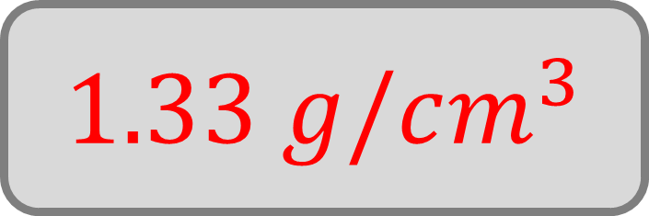
A sample of soil has a mass of 1.2 kg and a volume of 900 cm³.
Calculate the density in g/cm³ (to 2 dp).
 | Mass : | Volume
Soil | 1200 g : | 900 cm³
 | 1.33 g : | 1 cm³
$$1 kg=1000 g$$
$$1.33 g/cm^{3}$$

Slide 15
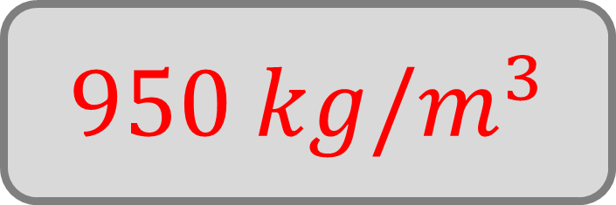
A container of liquid has a mass of 0.95 kg and a volume of 0.001 m³.
Find the density in kg/m³.
 | Mass : | Volume
Liquid | 0.95 kg : | 0.001 m³
 | 950 kg : | 1 m³
$$1 kg=1000 g$$
$$950 kg/m^{3}$$

Slide 16
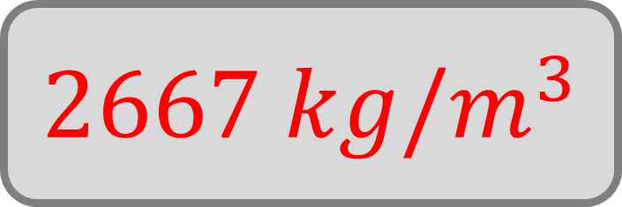
A stone has a mass of 320 g and a volume of 0.00012 m³.
Calculate the density in kg/m³.
 | Mass : | Volume
Stone | 0.32 kg : | 0.00012 m³
 | 2667 kg : | 1 m³
$$1 kg=1000 g$$
$$2667 kg/m^{3}$$

Slide 17
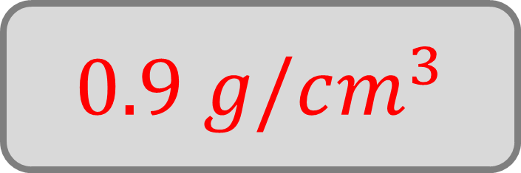
A block of metal has a mass of 3.6 kg and a volume of 4000 cm³.
Find the density in g/cm³.
 | Mass : | Volume
Metal | 3600 g : | 4000 cm³
 | 0.9 g : | 1 cm³
$$1 kg=1000 g$$
$$0.9 g/cm^{3}$$

Slide 18
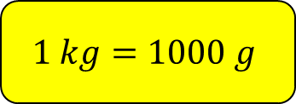
True or false:
If you cut an object in half, its density will double.
$$1 kg=1000 g$$
False

Slide 19
True or false:
If the mass of an object increases while its volume stays the same, its density increases.
$$1 kg=1000 g$$
True

Slide 20
True or false:
If heating an object increases the volume, therefore the density will also increase.
$$1 kg=1000 g$$
False

Slide 21
A pupil says:
“If two objects have the same mass, they must have the same density.”
Are they correct?
$$1 kg=1000 g$$
No

