Slide 1
Volume
08 September 2026

Slide 2
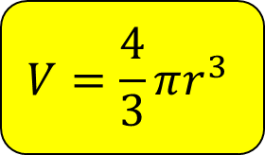


Calculate the volume of the sphere with radius 6 cm.
Give your answer to 1 decimal place.
Not drawn accurately
$$6 cm$$
$$V=\frac{4}{3}πr^{3}$$
$$904.8 cm^{3}$$

Slide 3


Calculate the volume of the sphere with radius 7.8 cm.
Give your answer to the nearest integer.
Not drawn accurately
$$7.8 cm$$
$$V=\frac{4}{3}πr^{3}$$
$$1988 cm^{3}$$

Slide 4


Calculate the volume of the sphere with diameter 11 cm.
Give your answer to the nearest integer.
Not drawn accurately
$$11 cm$$
$$V=\frac{4}{3}πr^{3}$$
$$697 cm^{3}$$

Slide 5

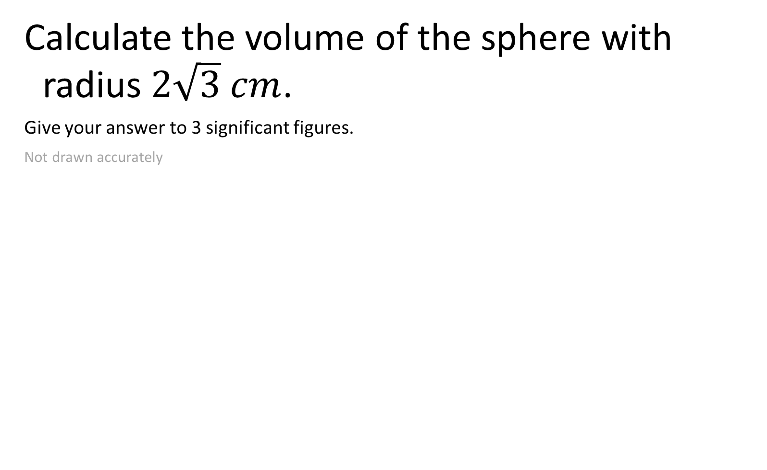

Calculate the volume of the sphere with radius $2\sqrt{3} cm$.
Give your answer to 3 significant figures.
Not drawn accurately
$$2\sqrt{3} cm$$
$$V=\frac{4}{3}πr^{3}$$
$$174 cm^{3}$$

Slide 6

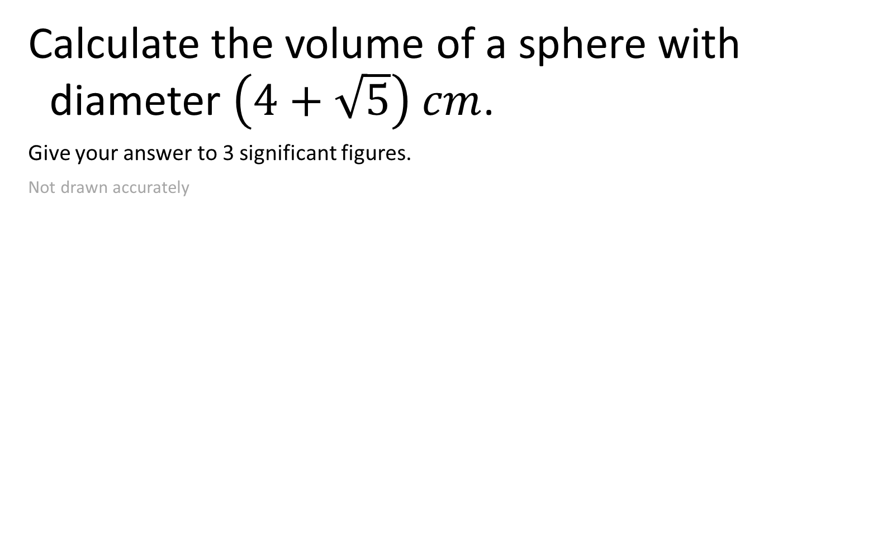

Calculate the volume of a sphere with diameter $\left(4+\sqrt{5}\right) cm$.
Give your answer to 3 significant figures.
Not drawn accurately
$$4+\sqrt{5} cm$$
$$V=\frac{4}{3}πr^{3}$$
$$127 cm^{3}$$

Slide 7


Calculate the total volume of six spheres with diameter 10 cm.
Give your answer to the nearest integer.
Not drawn accurately
$$10 cm$$
$$V=\frac{4}{3}πr^{3}$$
$$3142 cm^{3}$$

Slide 8

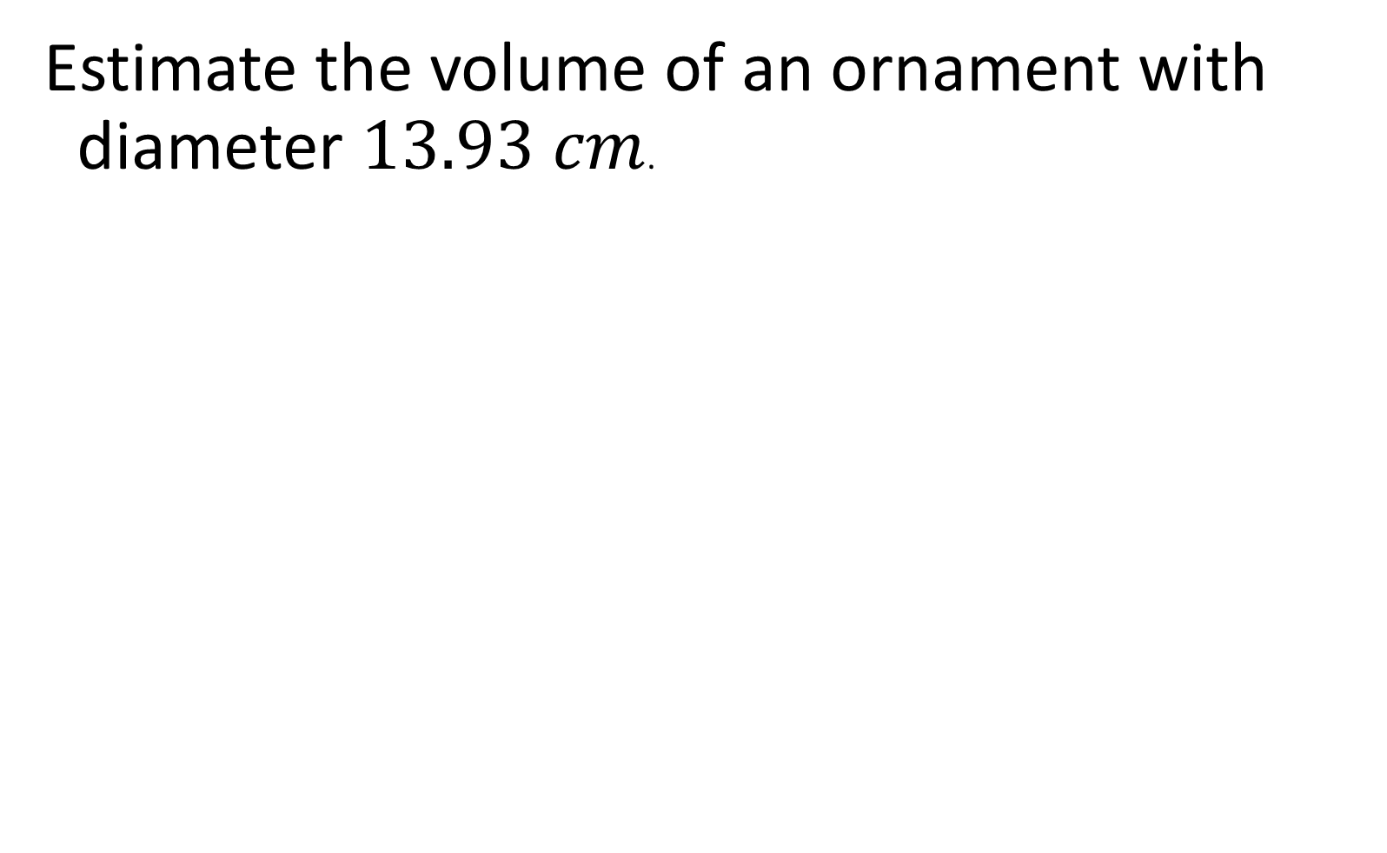
Estimate the volume of an ornament with diameter $13.93 cm$.
$$V=\frac{4}{3}πr^{3}$$
$$1400 cm^{3}$$

Slide 9

A hemisphere has a radius of 8 cm.
Calculate its volume.
Give your answer to 3 significant figures.
Not drawn accurately
$$V=\frac{4}{3}πr^{3}$$
$$1070 cm^{3}$$

Slide 10

A new dodgeball is modelled as a perfect sphere with a radius of 6.5 cm.
Calculate the volume of the ball.
Give your answer to 3 significant figures.
$$V=\frac{4}{3}πr^{3}$$
$$1150 cm^{3}$$

Slide 11

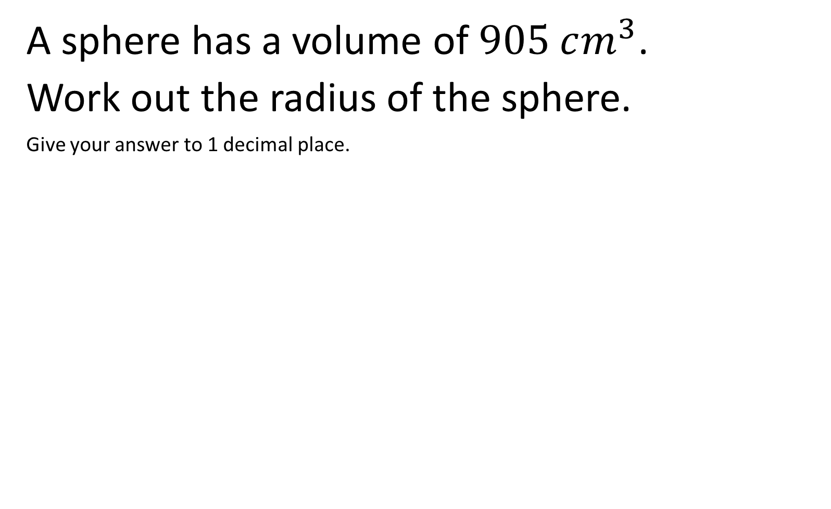
A sphere has a volume of $905 cm^{3}$.
Work out the radius of the sphere.
Give your answer to 1 decimal place.
$$V=\frac{4}{3}πr^{3}$$
$$6.0 cm$$

Slide 12

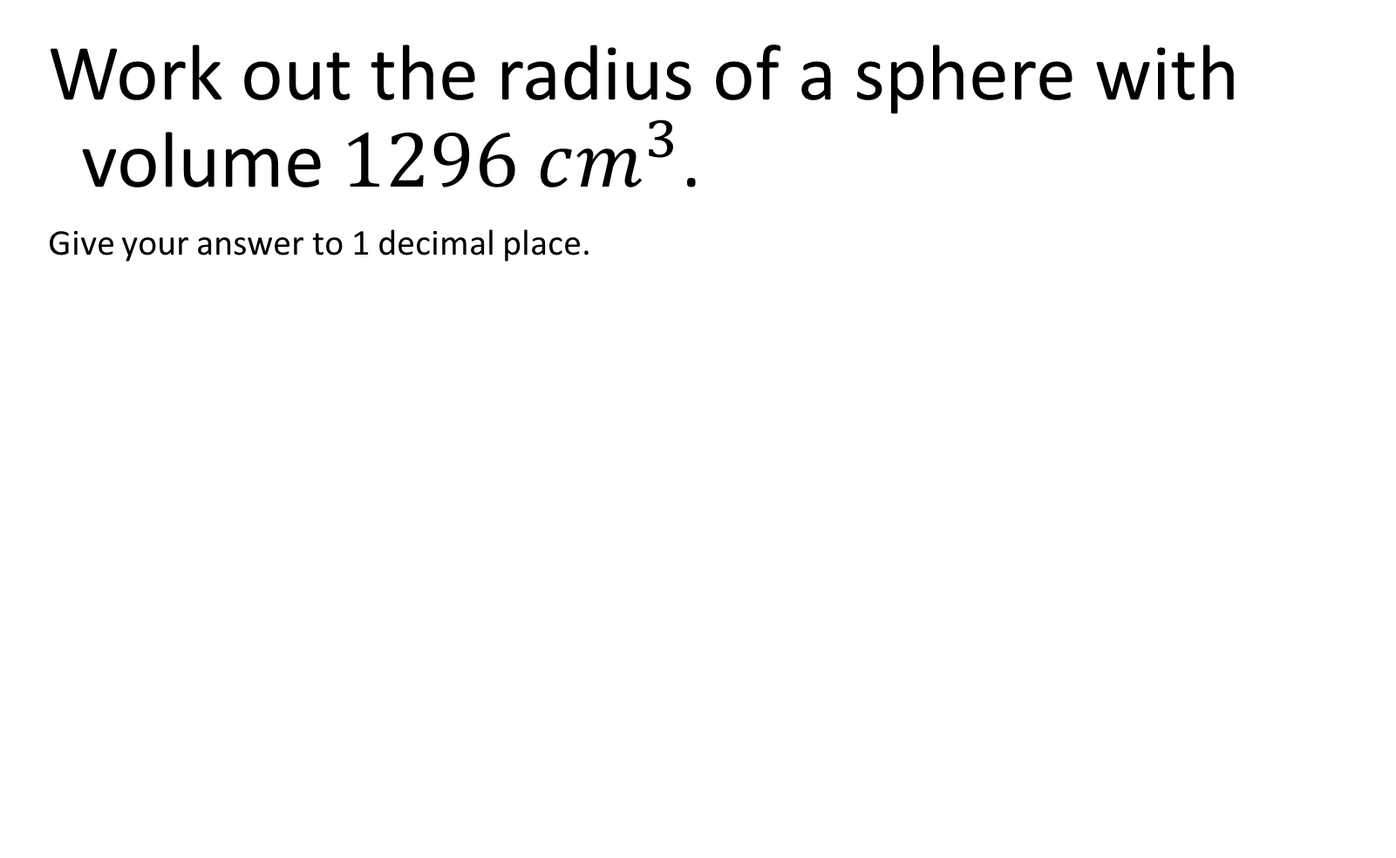
Work out the radius of a sphere with volume $1296 cm^{3}$.
Give your answer to 1 decimal place.
$$V=\frac{4}{3}πr^{3}$$
$$6.8 cm$$

Slide 13

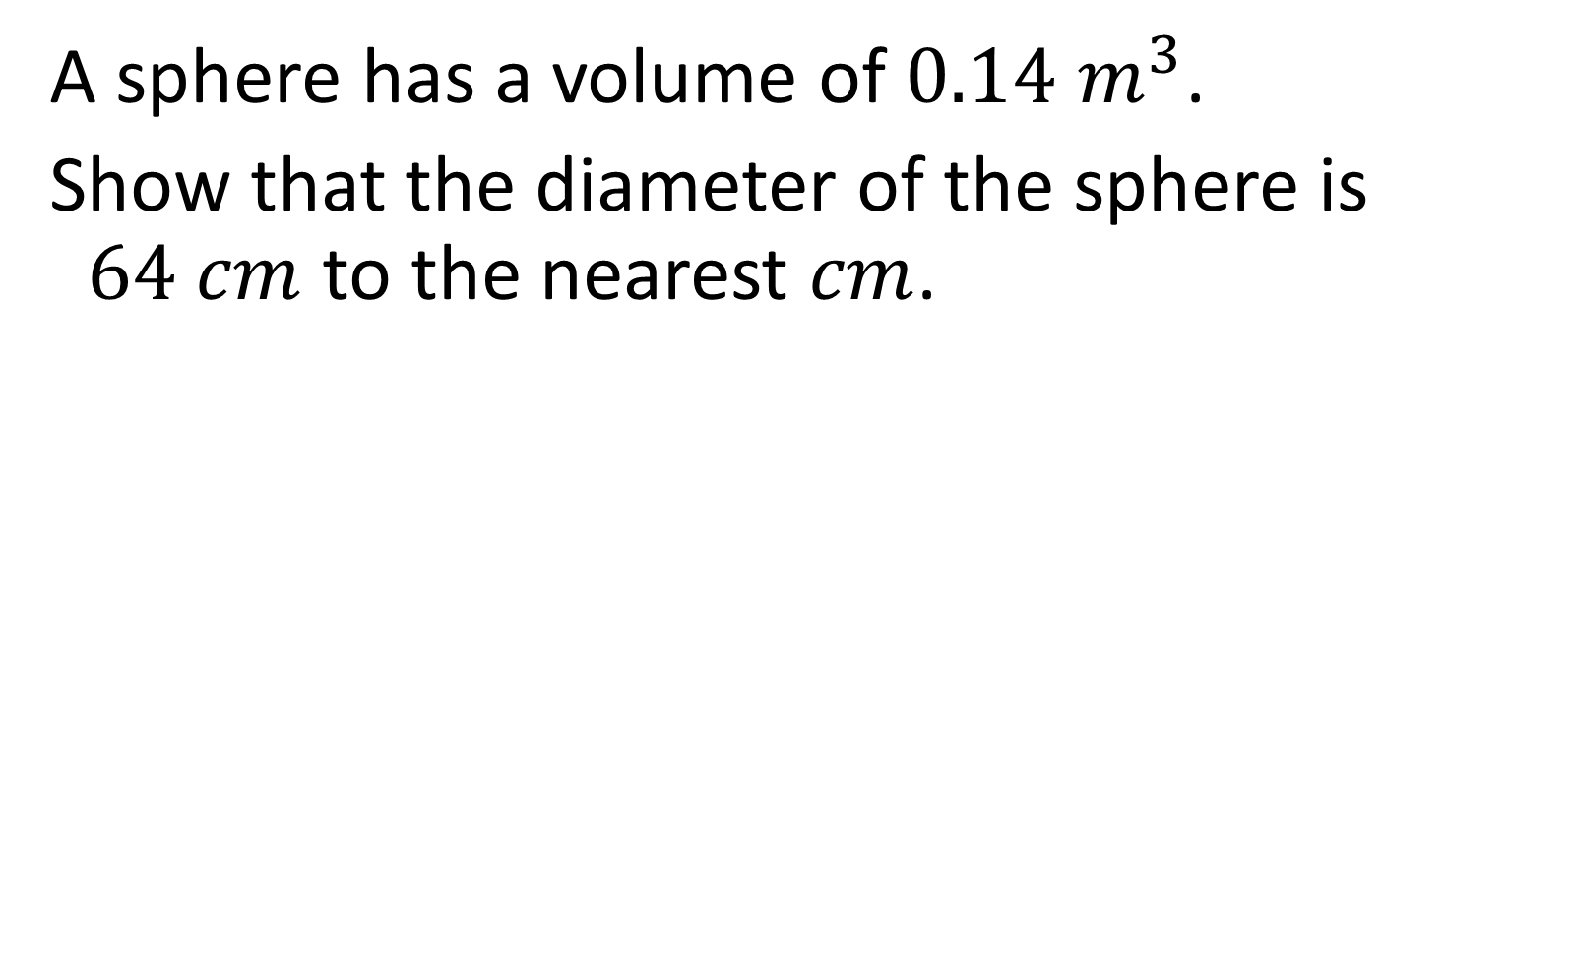
A sphere has a volume of $0.14 m^{3}$.
Show that the diameter of the sphere is $64 cm$ to the nearest $cm$.
$$V=\frac{4}{3}πr^{3}$$
$$0.64 m$$

Slide 14

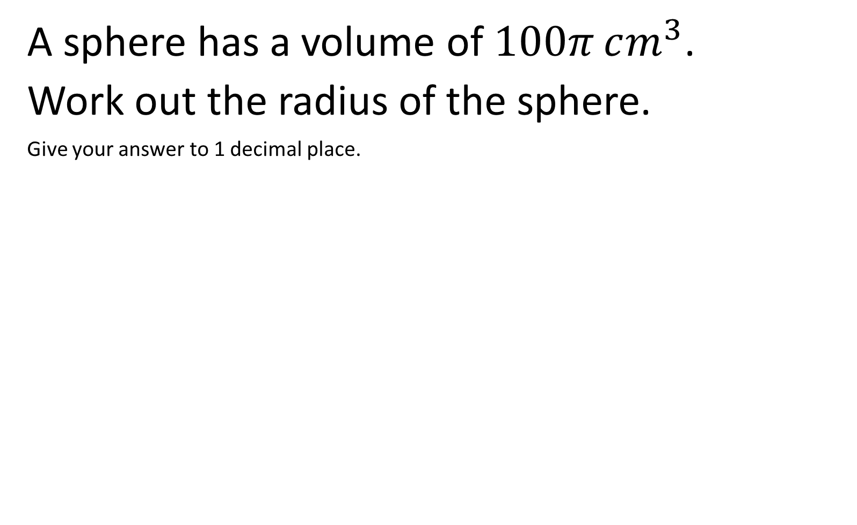
A sphere has a volume of $100π cm^{3}$.
Work out the radius of the sphere.
Give your answer to 1 decimal place.
$$V=\frac{4}{3}πr^{3}$$
$$4.2 cm$$

Slide 15
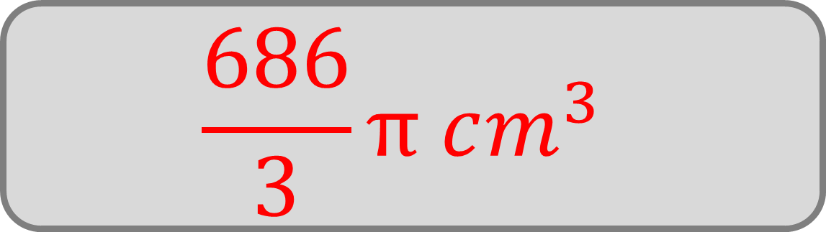
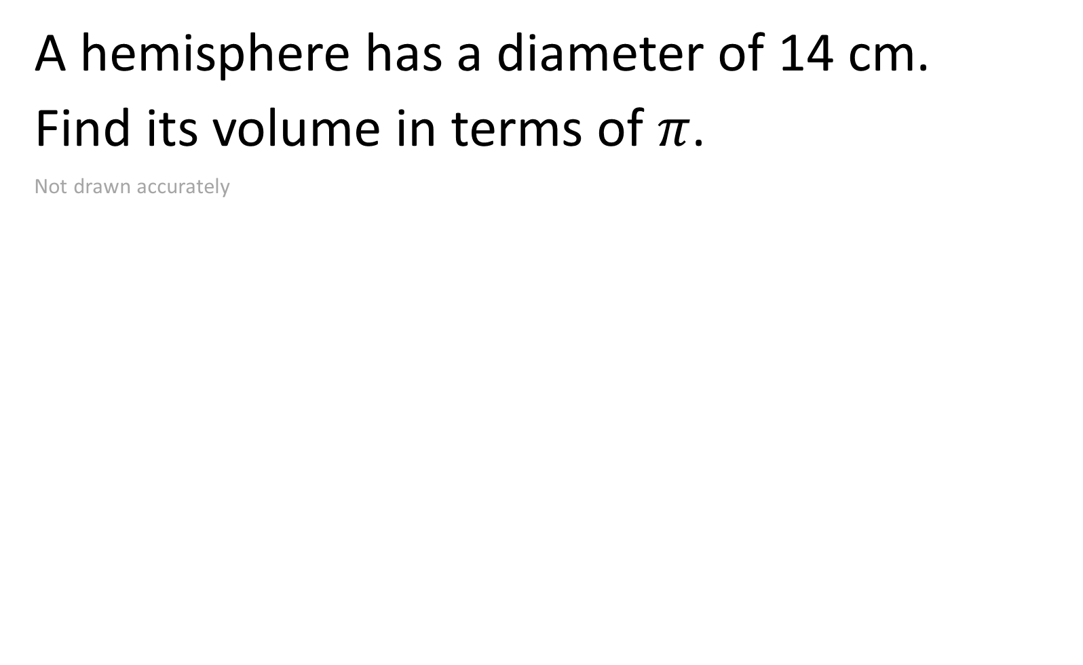
A hemisphere has a diameter of 14 cm.
Find its volume in terms of $π$.
Not drawn accurately
$$V=\frac{4}{3}πr^{3}$$
$$\frac{686}{3}π cm^{3}$$

Slide 16

A decorative water bowl is shaped like a hemisphere with radius 12 cm.
Calculate the maximum volume of water it can hold.
Give your answer in cubic centimetres, to 3 significant figures.
$$V=\frac{4}{3}πr^{3}$$
$$3620 cm^{3}$$

Slide 17

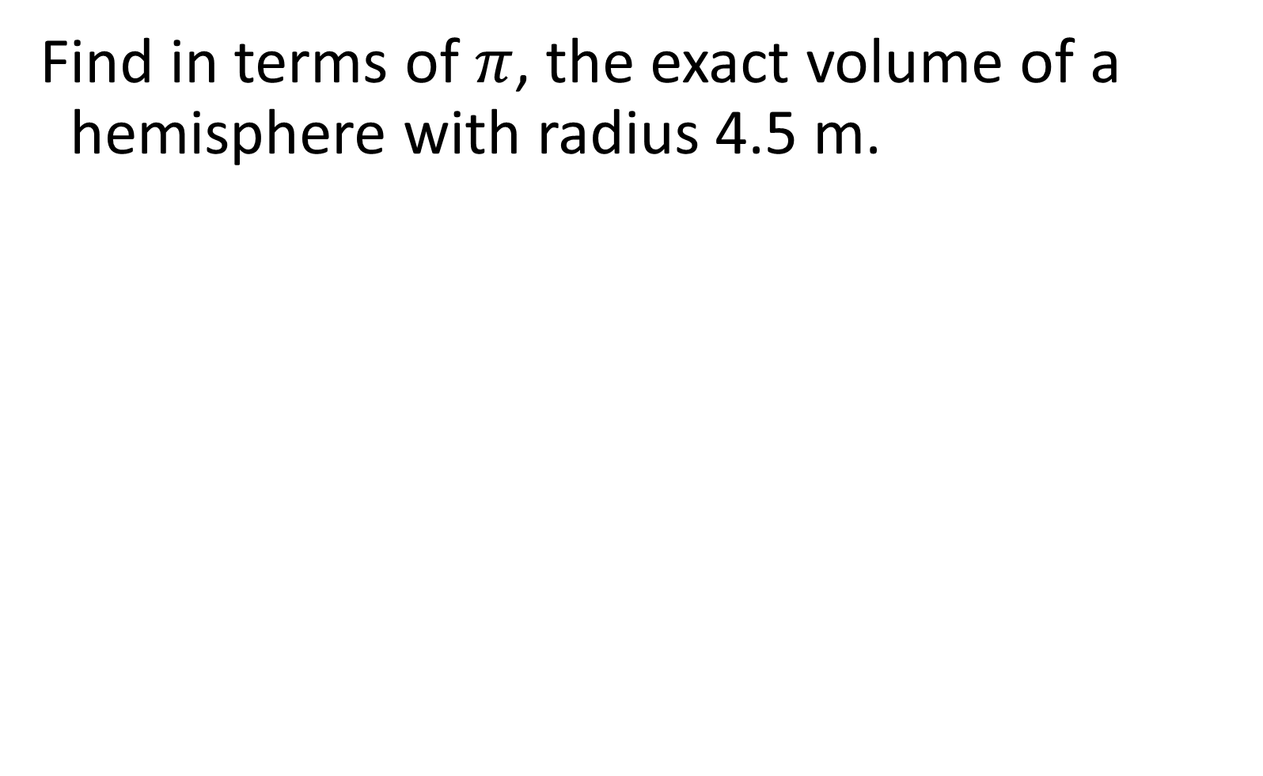
Find in terms of $π$, the exact volume of a hemisphere with radius 4.5 m.
$$V=\frac{4}{3}πr^{3}$$
$$\frac{243}{4}π m^{3}$$

Slide 18

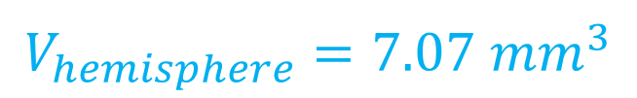
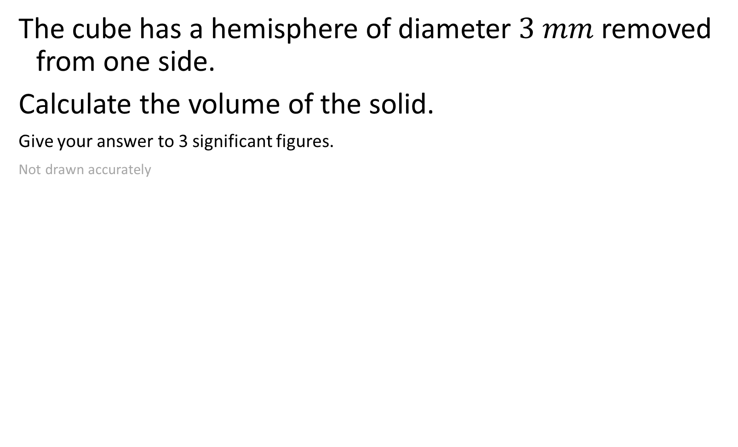


The cube has a hemisphere of diameter $3 mm$ removed from one side.
Calculate the volume of the solid.
Give your answer to 3 significant figures.
Not drawn accurately
$$V_{cube}=125 {mm}^{3}$$
$$V_{hemisphere}=7.07 {mm}^{3}$$
$$V=\frac{4}{3}πr^{3}$$
$$5 mm$$
$$118 {mm}^{3}$$

Slide 19
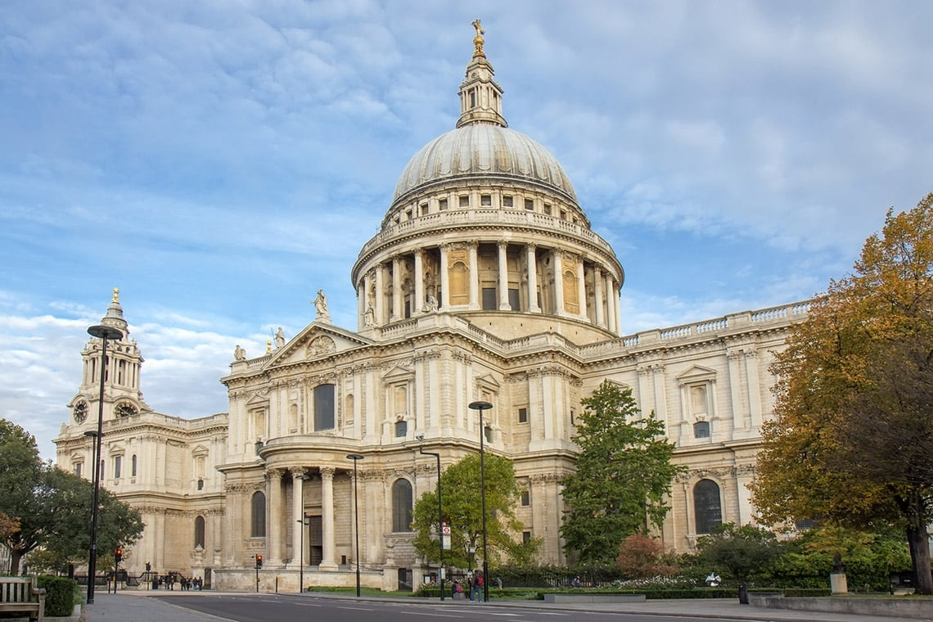

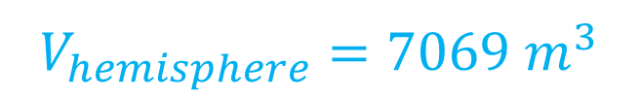
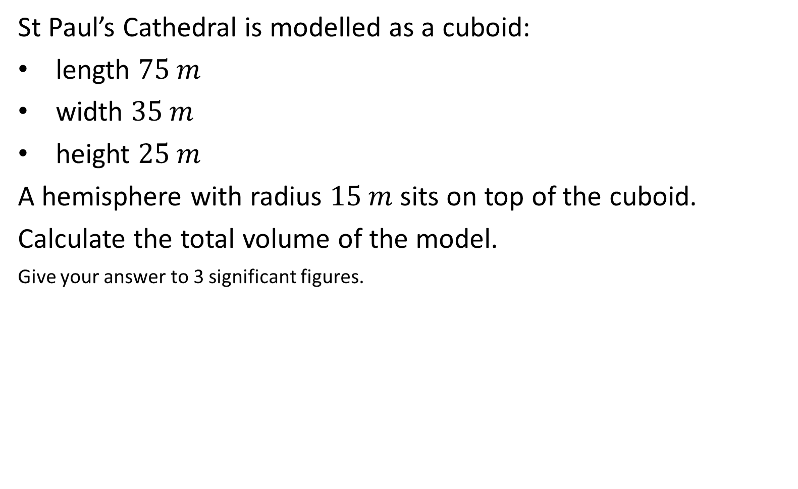

St Paul’s Cathedral is modelled as a cuboid:
length $75 m$
width $35 m$
height $25 m$
A hemisphere with radius $15 m$ sits on top of the cuboid.
Calculate the total volume of the model.
Give your answer to 3 significant figures.
$$V_{cuboid}=65625 m^{3}$$
$$V=\frac{4}{3}πr^{3}$$
$$V_{hemisphere}=7069 m^{3}$$
$$72700 m^{3}$$

Slide 20


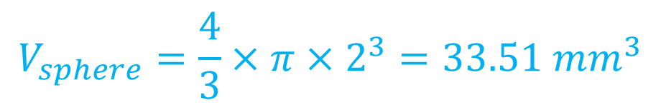


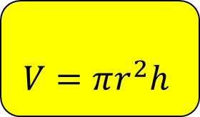
A tablet is $15 mm$ long and has a diameter of $4 mm$. Calculate the volume of the tablet.
Give your answer to 3 significant figures.
Not drawn accurately
$$15 mm$$
$$V_{sphere}=\frac{4}{3}×π×2^{3}=33.51 {mm}^{3}$$
$$4 mm$$
$$V=\frac{4}{3}πr^{3}$$
$$V_{cylinder}=π×2^{2}×11=138.23 {mm}^{3}$$
$$V=πr^{2}h$$
$$172 {mm}^{3}$$

Slide 21
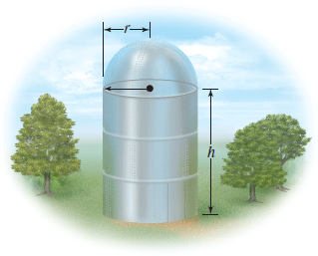




A grain silo is shaped as a cylinder with a hemisphere at the top. It is 14m tall, and has a diameter of 6m.
Calculate the volume of the silo.
Give your answer to 2 significant figures.
$$V_{hemisphere}=56.55 m^{3}$$
$$V=\frac{4}{3}πr^{3}$$
$$V_{cylinder}=π×3^{2}×11$$
$$=311.02 m^{3}$$
$$V=πr^{2}h$$
$$370 m^{3}$$

