Slide 1
Turning points
08 October 2026

Slide 2
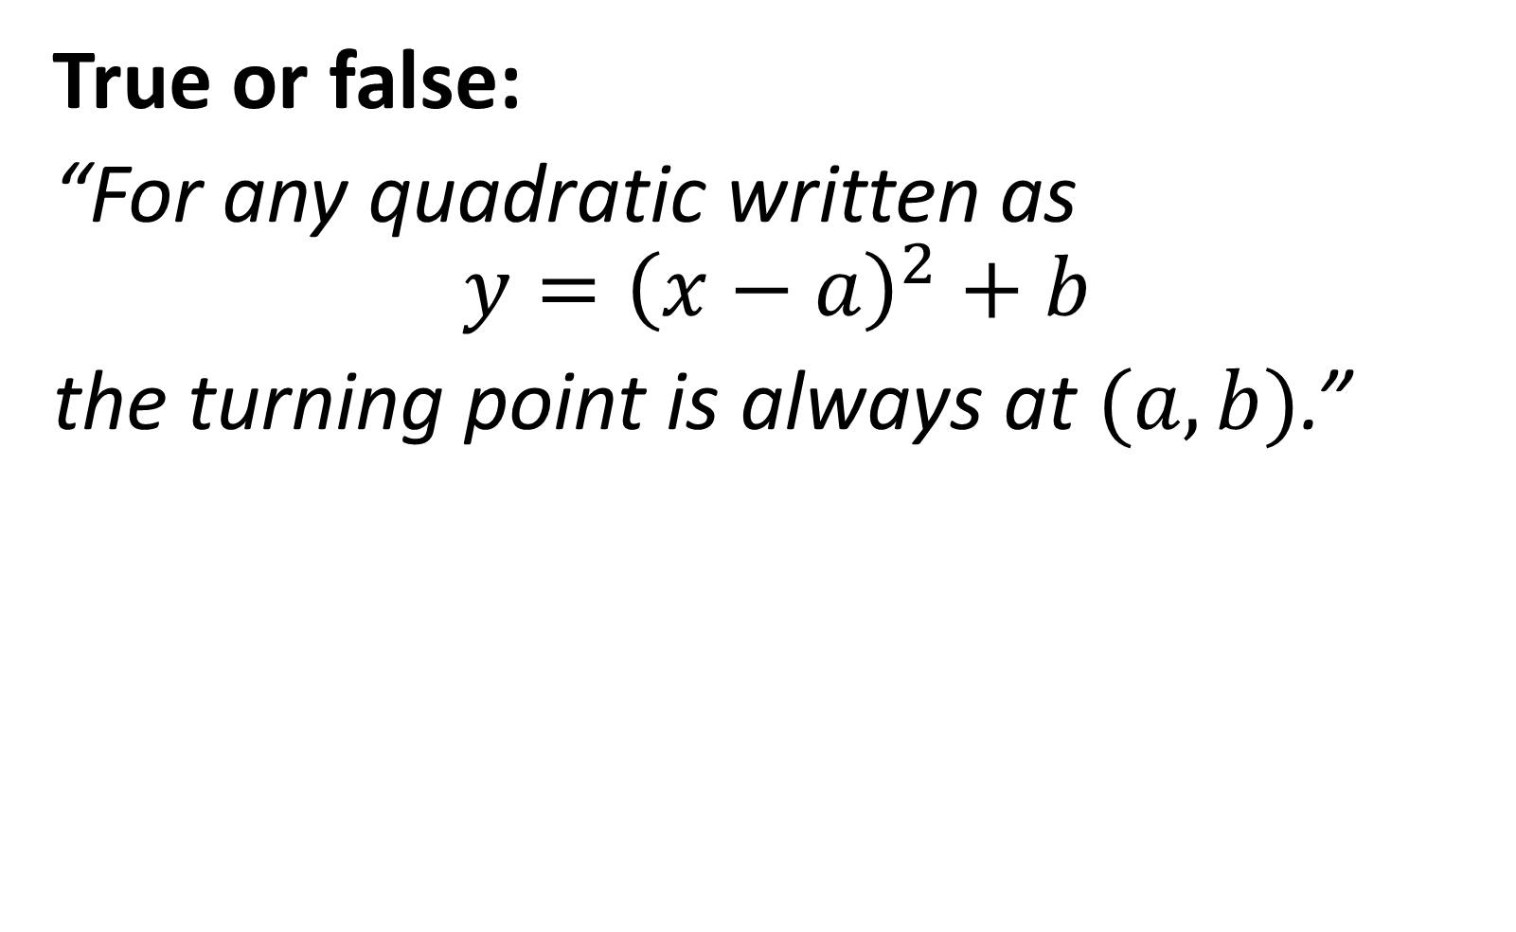
True or false:
“For any quadratic written as
$$y={\left(x−a\right)}^{2}+b$$
the turning point is always at $(a,b)$.”
True

Slide 3
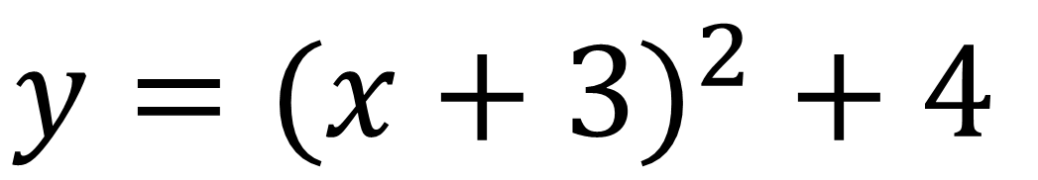

The equation below is given in ‘completed square form’
What is the turning point of this graph?
$$y={(x+3)}^{2} + 4$$
$$(−3, 4)$$

Slide 4
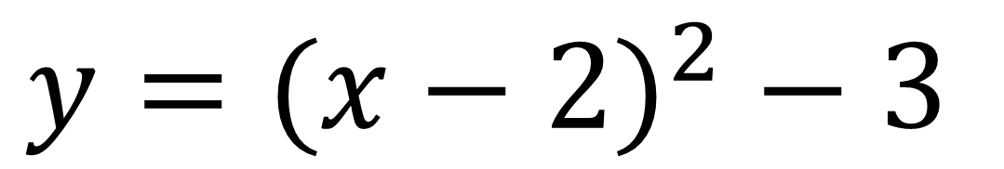

The equation below is given in ‘completed square form’
What is the turning point of this graph?
$$y={(x−2)}^{2} − 3$$
$$(2, −3)$$

Slide 5
True or false:
“Completing the square changes the turning point of the quadratic because rewriting the expression alters its graph.”
False

Slide 6
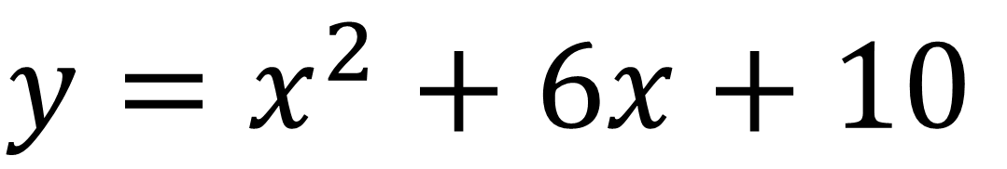

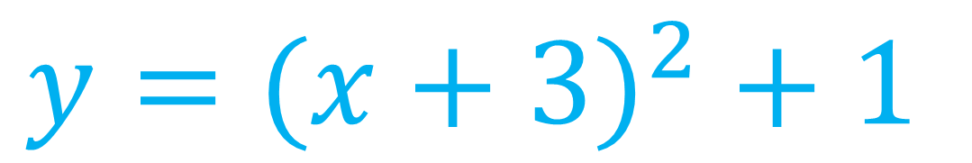
Write in ‘completed square form’ and state the turning point:
$$y=x^{2}+6x+10$$
$$y={(x+3)}^{2} + 1$$
$$(−3, 1)$$

Slide 7
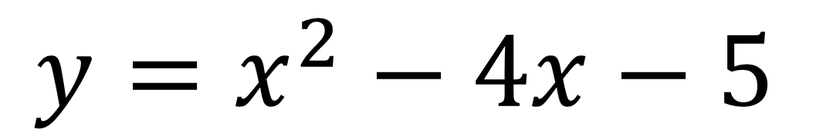

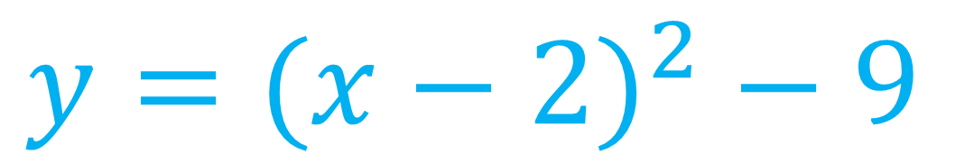
Write in ‘completed square form’ and state the turning point:
$$y=x^{2}−4x−5$$
$$y={(x−2)}^{2} − 9$$
$$(2, −9)$$

Slide 8
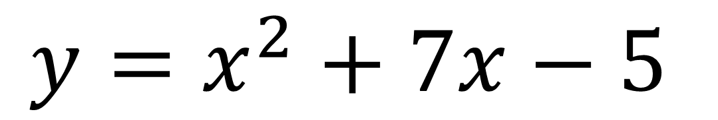
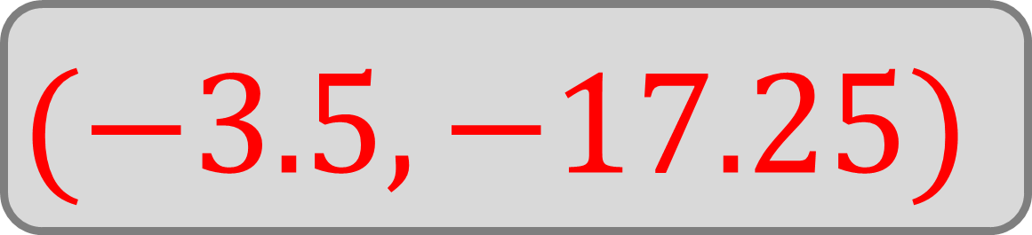
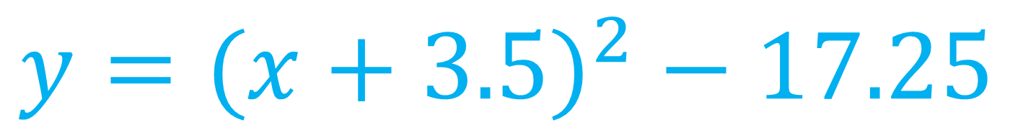
Write in ‘completed square form’ and state the turning point:
$$y=x^{2}+7x−5$$
$$y={(x+3.5)}^{2} − 17.25$$
$$(−3.5, −17.25)$$

Slide 9
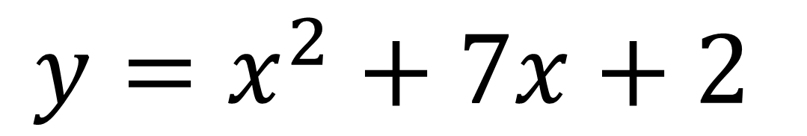
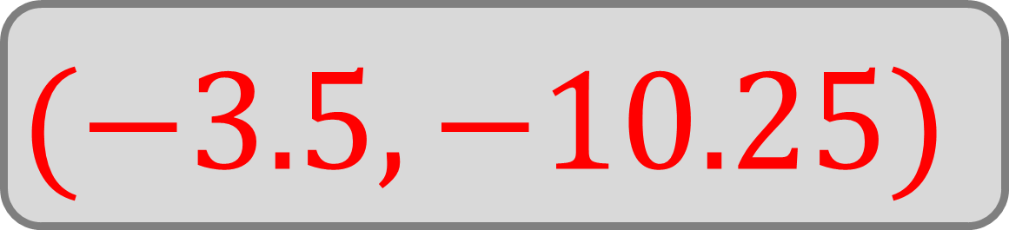
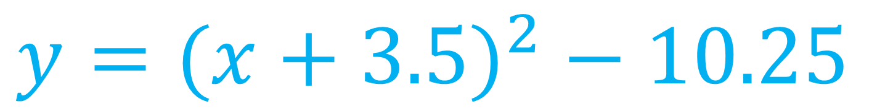
Write in ‘completed square form’ and state the turning point:
$$y=x^{2}+7x+2$$
$$y={(x+3.5)}^{2} − 10.25$$
$$(−3.5, −10.25)$$

Slide 10
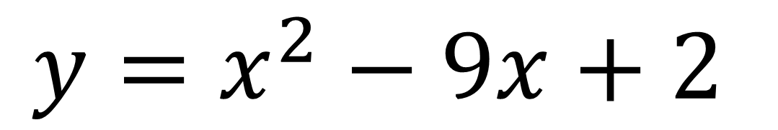
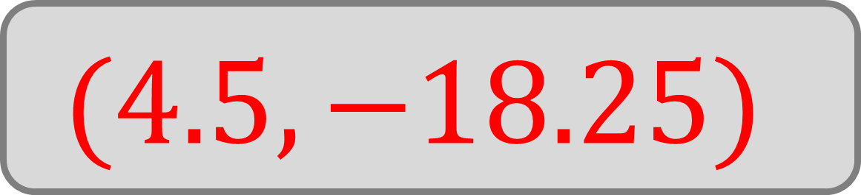
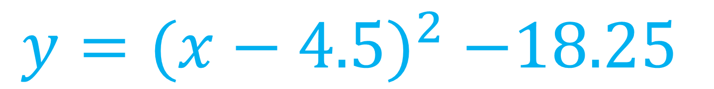
Write in ‘completed square form’ and state the turning point:
$$y=x^{2}−9x+2$$
$$y={(x−4.5)}^{2} −18.25$$
$$(4.5, −18.25)$$

Slide 11
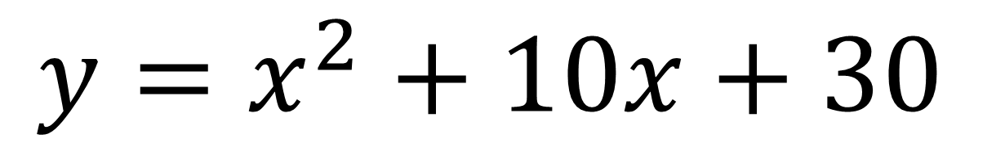


Write in ‘completed square form’ and state the turning point:
$$y=x^{2}+10x+30$$
$$y={(x+5)}^{2} + 5$$
$$(−5, 5)$$

Slide 12
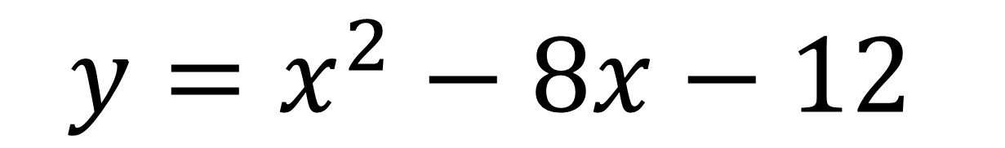


Write in ‘completed square form’ and state the turning point:
$$y=x^{2}−8x−12$$
$$y={(x−4)}^{2} − 28$$
$$(4, −28)$$

Slide 13
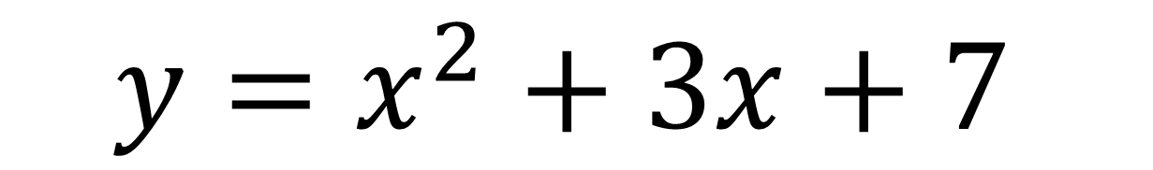
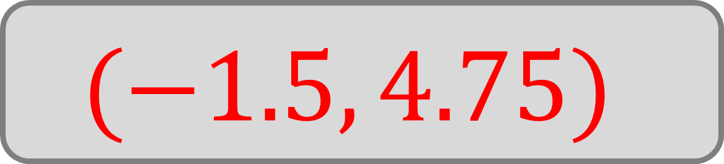
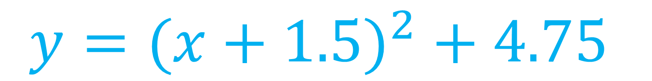
Write in ‘completed square form’ and state the turning point:
$$y=x^{2}+3x+7$$
$$y={(x+1.5)}^{2} + 4.75$$
$$(−1.5, 4.75)$$

Slide 14
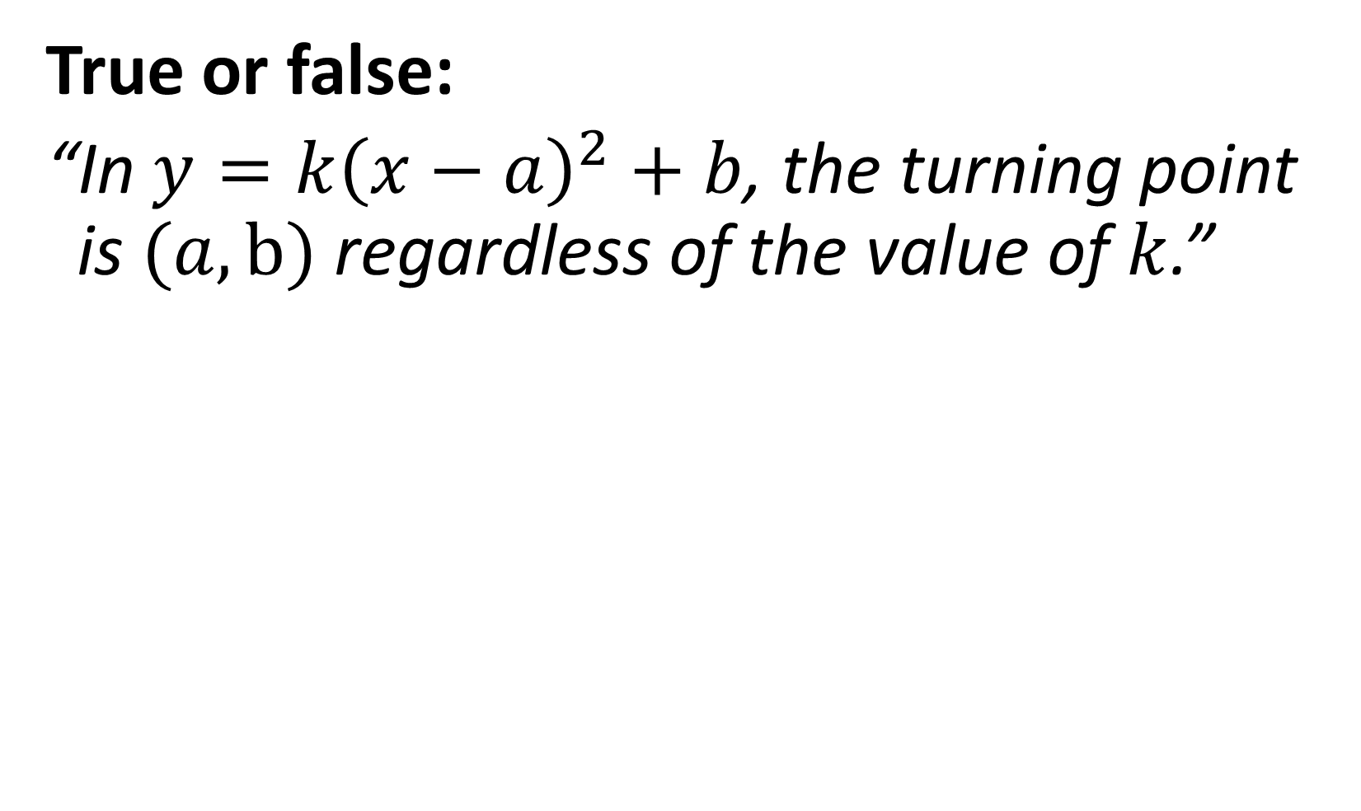
True or false:
“In $y=k{\left(x−a\right)}^{2}+b$, the turning point is $(a,b)$ regardless of the value of $k$.”
True

Slide 15
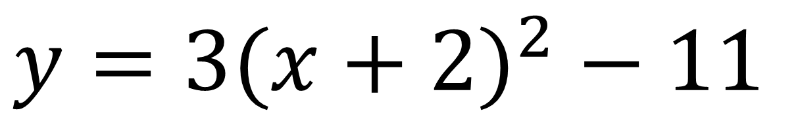

The equation below is given in ‘completed square form’
What is the turning point of this graph?
$$y=3{(x+2)}^{2} − 11$$
$$(−2, −11)$$

Slide 16
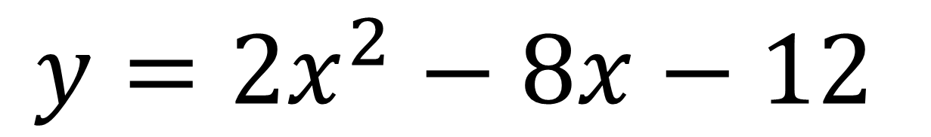

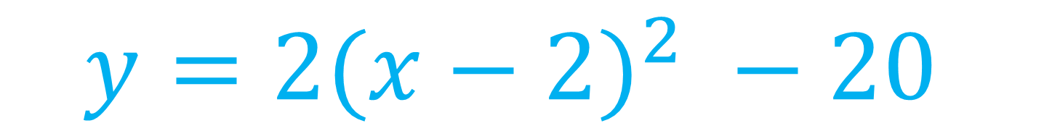
Write in ‘completed square form’ and state the turning point:
$$y=2x^{2}−8x−12$$
$$y={2(x−2)}^{2} −20$$
$$(2, −20)$$

Slide 17
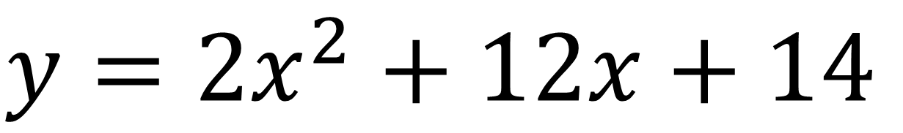


Write in ‘completed square form’ and state the turning point:
$$y=2x^{2}+12x+14$$
$$y={2(x+3)}^{2} −4$$
$$(−3, −4)$$

Slide 18
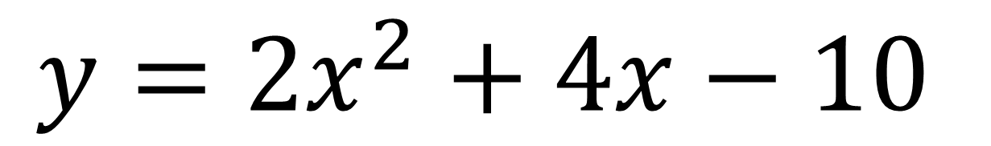

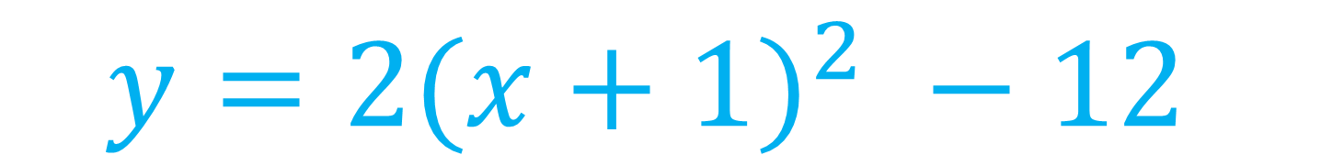
Write in ‘completed square form’ and state the turning point:
$$y=2x^{2}+4x−10$$
$$y={2(x+1)}^{2} −12$$
$$(−1, −12)$$

Slide 19
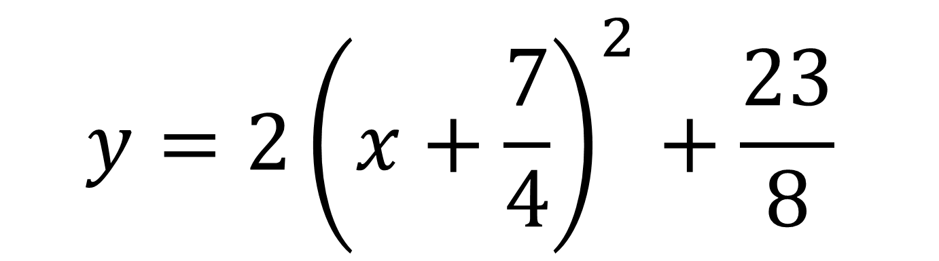
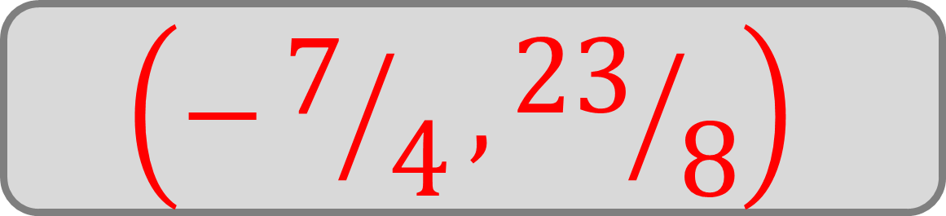
The equation below is given in ‘completed square form’
What is the turning point of this graph?
$$y={2\left(x+\frac{7}{4}\right)}^{2}+\frac{23}{8}$$
$$\left(−7/4,{23}/8\right)$$

Slide 20
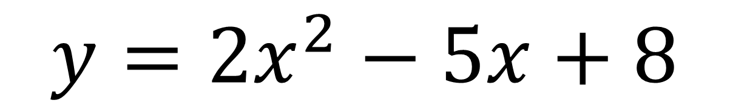

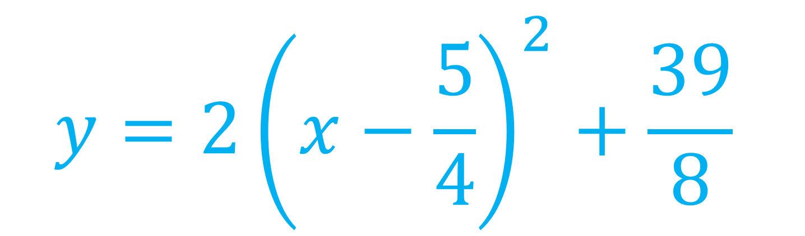
Write in ‘completed square form’ and state the turning point:
$$y=2x^{2}−5x+8$$
$$y={2\left(x−\frac{5}{4}\right)}^{2}+\frac{39}{8}$$
$$\left(5/4,{39}/8\right)$$

Slide 21
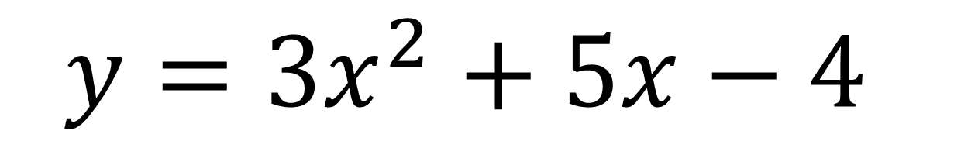
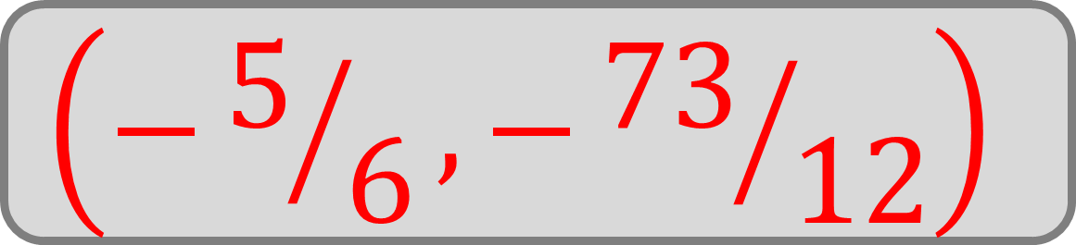
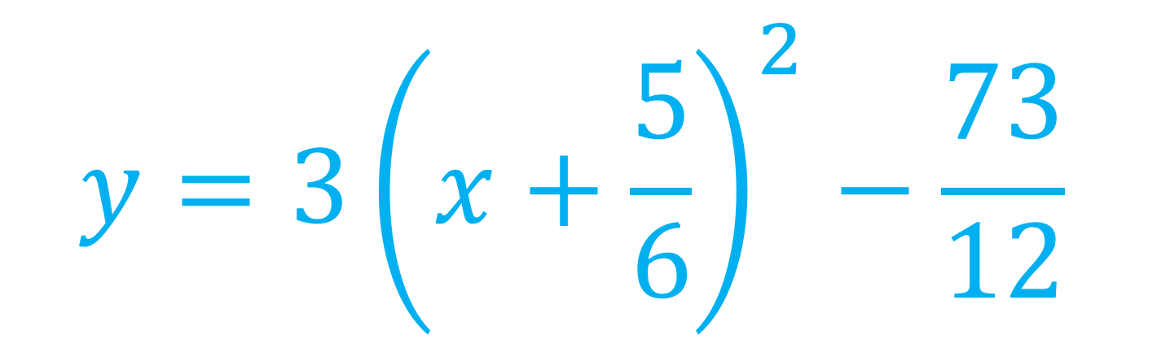
Write in ‘completed square form’ and state the turning point:
$$y=3x^{2}+5x−4$$
$$y={3\left(x+\frac{5}{6}\right)}^{2}−\frac{73}{12}$$
$$\left(−5/6,−{73}/{12}\right)$$

